Slide 1
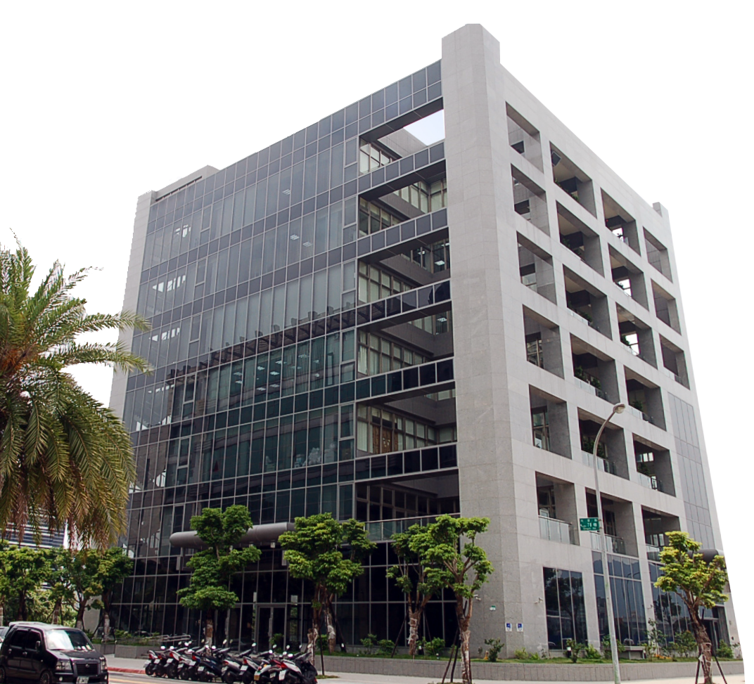

Fortune Information Systems Corp.
2023 1nd
Investor Conference
Stock symbol：2468
INTEGRITY．INNOVATION．SERVICE
2023/09/20
Speaker
Candy Tang
General Manager
Max Yang
General Manager
Date

Slide 2
Disclaimer
This presentation may contain statements of future prospects. The statement is based on the expectation of the present situation, but at the same time is limited by the known or unknown risks or uncertainties. Therefore, the actual results may be different from the content of the statement.
Except as required by laws, the company is not obliged to voluntarily update its presentation of the future outlook in the light of new information or future events.
There are variety of factors which may influence statements or contents been drafted within this presentation, therefore we strongly recommend audience to refer to the information published on MOPS website in case any adjustment has been made.

Slide 3
Company Overview
Financial Information
Operational Overview
Operational Performance
Industry Trends
Continuation and Growth Strategies
Q&A
AGENDA

Slide 4
Company Overview
- Candy Tang, General Manager

Slide 5
Company Overview
About Us
1977 Established
2001 IPO
Operational Locations
Headquarters: Taipei
Branch Offices:
Taoyuan
Hsinchu
Taichung
Kaohsiung
Overseas Subsidiary
Hong Kong
Number of Employees
Approximately 370
Technical Staff: Approximately 60%
With the core technical capabilities of each original dealer, the technical team can fully support the construction, development and maintenance of various software and hardware services.
Paid-up capital
NT$690 million
ISO27001 Certification
First passed in 2020. In 2022, expanded to branch and logistics services, enhancing our capacity in cybersecurity services.
Industry category
Information Service Industry

Slide 6
Commenced buying and selling of information equipment
Become the first IBM reseller.
Mainly sell computer equipment, printers and consumables.
1977
1993
Increase software value-added services
Introduce the “exceed” warehousing management system and promote the logistics warehousing management system related business.
2001
Stock Market Listing

Slide 7
2013
Strengthen IT integration capabilities
Develop IT automation management & monitoring management mechanism.
Cooperate with EMC and VMWARE to obtain Partner qualification.
Establish a technical service department to develop core technical capabilities.
Develop CMP cloud platform management solutions.
2017
Establishment of the Chunghwa Post iBox Project
Develop AIoT smart cabinet
2019
Become Dell EMC Platinum Partner
2020
Notes:
強化資訊科技整合能力

Slide 8
2020
Obtained ISO27001 certification.
and progressively expanded the scope of verification each year.
Fortune Technology Systems Corporation
established
2021
2023
Awarded the Annual
'Best Cloud Platform Technology Integration Award’
by VMware.

Slide 9
Company Overview
New Organizational Structure
Co-General Managers
Candy Tang, Max Yang
Business Development Center
Product and Marketing Center
Technology Center
Software Center
Management Center
Sales
Business Development
Strategic Alliances
Product Marketing Management
OEM Collaboration
Online and Offline Marketing
Website Maintenance
Solution Design
Contract Fulfillment
Technical Services
Maintenance
Hardware Training
Software Development
Customization
Localization
Maintenance Updates
Software Training
Listing Compliance
Financial Operations
Human Resources and Legal Affairs
Asset Management
General Affairs
Sales and Business Development
Contract and Business Execution
Logistics Resource Governance
Notes:
組織改革: 系統整合為核心
組織更加扁平化、職能化，強化技術與管理支援

Slide 10
Financial Information

Slide 11
Financial Information
2023 H1
Consolidated Balance Sheet
Consolidated Income Statements
Profit and Loss Comparison
2023 H1
Financial Information
Financial Ratio Analysis
Revenue Share in the First Half of 2023
Notes:
損益比較
財務指標分析
2023年上半年度營收佔比

Slide 12
Financial Information
Consolidated Balance Sheet
Unit: NTD in Millions
Item | 2023.06.30 |  | 2022.12.31 |  | 2022.06.30
 | Amount | % | Amount | % | Amount | %
Cash and cash equivalents | 187 | 9% | 304 | 14% | 156 | 8%
Contract assets | 683 | 34% | 636 | 30% | 509 | 26%
Accounts receivable | 340 | 17% | 383 | 18% | 369 | 19%
Inventories | 169 | 8% | 204 | 9% | 189 | 10%
Other current assets | 122 | 6% | 128 | 6% | 212 | 11%
Property, plant and equipment | 237 | 12% | 236 | 11% | 298 | 16%
Other non-current assets | 286 | 14% | 267 | 12% | 182 | 10%
TOTAL ASSETS | 2,024 | 100% | 2,158 | 100% | 1,915 | 100%
Short-term loans | 30 | 1% | 165 | 8% | 60 | 3%
Short-term notes and bills payable | 60 | 3% | 60 | 3% | 120 | 6%
Accounts payable | 453 | 23% | 442 | 20% | 326 | 18%
Other liability | 284 | 14% | 293 | 13% | 252 | 13%
TOTAL LIABILITIES | 827 | 41% | 960 | 44% | 758 | 40%
TOTAL EQUITY | 1,197 | 59% | 1,198 | 56% | 1,157 | 60%

Slide 13
Financial Information
Consolidated Income Statements
Unit: NTD in Millions
Item | 2023 01.01-06.30 |  | 2022 01.01-06.30 |  | Difference
 | Amount | % | Amount | % | Amount | Growth Rate
Operating revenue | 1,267 | 856% | 1,041 | 882% | 226 | 22%
Operating costs | 1,119 | 756% | 923 | 782% | 196 | 21%
Gross profit | 148 | 100% | 118 | 100% | 30 | 25%
Operating expenses | 100 | 68% | 87 | 74% | 13 | 15%
Operating income | 48 | 32% | 31 | 26% | 17 | 55%
Non-operating income and expenses | 4 | 3% | 10 | 8% | (6) | -60%
Income before income tax | 52 | 35% | 41 | 35% | 11 | 27%
Income tax expense | 12 | 8% | 8 | 7% | 4 | 50%
Net Income to Shareholders of the Parent Company | 40 | 27% | 33 | 28% | 7 | 21%
EPS(NT Dollar) | 0.57 |  | 0.47 |  | 0.10 | 21%

Slide 14
Financial Information
Profit and Loss Comparison
Unit: NTD in Millions

Slide 15
Financial Information
Financial Ratio Analysis
Item | 2022.06.30 | 2022.12.31 | 2023.06.30
Current Ratio | 193% | 173% | 183%
Quick Ratio | 154% | 146% | 154%
Debts ratio | 40% | 45% | 41%
Accounts receivable turnover days | 62 | 58 | 52
Inventory turnover days | 43 | 42 | 40
ROE | 5.7% | 5.3% | 6.7%

Slide 16
Financial Information
Revenue Share in the First Half of 2023

Slide 17
Financial Information
Product Category Sales Analysis
Gross Profit Analysis for the First Half of 2023
23%
17%
11%
10%
10%
Gross Profit Margin

Slide 18
Operational Overview
- Max Yang, General Manager

Slide 19
Company Overview
New Organizational Structure
Co-General Managers
Candy Tang, Max Yang
Business Development Center
Product and Marketing Center
Technology Center
Software Center
Management Center
Sales
Business Development
Strategic Alliances
Product Marketing Management
OEM Collaboration
Online and Offline Marketing
Website Maintenance
Solution Design
Contract Fulfillment
Technical Services
Maintenance
Hardware Training
Software Development
Customization
Localization
Maintenance Updates
Software Training
Listing Compliance
Financial Operations
Human Resources and Legal Affairs
Asset Management
General Affairs
Sales and Business Development
Contract and Business Execution
Logistics Resource Governance
Notes:
組織改革: 系統整合為核心
組織更加扁平化、職能化，強化技術與管理支援

Slide 20





Company Overview
Technology Center
01
02
03
04
05
06
07
08
Project Management
Systems Engineering
End-Device Maintenance
Call Center
Pre-sales Planning
Product Planning
On-site Services
Technical Logistics Support

Slide 21


Operational Overview
Core Business
Cloud Service
Multi-Cloud Management Platform, Container, Microservices
01
02
Software
Storage and Backup
SDS(Software-Defined Storage)、Data Storage、
Backup and Disaster Recovery Deployment
Hardware
03
Network Equipment,
SDN (Software-Defined Networking)
DLP (Data Loss Prevention), ELK Log Analysis and Monitoring, Privileged Account Management
Network&Security
System
Integration
Service
04
AIOT
i-Box, EZpost, Value-Added Machines
05
Maintenance
AI Solution
AI Servers, Digital Identity Recognition

Slide 22

Operational Overview
We offer a comprehensive Information Management System tailored for the insurance industry, along with peripheral systems, sales education and training, and consulting services.
Insurance Industry Information Outsourcing Services
Document Digitization Solutions
DOC.M represents over two decades of Fortune's expertise in document digitization and hardware-software integration. It is a comprehensive document management solution developed by integrating the practical applications.
Document Management
Professional image production service
With a history of participation in numerous government agency document management projects, we have built a strong reputation over the past two decades and earned the trust of many clients.

Slide 23

Operational Overview
ERP
WMS
TMS
Smart Logistics
Warehouse Logistics
Research and Development of Smart Pathways
Enhancing Dynamic Warehouse Management
Optimizing Smart Storage Locations
Order Management
Production Scheduling
Procurement Management
Basic Information
Shipping Module
Purchasing Module
Inventory Management
Reporting Module
Load optimization
Track and Trace
Integrating End-User Devices
EDIP
(ERP system)
Handheld System
PDA
AGV
AGF
Upper
system
Oracle
SAP
EC
Forklifts and Stackers
PDA (Personal Digital Assistant)
Automated Storage Machines
Subsidiary System
AGV/AGF
Management interface

Slide 24












Business Scope
Brand Sales and Service
Hardware Sales
Storage Backup System

Slide 25


















Business Scope
Brand Sales and Service
Internet Information Security
Cloud management platform
Software Application

Slide 26













Operational Overview
Professional competence
原廠 | 合作夥伴資格
Dell Technologies | Titanium Partner
VMware | Principal Level
HPE | Gold Partner
HPI | Gold Partner
NetApp | Gold Partner
Veeam | Gold Partner
IBM | Gold Partner
Forcepoint | Titanium Partner
Microsoft | Gold Partner
Acer | Gold Partner
Lenovo | ASP (Authorized Service Provider)
Oracle | OPN Partner (Oracle Partner Network)
Google | Partner Level
Cisco | Registered Partner
Fortune collaborates closely with multiple international leaders, benefiting from their outstanding technological and marketing support. This enables us to provide customers with top-notch professional services.

Slide 27




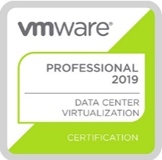


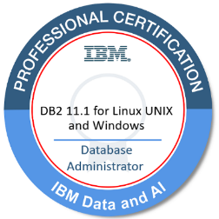


Operational Overview
Professional competence
800
Certifications
+
Technical service team possesses core technical capabilities in various OEM systems, enabling full support in the setup, development of software and hardware services, and maintenance.

Slide 28
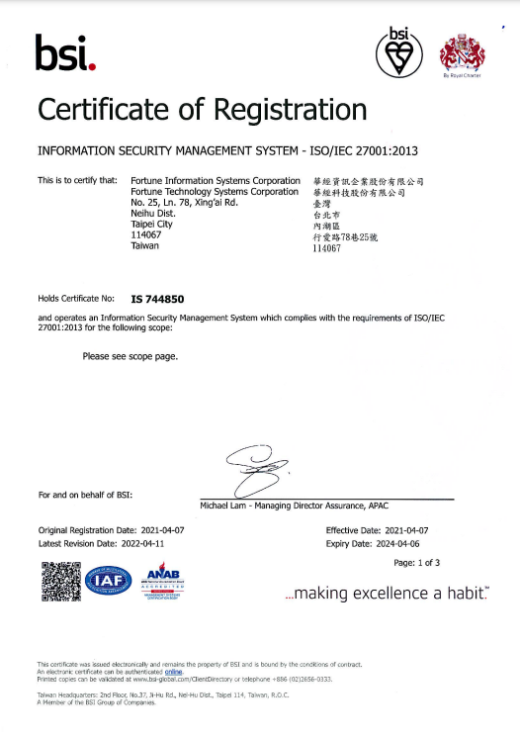
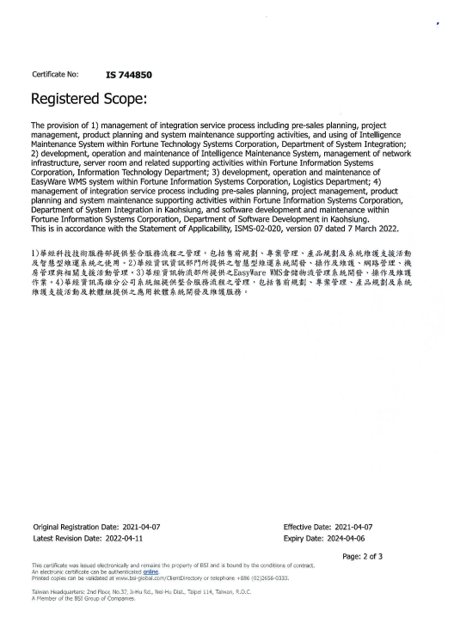


Operational Overview
Customer Trust and Business Competitiveness
BSI ISO /IEC 27001
Imported Information Security Management System (ISMS) and passed BSI ISO/IEC 27001 third-party verification.
PMP , Project Management Professional Certification
We have a team of professionals with expertise in various fields, most of whom possess knowledge aligned with international standards.

Slide 29
Operational Performance

Slide 30









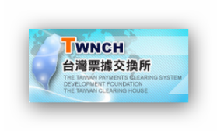








































Operational Overview
The Wins
Cloud Platform and Virtualization Construction
Storage Backup System Construction

Slide 31

























Operational Overview
The Wins
Application Virtual Platform Construction Backup
and Redundancy Infrastructure
Related Application System Setup Services
國家安全局
台灣國際纜網通信

Slide 32
Operational Overview
The Wins
Banking
Government
Others
票交所ACH系統第二異地備援採購案
國泰世華伺服器年度統購案
聯徵中心核心系統儲域網路軟硬體汰舊換新案
國泰世華VMware虛擬化軟體採購案
行動網銀暨海外網銀異地備援環境建置案
合作金庫電子商務系統伺服器汰換案
台灣企銀CyberArk提升案
台灣企銀AML資料儲存擴充案
台灣企銀開放式系統備份擴充案
Forcepoint購置案
中華郵政智能櫃購置採購案
國泰世華市場風險管理系統升級硬體設備採購案
國網中心民生物聯網雲端建置採購案
DNS網路安全升級案
端點資訊安全防護升級案
國網混合雲 B 標任務型導向 (Mission-critical)強韌雲端研究服務場域驗證
特定業務區域網路作業環境升級建置案
防毒軟體授權採購
微軟支援服務及軟體授權採購案
主機磁碟機汰舊換新案
連外區域網路作業環境升級建置案
伺服器等軟硬體採購案
區域網路作業環境軟硬體汰換案
點陣式印表機採購案
通信前置處理機汰換案
VxRail採購案
伺服器及儲存設備採購案
論文比對系統主機採購案
台灣運彩VMware軟體採購案
台灣運彩DELL設備採購
台灣運彩備份備援採購案
AD網域及虛擬化平台建置採購案
RFID 倉儲管理系統
RFID +Barcode 整合倉儲管理系統
WMS倉儲管理系統
TMS 運輸管理系統
端點防毒導入
病歷倉儲系統
雲平台伺服器儲存設備整合擴充案
腎臟科大數據平台整合案
全院工作站汰換案
護理站端末設備整合案
胸腔部儲存設備建置案
重粒子加速器週邊系統建置案
直線加速器系統建置案
Notes:
Roger 提醒: 黃色部分是比較久以前的案子 是否要移除

Slide 33
Industry Trends

Slide 34
Industry Trends
2023 Trends Report
Digital Twin
Automation Applications & Multi-Modal AI Development
Network Security
Digital Sovereignty
As the foundation of digital transformation, there's a need for more computing power, increased storage capacity, and data asset protection.
AI Servers
Digital Identity Recognition
The Security of Digital Supply Chains
Offsite Backup
Business Continuity Plan
Source: IDC Taiwan
IDC: Top 10 Predictions for the Taiwan ICT Market in 2023
https://www.idc.com/getdoc.jsp?containerId=prAP49941822
Notes:
數位雙生:
數位鏡像/數位映射。2023年開始，數位雙生的部署將更趨多元，並將在不同產業、不同企業規模間階段性的導入。
自動化應用&多模態AI發展:
人才與技術缺口將促使 35% 的 IT 組織投資於 AI 技能。
網路安全
2024年將有55%的組織向其客戶提供應用服務時，需簽署SBOM(軟體元件清單)以協助客戶建立軟體溯源能力、提升數位供應鏈安全性。
數位主權
因地緣政治的關係，企業更在意放在雲上的數據是否被完全的保護，並且關注數據中心所在位置。
數位雙生:
舉例: 一台飛機被製造出來，相對應的建立一個和實體飛機完全一樣的虛擬飛機
這台虛擬飛機記錄了這台實體飛機的一切資料，例如飛行紀錄、零組件、引擎、設備狀態…等等
都用軟體被記錄在伺服器中
這個虛擬飛機就好像實體飛機的數位孿生
假設這台飛機的生命週期有20年
任何故障維修都會被記錄在它虛擬身分上
運用產業很廣泛:
工廠建置
城市發展
健康醫療
….

Slide 35
Industry Trends
2023 Trends Report
Platform Engineering
Wireless Value Realization
Applied Observability
Sustainability
IaaS
PaaS
SaaS
Networking Equipment
Information Security
Data Monitoring and Analysis
Assisting in Business Decision-Making
ESG IT Service Solutions
Carbon Tracking Platform
Enterprise Carbon Management Service Platform
Source: CIO Taiwan
Gartner Research Report: 2023 Strategic Technology Trends
https://www.cio.com.tw/gartner-research-report-2023-strategic-technology-trends/
Notes:
平台工程:
越來越多企業會在內部建立平台團隊，將其內部的服務或元件等，以平台方式在內部提供。
可觀測性應用
能讓企業在正確的時間藉由觀測數據來做決策，獲得競爭優勢。 可觀測性應用將成為數據驅動型決策的最強大來源。
永續科技
ESG 相關技術和服務的投資力道更強。
企業需要新的可持續技術來提高 IT 服務的能源和材料效率，
實現其可持續性目標的 IT 解決方案。

Slide 36
Continuation &
Growth Strategies

Slide 37
Continuation Strategies
Core Technology
▋ System Integration
Cloud Service：FIS CMP, VMware, GCP, 微服務, HPE
Storage and Backup: Dell, DPA, HPE, Veeam, NetApp
Network Solution：Cisco, Juniper, Fortinet, Aruba
AI Infrastructure Solution：GPU Server
AIoT Solution：Smart Cabinet丶EZPOST
▋ Software Solutions
Cloud Platform Solutions：FIS CMP
Cybersecurity Solutions：Forcepoint DLP
WMS Solution：ERP, MES, BPM
Document Management Solutions: DOCM, DOCS
Software Tools: RedHat, InfuseAI, UiPath
Software Product Quality Analysis Platform: TIOBE
AI Application Software Solutions： AI Server、 Digital Identity Recognition, the team is searching..

Slide 38

Growth Strategies
Diverse Development of Core Technology
Cloud Solutions and Innovation
Information Security/Zero Trust
Enhancing the Flexibility and Performance of Cloud Solutions to Meet the Growing Demands of Customers for Virtualization, Elastic Deployment, and Data Security.
Security
Providing customers with Information Security Zero Trust solutions to achieve a comprehensive security network and enhance customer trust.
TIOBE Software Quality Testing.
Cloud
ESG
i-Box & Shopee Smart Cabinet
Carbon Tracking Platform, ezGHG Corporate Carbon Management Service Platform
integrates with smart energy management to enhance process energy efficiency, achieving energy savings and carbon reduction for sustainable operations.
AIoT
Advancing further into the AIoT (Artificial Intelligence of Things) domain, expanding EZPOST, and creating Smart Cabinet solutions.
ESG
AI Application
Enhancing the development of AI infrastructure layer solutions (GPU Server) to meet the growing AI workloads.
Authme digital identity recognition.
The team is also concurrently searching for suitable AI applications.
AI
Notes:
核心技術的多元發展將成為關鍵策略之一，
在不斷變化的科技環境中保持競爭力並擴大市場。
我們將專注於這些領域的技術整合和創新、構建強大的產品組合

Slide 39
THANK
ＹＯＵ
Q&A

