Slide 1
Stark Technology Inc.
2018 Investor Conference

Slide 2
Safe Harbor Notice
There are variety of factors which may influence statements or contents been drafted within this presentation, therefore we strongly recommend audience to refer to the information published on MOPS website in case any adjustment has been made.

Slide 3
STI General Information
Founded in 1993, public traded in 2000
490+ Employees
The largest domestic system integrator in Taiwan
One of Taiwan’s top 500 service enterprises company.
Rated as Taiwan’s top 6% - 20% company over the 3rd Corporate Governance Evaluation
Dedication to service and maintain 1,600+ majority of the 2,000+ company enterprise business
Providing more than 40 products & solutions to service our customers
Our vision is to assist our customers to become a Information Service Provider

Slide 4
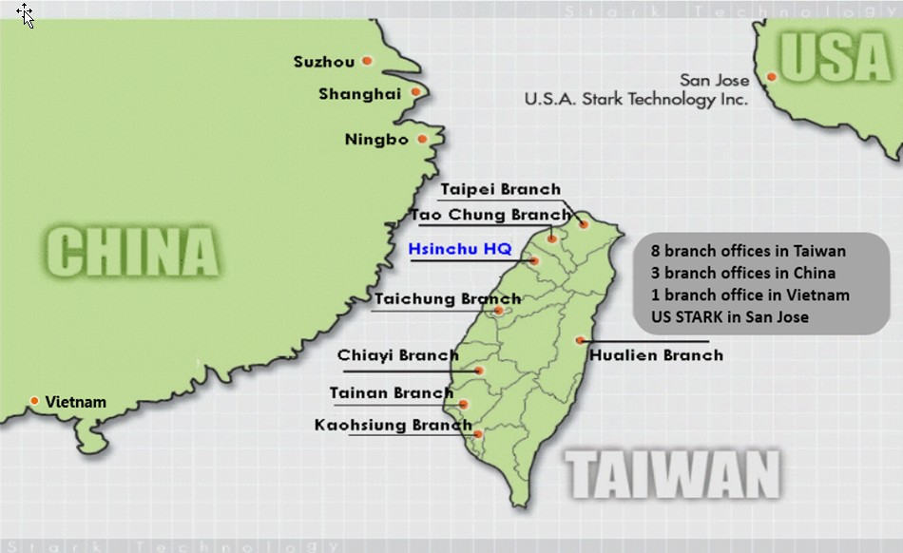
STI Service Network

Slide 5
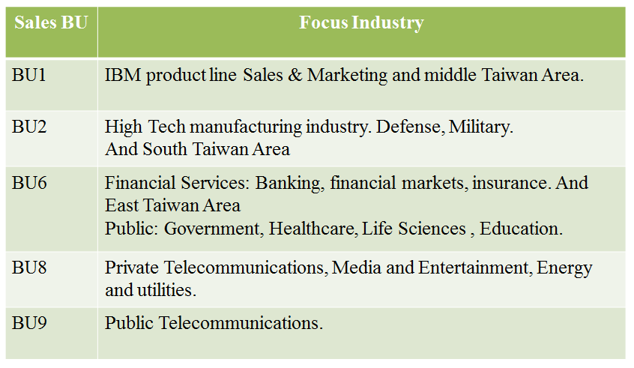
Sales Operation – by Industries

Slide 6









We’ve been worked and working on:
Cloud Services & Data Analytics
Infrastructure
internet
Enterprises
Factories
Enterprise/PC
Travel Cloud
Big Data &
Computing
Cloud
Cable
Medical
Cloud
Enterprise Apps
Data Integration
Deep Learning
Analytics
Broadband
Home/PC
SmartTV
Buyers, Sponsors
Mobile APP
FSI Cloud
(Fintech, Blockchain)
3G/LTE
Factory
Automation
Industry 4.0
IoT
WiFi
Smart Mobile
LoRa
Developers, Content Providers, Consumers
NB-IoT
IoT Devices
Inter-connect : Telecomm、Broadcast/Cable、Internet
Multi-Screens : PC、NB/Pad、Smartphone、SmartTV

Slide 7
Information Technologies
Consulting
Design
Deployment
Integration
Portal Personalization Content Mgmt Single sign-on
Enterprise Apps
ERP,CRM,SCM
MES, PLM
OSS, VAS
Probe/CEM
eCommerce
High Freq. Trade by Trade
AML
Travel
Medical
Gov’t
Professional
Services
IoT
(Environmental Monitoring)
MFG
Telco
FSI
Vertical Apps.
EAI@SOA Middleware Data Integration@BI
Data Mgmt.
Security
System & Platform Resource Mgmt (CPU/GPU@VM/Container/Bare Mental)
Networking Platform Load Balancing Network Mgmt

Slide 8


Tel-Communication Technologies
OTN/ROADM/OXC
Backbone
OXC
DWDM
NG-SDH/PTN Ring
STM-16/64
STM-1
Carrier-Ethernet
SDH Mux
ATM switch
Core/Regional
Gigabit Ethernet
Ring
FTTx, x-PON
Metro./Access
TDM
xDSL
Metro-Ethernet

Slide 9










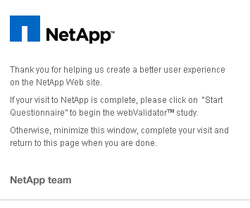
















Products & Solutions
Info. Security
Software Development Tools
Resource MGMT.
Data MGMT.
Data Comm.
Open Systems
Telcomm.
STI Professional Service

Slide 10
Balance Sheet Overview (Consolidated)
Units:NT$ thousand
 | 2017/12/31 |  | 2016/12/31 |  | 2015/12/31
 | AMT | % | AMT | % | AMT | %
Cash and cash equivalents | 1,401,185 | 33% | 1,686,989 | 36% | 1,208,877 | 29%
Accounts receivable | 1,065,080 | 24% | 1,337,737 | 28% | 1,619,777 | 39%
Inventories | 793,936 | 18% | 738,898 | 16% | 408,367 | 10%
Property,Plant and equipment | 455,609 | 11% | 369,736 | 8% | 380,805 | 9%
Total Assets | 4,310,512 | 100% | 4,679,015 | 100% | 4,177,332 | 100%
Current Liabilities | 1,739,542 | 40% | 1,901,145 | 41% | 1,377,590 | 33%
Equity | 2,529,187 | 59% | 2,743,859 | 59% | 2,773,476 | 66%
Source: Market Observation Post System

Slide 11
Income Statements Overview (Consolidated)
Units: NT$ thousand
 | 2017/12/31 |  | 2016/12/31 |  |  | 2015/12/31
Item | AMT | % | AMT | % | YOY | AMT | %
Revenues | 4,201,110 | 100% | 4,222,518 | 100% | -1% | 4,402,929 | 100%
Gross profit | 1,115,800 | 26% | 1,103,872 | 26% | 1% | 1,114,157 | 25%
Operating expense | 778,327 | 18% | 778,576 | 19% | 0% | 815,775 | 18%
Operating income | 337,473 | 8% | 325,296 | 7% | 4% | 298,382 | 7%
Other income | 26,476 | 1% | 29,854 | 1% | -11% | 31,678 | 0%
Pre-tax income | 363,949 | 9% | 355,150 | 8% | 2% | 330,060 | 7%
Net income | 305,667 | 8% | 299,699 | 7% | 2% | 268,194 | 6%
EPS(NT$) | 2.56 |  | 2.25 |  |  | 2.02
The 2018 general shareholder’s meeting is scheduled at 9:00 am on May 28 (Monday),2018 at No.282, Beida Rd. , Hsinchu City, Taiwan (R.O.C.) (The Third Credit Cooperative of Hsinchu on the 13th-floor conference center)
Source: Market Observation Post System

Slide 12
Sales Revenue & Net Income

Slide 13
EPS & Capital
Record date of the capital reduction :2017/07/01,ratio:20%,
common shares after the capital reduction:1,063,603

Slide 14
Sales Revenues by Type
Revenue:42.01billion
Revenue:42.23billion

Slide 15
Q & A
Thank you!!

