Slide 1


揚博科技股份有限公司
Ampoc Far-East Co., Ltd
2024/09/12
Investor Conference
1

Slide 2
CONTENTS
Ampoc Profile
Company Status
Financial Information
Own Brand Equipment
- Introduction and Prospect
Distribution Business
- Introduction and Prospect
2

Slide 3
Company Profile
01
3

Slide 4
Profile
Since
1976
Capital
11.4 Million
Turnover
33.54 Million
Employee
340 people
1980-1990
2001-2010
2021- now
Ampoc was founded with initial registered capital of NT$1 million;
TCM Japan established TTCM in CHUNG-LI industrial zone for PCB wet process equipment manufacture. Ampoc invested TTCM and obtained global exclusive distribution ship excluding Japan.
Company name changed as “AMPOC FAR-EAST CO., LTD., capital increased to NT$ 0.9 Billion.
Ampoc (2493) was listed on the Taiwan Stock Exchange on 01/23/2002.
ESG task force established.
ECO Heat exchange System developed.
2023 new purchase of Nanyuan Road factory for future business development.
Ampoc purchased the office in Taipei as headquarters.
Ampoc was approved as IPO.
AMPOC merged TTCM.
“Ampoc Wing” was developed and shipped to customer for production usage.
HK subsidiary was approved by the board of directors.
AMPOC Shanghai was invested by HK subsidiary.
1976- Establishment
1991-2000
2011-2020
4

Slide 5
Company Status
02
5

Slide 6
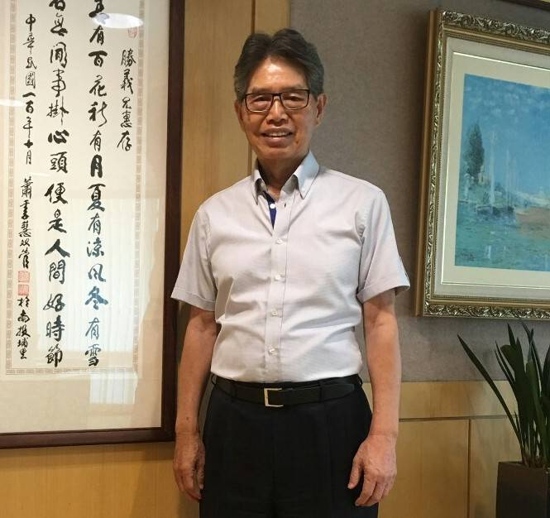
Company status
~AMPOC considers serving customers as its mission, and actively acts as a coordinator for information technology industry~
2
4
9
3
2 divisions
Manufacturing Management Division
Business Management Division
4 cores
Advanced manufacture
Hi-tech R&D
Advanced semiconductor process
Energy saving and carbon reduction
9 mindsets
Quality first
Innovation
profession
Process improvement
Engagement management
International marketing
Service first
Social responsibility
Sustainability
3 technologies
Ampoc Wing
Ampoc ECO
Ampoc 5A
Mr. Ronald Su
(CEO & Chairman)
6

Slide 7
Financial Information
03
7

Slide 8
Financial Information
2022~2024H1Consolidated Balance sheet
Unit: NT$ thousands (Except EPS: NT$)
Year Item | 2022 | 2023 | 2024 H1
Net Revenue | 3,448,384 | 3,354,285 | 1,762,665
Gross profit | 1,098,413 | 1,219,708 | 628,990
Gross margin(%) | 31.85 | 36.36 | 35.68
Operating income | 756,369 | 836,161 | 430,027
Net income after tax | 592,400 | 690,310 | 349,703
EPS | 5.18 | 6.03 | 3.06
8

Slide 9
Financial Information
2022~2024H1 Consolidated Income statement
Unit: NT$ thousands (Except EPS: NT$)
Year Item | 2022 | 2023 | 2024 H1
Current Assets | 3,992,366 | 3,869,784 | 3,839,798
Non-current Assets | 633,581 | 1,113,823 | 1,124,581
Total Assets | 4,625,947 | 4,983,607 | 4,964,379
Current Liabilities | 1,762,805 | 1,709,646 | 1,979,219
Non-current Liabilities | 98,176 | 273,407 | 198,822
Total Liabilities | 1,860,981 | 1,983,053 | 2,178,041
9

Slide 10
Financial Information
2022~2024H1 Financial Analysis
Year Item | 2022 | 2023 | 2024 H1
Debt Ratio(%) | 40.23 | 39.79 | 43.87
Current Ratio(%) | 226.48 | 226.35 | 194.00
Average Inventory Turnover(Times) | 1.91 | 1.86 | 2.19
Return on Equity (%) | 22.76 | 23.95 | 12.09
10

Slide 11
Own Brand Equipment
- Introduction and Prospect
04
11

Slide 12
Own Brand Equipment
Introduction
04
12

Slide 13

ESG
E
Environmental
S
G
Social
Governance
13

Slide 14
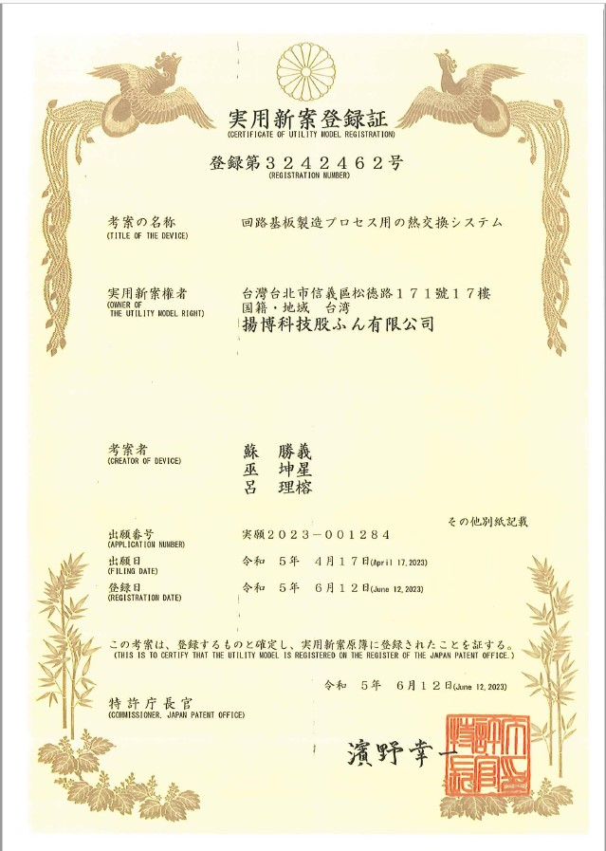
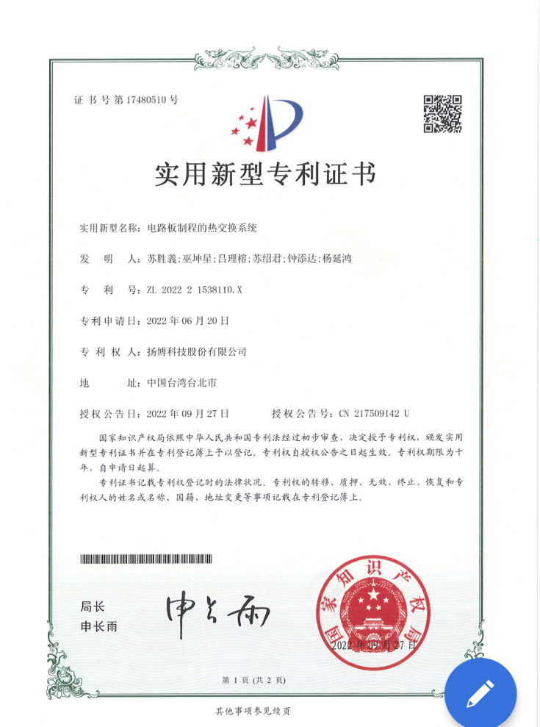
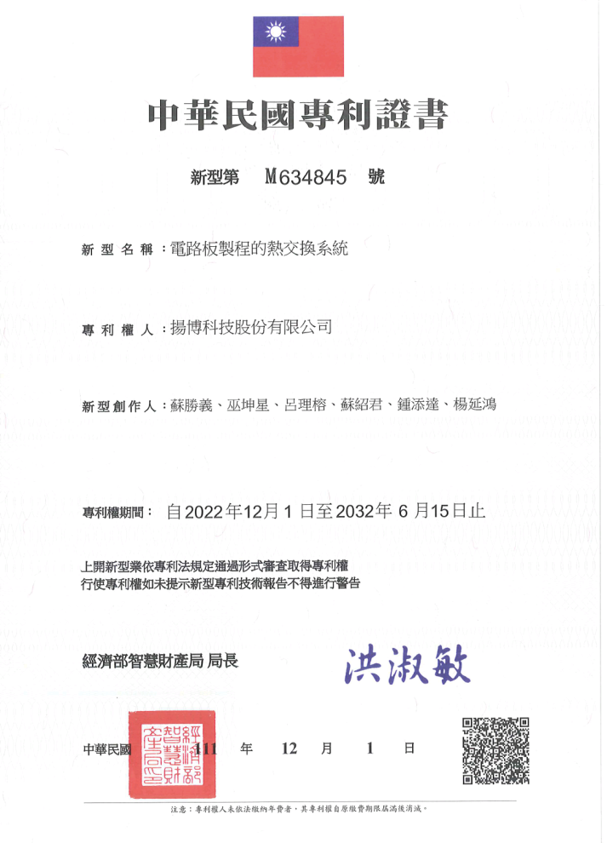
Patents on ECO System
14

Slide 15

ECO System video
15

Slide 16
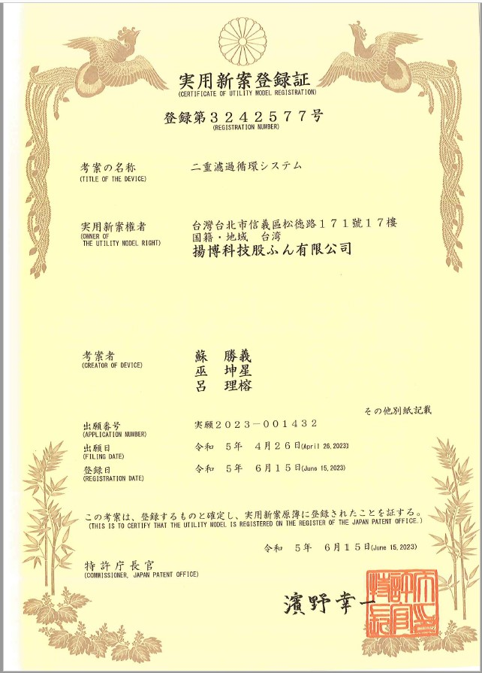
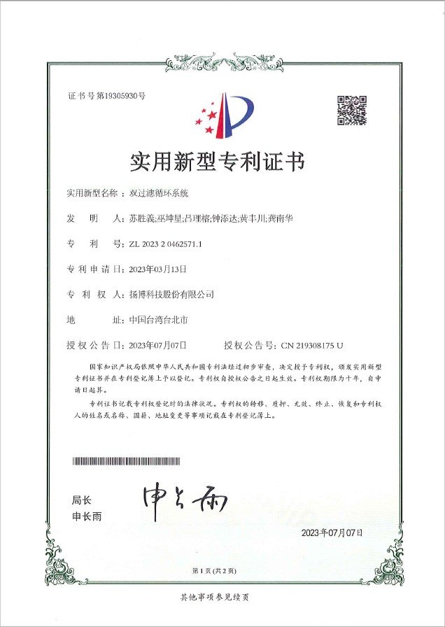
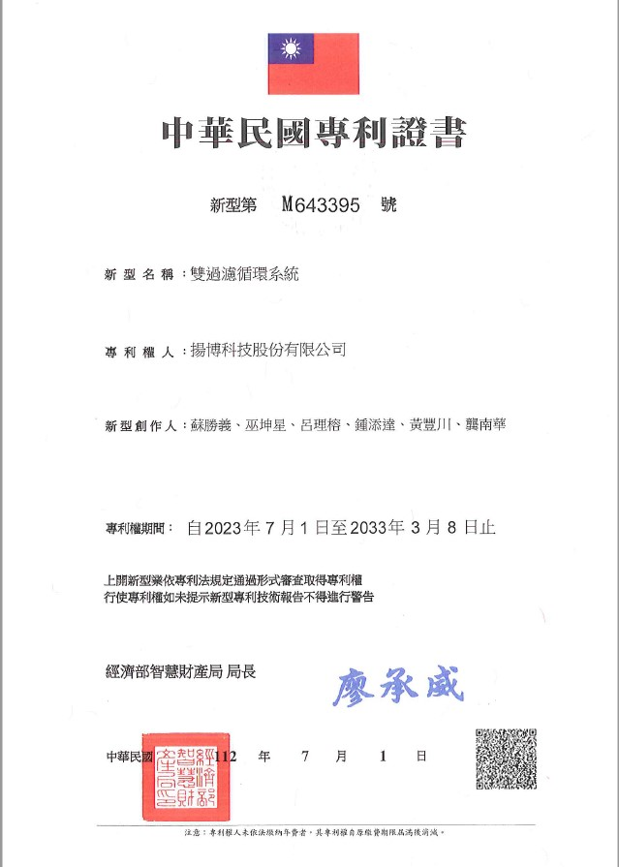
Patents on Ampoc Pure
16

Slide 17
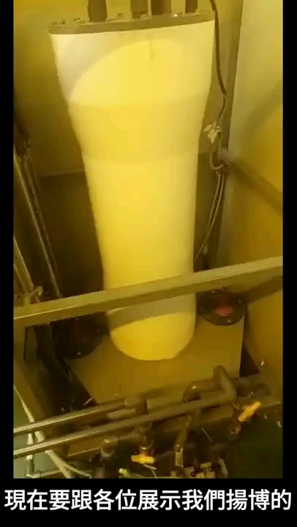
Ampoc Pure Purification System
17

Slide 18
Own Brand Equipment
- Retrospect and Prospect
18

Slide 19
2024 H1 Retrospect and Prospect
  In the first half of 2024, the primary self-manufactured equipment usage will be focused on substrates and HDI, and there is a significant proportion in substrate-like applications. The market applications include smartphones, automotive electronics, servers, and other product markets.
  The Ampoc 7A (Arrows) patented new product will be launched, which will be publicly presented at TPCA from Oct. 23-25 this year. Besides addressing glass substrate equipment, the two patented designs, the ECO heat recovery system and the Ampoc PURE purification system, contribute significantly to energy saving and carbon reduction in response to global warming trends.
  In response to customers moving their factories to Southeast Asia, we are progressively installing equipment and will establish a service point in Thailand to closely communicate with customers, provide after-sales service, and seize business opportunities.
19

Slide 20
2024 H1 Retrospect and Prospect
Future Equipment Development and Demand Outlook:
High-end Process Equipment for ABF Substrates and Glass Substrates.
Competition in High-end Products among PCB Manufacturers, including 5G-related substrates, substrate-like materials, HDI, and flexible PCB equipment.
Demand for PCB Equipment related to Electric Vehicles and Safety.
Ongoing Development of Energy-saving, Waste-reducing, and Dust-free Equipment.
20

Slide 21
Distribution Business
- Introduction and Prospect
05
21

Slide 22
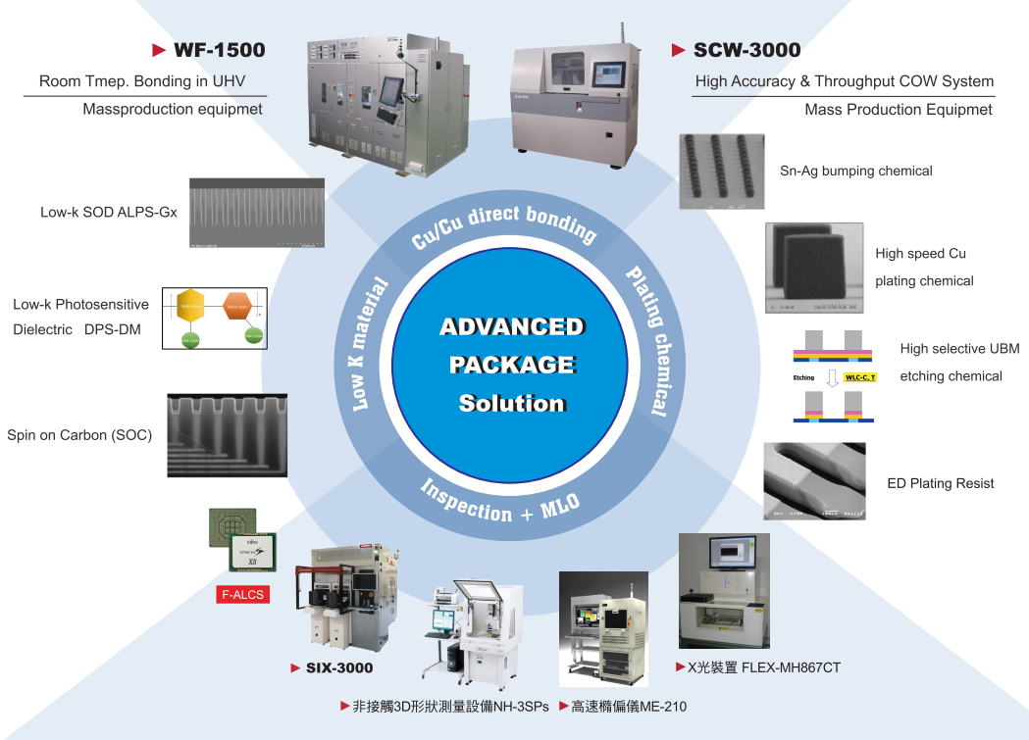
Target & Planning
Advance package/Material/Inspect solution
22

Slide 23
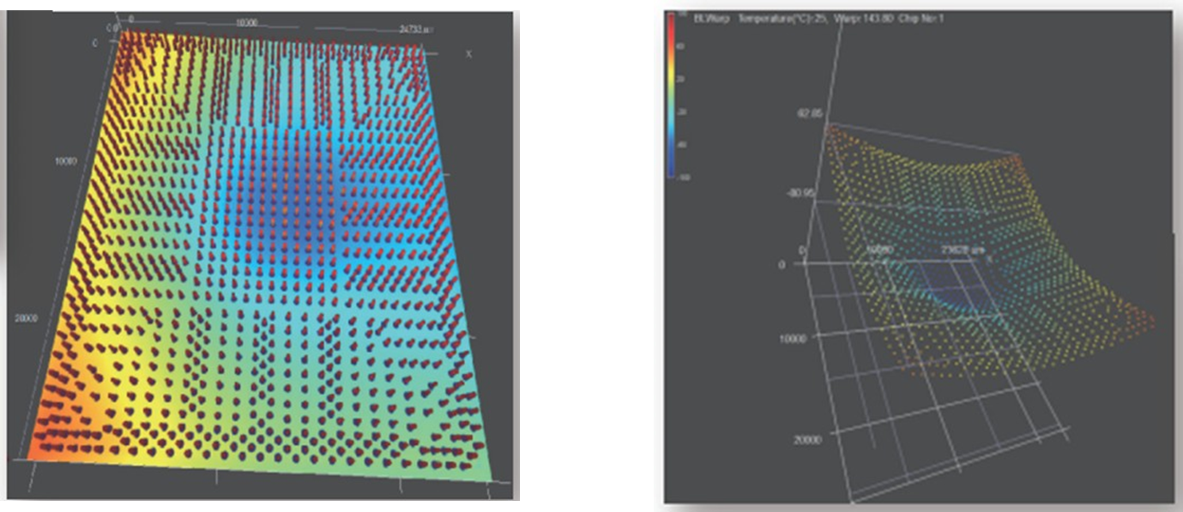
Target & Planning
3D Measurement Equipment
Function: Used for morphology measurement before bonding.
Purpose: Variations occur during advanced packaging processes. This equipment provides a large amount
of morphological data after measurement, significantly improving bonding yield.
23

Slide 24
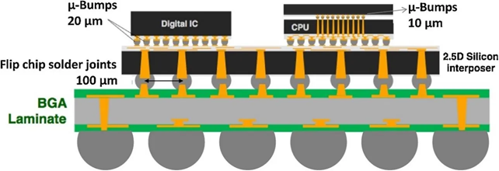
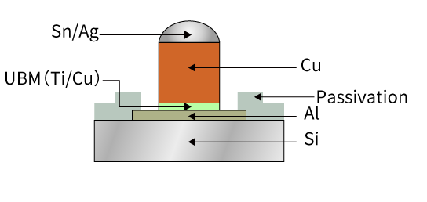
Target & Planning
Material
Advanced PKG
Micro Bumping/SnAg (Mass production now)
Cu Pillar(Mass production now)
Dielectric (developing)
Semicon Front-end materials
Lithograph material
Domestic/foreign factories are now testing
Equipment
AI
2.5D Bonder (validation in progress)
3D Bonder (End customer product is undergoing final validation)
3D Bonding Inspection Machine
Process
Application
Chip On Wafer on Substrate
HPC
Si Photonics
FOPLP (Fen Out Panel Level Package)
AI
資料來源：https://www.shinko.co.jp/english/product/package/assembly/cu-pillar.php
24

Slide 25
2023-2024 Retrospect and Prospect
Revenue from advanced semicon PKG by the operations division has benefited from the growth in AI demand, with significant improvements observed in high-end packaging, photolithography processes, and overseas markets.
Revenue comparison H1 2023 vs H1 2024 ：
  High-end packaging grew by 15%；
  Photolithography materials grew by 64%；
  By sales region: Taiwan increased by 31%, while overseas regions grew by 8%.
25

Slide 26
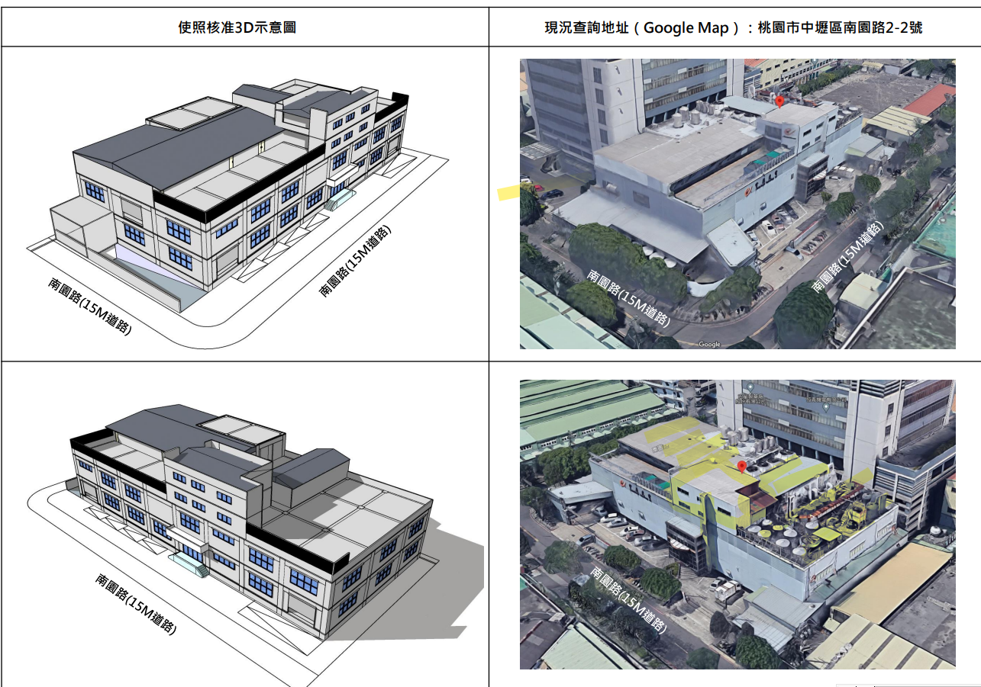
2023-2024 Retrospect and Prospect
2023 - new Zhongli factory building (as shown in the image on the right) was purchased for operation need and future market layout planning.
2024 August - The factory license and factory registration were completed.
2024~2025 - The factory renovation and repairs are scheduled.
圖：中壢工業區新購廠房
26

Slide 27
Thank you for your Attention!
27

