Slide 1
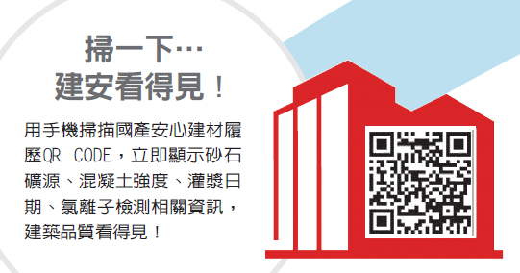
Goldsun Building Materials Co., Ltd.
I. Company Profile
II. Operating Performance in 2022 and the first quarter of
2023
III. Outlook for Future Operations
IV. Company's Potential Advantages
V. Important Appendix
Jun 7, 2023
Scan to check the building safety
Scan the QR code with your smartphone to see the traceability records from Goldsun. They immediately show the source of sand and gravel, the strength of concrete, date of pouring, chloride ions inspection, and other information, giving you access to information on building quality.

Slide 2

I. Company Profile
(I)Company Group Introduction
Company history
Key domestic re-investment companies
Overseas re-investment companies
Domestic operating activities
Invested in Wellpool (stock code 8424), with 51% in shareholding in 1984.
Established Taipei Port Terminal Company in 2009, and officially started operations in 2016.
Established in 1954. Listed in the Taiwan Stock Exchange since 1978. Current capital at NT$11.8 billion.
Established a ready-mix concrete plant in Suzhou from 2003-2005
Established shipping and other related businesses in 2012~2018
A leader in Taiwan's ready-mix concrete market.
28 ready-mix plants in Taiwan.
Revitalization of the corporate group's land assets and innovation of construction business.
P.1

Slide 3
P.2

Slide 4
II. Operating Performance in 2022 and the first quarter of 2023
(I)Consolidated revenue structure in the past three years
Unit: NT$ 100 million
P.3

Slide 5
Note: In Q1 of 2022, there was a profit of 1.743 billion from the disposal of "Kaohsiung Land". In May 2021, there was 175 million "income from disposal of Kunshan factory".
P.4

Slide 6
III. Outlook for Future Operations
(I)
With the following six trends in development, the orders on hand have reached a new high of more than 8 million M³ (1.23 times the annual sales volume of 6.5 million M³). Under the strategy of "Selecting the best for shipment," not only gross profit and profitability have increased significantly.
The construction and expansion of semiconductor industry clustering, further driving the development of real estate around those companies.
The emerging industrial parks will drive the demand and prosperity of the surrounding construction and real estate properties.
  (Industry migration + Construction in place + Population migration = New town)
The Ministry of the Interior is actively amending the law and setting volume bonus to promote urban renewal: a large number of cases will be released for the replacement of dangerous old house, commercial offices, factory offices, and residential buildings. At present, it is only the beginning (start) step, and it will still be sustainable in the future century-old business opportunity.
In order to resolve the problems of demand for industrial land, the program of the “renewal of factories and offices” will accelerate to create (energy-saving, smart, energy storage)-enabled and functional factories and offices.
Driven by the three major demands of "natural division of households (1 household with 4 persons ↓ 2.8~3 persons" + "rigid demand for self-occupation" + "returning Taiwanese businessmen to purchase property"), the housing market can still maintain an upward trend.
The “Great South, Great Development” policy will be invested with NT$ 900 billions of funds within the next 4 years, for measures of public infrastructure, tax preference and start-up assistance in southern cities and counties to balance the regional development. Also, there will be two science industrial parks established in Pingtung and Chiayi, respectively, which aim to form a science corridor in the great south with Tainan Science Park, Chiaotou Science Park and Shalun Smart Green Energy Science Park.
P.5

Slide 7
(II)
The current housing policy has indeed delayed some construction projects, but "MRT construction", "railway construction" and "public-office urban renewal" have become new trends in the layout of construction companies, and the number of commercial-office building projects has increased , the construction of MRT houses, and the active development and establishment of major industrial parks (industrial parks) in the south, these are enough to make up for the loss in the preceding item.
(III)
  The company's 28 ready-mixing plants in Taiwan are located in the hubs of various regions. They can flexibly dispatch and support each other from 3 to 5 plants to achieve the optimal collaborative supply capacity. It is the first choice for technological workshops that require continuous pouring of a large amount of concrete..
(IV)
  In order to meet the needs of customers and expand the company's operating scale and performance, in addition to adding the Rende factory in Tainan and renting the Taiping factory in Taichung, we also expanded production equipment in the Xizhi factory in New Taipei, the Renwu factory in Kaohsiung, and the Fengshan factory. Under the successful strategy of "selecting the best to ship", it is expected that the operation in 2023 will achieve another success and reach a higher level.
P.6

Slide 8
(V)
  Combined with the calcium silicate board of “WELLPOOL Co.,LTD", the "Chiayi Concrete Plant" was selected to add ALC (Autoclaved Light weight Concrete) lightweight partition boards, commonly known as improved white bricks (one piece = 40 cm × 60 cm × 10 cm = 0.024m³ , can replace 24 red bricks, and the weight is 1/4), the plant's planned production capacity is 200,000 m³ (actual mass production can reach 350,000 m³), the current unit price is 3,100 yuan/m³, and it will be officially mass-produced by the end of 2021 , officially entered the "light compartment market" with business opportunities of NT$10 billion.
(VI)
The company's profits have increased significantly. From 2021 to 2022, the "net cash inflow from operating activities" will reach 3.836 billion and 2.978 billion respectively. Sufficient funds can be used for effective capital expenditures, and the ability to follow the trend of "high dividend rate and high yield" step forward.
P.7

Slide 9
IV. Company's Potential Advantages (Highlights)
(I)
In response to the government's "Eastern District Gateway Program," the development of the Nangang Depot will create substantial asset appreciation and realize future benefits.
(II)
The company's assets are abundant and acquired at an early stage. The cost is very low, and there is room for value growth. It can provide stable cash flow and is also a source of non-industry income.
The company has its own ready-mixed concrete plant in the province, with a total area of about 50,000 ping. Most of them were acquired in the early stage. After decades of development and construction, the adjacent areas have gradually prospered and the land value has increased. They are already planning to apply for changes in land use through "urban renewal", "urban rezoning" or "section expropriation". In order to increase the value of assets, there will be a second and a third... Nangang factory development project, so every year, the capital expenditure for the purchase of a new factory site needs to be compiled as a plan for future replacement factories.
For example, China National Building Materials Group owns: 1,260 pings of land adjacent to Zhonghua East Road in Tainan City, which is not only an important land with high value-added and strong cashability, but also Nanfeng Village, the State Guest Studios in the layout of major metropolises in Tainan. , located next to the Wangpingshi rezoning area in Xindi, Tainan, where the blue line of the Tainan MRT has recently been demarcated. The potential value is high, and it will help to establish a major advantage in the future operation and asset activation of the domestic building materials industry.
P.8

Slide 10
(III)
  The "Great Southern Project" to build the South Taiwan Technology S Corridor can strengthen the operating advantages of the company's factories in Yunlin, Chiayi, Tainan, and Kaohsiung, especially the Kaohsiung factories that are located at the core of the Semiconductor S Corridor, and the benefits are even more significant.
(IV)
  The company group has been carrying out innovative research and development for a long time, and has won the "Concrete Engineering Excellence Award" for three consecutive bienniums. It is the main designated high-end concrete supplier for the proton and heavy particle cancer medical centers of electronics factories and major medical institutions.
(V)
  In recent years, we have formulated a carbon competitive advantage strategy. In addition to being recognized as one of Taiwan's top 100 carbon competitive companies by Business Weekly, we have recently obtained the greenhouse gas inventory verification (ISO 14064-1, ISO 14064-1, ISO 14064-1, Commonly known as carbon inventory certification), to improve the carbon competitiveness of the whole group and keep pace with the world!
(VI)
  In order to lay the foundation for the company's future carbon competitive advantages, various important projects such as national-level scientific and technical colleges have been comprehensively launched, including: development and research of new-generation power storage cementitious composite materials, development of high-pressure steam curing lightweight cellular concrete low-carbon process development, establishment of TAF Laboratory, which implements national-level inspection capabilities, took the lead in becoming the first ready-mixed concrete enterprise organization in China to pass this inspection project.
P.9

Slide 11
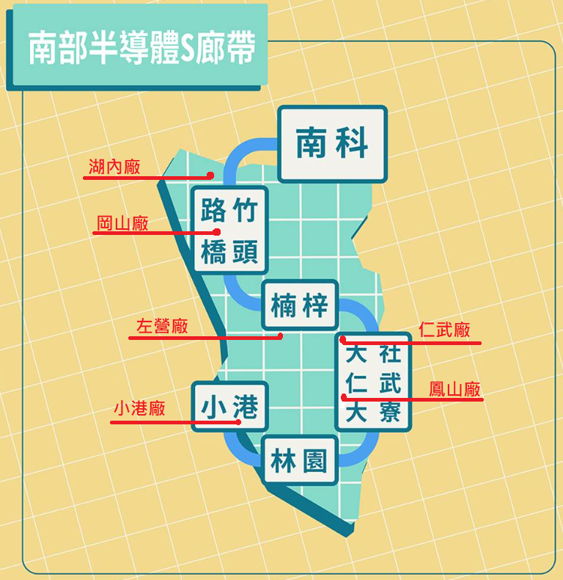
(高雄市南部行政區域圖)
P.10

Slide 12
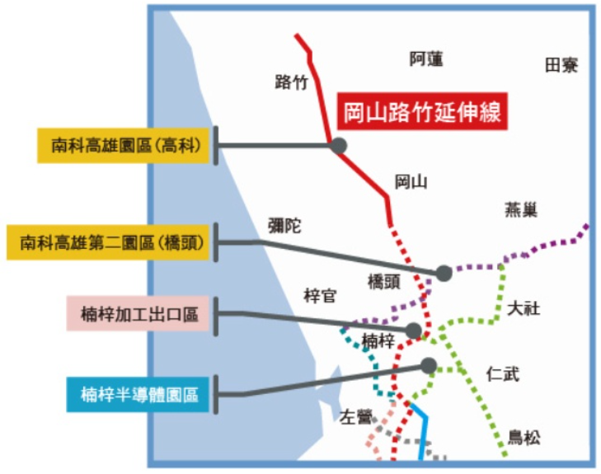
P.11

Slide 13
V、 Appendix

Slide 14
Appendix
A. Construction project price index - Ready-mix concrete
2019/6 ~ 2021/5
Year / Month | Jun, 2019 | Jul | Aug | Sep | Oct | Nov | Dec | Jan, 2020 | Feb | Mar | Apr | May | Jun | Jul | Aug | Sep | Oct | Nov | Dec | Jan, 2021 | Feb | Mar | Apr | May
Price Index | 87.4 | 88.0 | 88.3 | 88.7 | 89.1 | 89.6 | 90.8 | 92.0 | 94.0 | 95.9 | 96.5 | 96.8 | 96.9 | 97.0 | 97.2 | 97.2 | 97.2 | 97.2 | 97.7 | 98.0 | 98.2 | 98.4 | 98.6 | 98.7
Source: National Statistics of the ROC
P.12

Slide 15
Appendix
B. Construction project price index - Ready-mix concrete
2021/6 ~ 2023/5
Year / Month | Jun, 2021 | Jul | Aug | Sep | Oct | Nov | Dec | Jan, 2022 | Feb | Mar | Apr | May | Jun | Jul | Aug | Sep | Oct | Nov | Dec | Jan, 2023 | Feb | Mar | Apr | May
Price Index | 99.1 | 99.8 | 100.2 | 100.4 | 101.4 | 102.8 | 104.6 | 105.4 | 105.8 | 106.5 | 108.6 | 112.2 | 113.9 | 115.5 | 115.6 | 117.0 | 117.4 | 118.0 | 118.7 | 119.4 | 119.8 | 119.9 | 120.0 | 120.0
Source: National Statistics of the ROC
P.13

Slide 16
Appendix
P.14

Slide 17
D. 2023 Q1 construction license and start-up status are still normal
Appendix
Unit: 10,000 meters
P.15

Slide 18
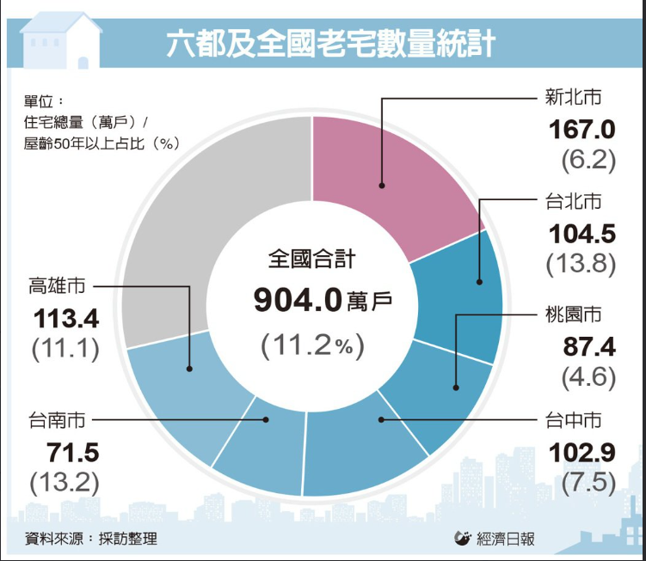
P.16

