Slide 1
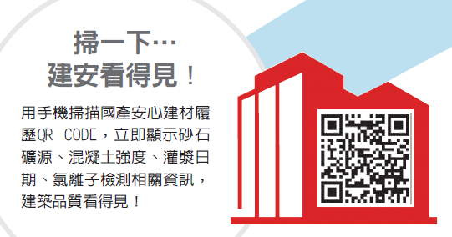
Goldsun Building Materials Co., Ltd.
Company Profile
2025 Operating Performance
Outlook for Future Operations
Q&A
Mar 12, 2026
Scan to check the building safety
Scan the QR code with your smartphone to see the traceability records from Goldsun. They immediately show the source of sand and gravel, the strength of concrete, date of pouring, chloride ions inspection, and other information, giving you access to information on building quality.

Slide 2

Company Profile
Company history
Key domestic re-investment companies
Overseas re-investment companies
Domestic operating activities
Invested in Wellpool (stock code 8424), with 51% in shareholding in 1984.
Established Taipei Port Terminal Company in 2009, and officially started operations in 2016.
Established Goyu Building in 2019. Established Galc Inc in 2021
Invested in Reset Resource Technologies in 2024, and held 67% of shares
Established a ready-mix concrete plant in Suzhou from 2003-2005
Established shipping and other related businesses in 2012~2018
Established in 1954. Listed in the Taiwan Stock Exchange since 1978. Current capital at NT$11.8 billion.
A leader in Taiwan's ready-mix concrete market.
26 ready-mix plants in Taiwan.
Revitalization of the corporate group's land assets and innovation of construction business.
P.1

Slide 3
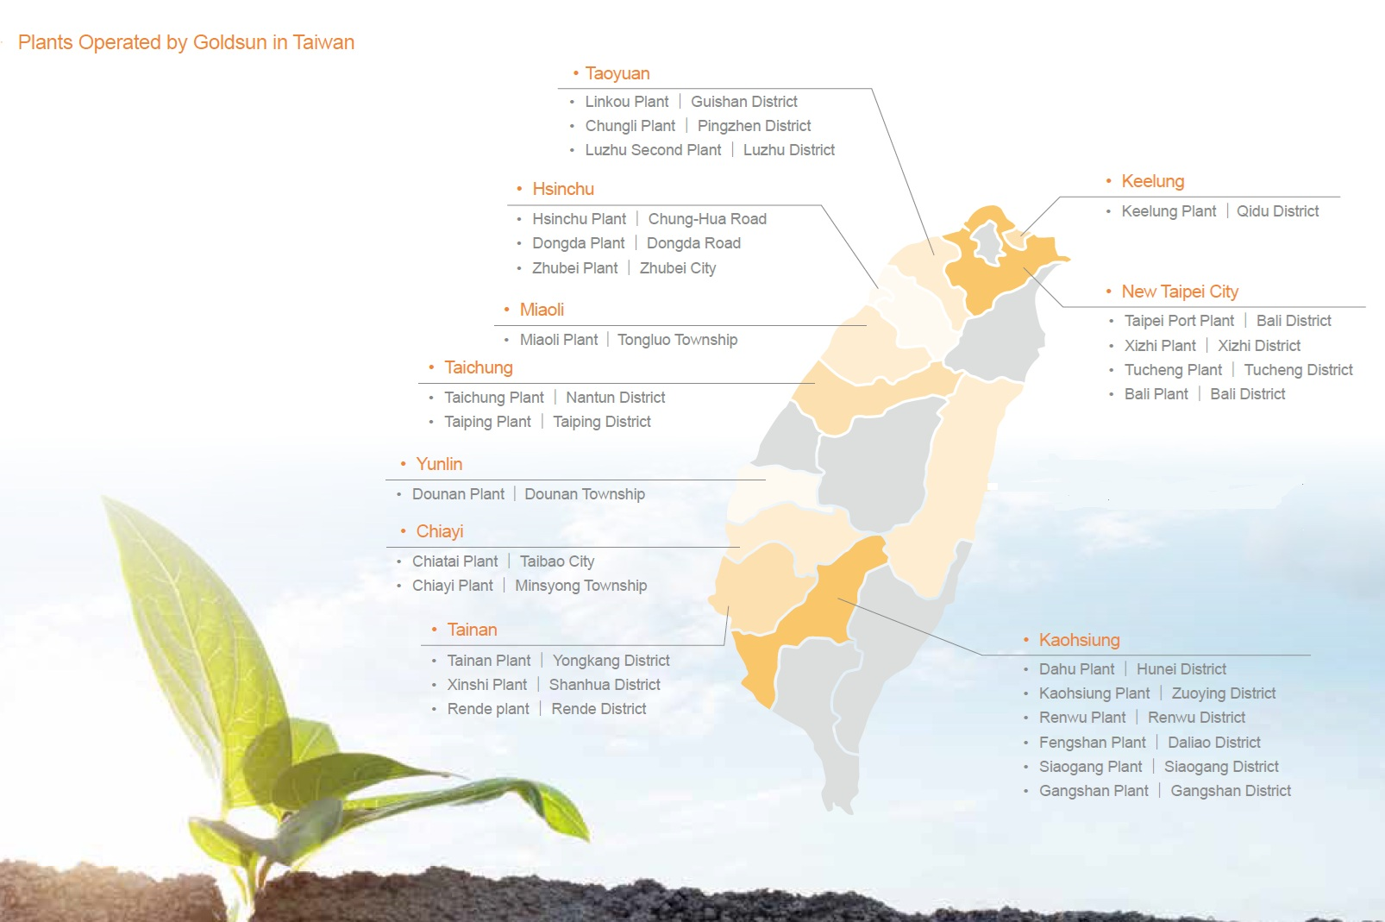
Plants Operated by Goldsun in Taiwan
Goldsun's headquarters in Neihu and 26 plants across major cities in Taiwan achieved coordinated operations in providing massive ready-mix concrete products, which is highly welcomed by tech corporations, construction sites and major infrastructure projects.
P.2

Slide 4
Statements of Comprehensive Income
P.3

Slide 5
Consolidated Revenue Structure：
Unit: NT$ 100 million
P.4

Slide 6
Comparison of operating performance and growth in the past three years
Unit: NT$ 100 million
Note: (1)2023 Proceeds from disposal 「 Suzhou Changshu Factory 」0.211 billion and Q4「 Taoyuan Factory 」0.336 billion 。
(2)2024 Proceeds from disposal Tainan shopping mall land 1.039 billion。
P.5

Slide 7
Total Building floor area
Unit: square meter
year/ month | Dec | Jan, 2025 | Feb | Mar | Apr | May | June | July | Aug | Sep | Oct | Nov | Dec
same period | 3,085,367 | 3,067,345 | 1,962,623 | 2,822,992 | 3,358,467 | 3,550,598 | 4,087,426 | 3,382,399 | 4,001,961 | 2,634,719 | 2,389,187 | 3,749,813 | 4,589,431
This issue | 4,589,431 | 3,191,208 | 1,897,170 | 3,156,259 | 2,574,441 | 2,827,507 | 2,653,427 | 2,904,220 | 2,561,186 | 2,947,437 | 2,757,461 | 2,363,557 | 2,840,632
Compare | 1,504,064 | 123,863 | -65,453 | 333,267 | -784,026 | -723,091 | -1,433,999 | -478,179 | -1,440,775 | 312,718 | 368,274 | -1,386,256 | -1,748,799
increase or decrease rate | 48.7% | 4.0% | -3.3% | 11.8% | -23.3% | -20.4% | -35.1% | -14.1% | -36.0% | 11.9% | 15.4% | -37.0% | -38.1%
* Source : Department of Interior and Construction; Total construction floor area for concrete construction + Steel reinforced concrete construction +Total floor area of ​​steel structure building license
P.6

Slide 8
Outlook for Future Operations
The company plans to invest in the construction of its second slag grinding plant and commence operations at two new ready-mixed concrete plants in Taichung and Xizhi. In addition to producing low-carbon, high-end refined slag powder to leverage the diversified strategic advantages of 'Material is King,' these moves will also continuously expand and drive new operational momentum.
Currently, the company has officially applied high elastic modulus concrete in the advanced factory construction projects of major technology companies in the Kaohsiung Science Park. In the future, it will be expanded to Hsinchu Baoshan Phase II, Central Taiwan Science Park Phase II, Chiayi Science Park, Southern Taiwan Science Park and Kaohsiung Nanzi Science Park.
In the Guandu Plain, located just a few kilometers from the Beitou-Shilin Technology Park (BSTP), the Company holds approximately ten land parcels totaling nearly 20,000 ping. Given the proximity to BSTP, these land assets are expected to possess substantial potential development value once the government completes the national land planning and the urban-planning district expropriation process, and the returned land is allocated.
Regarding the large-scale development project in Nangang, the project is progressing on schedule and is expected to be completed around the end of 2027. With NVIDIA’s new R&D center set to move into the neighboring Ruentex Yucheng Building, the project’s significant potential value is further enhanced.
P.7

Slide 9
Q&A
P.8

