Slide 2
Disclaimer
Profile
Operating Strategies
Financial Data
Business Activities—Existing Houses
Business Activities—Pre-sale Houses
Business Activities—Development
The prospective statements released or mentioned in this presentation are based on our company’s data as well as the current situation.
The forward-looking statements contained in this presentation are affected by risks, uncertainties, and people’s inferences. As a result, actual results may differ materially from those in the forward-looking statements. There are various factors that can affect our prospective statements, including but not limited to the increasing cost of raw materials, market demands, changes of policies or financial situations, and risks that our company cannot control.
Our company makes no representation or warranty, whether explicitly or implied, as to the accuracy, completeness or reliability of these forward-looking statements, nor do the statements represent a complete description of our company, the current situation, or further important developments. Our statements on future outlook represent our company’s views regarding the future and the data. Our company does not guarantee the accuracy of the data nor undertake any obligation to update or correct any forward-looking statements, whether as a result of new information or future events.
No third party may use the presentation and its contents without our company’s written permission.

Slide 3
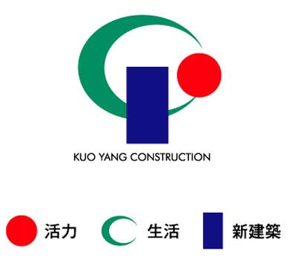

Establishment & Background
Founded in 1972, Kuo Yang Construction grew as Taiwan's economy started taking off. Over the past 50 years, Kuo Yang's focus has turned into the technology industry. And as technology has developed into today's exquisite tourism and culture-creative industries, we continuously pursue excellence and express it in the architecture that Kuo Yang has so long been praised for.
In 2000, Kuo Yang foresaw a new era that would be affected by globalization and a love of quality lifestyles. As a result, Kuo Yang took the lead in integrating resources such as construction planning and property management. By successfully utilizing creativity in construction, Kuo Yang has added new value to buildings. That value lies in making architecture not just be buildings, but in being homes that carry on a dialog with life, and which bring a feeling of safety. A home should also be the source of energy and growth for all family members.
Disclaimer
Profile
Operating Strategies
Financial Data
Business Activities—Existing Houses
Business Activities—Pre-sale Houses
Business Activities—Development
Red→Vitality
Energetic & Innovative
Represents the company's energy and reflects its young spirit
Green→Life
Alive & Environmental
Represents the company's management philosophy
of providing better living spaces
by promoting a green and environmentally-friendly lifestyle.
Profile:
Company Name: Kuo Yang Construction Co., Ltd.
Stock Code: 2505
Date of establishment: June 2, 1972
Time to market: November 14, 1979
Paid-in capital: NT$3.8 billion
Market capitalization NT$6.8 billion (estimated based on the closing price of NT$18 on 2023/10/31)
Revenue: NT$435 million (2023/1/1-2023/9/30)
Company website URL: www.kycc.com.tw/
Blue→New Architecture
New Architecture & A New Era
Represents the company's modern fusion of architectural vocabulary
and expresses the company's solid determination to reach sustainability

Slide 4
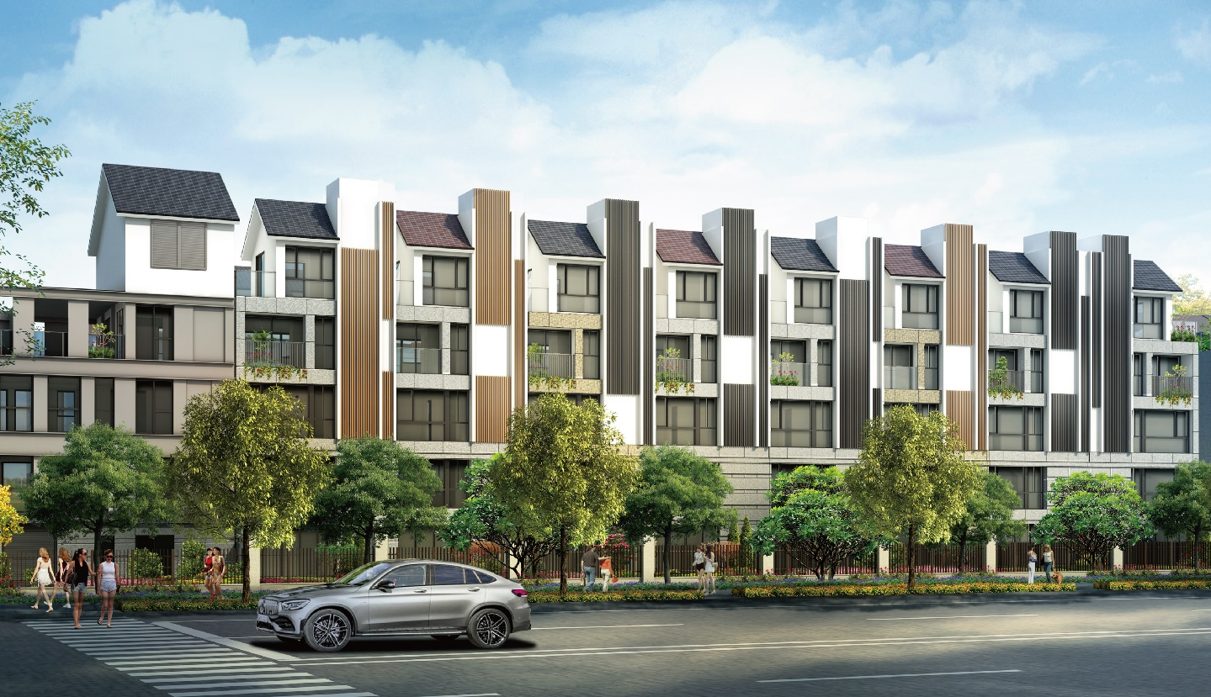
A. Operating Model:
  Add value to the land with brand advantages and improve after-sales service; establish the brand’s image to address the changes in the real estate market, and thereby propose correct selling strategies.
B. Product Marketing and Product Value:
  Reduce market risks through the advantages of products and prime locations.
Disclaimer
Profile
Operating Strategies
Financial Data
Business Activities—Existing Houses
Business Activities—Pre-sale Houses
Business Activities—Development
D. Customer Service:
  Provide construction schedules, develop a comprehensive community, and provide checks for the structural health of houses. These services help make our company a thoughtful construction company for house buyers.
C. Management:
  Improve corporate governance as well as work and management efficiency.
Build happy homes for Kuo Yang's customers.
Make customers' dreams come true.

Slide 5
Unit: NT$1,000
Disclaimer
Profile
Operating Strategies
Financial Data
Business Activities—Existing Houses
Business Activities—Pre-sale Houses
Business Activities—Development
Item | 2021 | 2022 | 2023 Q1-Q3
Operating revenue | 5,124,284 | 3,954,516 | 434,674
Operating costs | (3,762,094) | (3,169,639) | (283,398)
Operating profit | 1,362,190 | 784,877 | 151,276
Gross profit margin | 26% | 20% | 35%
Operating profit (loss) | 940,233 | 279,217 | (45,648)
Non-operating income | 225,397 | 274,182 | 245,455
Pre-tax profit | 1,165,630 | 553,399 | 199,807
Income tax expenses | (183,493) | (67,481) | (18,635)
Net profit for the period | 982,137 | 485,918 | 181,172
EPS | 2.58 | 1.28 | 0.48

Slide 6
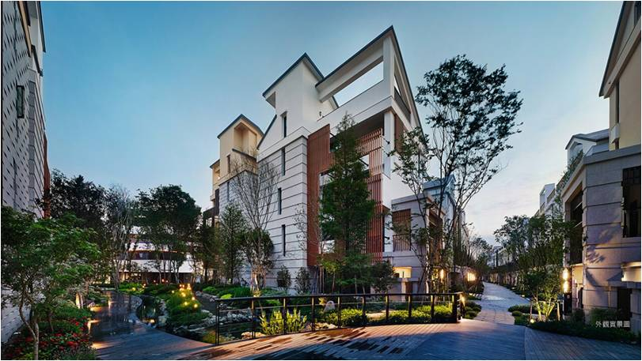
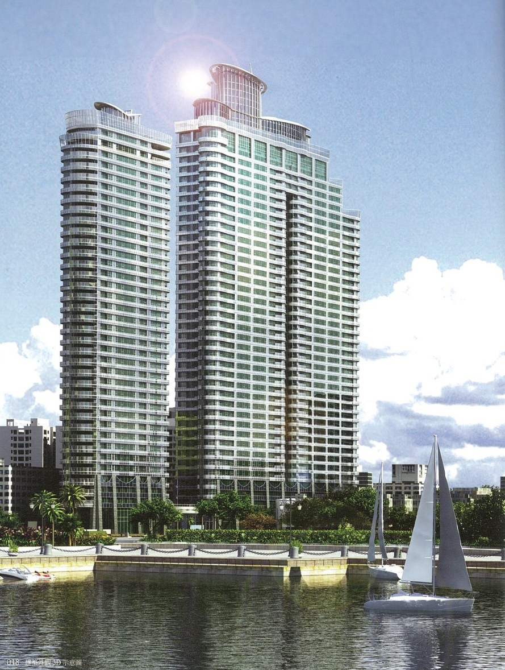
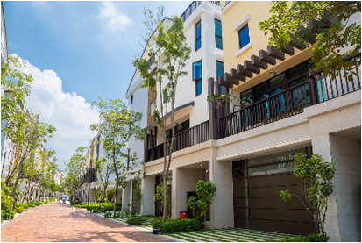
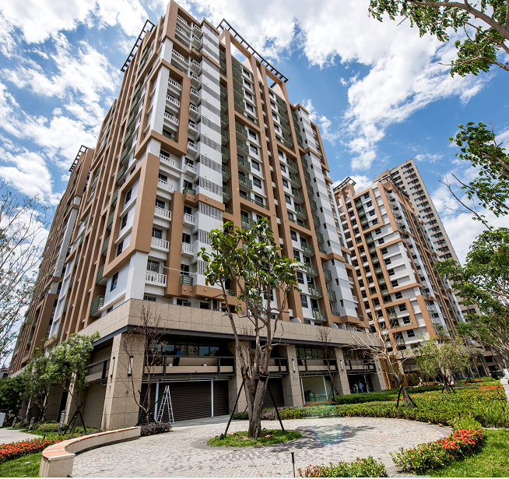
Case | Location | Number of units/vehicles | Sales amount (NT$100 million) | Ratio of Kuo Yang’s investments
Kuo Yan | Kaohsiung City | 14/48 | 10 | 100%
The Green Place | Tainan City | 12 households | 4.6 | 65%
Smile Era | Kaohsiung City | 1/34 | 0.4 | 70%
Total |  | 27/82 | 15
Disclaimer
Profile
Operating Strategies
Financial Data
Business Activities—Existing Houses
Business Activities—Pre-sale Houses
Business Activities—Development

Slide 7
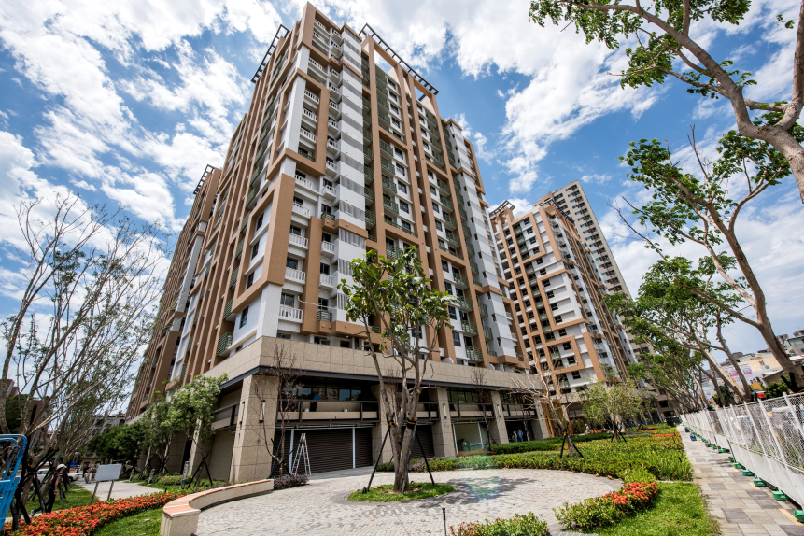

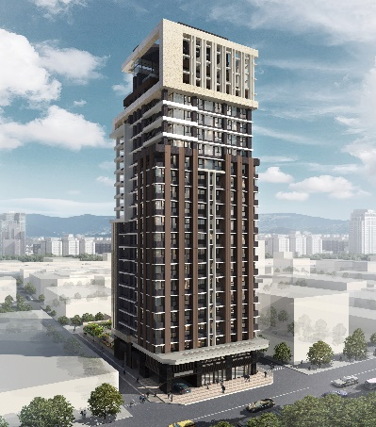
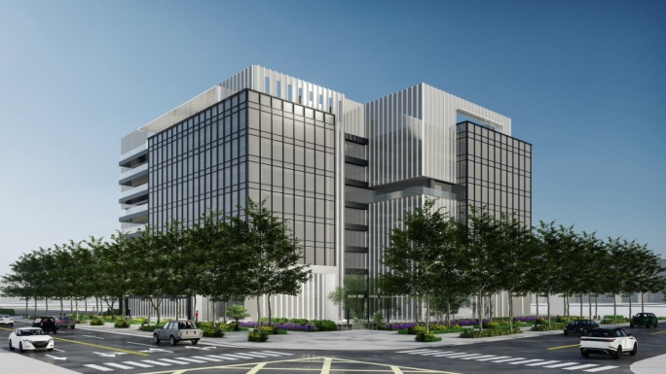
Category | Case | Location | Sales (NT$100 million) | Estimated year for obtaning building use permit | Ratio of Kuo Yang’s investments
Residential buildings | Kuo Yang Jilin Urban Renewal | Taipei City | 16 | 116 | 100%
 | The Green Place - Green Light Area | Tainan City | 34 | 114 | 65%
 | Shin Tokyo City (Fengshan Project) | Kaohsiung City | 50 | 114 | 50%
 | 3 projects Subtotal |  | 100
Plants and offices | Kuo Yang Intercontinental (Neihu Project) | Taipei City | 68 | 113 | 50%
 | Kuo Yang Digital (Sanchong Project) | New Taipei City | 68 | 115 | 50%
 | 2 projects Subtotal |  | 136
Residential building + plant | 5 projects Total |  | 236
Disclaimer
Profile
Operating Strategies
Financial Data
Business Activities—Existing Houses
Business Activities—Pre-sale Houses
Business Activities—Development

Slide 8
Disclaimer
Profile
Operating Strategies
Financial Data
Business Activities—Existing Houses
Business Activities—Pre-sale Houses
Business Activities—Development
Category | Case | Location | Land area acquired (pings) | Estimated date for obtaining building license | Ratio of Kuo Yang’s investments
Residential buildings | Xindian Baoyuan Urban Renewal | New Taipei City | - | 2024/03 | 80%
 | Good morning, Kuo Yang Phase 2 | Keelung | 4,884 | 2024/03 | 55%
 | Kaohsiung Gushan Project | Kaohsiung City | 1,484 | 2023/09 | 50%
 | Kaohsiung Special Trade Zone 3 Urban Renewal Project | Kaohsiung City | - | 2024/12 | 80%
 | 4 projects Subtotal |  | 6,368
Plants and offices | Xiwan Road | New Taipei City | 5,551 | 2024/08 | 50%
 | Tucheng Project | New Taipei City | 3,695 | 2024/10 | 50%
 | Zhonghe Plant and Office | New Taipei City | 1,675 | 2024/03 | 40%
 | 3 projects Subtotal |  | 10,921
Residential building + plant | 7 projects Total |  | 17,289

Slide 9
Q & A
Thank you!

