Slide 1


Stock Code︰2528
皇普建設股份有限公司
CROWELL DEVELOPMENT CORP.
2023 Corporate Briefing Session
May 26, 2023

Slide 2


Disclaimer
The forward-looking information mentioned in this presentation and the relevant news released at the same time is based on the information obtained by the Company based on the current status of the Company and the general economic conditions.
The forward-looking statements involve certain risks, uncertainties and inferences that might be beyond our control and could cause actual results to differ materially from those contained in the forward-looking statements. Potential risks and uncertainties include factors such as rising costs of raw materials, changes in market demand, policies and regulations and general economic conditions, and other factors beyond the Company's control.
The Company The outlook reflects the Company's current views on the future. When there are changes or adjustments to these views in the future, the Company does not guarantee the accuracy of the information in this presentation. It is not responsible for updating or amending the data and content in this presentation.
This presentation and its contents may not be arbitrarily accessed by any third party without the written permission of the Company.

Slide 3
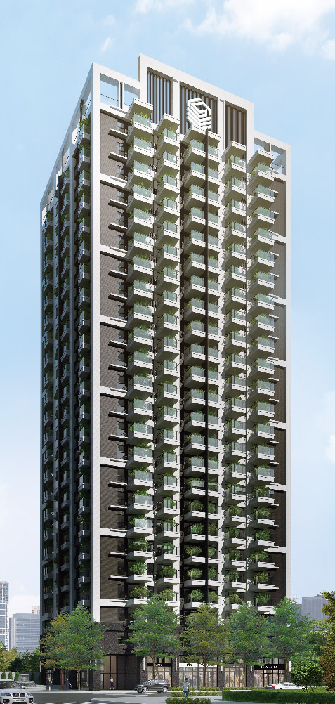
Agenda
01
Company Profile
02
Financial Information
03
Overview of Operations – Projects completed
04
Overview of Operations – Presale projects (under construction)
05
Overview of Operations – 2023 Proposal planning
06
Construction management and Corporate Sustainability ESG

Slide 4
Company Profile
Date of Establishment: 1985/01/17
Date of IPO: 1995/03/10
Stock Code: 2528
Capital: NT$3,799,974 thousand
Main business areas: Commissioned to construct and sell public housing buildings.
Company address: 6th Floor, No. 747, Wenzhong Road, Taoyuan District, Taoyuan City
Company's website: http://www.crowell.com.tw

Slide 5
Key milestones
● Proposal sales of the Platinum Garden project in the Yangmei District.
●Private placement to raise cash capital of NT$ 417,150 thousand.
●Issue secured convertible corporate bonds to raise NT$700,000 thousand.
● Proposal sales of the Landmark House project in Zhubei City.
● Proposal sales of the Crowell Tower 100 project in Kaohsiung City and the Crowell Manor project in Taichung City.
●Private placement to raise cash capital of NT$529,120 thousand.
●Private placement to raise capital of NT$ 870,000 thousand.
● Proposal sales of the Garden Avenue in Zhongli District.
●Obtain the use permit for The Landmark House in Zhubei City.
●The Da-Hsin section is under construction.
2017
2018
2019
2020
2021
2022
2023
●Cash capital increase of NT$450,000 thousand.
●Private placement to raise cash capital of NT$ 532,850 thousand.
● Proposal sales of the Metro Value Paradise project in Taoyuan City and the Great Downtown Mansion project in Tainan City.
●The handover of the Landmark House in Zhubei City has been completed.
●Proposal planning is underway such as Xin-Bi Section, National Day Section,Qing-Ping Section, etc.
●Co-investment with Ho Chu Investment and Yuan-An Investment, serve as directors.
●The Landmark House in Zhubei City and the Crowell Manor in Taichung City won the 21st National Golden Award for Architecture.
●The Crowell Manor in Taichung City won the Best Planning and Design of Residence in the 2020 Taiwan Real Estate Excellence Awards.
●Won the 2020 Taiwan Trustworthy Builder Award.
●Won the 2021 Happy Enterprises to Work For -- Construction Industry Golden Award issued by 1111 Human Resources Bank.
●Won the 2022 Happy Enterprises to Work For -- Construction Industry Silver Award issued by 1111 Human Resources Bank.

Slide 6
Financial Information
Individual Statement of Comprehensive Income
Unit: In NT$1,000
Item | 2020 | % | 2021 | % | 2022 | % | 1Q2023 | %
Operating revenue | 1,174,984 | 100% | 3,193,914 | 100% | 1,728,983 | 100% | 1,819,111 | 100%
Gross profit | 165,979 | 14% | 785,123 | 25% | 443,603 | 26% | 496,577 | 27%
Operating income | (206,795) | (18%) | 567,584 | 18% | 310,125 | 18% | 413,988 | 23%
Non-operating income and expenses | (3,078) | - | (3,900) | - | (14,539) | (1%) | (2,373) | -
Profit (loss) for the year | (210,459) | (18%) | 490,154 | 15% | 238,391 | 14% | 337,800 | 19%
Total comprehensive income for the year | (210,459) | (18%) | 490,154 | 15% | 238,391 | 14% | 337,800 | 19%
Basic earnings per share (NT$) | (0.73) |  | 1.49 |  | 0.64 |  | 0.89
Diluted earnings per share (NT$) | (0.73) |  | 1.35 |  | 0.58 |  | 0.82
Distribution of cash dividends (NT$/share) | - |  | 0.46 |  | 0.5 |  | -
2017

Slide 7
Financial Information
Individual Balance Sheet
Unit: In NT$1,000
Item | 2020 | % | 2021 | % | 2022 | % | 1Q2023 | %
Cash and cash equivalents | 135,868 | 1% | 452,692 | 3% | 270,885 | 1% | 869,155 | 5%
Inventories | 10,792,456 | 88% | 14,528,604 | 88% | 17,401,373 | 91% | 16,895,398 | 89%
Total assets | 12,289,613 | 100% | 16,554,049 | 100% | 19,205,445 | 100% | 19,077,197 | 100%
Current liabilities | 3,896,770 | 32% | 7,276,638 | 44% | 10,098,489 | 53% | 9,823,101 | 51%
Non-current liabilities | 4,650,652 | 38% | 5,045,066 | 30% | 3,943,872 | 21% | 3,943,211 | 21%
Total liabilities | 8,547,422 | 70% | 12,321,704 | 74% | 14,042,361 | 73% | 13,766,312 | 72%
Capital | 3,299,974 | 27% | 3,299,974 | 20% | 3,799,974 | 20% | 3,799,974 | 20%
Total equity | 3,742,191 | 30% | 4,232,345 | 26% | 5,163,084 | 27% | 5,310,885 | 28%
Net Worth Per Share (NT$) | 11.34 |  | 12.83 |  | 13.59 |  | 13.98
Return on equity | (6.29%) |  | 12.29% |  | 5.07 |  | 6.45
2017

Slide 8
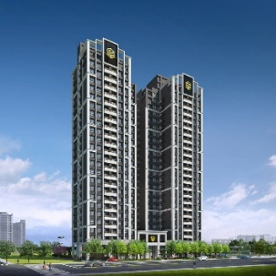
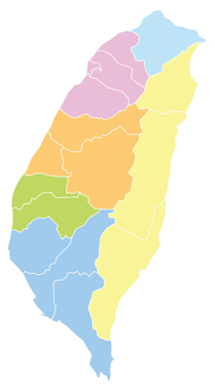
Overview of Operations –
Projects completed
The Landmark House
Site address: Zhubei City, Hsinchu County
*Base area: 1,083.66 ping
*Design plan: 24 floors above ground and 5 floors underground, 274 units in 2 buildings
*Design plan:26-40 ping
*Car parking: 291 units
•The handover has been completed from the end of 2022 to the beginning of 2023

Slide 9
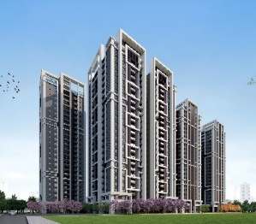
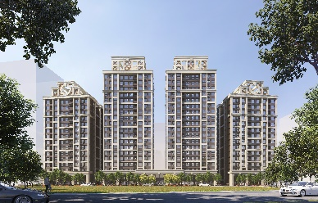

Overview of Operations –
Presale projects (under construction)
Garden Avenue
It is planned to have a private green avenue measuring 140 meters in width in the 1,800 ping wide-open space in Qingpu by HSR
The Crowell Manor
Plan
Sales, construction
Current progress
Handover
2024
➢The former site of Guanghua Vocational High School,
a large base measuring 3,400 ping
➢The construction applies the Alfa Safe patented anti-
shock method
➢All units have the VAF smart flow antibacterial
system
➢Build a public hall and villa garden suitable for all
ages
The Crowell Tower 100
Smart residential building in the central part of Kaohsiung City
➢Light Rail 2 and 3 and the National Science and
Technology Museum Station, 3 tracks merge to
form the best economy circle
➢All units have the VAF smart flow antibacterial
system
➢Water purification and softening system for the
entire building, and all units use the airtight
windows made by Chin Hong for sound insulation
Plan
construction
Current progress
Handover
2024
Plan
Construction
Current progress
Handover
2024

Slide 10
Overview of Operations –
Presale projects (under construction)
Project name | The Crowell Manor (presale) | The Crowell Tower 100 (presale) | Garden Avenue (presale) | Dazhu Phase 1 (undisclosed sale) | Grand Total
Location | North District, Taichung City | Lingya District, Kaohsiung City | Zhongli District, Taoyuan City | Luzhu District, Taoyuan City
Base area | 3,414.02 ping | 769.86 ping | 1,872.26 ping | 1,332.27 ping | 7,388.41 ping
Expected year of completion | Expected to be completed in 2024 | Expected to be completed in 2024 | Expected to be completed in 2024 | Expected to be completed in 2025
Number of floors | B4 to 24th floor | B5 to 24th floor | B4 to 19th floor | B4 to 20th floor
Number of households | 920 units | 367 unites | 372 unites | 288 unites | 1,947 unites
Number of stores | 16 unites | 9 unites | 14 unites | 11 unites | 50 unites
Total number of units | 936 unites | 376 unites | 386 unites | 299 unites | 1,997 unites
Number of car parking spots | 949 | 263 | 443 | 302 | 1,957
2017

Slide 11
Overview of Operations –
2023 Proposal planning
Location | Site location | Type | Base area | Current progress
Zhongli District, Taoyuan City | Qingpu -- Residential (Qing-Ping Section) | Residential | 907.05 ping | Under Planning
Luzhu District, Taoyuan City | A10 Rezoning Area -- Residential (Xin-Bi Section) | Type 2 Residential | 1,866.23 ping | Under Planning
Yingge District, New Taipei City | Yingge Old Street -- Residential (National Day Section) | Type 1 Residential | 2,887.40 ping | Under Planning

Slide 12

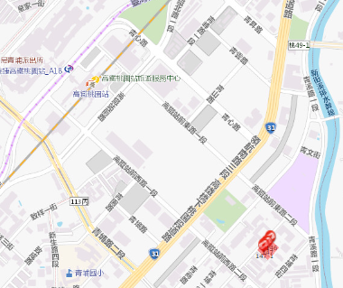
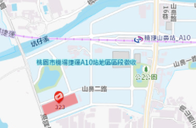
Overview of Operations –
2023 Proposal planning (continued)
Taoyuan City
Luzhu District
Taoyuan City
Zhongli District
Taoyuan City
Parcel Number 323 in Xin-Bi Section
Parcel Numbers 146, 147 and 147-1 in Qing-Ping Section
Traffic: A10 MRT Station, National Freeway 1
Commercial district: COSTCO Taoyuan
Nankan Store, Tai Mall Shopping Center
Traffic: HSR Taoyuan Station and MRT Taoyuan Airport
Line A18 HSR Taoyuan Station
Commercial district: HSR district in front of A18 station,
Gloria Outlets, Yokohama Hakkeijima,
Xpark Aquarium, Shin Kong Cinemas,
shopping centers, IKEA flagship stores
and other shopping malls, Taoyuan
Museum of Fine Arts

Slide 13
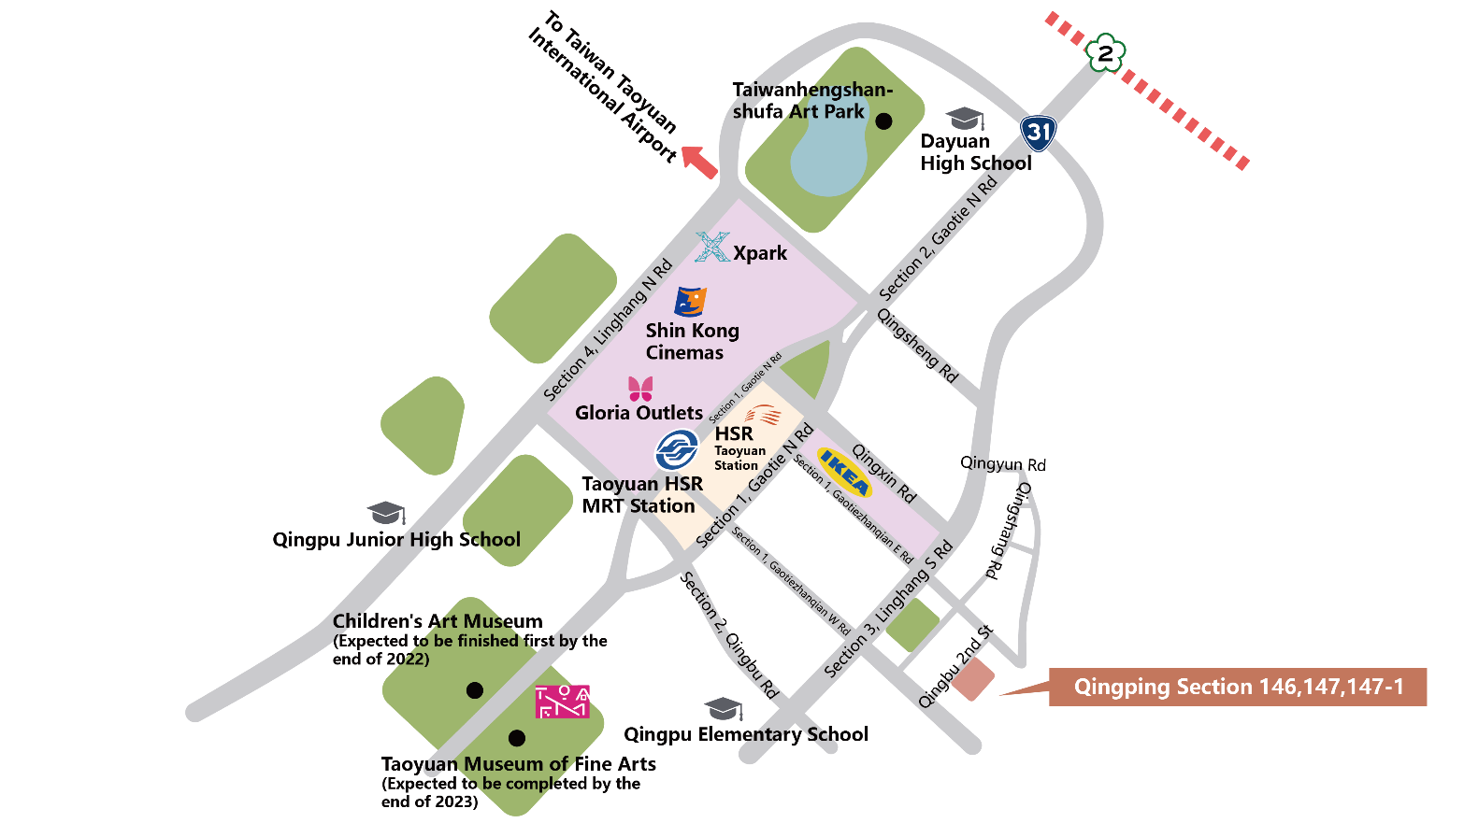
Overview of Operations –
2023 Proposal planning (continued)
Qingpu special zone

Slide 14
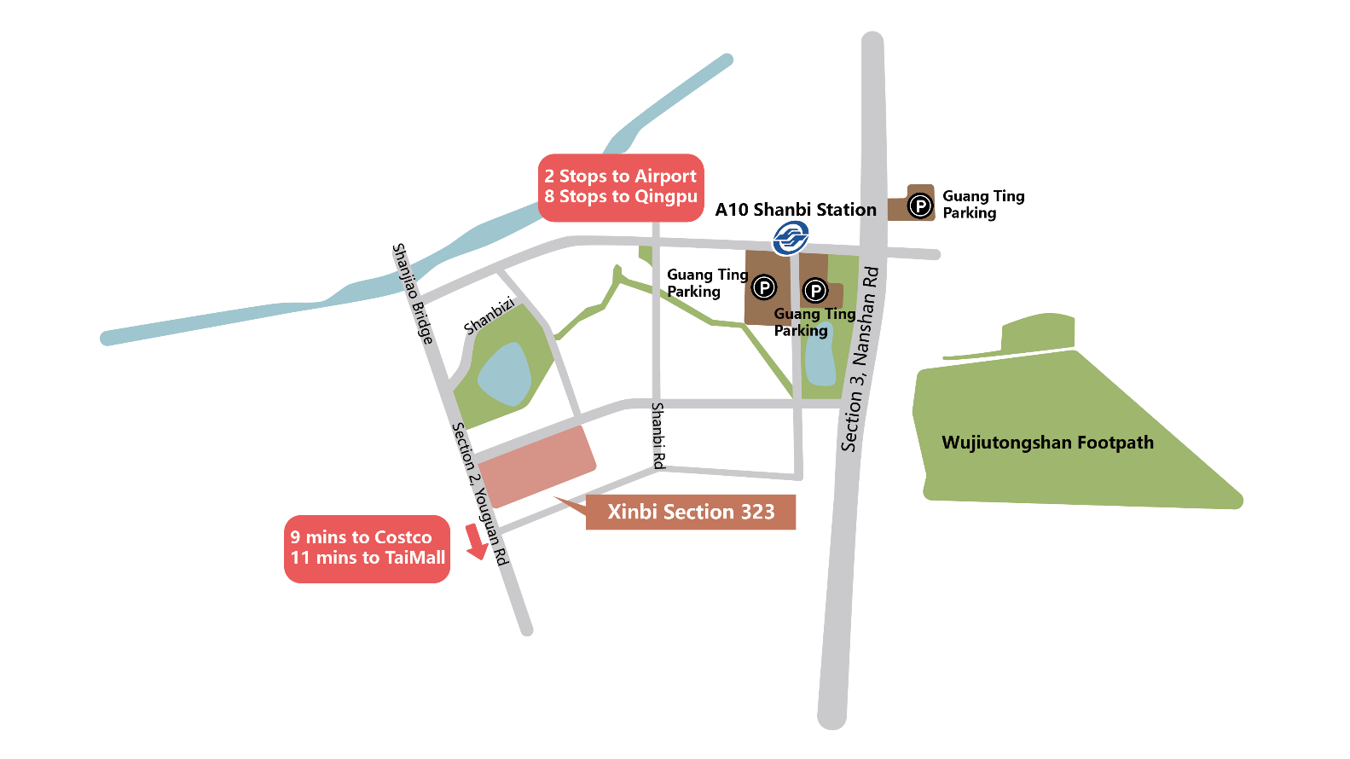
Overview of Operations –
2023 Proposal planning (continued)
A10 rezoned area in Taoyuan

Slide 15

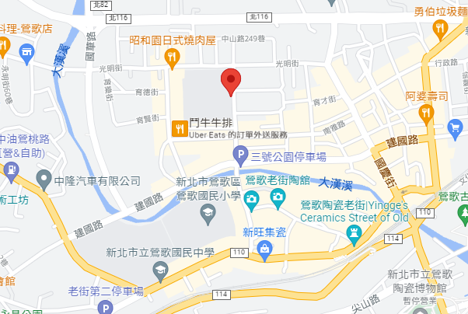
Overview of Operations –
2023 Proposal planning (continued)
Parcel Numbers 1321 and 1315 in Guoqing Section
Transportation: Yingge Railway Station, Sanying
Interchange, Danan Interchange,
Shulin Interchange, MRT Sanying
Line LB10
Commercial district: Jian-Guo Market, Yingge Old
Street, Jian-Guo Elementary
School, Yingge Junior High
School
Yingge District, New Taipei City
New Taipei City

Slide 16
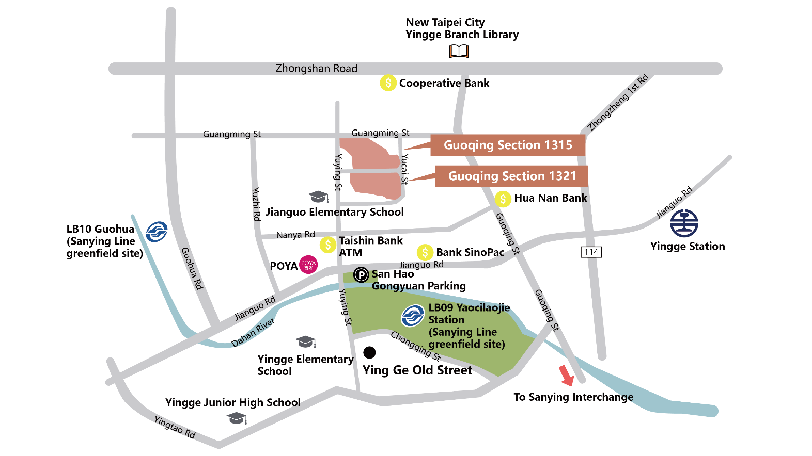
Overview of Operations –
2023 Proposal planning (continued)
Yingge District, New Taipei City

Slide 17
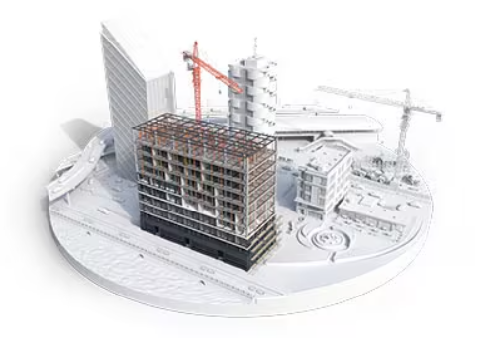

Construction management
BIM(Building Information Modeling)
PCM(Professional Construction Management)
Using Building Information Modeling for drawing and construction review, enhancing the preparation of pre-construction drawings and construction methods; reviewing clashes and conflicts between MEP systems and the building structure through 3D modeling, simulating the construction process and optimizing pipeline layout to reduce potential risks such as water leakage and structural safety issues resulting from heavy construction and modifications, thereby improving overall project quality.
We achieve the goals by optimizing project plans, coordinating team members, supervising the construction processes, and ensuring quality control. Various tools and techniques will be used in this process to ensure that the project is carried out according to the expected requirements and schedule, it provides more efficient, controllable, and reliable approach to project management, thereby reducing project costs, minimizing project risks, improving project quality and schedule control.

Slide 18
Corporate sustainability ESG
Corporate Governance Evaluation Results
The 2022 evaluation result is 92 points, ranked between 21% and 35%.
The 2021 evaluation result is 84 points, ranked between 21% and 35%.
The 2020 evaluation result is 69 points, ranked between 36% and 50%.
92
Average score of publicly traded companies
5%
104
6%~20%
94
21%~35%
83
36%~50%
74
51%~65%
65
66%~80%
57
80%~100%
42

Slide 19

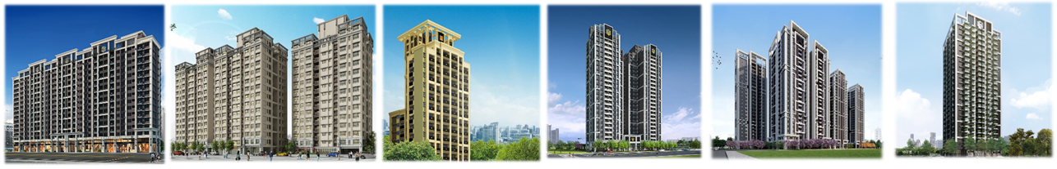
Stock Code: 2528
https://crowell.com.tw/
Thank you.

