Slide 1
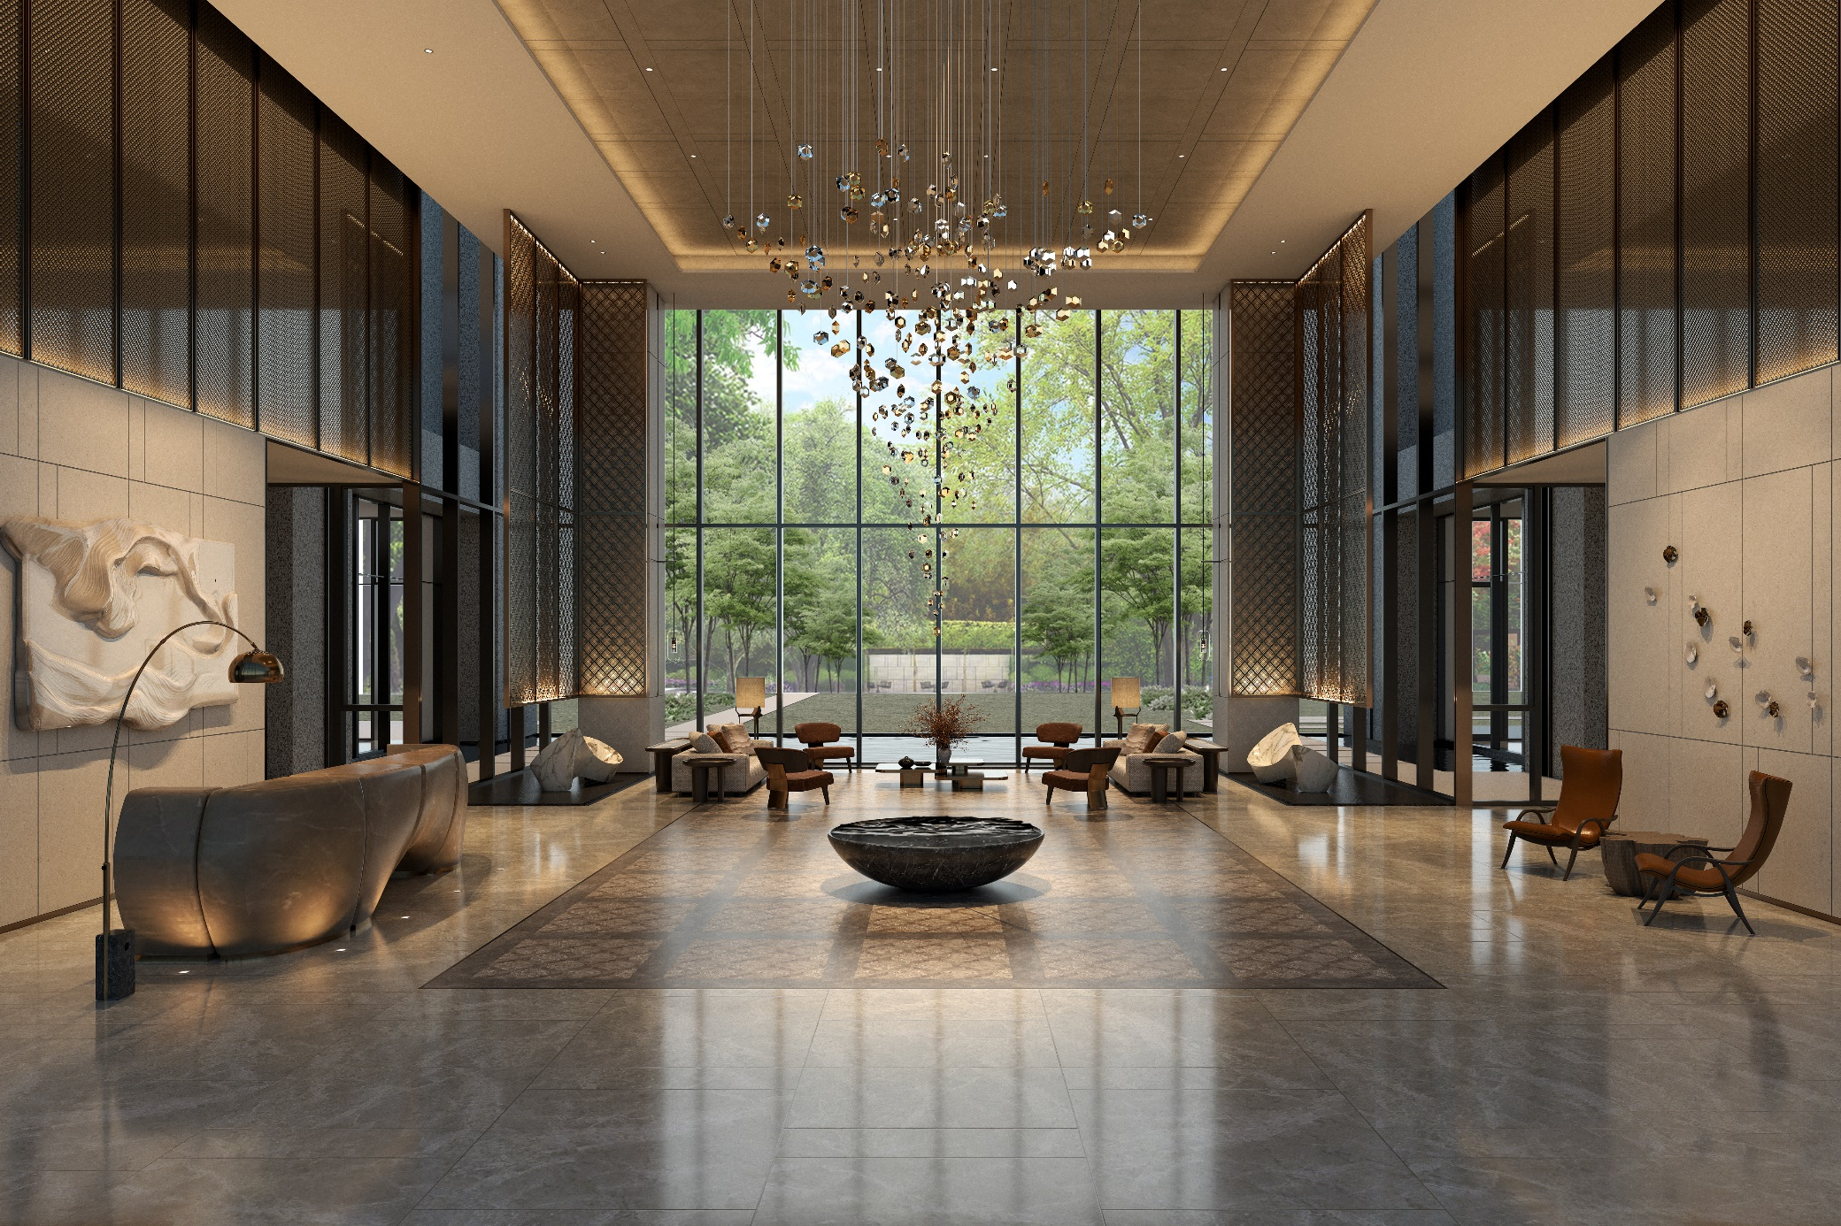

華固建設2024Q1
Upper Mansion

Slide 2
Disclaimer Statement
This presentation contains forward looking statements which are estimated based on the current status of Huaku Development Co., Ltd. and general economic conditions.
The forward looking statements involve certain risks and uncertainties that could cause actual results to differ materially from those contained in the forward looking statements. Potential risks and uncertainties include such factors as general economic conditions, foreign exchange fluctuations, rising cost of raw materials, competitive products and pricing pressures and regulatory developments.
Forward looking statements involve significant risks and uncertainties, should not be read as guarantees of future performance or results, and will not necessarily be accurate indications of whether or not such results will be achieved.
This presentation may not be stored, copied, distributed, transmitted without Huaku Development Co., Ltd. permission.

Slide 3
Finance

Slide 4
Dividend Policy
The total shareholder dividends for each year are not less than 50% of the distributable surplus in the current period, and the cash dividends are not less than 60% of the total shareholder dividends.
Note: The after-tax surplus of the current year is set out as a statutory surplus reserve, a special surplus reserve or a reversal of the special surplus reserve, which can be the distributable surplus in the current period.
The company implements a balanced dividend policy and hopes that dividends will be distributed steadily in the long term. In the next 5 years, the annual cash dividend payment is higher than NT$5 as the predetermined goal.
Note: The details of the actual total shareholder dividends paid out each year shall still be implemented after the resolution of the board of directors.

Slide 5
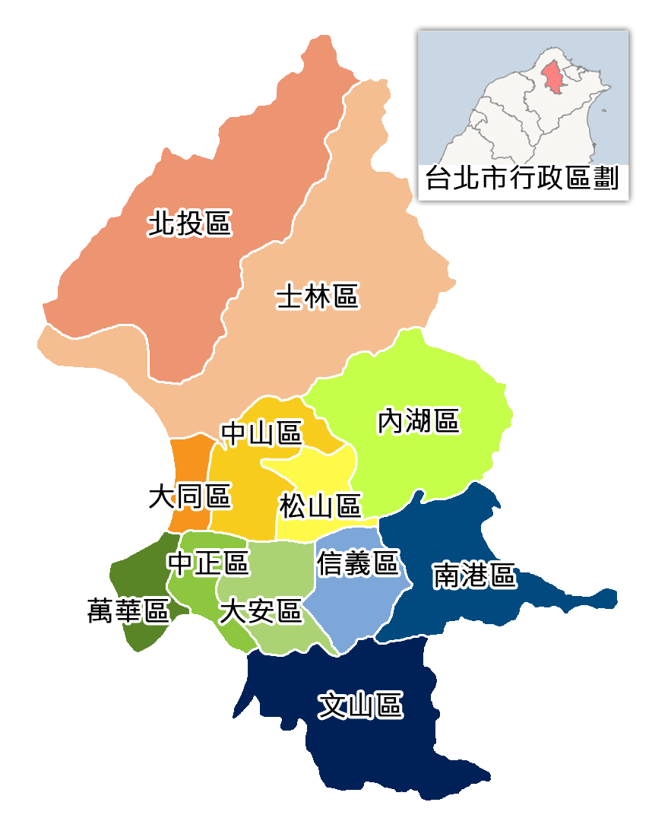
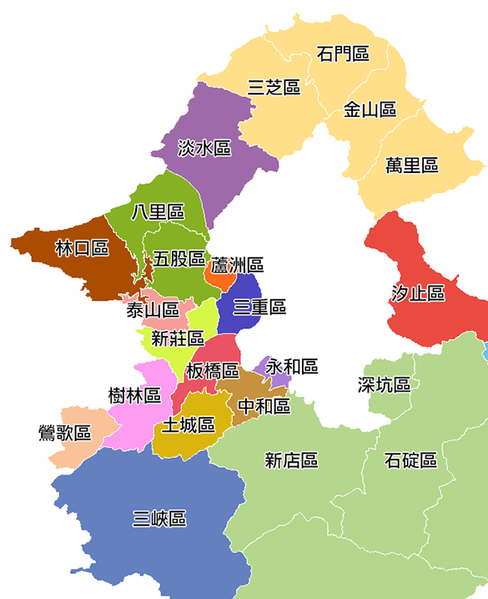
Locations – Greater Taipei
ZhengDaBeiTou
Greenside Mansion
RenYiJie#57
RenYiJie#89
Casa Blanca
National Landmark
Sky Tower
Fortune One
Central Landmark
HePu
Asia One
Moon Light
Da`an Tower
ZhengDaXinDian
XinYiGuangFu

Slide 6
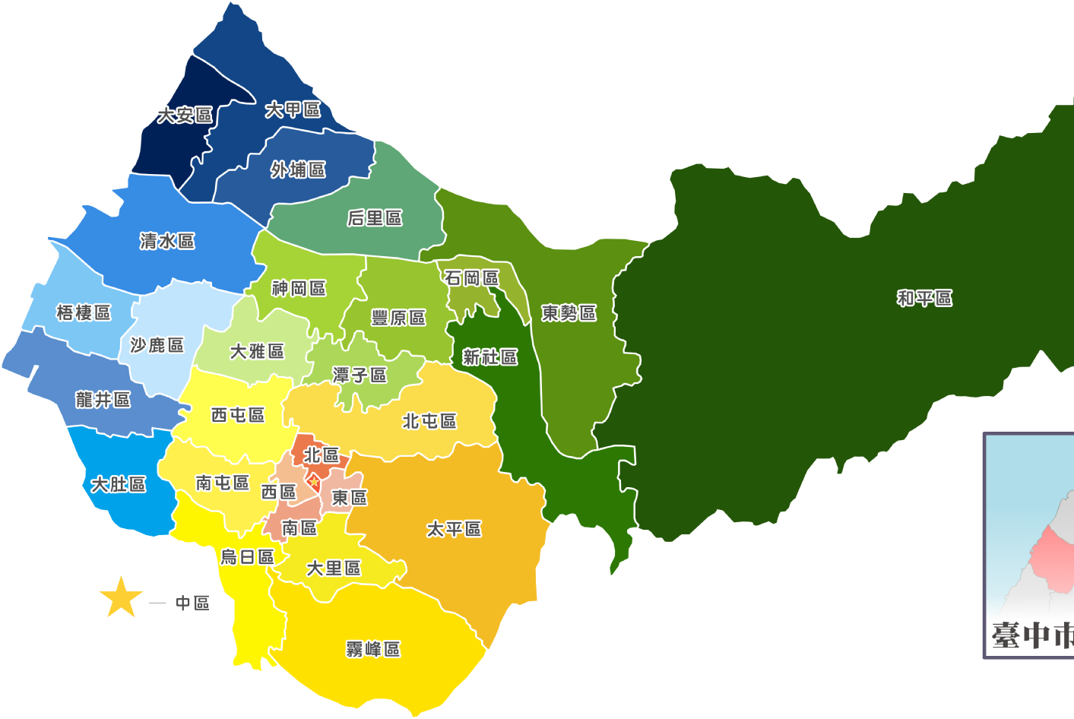
Locations – Taichung
TaichungJingMaoWuLu
TaichungFengLeLu
Upper Mansion

Slide 7
Presale

Slide 8
Unsold

Slide 9
Land Reserve

Slide 10
Schedule

Slide 11
Q & A

