Slide 1
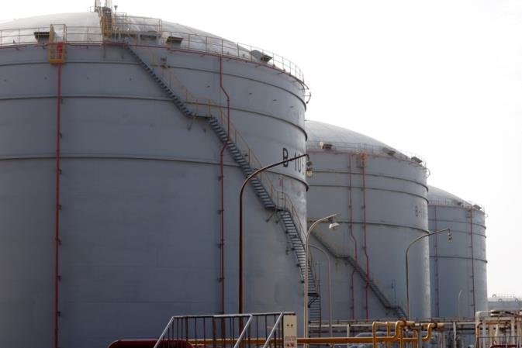
Prime Oil Chemical Service Corporation
Press Conference
August 25, 2020

Slide 2
Outline
Company Profile and Financial Snapshots
Tank Storage Service Division update
Energy Division update
Summary
Q&A

Slide 3
Company Profile and Financial Snapshots

Slide 4
About POCS
Prime Oil Chemical Service Corporation (POCS) was founded in 1978. We are a listed company on the Taiwan Stock Exchange (Stock Symbol 2904.tw). We have two main business divisions now.
Tank Storage Service Division contributes the majority of the revenues. With over 30-year experience, we are the largest-scale and the most well-managed petrochemical shore tank storage service provider in Taiwan.
Tank Storage Service Division primary clients are well-known petrochemical manufacturers and traders. Our service quality has earned the trust of our clients by obtaining ISO 9001, ISO 14001, OHSAS 18001certifications and participating in CDI-T.
POCS started its Energy Division in 2016. Together with our subsidiary POCS Power Co., Ltd, we look for suitable locations to build photovoltaic power generation systems as a way to collect long-term electricity sales or receive rental revenues, as our main business model.

Slide 5
Sales Revenue by Division
（ NTD$K）
Tank Storage Service Division accounts for 91% and 84% of consolidated sales revenue in 2019H1 and 2020H1

Slide 6
Financial Snapshots (1)
Consolidated F/S | 2020H1 | 2019 | 2018
Sales Revenue | 262,980 | 505,225 | 475,680
Gross profit % | 46% | 46% | 43%
Operating Income % | 33% | 33% | 30%
Net Income % | 31% | 27% | 25%
EPS | 1.18 | 1.96 | 1.72
Stable profitability and scale-up

Slide 7
Financial Snapshots (2)
Consolidated F/S | 2020H1 | 2019 | 2018
Current assets | 243,685 | 228,460 | 252,279
Non-current assets | 1,393,918 | 1,196,604 | 1,013,512
Total assets | 1,637,603 | 1,425,064 | 1,265,791
Current liabilities | 420,115 | 241,805 | 194,267
Non-current liabilities | 255,912 | 179,771 | 97,286
Total liabilities | 676,027 | 421,576 | 291,553
Shareholders' equity | 961,576 | 1,003,488 | 974,238
Liabilities + Shareholders' equity | 1,637,603 | 1,425,064 | 1,265,791
The major difference of 2020H1 is the escalated installed capacity in Energy Division

Slide 8
Tank Storage Service Division

Slide 9
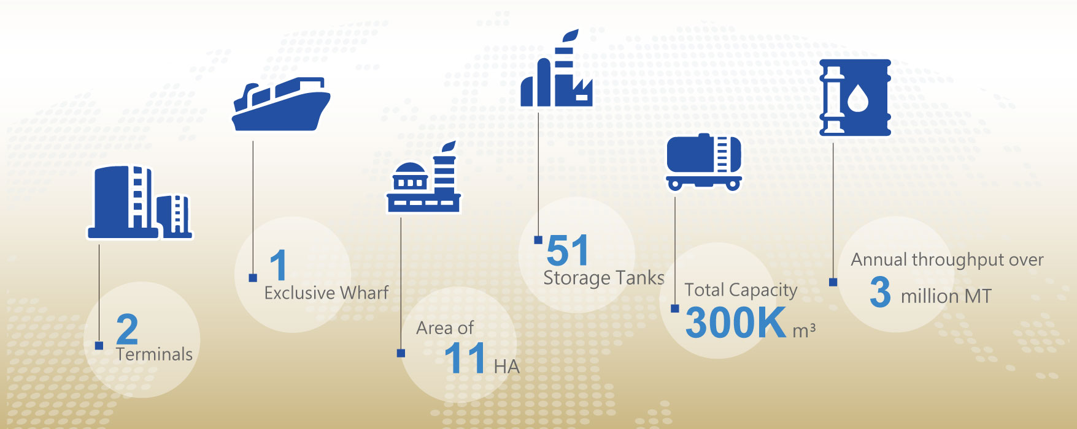
About Tank Storage Service Division

Slide 10
Terminal Profile
 | West #5 | West #2
Area (M²) | 81,054 | 29,223
Number of Tanks | 20 | 31
Capacity (KL) | 242,200 | 63,450
Loading bays | 12 | 18
Employees | 26 | 23
Throughput (MT/2019) | 2,452,014 | 388,423
Cargos | Oils & chemicals | Chemicals
Key clients | Global oil traders, chemical manufacturers & traders

Slide 11
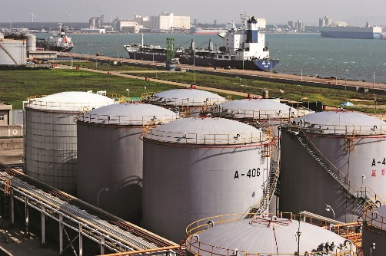

Services Offered by POCS
Piping
Storage management
Bulk cargo loading
Ship/Tanker Truck/ISO-tank discharging
Drumming
Warehousing
Tanker Truck/ISO-tank loading

Slide 12
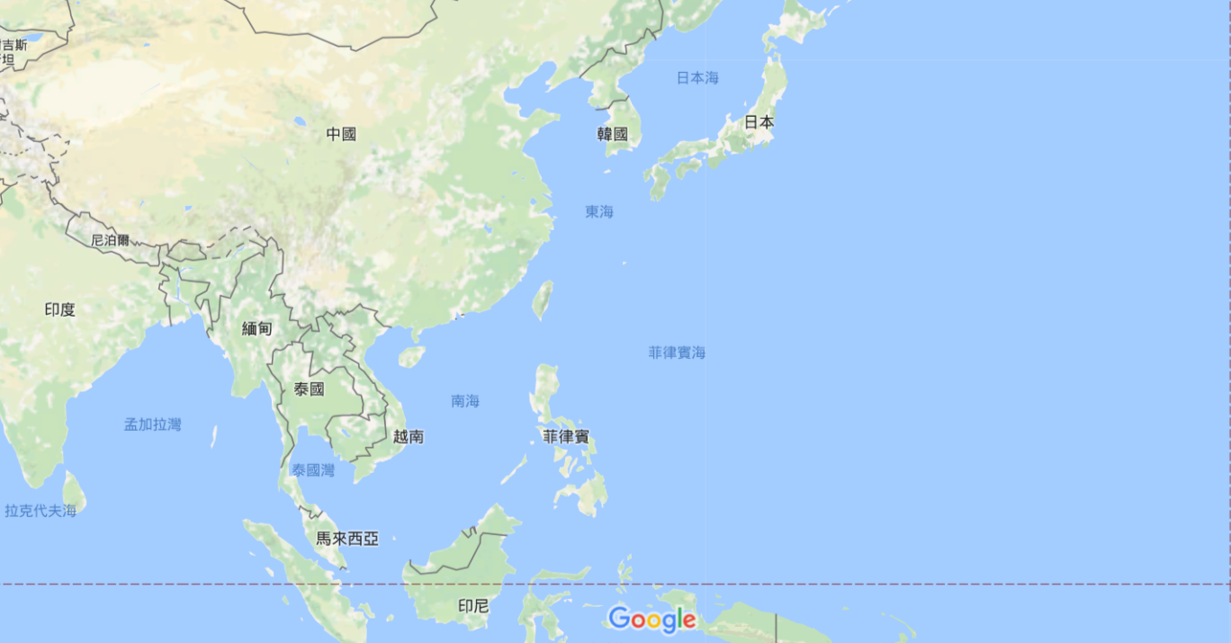
Coverage of Cargo Transportation

Slide 13
Our Advantages
Own a various range of capacity and types of shore tanks to meet different needs
Can provide customized services
Have had 30-year experiences in handling all kinds of petrochemical cargos
Offer comprehensive services by in-house staff
Focus on our core business to provide the most professional services to clients

Slide 14
Revenues of Tank Storage Service Division
（NT$K）

Slide 15
Cargo Throughput
POCS has started the business of Free Trade Zone in Port of Taichung since 2007. We have offered our services to the global leading oil traders for several years. The annual cargo throughput are around 3 million metric tons since 2012. The throughput in 2020H1 is slightly bigger than 2019H1.

Slide 16
Outlook
The COVID-19 pandemic has had a serious impact on the global economy. The recovery of the economy in the Asia-Pacific region is the key factor of the demand for oil products and the willingness of the clients to lease tanks.
The tension between US and China will still affect the global petrochemicals market.
The strategy of oil traders may be influenced by global oil price and market supply & demand.
The operating costs of our terminals are on the rise due to stricter relevant regulations.

Slide 17
Energy Division

Slide 18
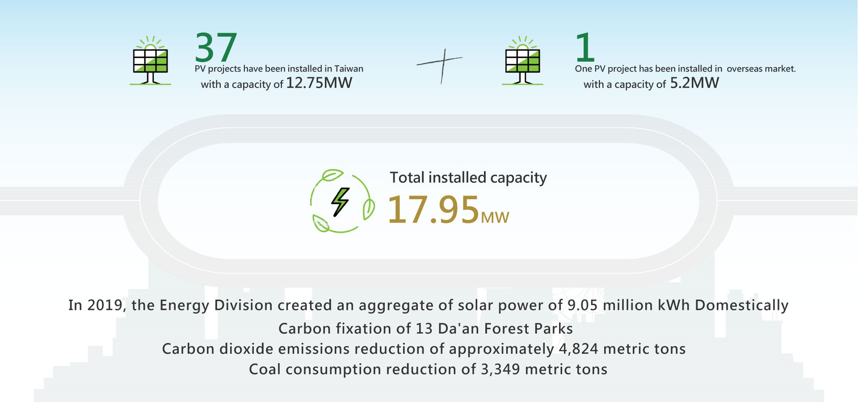
About Energy Division

Slide 19
PV Systems Status (1)
Completed
  Domestic: 12.75MWp
  Overseas: 5.2MWp (Cambodia)
  Grand Total: 17.95MWp
Year | Capacity (MWp) | Type | Remark
2019 | 7.75 | Roof-mounted | As of Dec 31st 2019
2020 | 3.01 | Roof-mounted | Via sale and purchase agreement
2020 | 1.99 | Ground-mounted | Construction completed
Total | 12.75

Slide 20
PV Systems Status (2)
Under Construction
  Six projects obtained in the first half of 2020; details are as below
Project name | Capacity (MWp) | Type | Estimated complete date
Taoyuan (1) | 0.62 | Ground-mounted | Dec 2020
Taoyuan (2) | 0.43 | Ground-mounted | Dec 2020
Tainan (4) | 1.26 | Ground-mounted | Feb 2021
Taichung (4) | 1.51 | Ground-mounted | Mar 2021
Kaohsiung (21) | 0.50 | Covered playground | Apr 2021
Kaohsiung (22) | 0.88 | Covered playground and Ground-mounted | Apr 2021
Total | 5.2

Slide 21
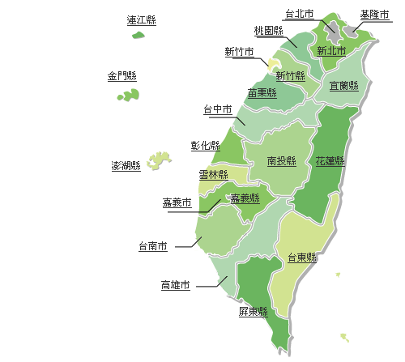
Domestic PV Systems
Area | Plant no. | MW
Taichung | 3 | 0.927
Nantou | 1 | 0.397
Yunlin | 2 | 2.494
Tainan | 3 | 0.868
Kaohsiung | 20 | 5.780
Pingtung | 6 | 1.555
Hualien | 2 | 0.731
Total | 37 | 12.75
Note: Not inclusive of the power plant under construction.
Taichung
Nantou
Hualien
Yunlin
Tainan
Kaohsiung
Pingtung

Slide 22
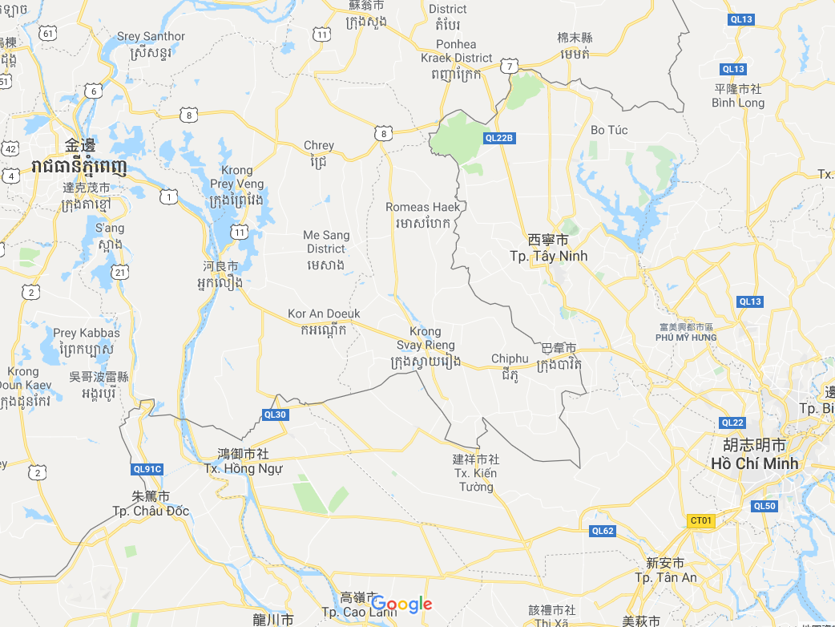
Overseas Solar Power Plant－Cambodia
No. of Power Plant
1
Capacity
5.2MW

Slide 23
Revenues of Energy Division

Slide 24
Future Plans
Expand large-scale roof-mounted, ground-mounted (activity center, parking lot and outdoor aquaculture-PV coexistence), and covered playground projects.
Bid in various tenders from the government.
Evaluate the feasibility of acquiring existing solar power plants to scale up.
Evaluate overseas solar power business opportunities.

Slide 25
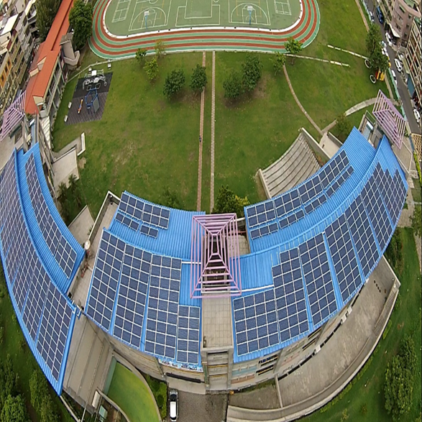
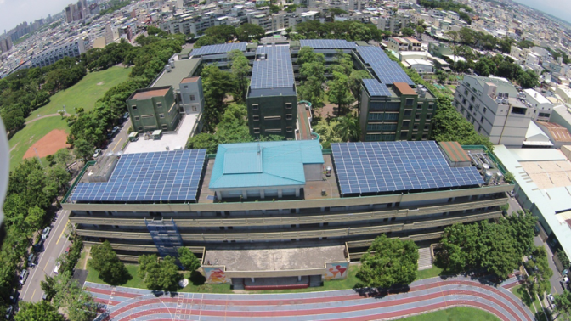
PV Project Developed (1)
Wun-Shan Elementary School, Kaohsiung
Sing-Ren Junior High School, Kaohsiung

Slide 26
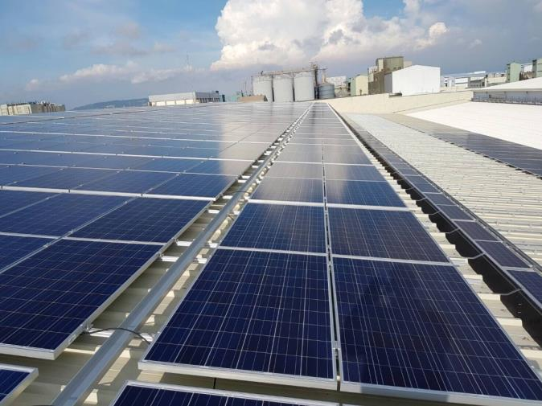
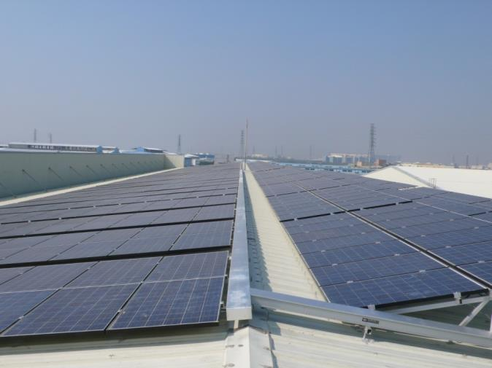
PV Project Developed (2)
Zong-Lien Industry Co., Ltd. Kaohsiung
Super-Cheng Industrial Co., Ltd. Kaohsiung

Slide 27
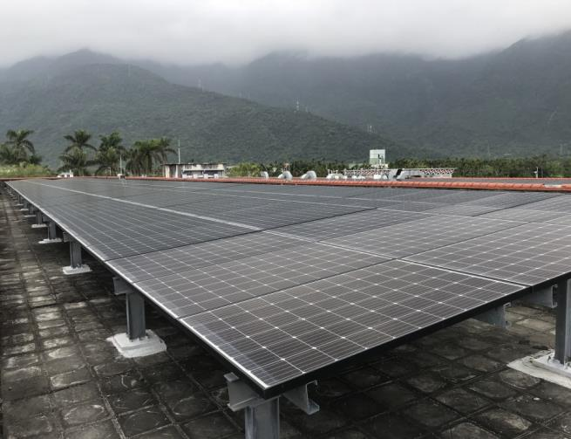
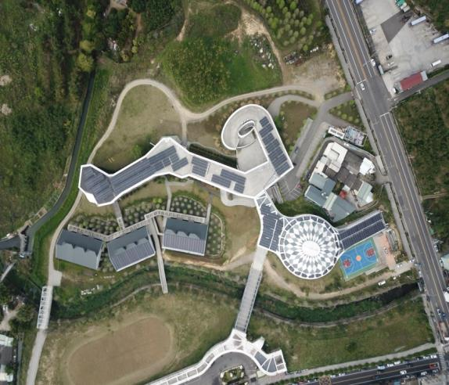
PV Project Developed (3)
Dahan Institute of Technology
Hualien
Ta-Ming High School
Taichung

Slide 28
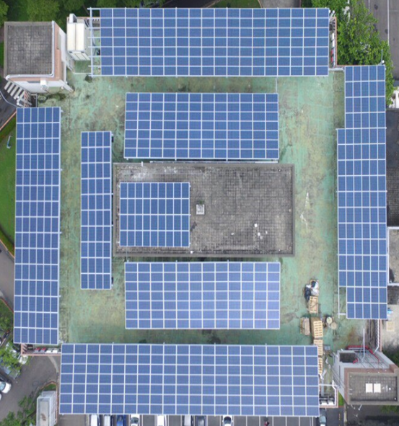
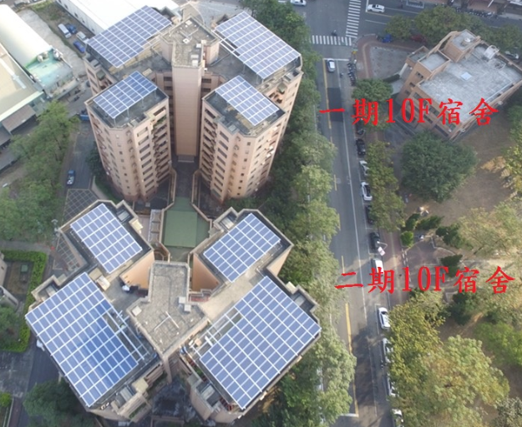
PV Project Developed (4)
Veterans General Hospital-
Parking lot
Veterans General Hospital-
Dormitory Phase I & II

Slide 29
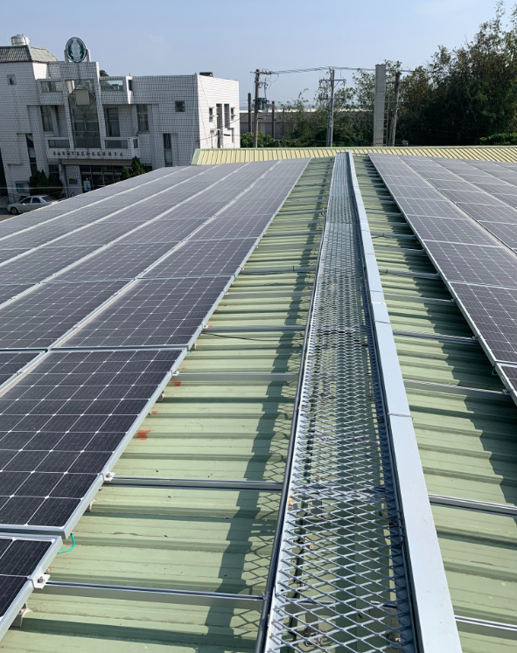
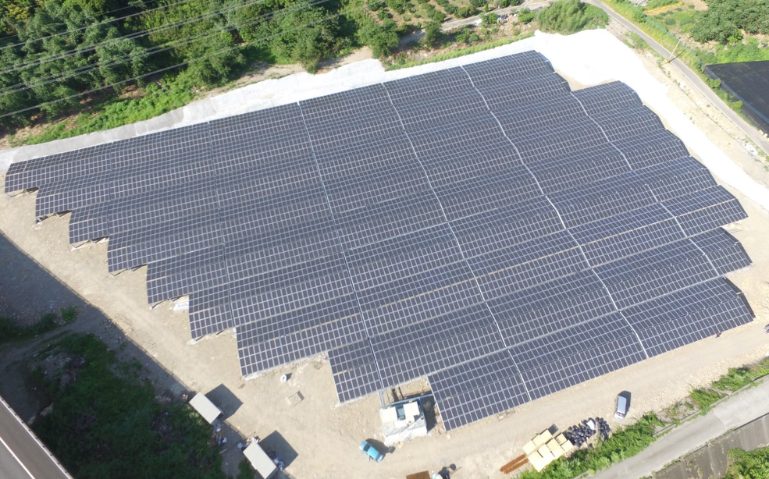
PV Project Developed (5)
Tainan Liujia Farmers Association
Yunlin Gukeng Ground-mounted

Slide 30
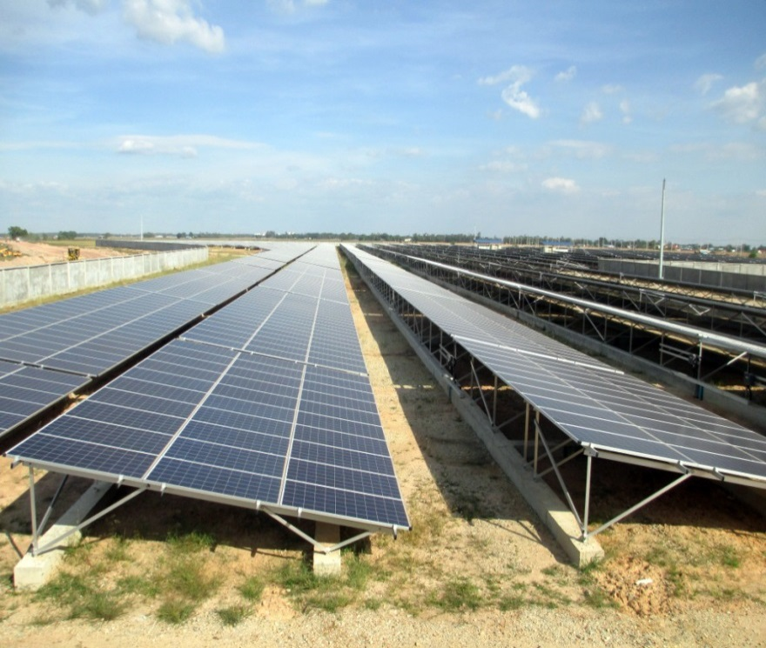
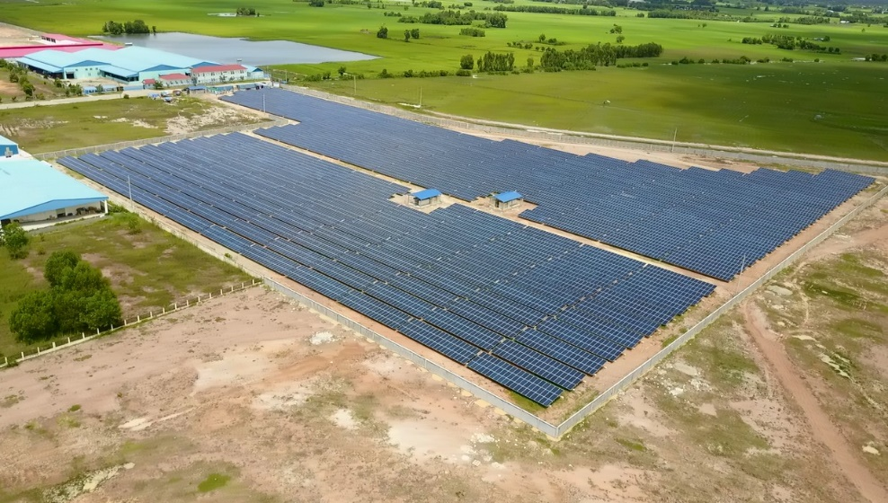
PV Project Developed (6)
Tai Seng Bavet SEZ, Cambodia

Slide 31
Summary

Slide 32
Tank Storage Service Division
Outlook: Stable
Goal: To earn management-oriented benefit by sustainable advancing of professional storage services
Key Management Success Factors :
  Upgrading expertise of all staff
  Continuous upgrading of hardware and software
  Management System Optimization

Slide 33
Energy Division
Outlook: the key revenue driver as installed capacity grows in the coming years
Goal: To integrate relevant resources to create a reasonable rate of return IRR
Key Management Success Factors:
  Proficient Project development and project management capabilities
  EPC and PV systems maintenance management
  To develop new business opportunities in renewable energy

Slide 34
Q & A

