Slide 1

Collin Co.,Ltd.(2906)
More than satisfaction
Investor Conference
Dec.22.2017

Slide 2
Index
Company Profile
Core Business
Financial Result
Strategy and Development
Q&A
Disclaimer

Slide 3
Company profile
Established: May, 1969
Stock Listed: Since Dec., 1989
Capital: NTD2.02 Billion
Book Value: NTD13.93 / share
Employee Number: 498
Chairman: Lee, Hsi-Lu
CEO: Lee, Chung-Liang
Core Businesses: Export Business、Fashion Retail 、Bio-Medical Business ( as of up to date)

Slide 4
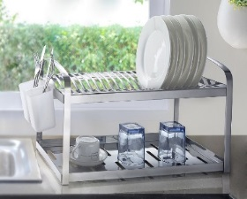
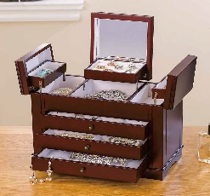
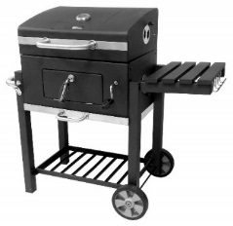
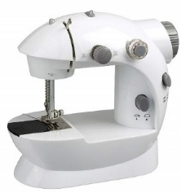
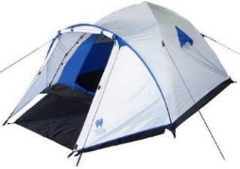
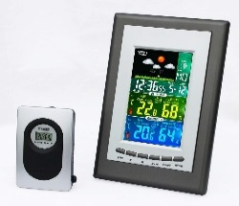
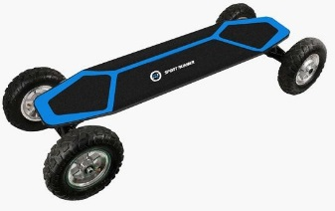
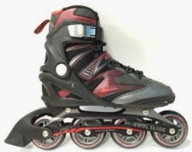
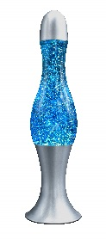
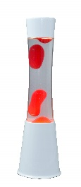
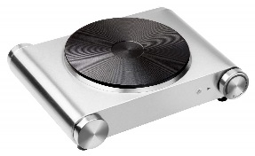

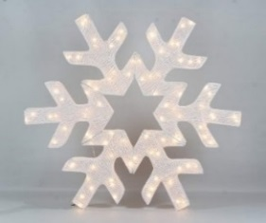
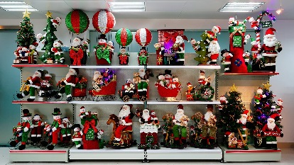
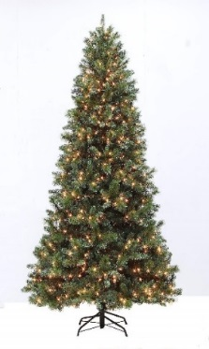
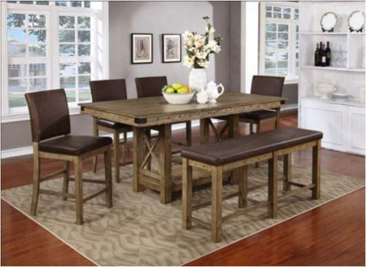
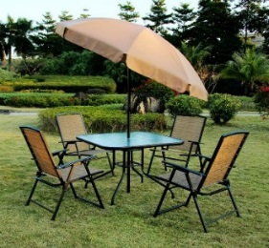
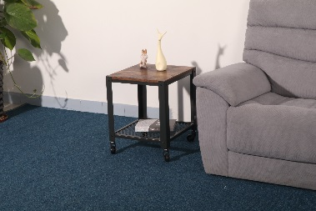
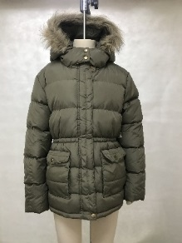
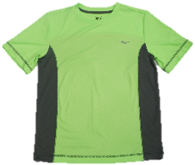
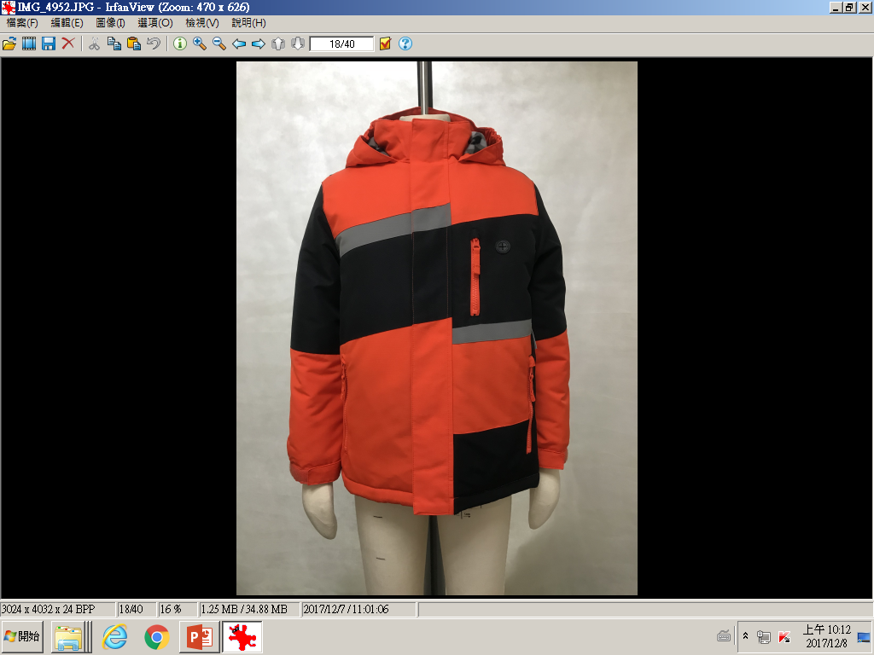
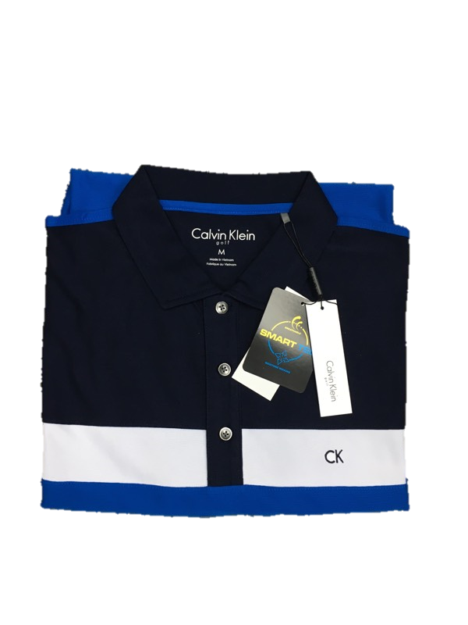

Export Business – Main Product Categories
Houseware、Giftware、Tool Sets、BBQ & Grills、PVC products、Sporting goods, Electric appliances
X’mas trees 、 lightings & decorations
Indoor & Outdoor furniture
Garment

Slide 5














Export Business – Buyers and Branches
Major buyers:
Oversea branches:
USA、Canada、Mexico 、China (Hong Kong 、
Shenzhen 、Shanghai)、Viet Nam

Slide 6
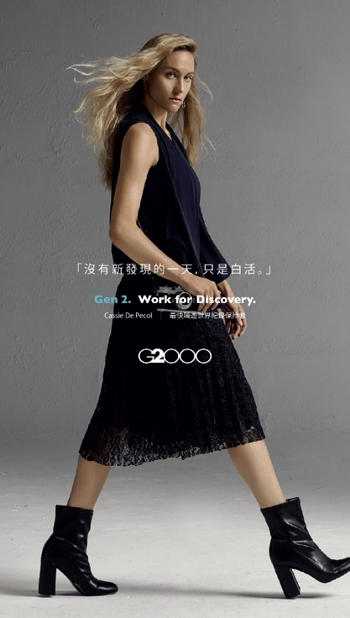

Fashion Life Business – Brand introduction
Collins has carried G2000 apparel of Hong Kong since 1989 and received a strong reputation of the brand. In 2013, we started to cooperate with Hyungji Group to develop Korea fashion brands in Taiwan. Now our fashion franchise business covers 90 shops and counters .
“G2000” is a Hong Kong base brand. It’s the best choice for urban clothing, offering high qualities and values to satisfy the needs of young white- collared men and women.

Slide 7
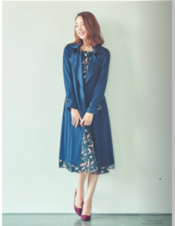
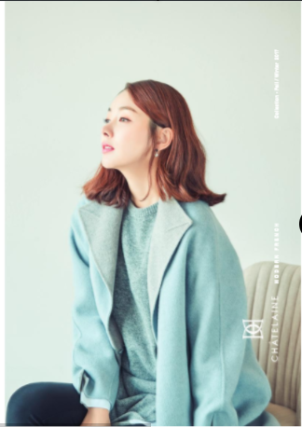
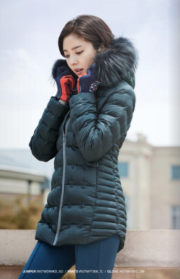

Fashion Life Business – Brand introduction
“Chatelaine” is from Korea. The concepts of design focus on French style and casual look . It’s for women who deems themselves chic and fashionable.
“Wild Roses” is women’s brand for exercise wear, suitable for hiking ,yoga and travel. Its colorful, functional and technical designs give every woman a healthy breathe and confident living.

Slide 8
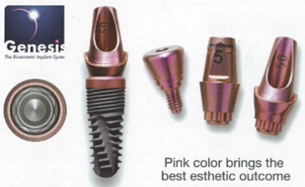
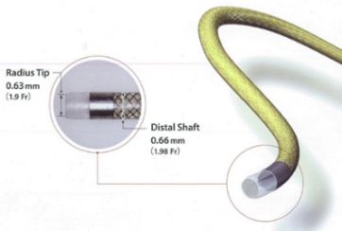
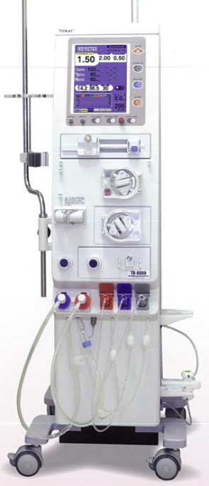
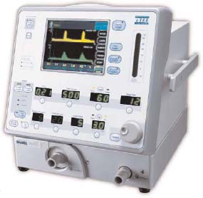

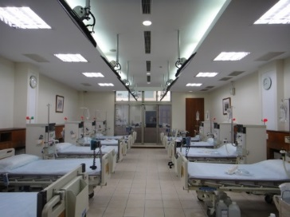
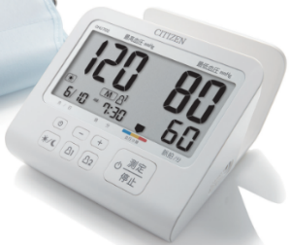
Bio-Medical Business- Hi-Clearance Inc.
Since June, 2016, Collins has taken controlling power over Hi-Clearance Inc., an OTC firm. Hi-Clearance is operating in distribution of medical equipment and bio-chemical reagents and medical management services. Its main products and services are below:
Dentistry
Cardiology & Radiology
Bio-Medical
Respiratory & Sleeping
Hemodialysis
Consultancy
Homecare Devices

Slide 9
Bio-Medical Business- Hi-Clearance Inc.
Per review financial report as of Sept. 30, 2017, Hi-Clearance’s operation revenue had reached NTD2.2 billion, resulting in an EPS of NTD5.09. Per internal financial report as of Nov. 30, 2017, the operation revenue had been NTD2.7 billion, achieving a 5.53% year-to-year growth.

Slide 10
Collins Group –Consolidated P&L
Per reviewed financial report as of Sept. 30, 2017,Collins Group operation revenue had reached NTD5.45 billion, resulting in an EPS of NTD0.12. Per internal financial report as of Nov. 30, 2017, the operation revenue had been NTD6.5 billion, achieving a11.38% year-to-year growth.
In NTD 1000
Item | 2016.1~12 | 2016.1~9 | 2017.1~9 | Var%
Operating Revenue | 6,625,768 | 4,806,468 | 5,451,645 | 13%
Gross Profit | 1,488,330 | 1,062,789 | 1,246,748 | 17%
Gross Profit Rate | 22% | 22% | 23% | 3%
Non-Operating Income and expenses | (20,204) | (52,670) | (21,308) | -60%
Net Income | 196,253 | 53,047 | 119,362 | 125%
Net Income Attributable to Owners of Parent | 96,891 | 10,667 | 25,682 | 141%
EPS(NT dollar) | 0.46 | 0.05 | 0.12 | 140%

Slide 11
Revenue breakdown by operations

Slide 12
Dividend Distributed

Slide 13
Strategy and Development
Export Business: To enhance the abilities of R&D of products , keep exploring emerging markets and seeking the opportunities to develop E-commerce development.
Fashion Retail: To provide wide range of product mix for customers , continue to review the profitability of each sales location and promote the new brands by advertising and commercials .
Bio-Medical Business: Beside intensively expanding the bio-Medical business ,we will also make our best effort to probe the potential businesses.

Slide 14
Disclaim
This report is based on information the company obtains from existing sources . Some information may be affected by uncertain factors resulting in the discrepancy between original plans and future prospects。
The adjustment or change will be notified on Market Observation Post System(MOPS).

Slide 15

Q&A

