Slide 1
Taiwan Tea Corp. 2021
QIC Taiwan CEO Week
April | Taipei

Slide 2
Disclaimer
The presentation and the relevant information mentioned in this material, including operating performance, financial performance and the business outlook, have been compiled from both internal and external resources.
These forward-looking statements involve known and unknown risks, uncertainties and other factors, including price variation, competition, global economy, exchange rate movement and market demand, which may cause actual results to differ materially from those implied by such forward-looking statements.
This Presentation should not be considered as the giving of investment advice by the Company or any of its shareholders, directors, officers, agents, employees or advisers. Each party to whom this Presentation is made available must make its own independent assessment of the Company after making such investigations and taking such advice as may be deemed necessary. In particular, any estimates or projections or opinions contained herein necessarily involve significant elements of subjective judgment, analysis and assumptions and each recipient should satisfy itself in relation to such matters.
The forward looking statements expressed in this material reflect the Company’s current view about the future as of today. The Company is not responsible for any updates if there are any changes in the future.

Slide 3
Executive Summary
Established in 1950, Taiwan Tea (2913 TT) is dedicated in three major business lines: 1) Tea cultivation, tea leaf and tea product manufacturing and marketing; 2) Agriculture tourism; and 3) Land development
TTC is the 2nd largest landowner in Taiwan with land asset of 3,747 ha, current market cap is US$ 480 mn (2021/4/13). 2020/3M2021 revenue was NT$ 312mn/ 91mn
In 2019, Mr. Wu, Ching-yuan was elected as the Chairman of Taiwan Tea. Chairman Wu committed to focus on core business, and pledged to boost the tea leaf manufacturing and shipment to turn around the business.
Taiwan Tea also leverage its tea garden and tea culture to develop tourism business. At the same time, the management team actively review its own land assets for further development and collaboration, to create sustainable revenue and profit.

Slide 4
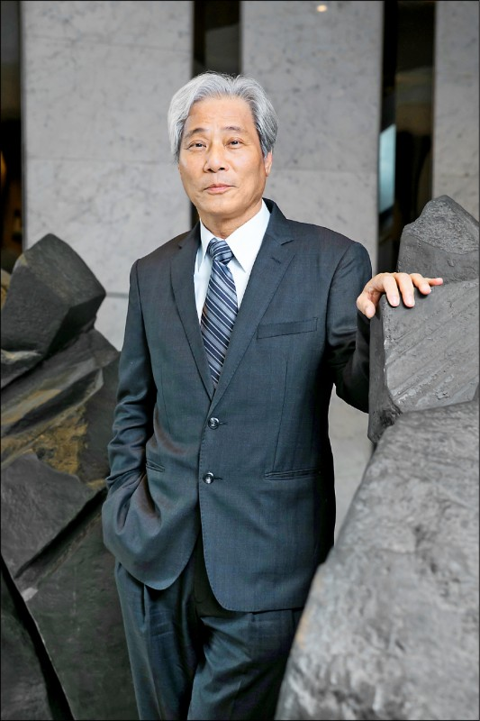
Strong Leadership
Chairman: Wu, Ching-Yuan
Chairman Wu graduated from National Taipei University of Technology and hold the associate degree in Mechanical engineering，he also holds a Masters degree in architecture & Urban Planning from Chung Hua University.
Mr. Wu was elected to be the Chairman in 2019
Chairman Wu introduced successful experience of Sanyang Motor and up to date industrial technology, to accelerated the development of the largest plantation: Laupi tea garden, and completed the entire 452 ha plantation. Meanwhile, Chairman Wu actively reviewed the land asset for proper utilization.
Under his leadership, Taiwan Tea’s revenue has grown 4.3% in 2020 and the net loss has been shrunk from $0.18 per share in 2019 to $0.02 in 2020.

Slide 5
TTC’s Way to Success
Core Business
Tourism
Land Asset
Maintain and strengthen TTC’s leading position in the tea market in Taiwan, and achieve sustainably profitable.
Taiwan Tea’s tea leaf production will quadruple and reach 3,000 tons/ year by 2025.
Leveraging tea plantations and land in the beautiful mountainous areas with great potential for tourism and leisure, and become a solid second revenue and profit stream.
The land capital of Taiwan Tea should be utilized properly. With continuous revitalization and reinvestment, to maximize the value of the land.

Slide 6
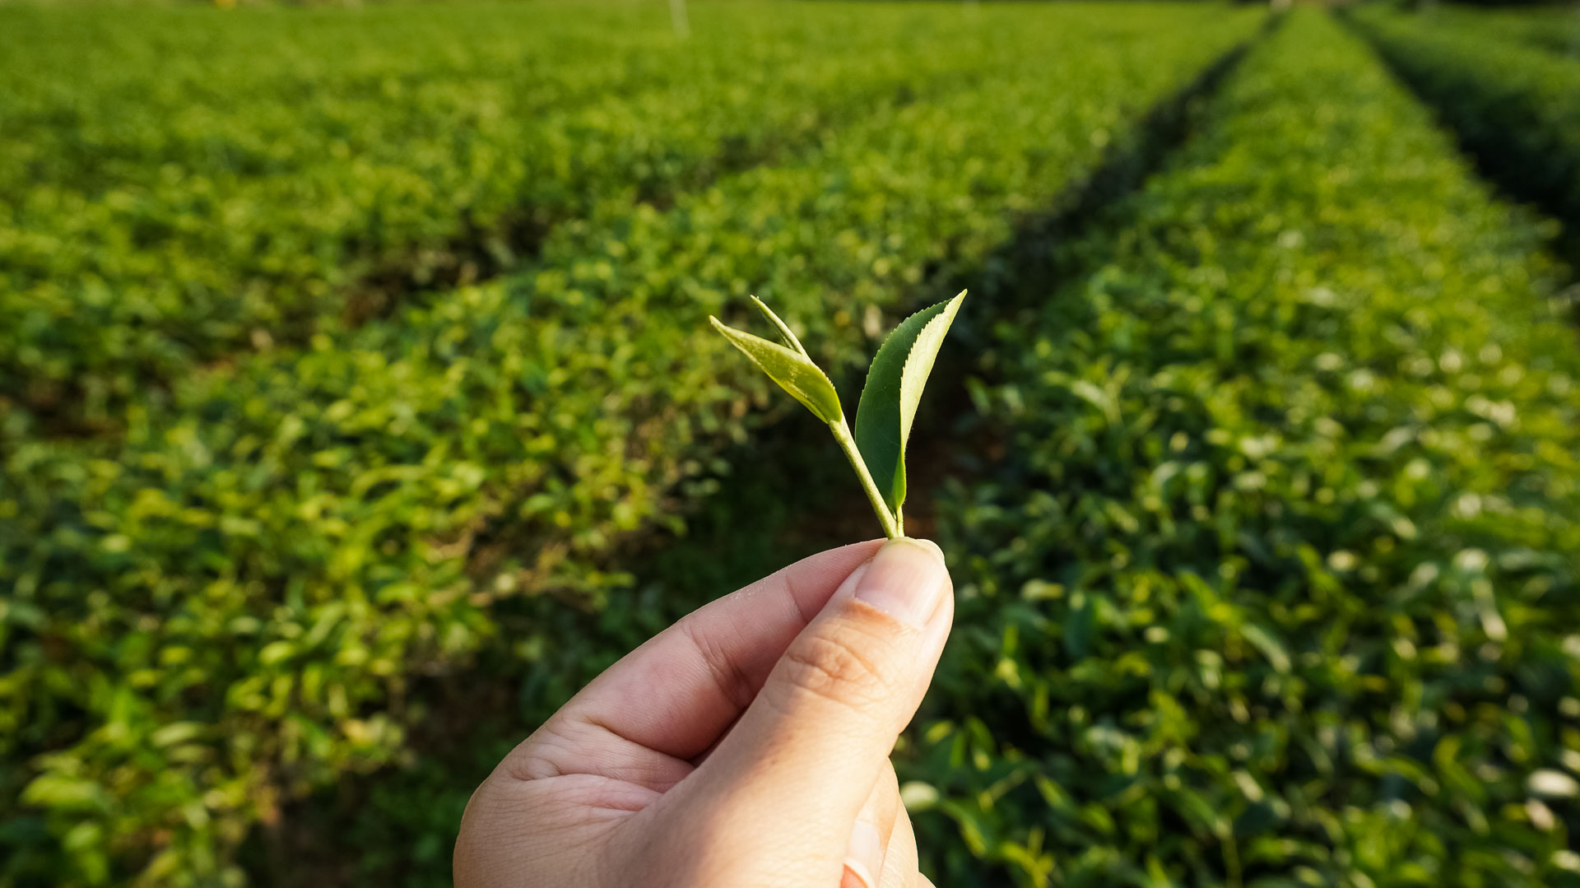
Tea Production
Photo Credit: https://ezgo.coa.gov.tw/zh-TW/Front/News/Detail/1279

Slide 7





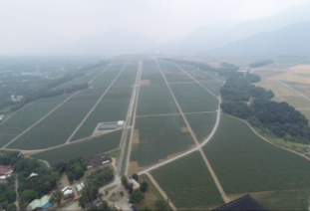
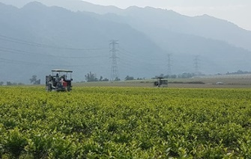
Tea Garden & Factories
復興茶廠、大溪老茶廠
熊空茶廠、大寮茶文館
DAXI TEA FACTORY
XIONGKONG TEA GARDEN
Area: 3.4 ha
Cultivars : Green tea & black tea
Area: 5.423 ha
Cultivars : Organic Green Tea, black tea and Oolong Tea
三義茶廠、銅鑼茶廠
魚池茶廠、日月老茶廠
SANYI、TONGLUO TEA FACTORY
ANTIQUE ASSAM TEA FARM
Area: 16 ha
Cultivars : Oriental Beauty Tea
Area:20 ha
Cultivars : TTES No. 8、No. 18、No. 21
LAUPI TEA FARM
精製廠、老埤農場
鹿篙咖啡莊園
Area:717 ha
(Tea Garden Approx. 452ha)
Cultivars: TTES No. 8,No. 2,No. 17,No. 18, Chin-Shin Da Pan and Shi-Ji-Chun (Four Season)
LUGAO COFFEE GARDEN
Coffee Garden field: 13 ha
Local specialty : Sun Moon Lake Coffee

Slide 8
First Smart Tea Garden in Taiwan
Micro-weather management
We set up 6 micro-weather station and soil moisture sensor to monitor the parameters of plant growth, to analyze the best condition for cultivation.
Applying precision irrigation technology developed by Netafim. With 14,000 drip holes per hectare covering over 94% of planting area, we managed to save 70% of irrigation water and 50% of fertilizer.
Precision irrigation
We applied 3 platforms to collect big data: 1) Smart Agri-management Platform(SAMP) for product traceability; 2) Dispatching App to monitor productivity of each production unit; and 3) Plant doctor App to monitor the entire process of cultivation.
Big data management
Organic and High Quality
We started our organic plantation in 2003. TTC pledged to produce our tea leaf at the highest safety and highest quality standard. We also use biodegradable bioplastic for our product packaging.

Slide 9
Laupi Tea Farm Progress
Progress at the end of 2019
20%
87%
Operating Machines construction
Tea Plantation
99%
10%
Tea Factory construction
Warehouse construction
100%
50%
99%
100%
Progress at the end of 2020

Slide 10
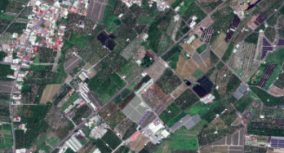
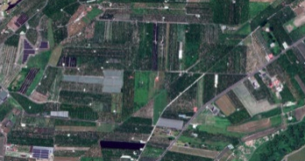
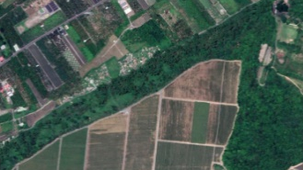
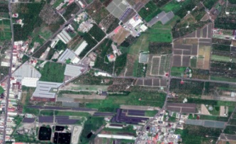
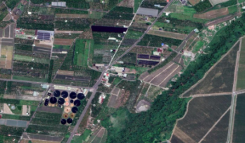
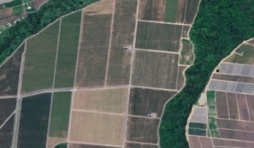
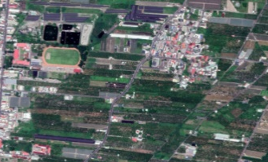
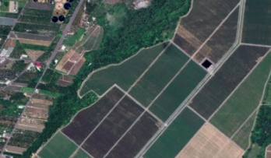
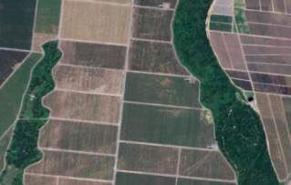
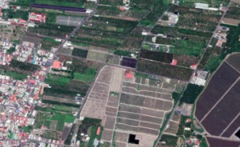
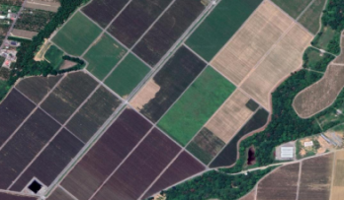
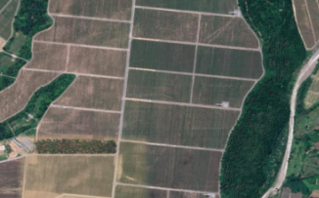
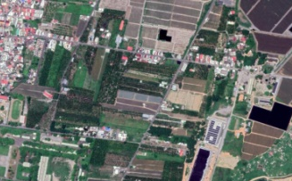
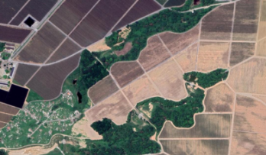
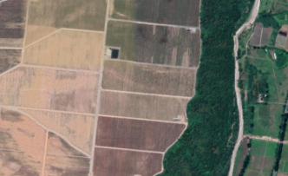
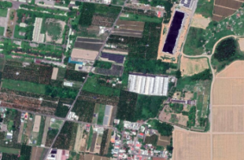
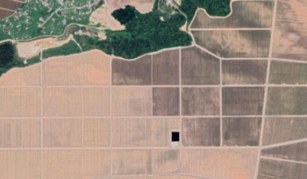
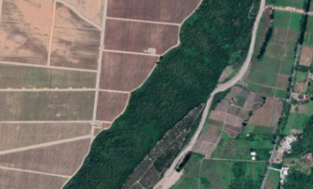
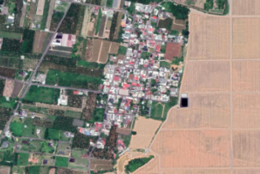
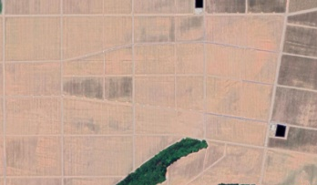
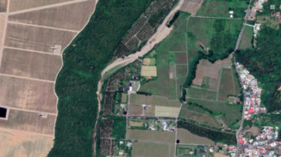
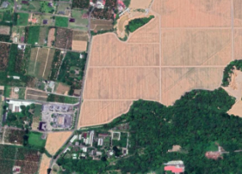
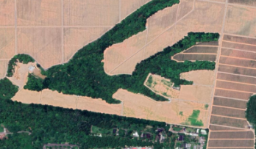
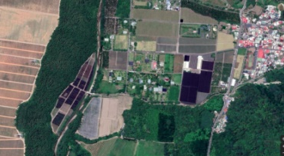
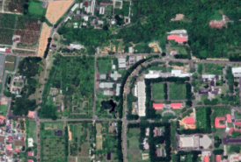
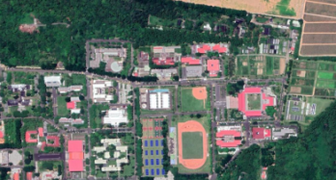
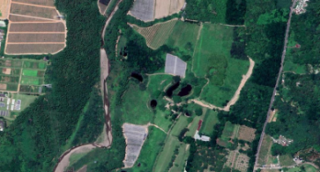
Business Highlight-Laupi Tea Farm
Tea Area [Phase 1]
(Cultivated area 111 hectares)
Tea Area [Phase 2]
(Cultivated area 126.5 hectares)
Pingdong Branch Office
Dormitory Phase II
Tea Tree Nursery
Temporary Tea Factory
Tea Factory
Warehouse
Tea Area [Phase 3]
(Cultivated area 105 hectares)
Tea Area [Phase 4]
(Cultivated area 109.5 hectares)
Laupi Tea Farm
The total planting area 452 hectares

Slide 11
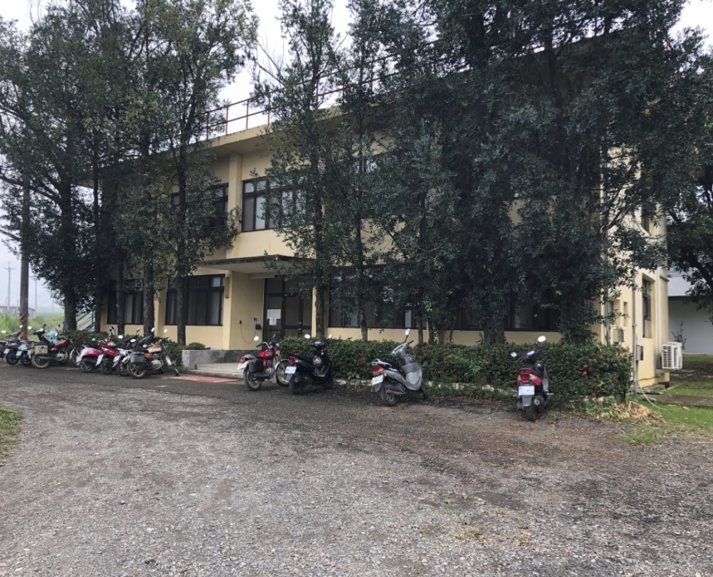
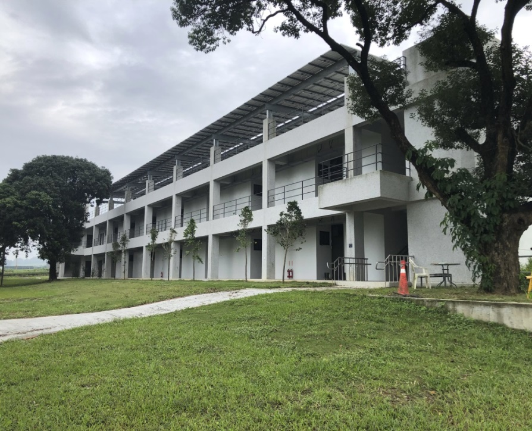
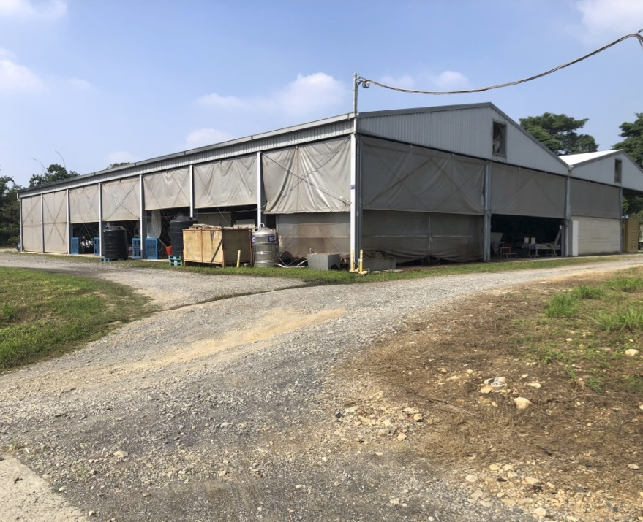
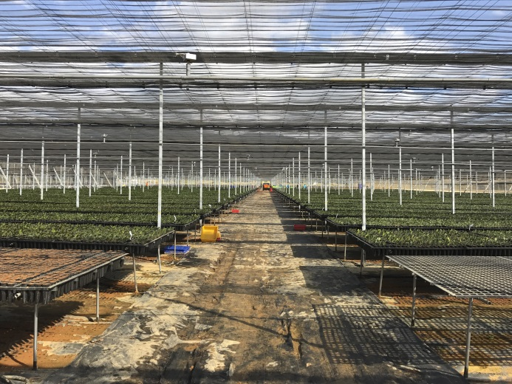
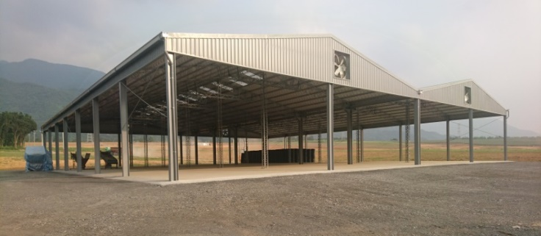
Laupi Tea Farm Facilities
Pingdong Branch Office/Laupi Tea Farm
Laupi Tea Farm Dormitory Phase II
Laupi Temporary Tea Factory
Tea Tree Nursery

Slide 12
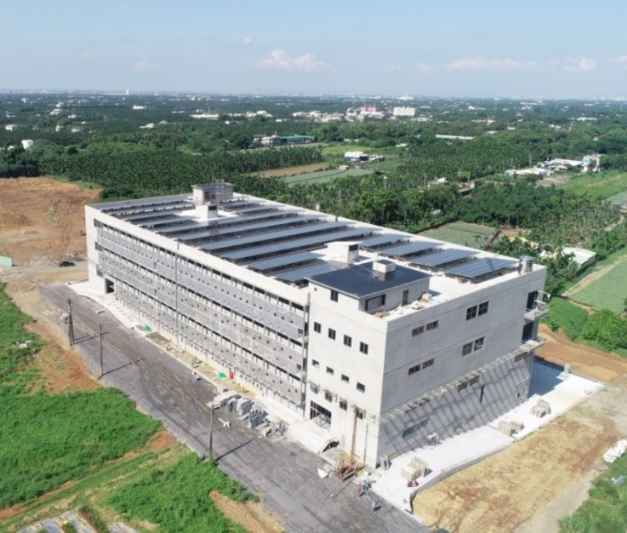
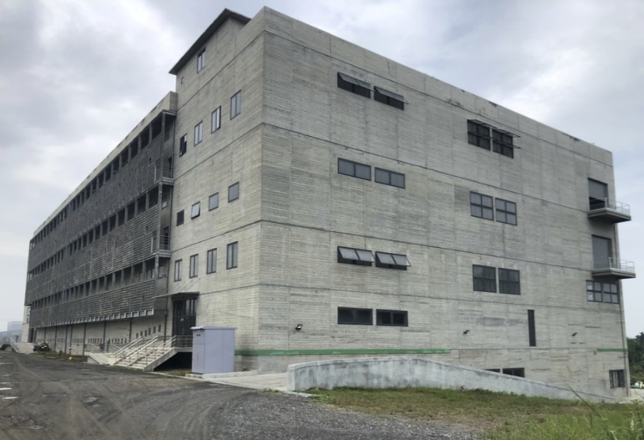
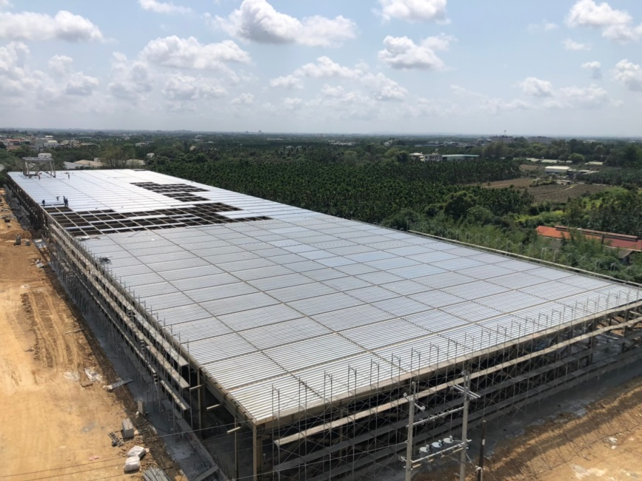
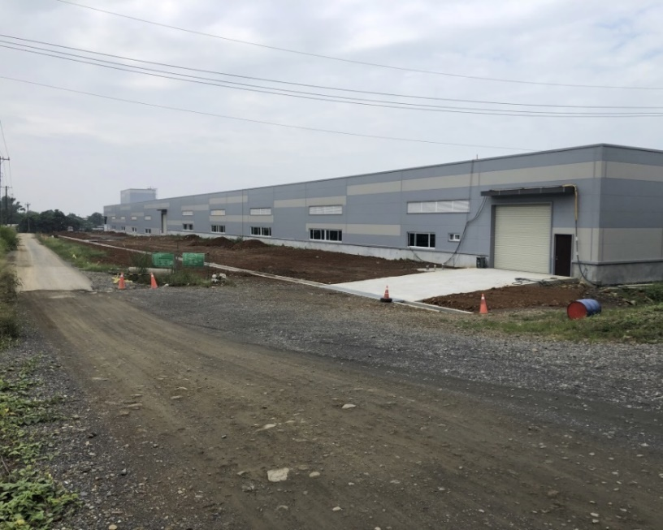
Laupi Tea Farm Facilities
Laupi Tea Factory
Laupi Warehouse

Slide 13
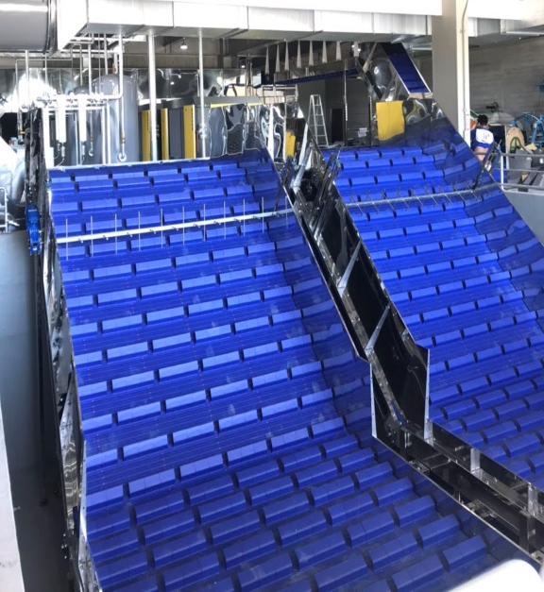
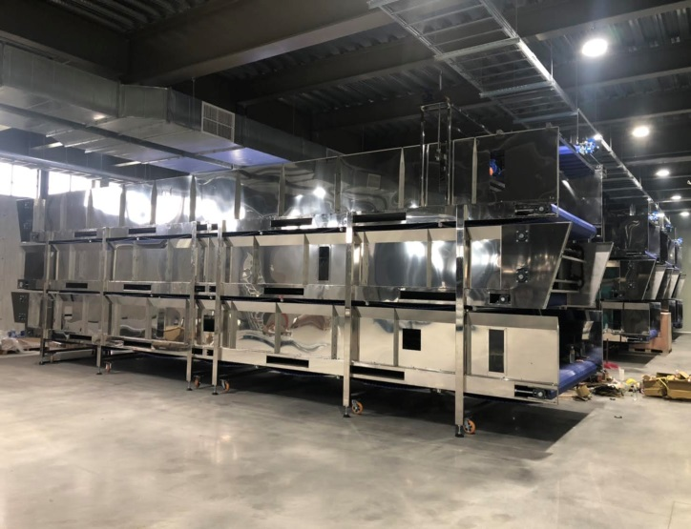
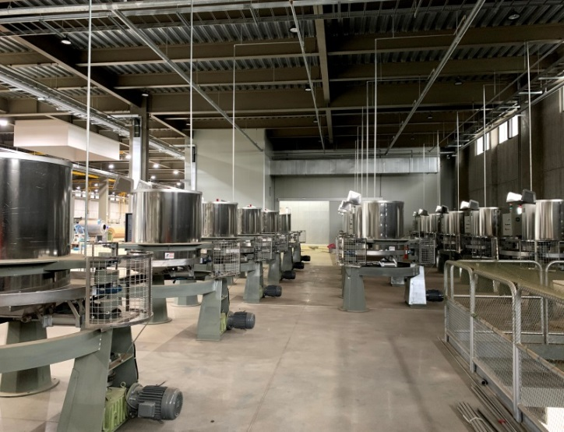
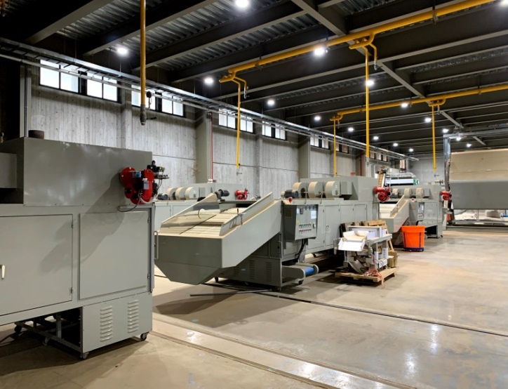
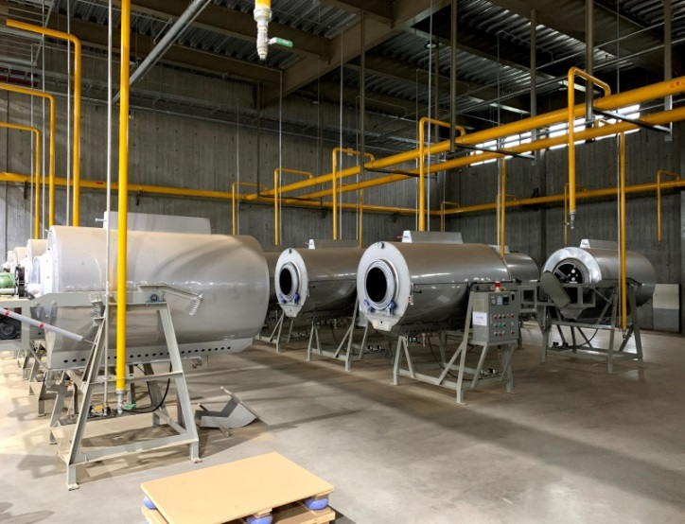
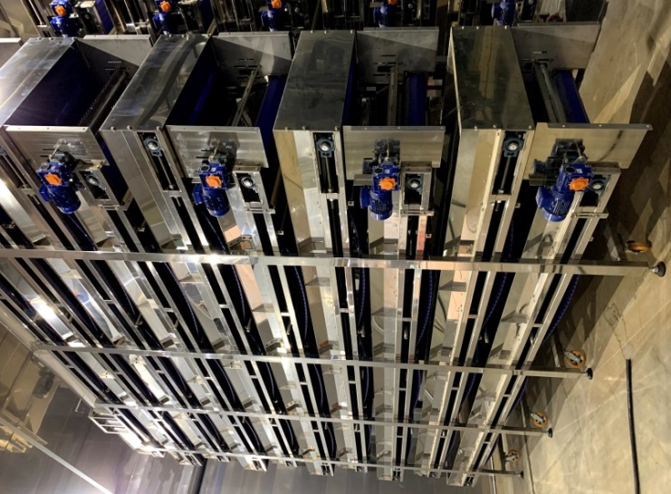
Automated Tea production line
Gathering Tea Leaves
Withering
Rolling
Drying
Frying
Fermenting

Slide 14
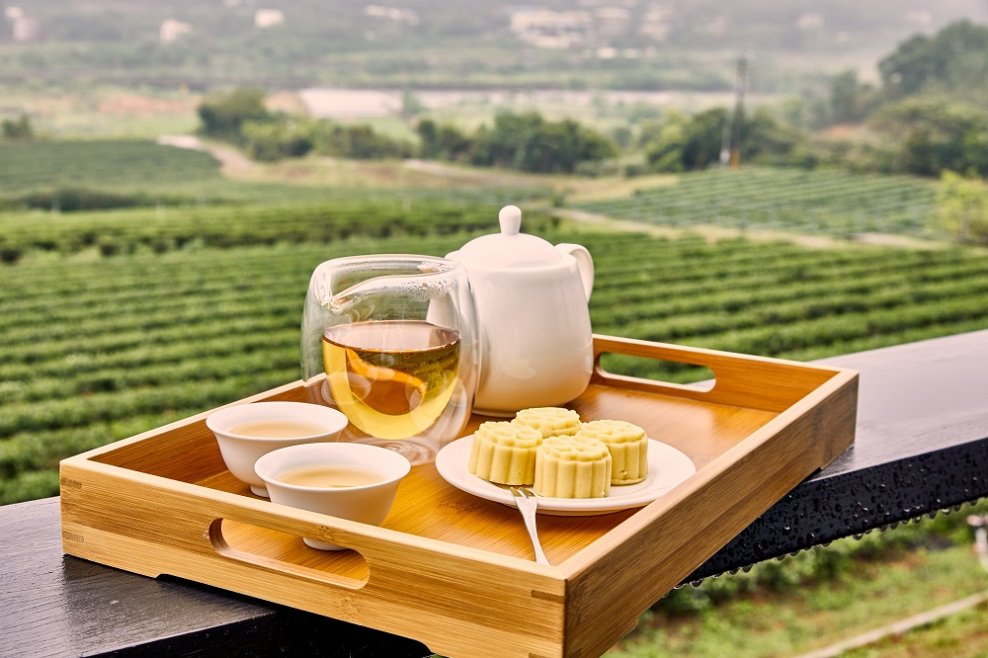
Tourist Farm

Slide 15
Recreational Business Highlights
DAXI TEA FACTORY
9.8 ha
TONGLUO TEA FACTORY
15.9 ha
XIONGKONGTEA GARDEN 165.8 ha
DALIAO HISTORICAL HOUSE
2.7 ha
ANTIQUE ASSAM TEA FARM
3.7 ha
LUGAO COFFEE GARDEN
7.8 ha
Recreation Operating revenue (Unit:NT$Thousand) | 2020 | 2019 | YoY | YoY(%)
Xiongkong Tea Garden | 17,852 | 10,294 | 7,558 | 73%
Daliao Historical House | 2,806 | 2,624 | 181 | 7%
Daxi Tea Factory | 34,926 | 34,414 | 512 | 1%
Tongluo Tea Factory | 18,465 | 15,021 | 3,444 | 23%
Antique Tea Factory | 58,237 | 67,628 | -9,390 | -14%
Lugao Coffee Garden | 31,074 | 7,575 | 23,500 | 310%

Slide 16
Leisure Business Outlook
To develop tea farm leisure industry
- Establish new leisure farms in line with current business operation
- By applying for leisure farm operating permit to speed up transformation for current farm facilities
- Consolidate the newly approved leisure farm into the TTC leisure franchise
New Leisure
Farm / Pasture
Xiongong second leisure farm
( camping area )
Daxi leisure farm
Shuitou farm
( pasture )
Leisure Industry
Farm
Transformation
Miaoli Tongluo leisure farm expansion
Turn Lugao coffee garden to
Lugao leisure farm
Leisure Farm
Registered
and Operated
Xiongong leisure farm
Shihmen leisure farm
Building License Permitted
Xiongong tea factory
Zhuwei agricultural facility

Slide 17
Land Development

Slide 18








Land Development - Selected cases
Commercial
Park
TTC Sanyi Industrial/Commercia Park
  •In2008, acquired development permission
  •In2010, completed water conservation and land preparation
  •In2010, completed revising land functional zone
Residential
Project
Miaoli Tongluo Residential Project
    •In2014, acquired development permission
  •In2019, completed water conservation and land preparation
  •In2019, completed revising land functional zone
Commercial Park
Exhibition Hall/Hotel
Miaoli Tongluo Industrial/Commercial Park
    •In2014, acquired development permission
  •In2019, completed water conservation and land preparation
  •In2019, completed revising land functional zone
Land Development
Increase asset value
Recreational
Park
Sun Moon Lake Recreational Project
    •In2015, acquired development permission
    •In2018, water conservation and land preparation
    plan permitted
    • Connecting road improvement required
Land asset vitalization is our main goal from 2007
Developed large land cases step into constructing and operating phases
Select potential land to develop in 2021
Development Projects
of Next Year
Profession consulting
Potential cases selection
Financial investment

Slide 19
Land Development strategy
To increase asset value
- Land asset revitalization is our priority, we continue to review our land asset and evaluate potential profit
- Initiate promising development projects in accordance with government’s land policy
- Collaborate with financial partners for the projects completed changing of land category
- Review developable land, and propose to be ruled out from hillside restricted zone
Completed Projects
  → Investment promotion
TTC Sanyi
Industrial / Commercial Park
Miaoli Tongluo
Industrial / Commercial Park
Miaoli Tongluo
Residential
Project
Land Development Cases
New Projects
  → Official review process
Miaoli Tongluo Industrial Park
Miaoli Tongluo Recreational Park
Reassess Project
→ After Land Act enforcement
Hillside zone revised
→ Zone plan proposed
Sun Moon Lake Recreational Project
Laupi Tea Farm
Hillside zone revised

Slide 20

Financials

Slide 21
Historical Cash Dividend 2013-19
NT$ mn | 2013 | 2014 | 2015 | 2016 | 2017 | 2018 | 2019
Net Income | $1,023 | $833 | $760 | $310 | $622 | $-42 | $-146
Cash Dividend | $360 | $475 | $385 | $385 | $385 | $237 | $0
DPS (NT$/share) | $0.50 | $0.61 | $0.50 | $0.50 | $0.49 | $0.30 | $0.00
Cash Yield (%)⁽¹⁾ | 2.6% | 4.0% | 3.2% | 3.0% | 2.8% | 1.9% | 0.0%
Payout Ratio (%) | 33% | 53% | 50% | 124% | 61% | - | 0%
Ex-div Date | 2014/7/16 | 2015/7/17 | 2016/7/21 | 2017/8/25 | 2018/11/28 | 2019/8/23 | -
Source:TEJ, Capital IQ
Note 1： Stock price based on closing price the day before Ex-div date

Slide 22
5-year Income Statement
NT$ Million | 2015 | 2016 | 2017 | 2018 | 2019 | 2020 |  | YoY (%)
 |  |  |  |  |  |  |  | 2015 | 2016 | 2017 | 2018 | 2019 | 2020
Sales Revenue | 937 | 611 | 2,252 | 254 | 299 | 312 |  | (50.2) | (34.8) | 268.7 | (88.7) | 17.6 | 4.3
Gross Profit | 400 | 275 | 740 | 116 | 121 | 125 |  | (36.0) | (31.1) | 168.9 | (84.4) | 4.5 | 3.1
Operating Profit | 74 | -38 | 386 | -173 | -169 | -148 |  | (71.2) | (152.0) | - | (144.8) | - | -
Income before Tax | 725 | 306 | 605 | -54 | -173 | -33 |  | (17.3) | (57.8) | 97.6 | (108.9) | - | -
Net Income to Parent | 760 | 310 | 622 | -42 | -146 | -17 |  | (8.8) | (59.2) | 100.6 | (106.7) | - | -
EPS (NT$) | 1.01 | 0.40 | 0.81 | -0.05 | -0.18 | -0.02 |  | (12.9) | (60.1) | 100.6 | (106.6) | - | -
Key Financial ratio (%)
Gross Margin | 42.7 | 45.1 | 32.9 | 45.5 | 40.4 | 40.0
Operating Margin | 7.9 | (6.3) | 17.1 | (67.9) | (56.5) | (47.3)
Opex ratio | 34.8 | 51.3 | 15.7 | 113.4 | 96.9 | 87.3
Net Margin | 81.1 | 50.8 | 27.6 | (16.5) | (48.8) | (5.6)

Slide 23
5-year Balance Sheet
NT$ Million | 2015 | 2016 | 2017 | 2018 | 2019 | 2020 |  | YoY (%)
 |  |  |  |  |  |  |  | 2015 | 2016 | 2017 | 2018 | 2019 | 2020
TOTAL ASSETS | 25,733 | 24,372 | 23,619 | 24,356 | 24,596 | 25,098 |  | 19.1 | (5.3) | (3.1) | 3.1 | 1.0 | 2.0
Cash | 167 | 78 | 198 | 186 | 125 | 176 |  | (7.6) | (53.2) | 153.1 | (5.9) | (32.6) | 40.5
NR & AR | 141 | 39 | 21 | 15 | 19 | 18 |  | (42.9) | (72.5) | (46.0) | (26.4) | 19.9 | (5.5)
Inventory | 2,002 | 2,034 | 791 | 823 | 885 | 895 |  | 0.4 | 1.6 | (61.1) | 4.0 | 7.6 | 1.2
Fixed Asset | 883 | 3,721 | 4,272 | 6,017 | 6,092 | 6,504 |  | 9.8 | 321.3 | 14.8 | 40.8 | 1.2 | 6.8
TOTAL LIABILITIES | 9,602 | 8,314 | 7,333 | 8,204 | 8,832 | 9,306 |  | 46.0 | (13.4) | (11.8) | 11.9 | 7.7 | 5.4
Bank Loans | 5,355 | 3,861 | 3,351 | 4,640 | 5,396 | 5,923 |  | 201.5 | (27.9) | (13.2) | 38.5 | 16.3 | 9.8
NP & AP | 46 | 884 | 441 | 18 | 13 | 16 |  | (73.0) | 1841.5 | (50.1) | (95.8) | (28.2) | 19.6
TOTAL EQUITY | 16,131 | 16,058 | 16,286 | 16,152 | 15,764 | 15,792 |  | 7.3 | (0.5) | 1.4 | (0.8) | (2.4) | 0.2
A/R turnover days | 75.7 | 53.8 | 4.9 | 26.2 | 20.7 | 21.1
Inventory turnover days | 1,357.9 | 2,195.6 | 341.1 | 2,124.9 | 1,749.5 | 1,736.3
A/P turnover days | 72.7 | 505.3 | 159.9 | 604.4 | 32.4 | 28.3
ROE (%) | 4.9 | 1.9 | 3.8 | (0.3) | (0.9) | (0.1)
ROA (%) | 3.2 | 1.2 | 2.6 | (0.2) | (0.6) | (0.1)

Slide 24
Q & A

Slide 25
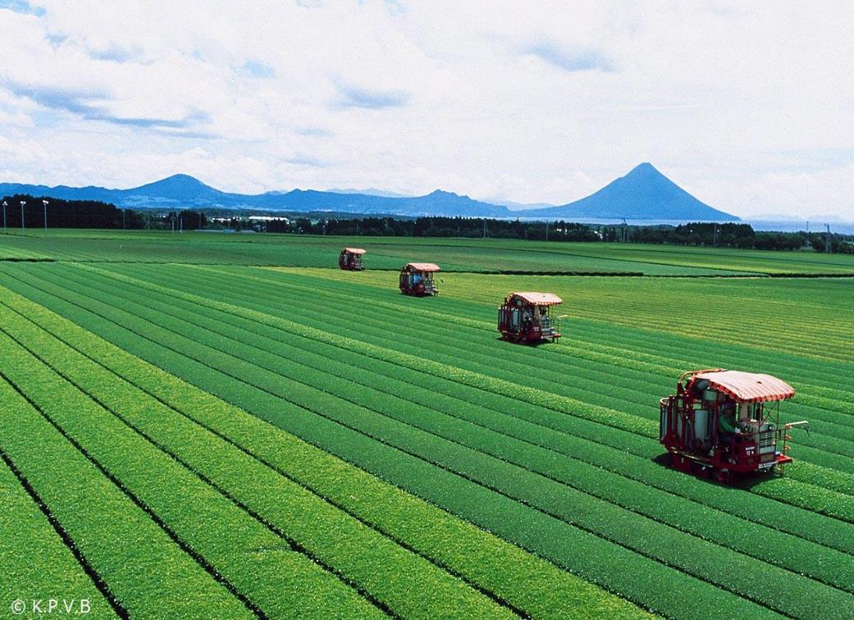
Thank you.
臺北市南港區園區街3號15樓(南港軟體科學園區F棟)
+886-2-26557799
www.ttch.com.tw

