Slide 1
2022 Conference
Ji-Haw Industrial Co. Ltd.

Slide 2
目錄
01.
04.
ICT Trend predictions
  ICT Key topics
  AI Development
  Future Industries
The current world climate on the ICT market
  The pandemic’s effects on Taiwan’s ICT market
  The Russo-Ukrainian War on Taiwan’s ICT market
02.
Global Device Market
05.
03.
The current state of development and the future
Automobiles
  Electric Cars
  Autonomous Cars

Slide 3
In the last 3 years
ICT Trend Predictions

Slide 5
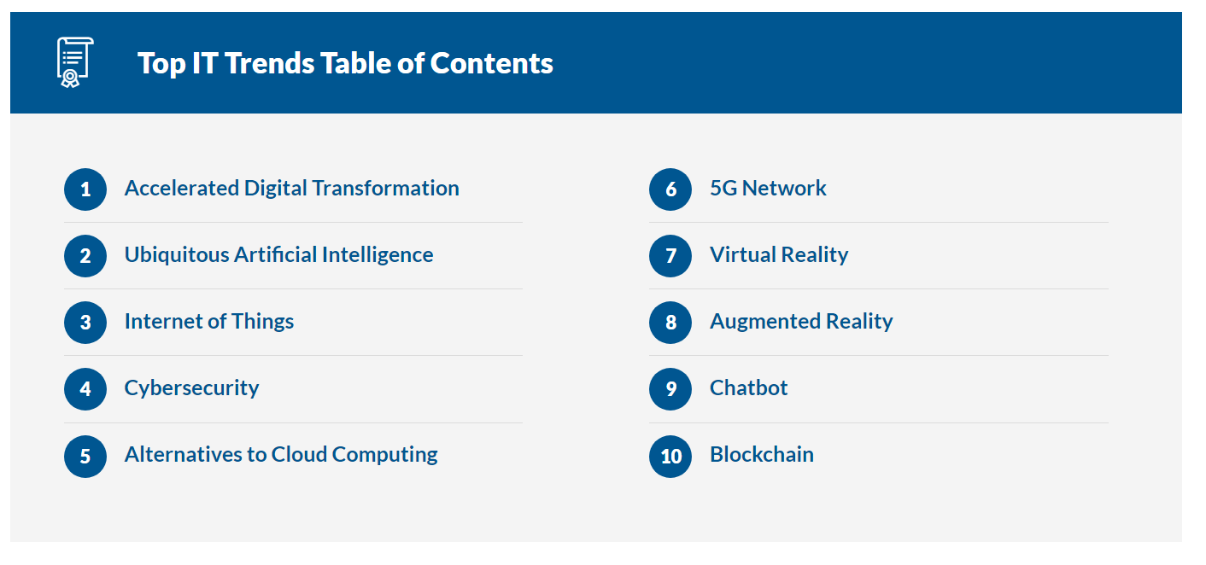

Slide 6
2022
ICT Key Topics

Slide 7
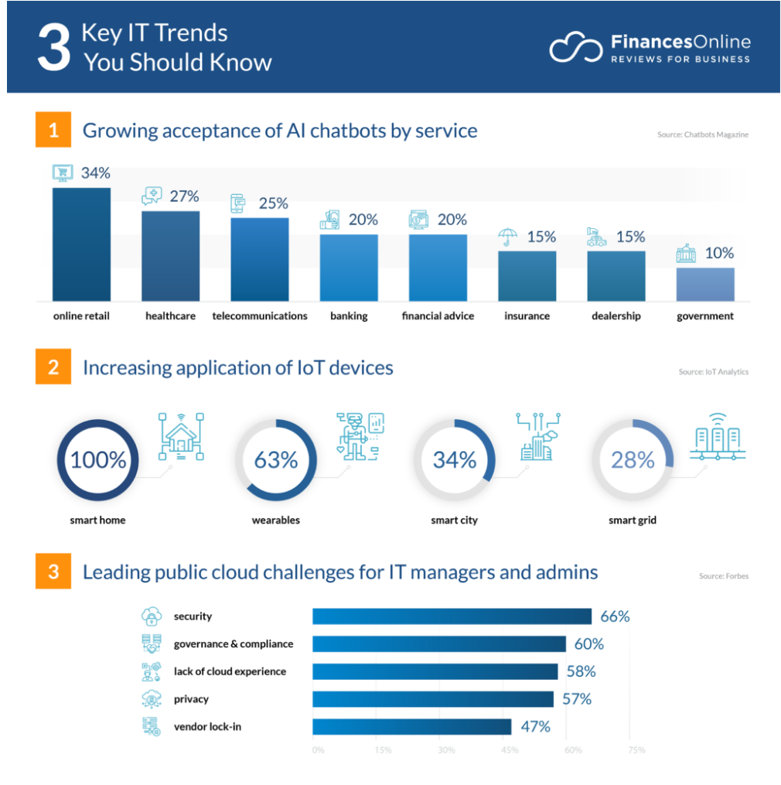
Source：https://reurl.cc/RODDL9

Slide 8
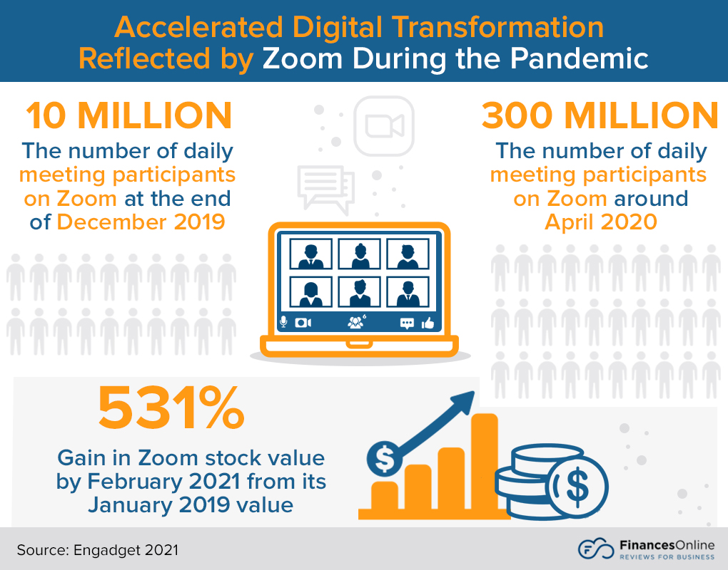
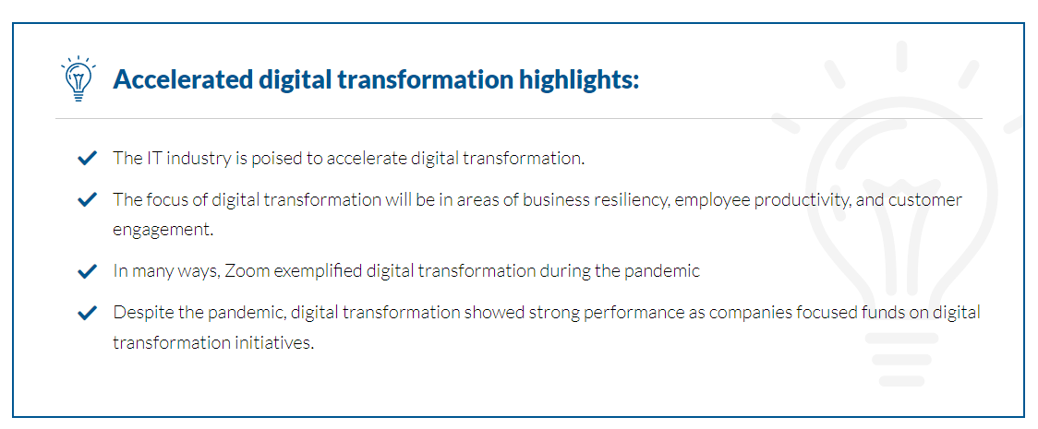
1. Accelerated Digital Transformation
Source：https://reurl.cc/RODDL9

Slide 9
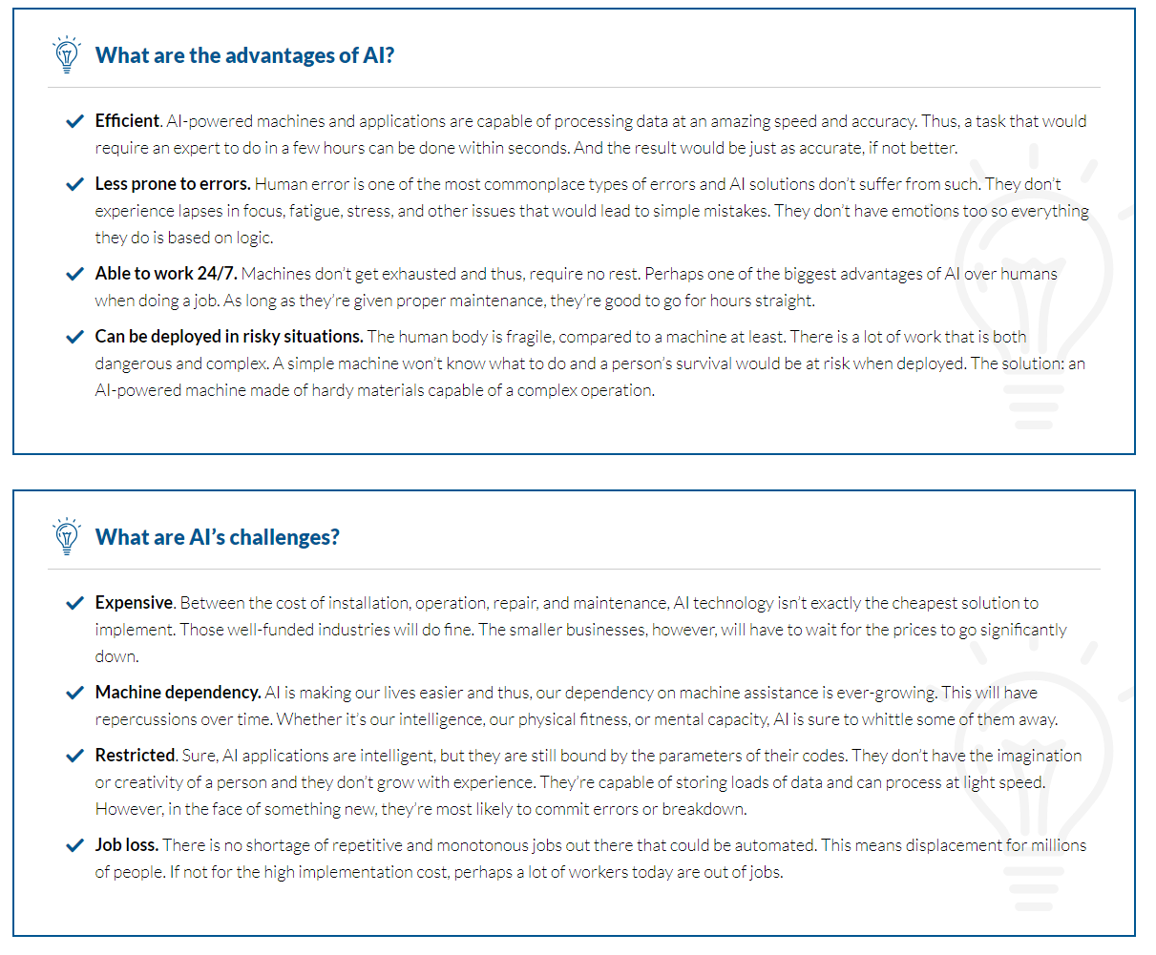
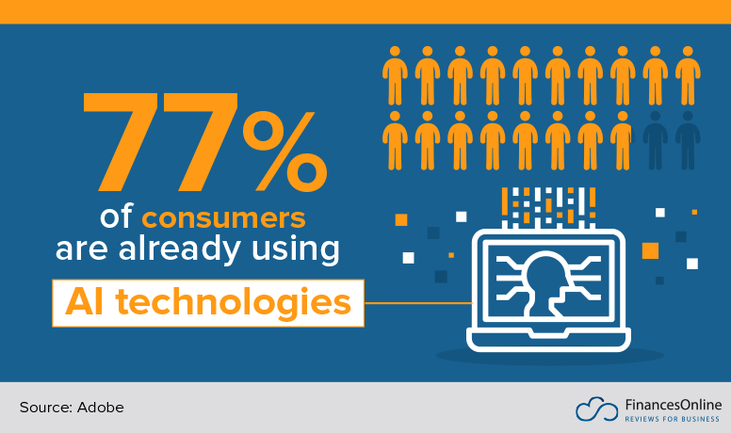
2. Ubiquitous Artificial Intelligence
Source：https://reurl.cc/RODDL9

Slide 10
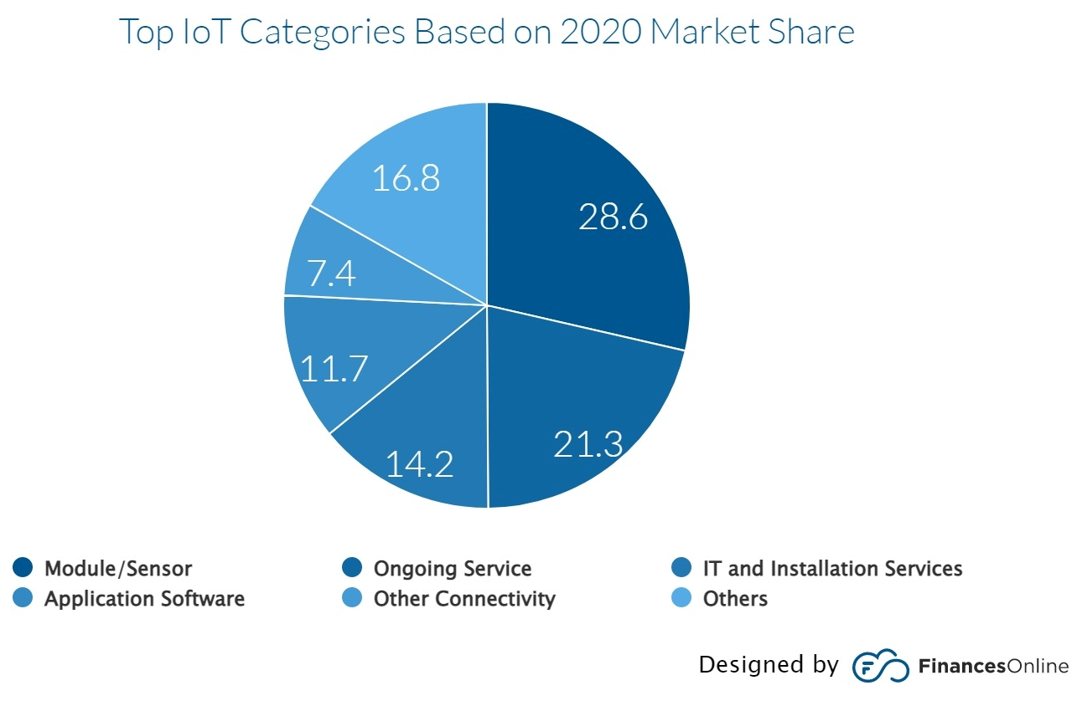
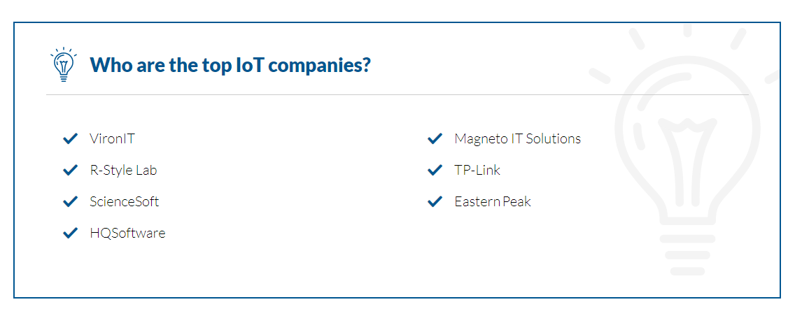
3. Internet of Things
Source：https://reurl.cc/RODDL9

Slide 11
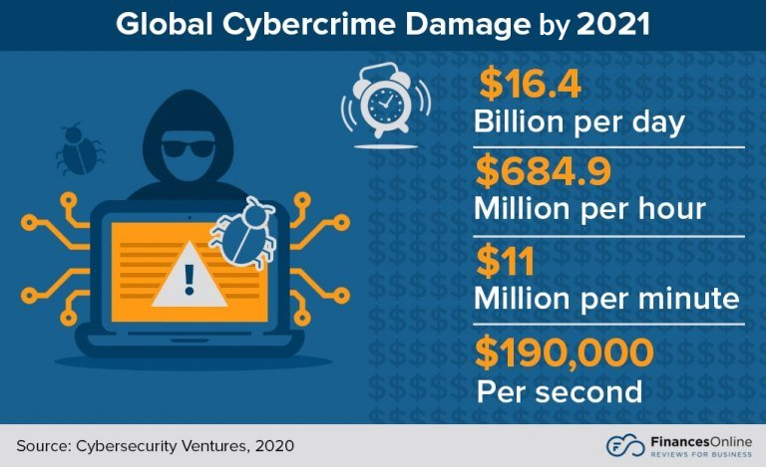
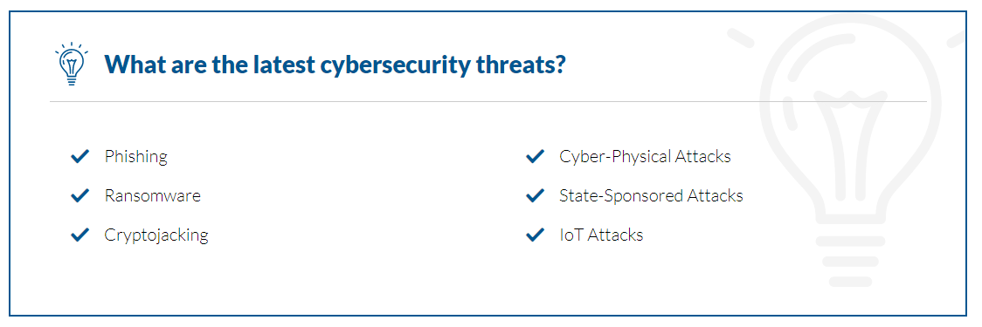
4. Cybersecurity
Source：https://reurl.cc/RODDL9

Slide 12
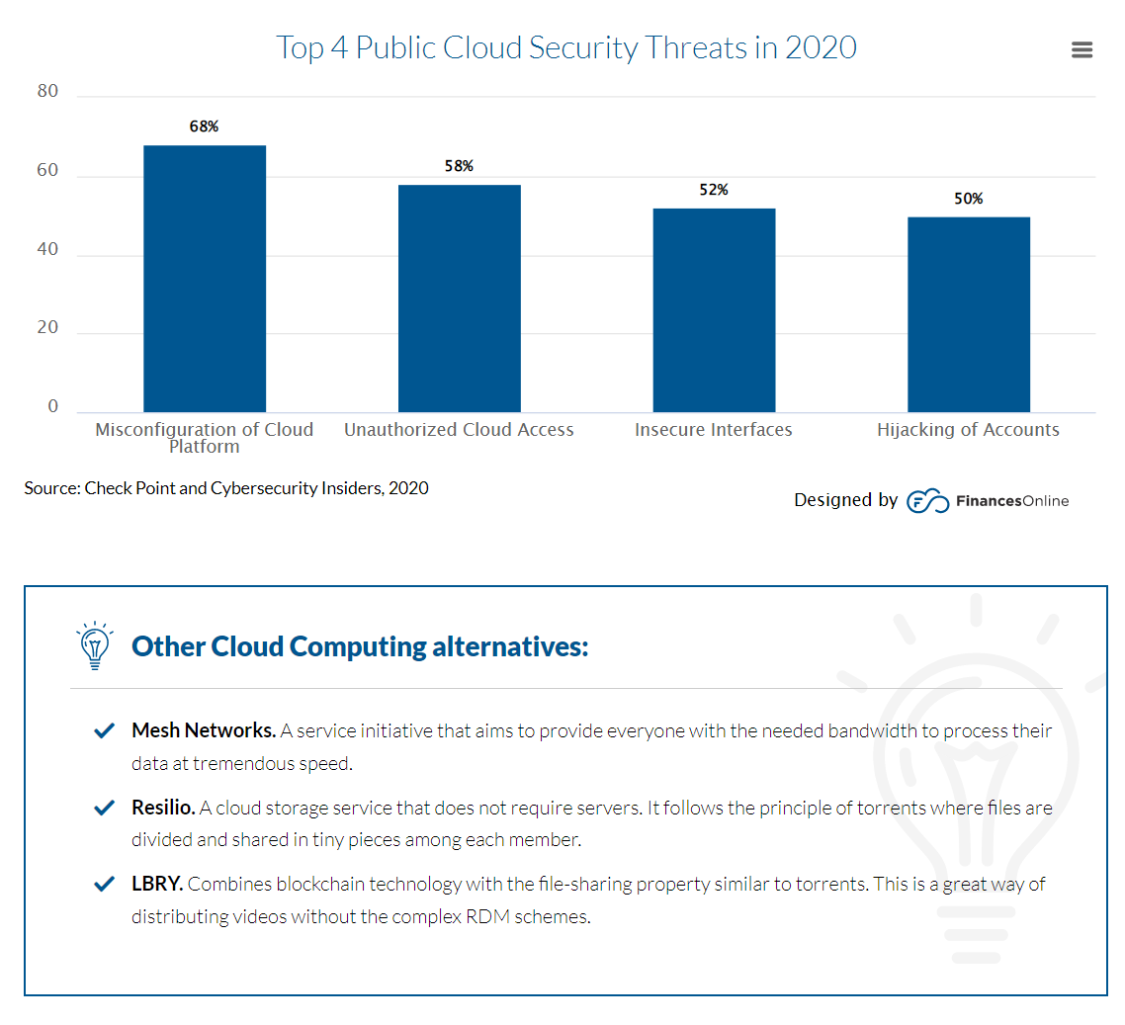
5. Alternatives to Cloud Computing
Source：https://reurl.cc/RODDL9

Slide 13
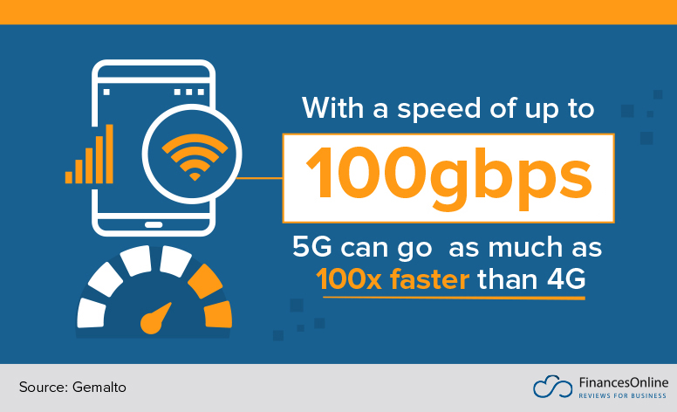
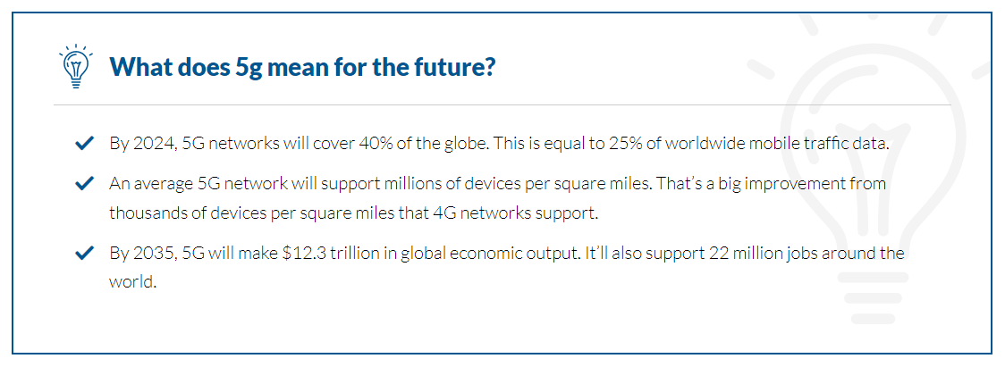
6. 5G Network
Source：https://reurl.cc/RODDL9

Slide 14
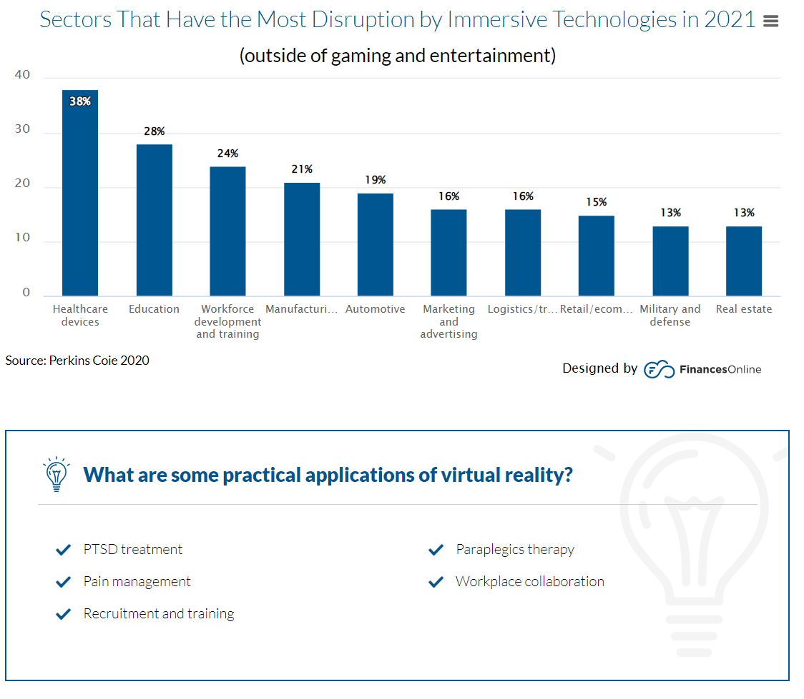
7. Virtual Reality
Source：https://reurl.cc/RODDL9

Slide 15
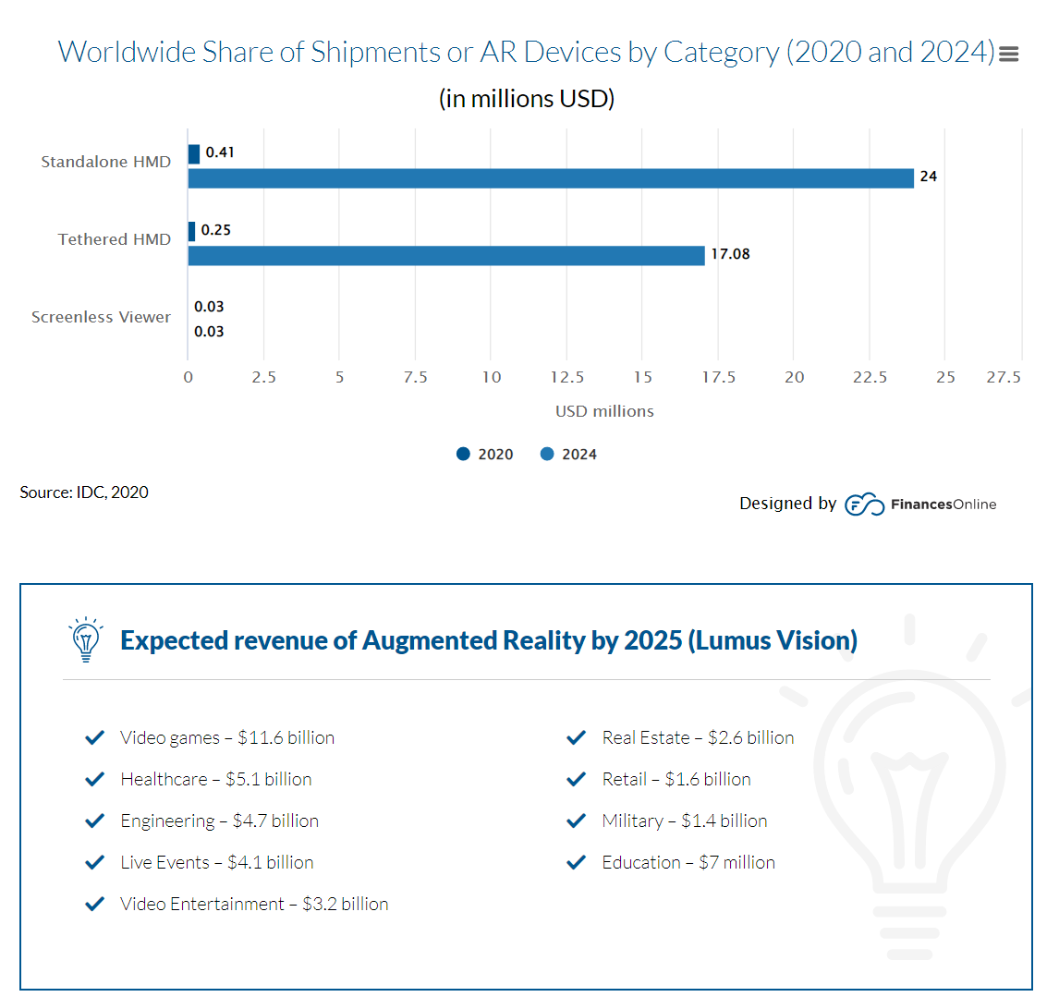
8. Augmented Reality
Source：https://reurl.cc/RODDL9

Slide 16
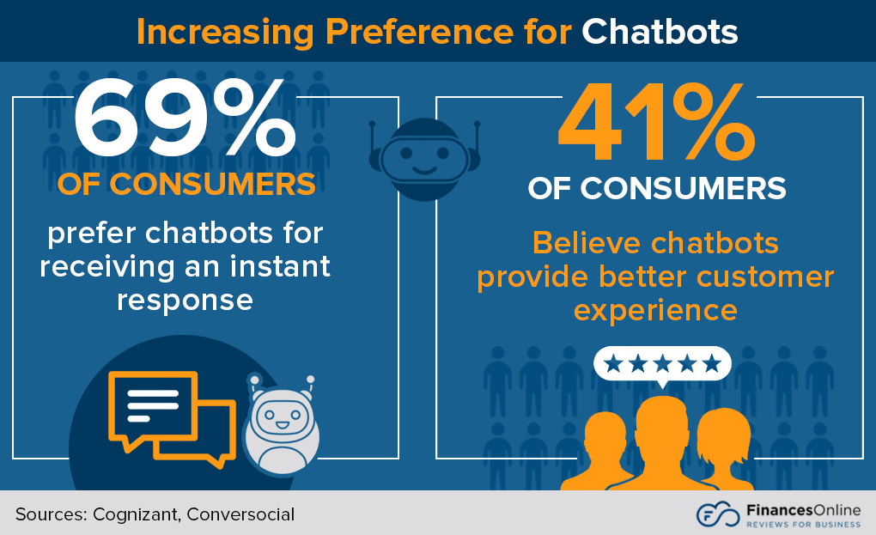
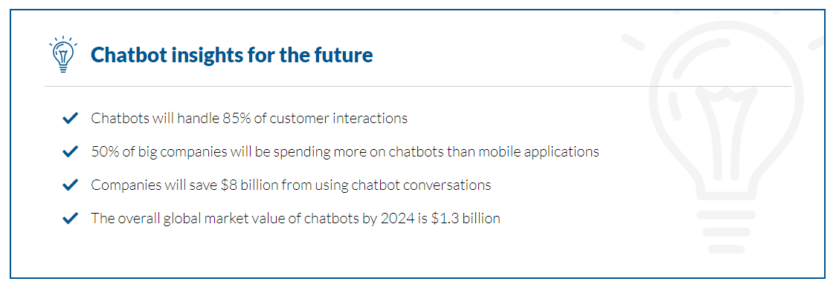
9. Chatbot
Source：https://reurl.cc/RODDL9

Slide 17
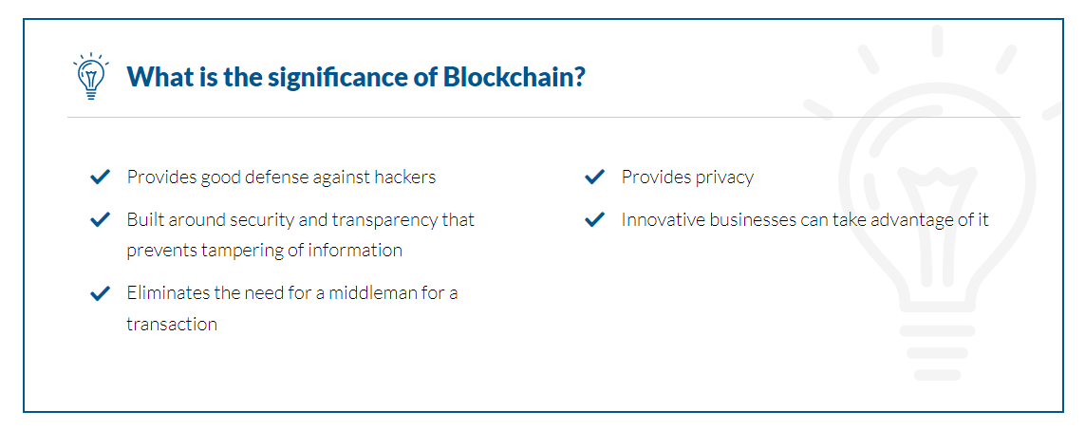
10. Blockchain
Source：https://reurl.cc/RODDL9

Slide 18
AI development
ICT

Slide 19
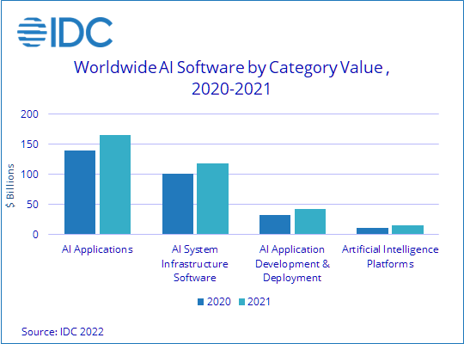
IDC expects the AI market value will reach nearly $450 billion in 2022 and maintain a year-over-year growth rate in the high teens throughout the five-year forecast.
Source ：https://reurl.cc/deGdd2

Slide 20
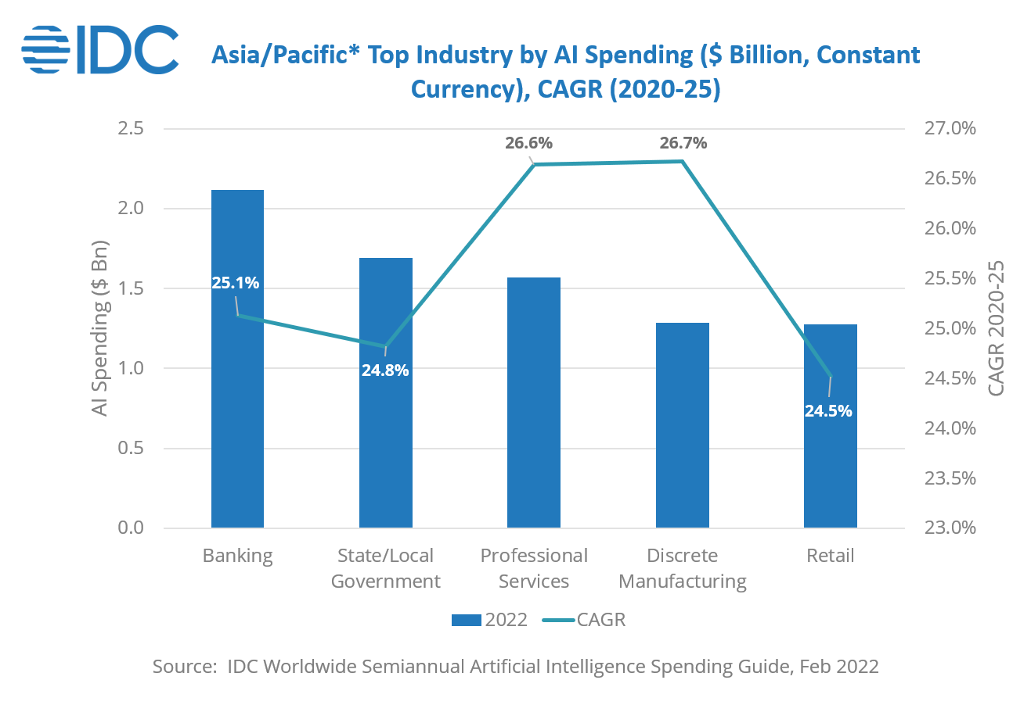
Source ：https://reurl.cc/MXkZYk、https://reurl.cc/jRgqXn

Slide 21
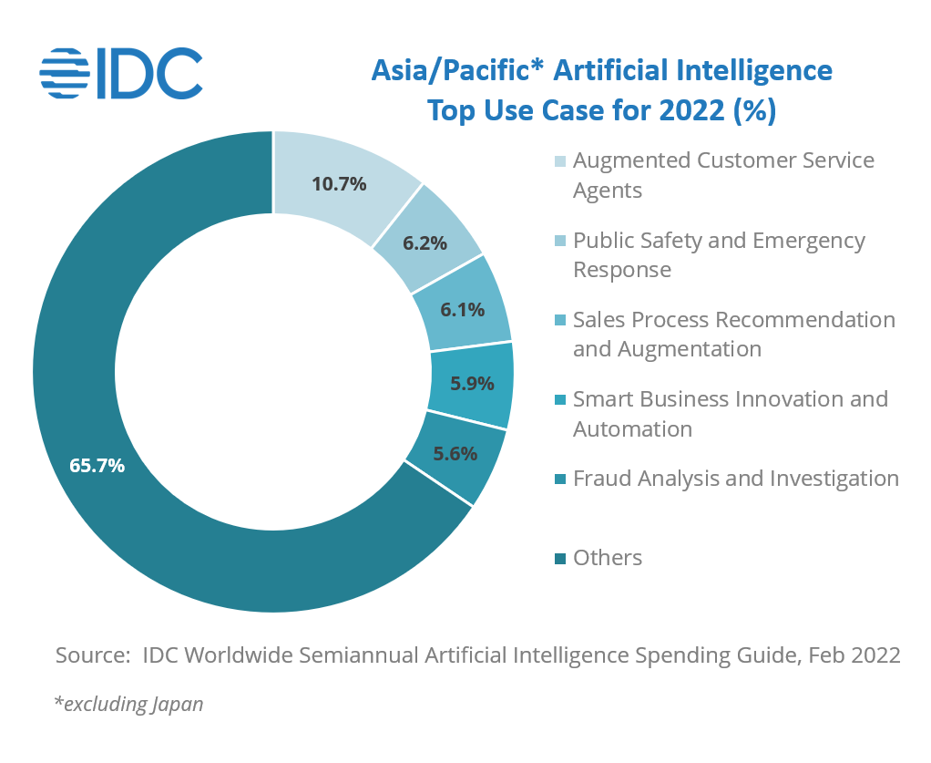
Source ：https://reurl.cc/MXkZYk、https://reurl.cc/jRgqXn

Slide 22
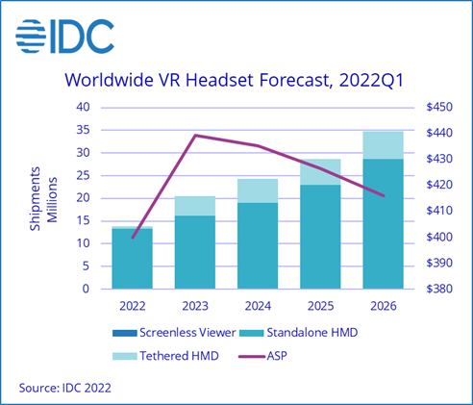
Source ：https://reurl.cc/mZv6Lj

Slide 23
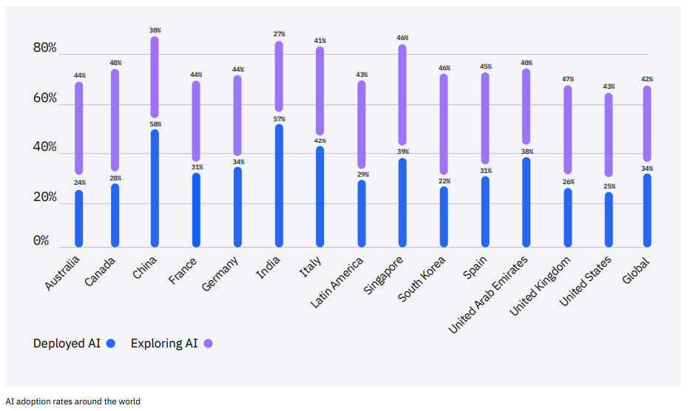
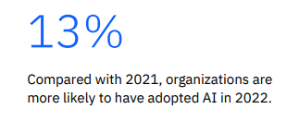
IBM Global AI Adoption Index 2022
AI adoption continued at a stable pace in 2022,
  With more than a third of companies (35%) reporting the use of AI in their business, a four-point increase from 2021.
  The gap in AI adoption between larger and smaller companies also grew significantly.
  Compared with 2021, organizations are more likely to have adopted AI in 2022.(↑13%)
  Industry disparities are also significant, with companies in the automotive and financial services industries far more likely to be deploying or accelerating their rollout of AI than their peers.
  The chemical, oils and gas industry; and the aerospace and defense industry reporting that their organization is training employees to work with new AI automation technology at the highest rates.
Source ：https://reurl.cc/Ydj6Do、https://reurl.cc/rZ18kb、https://reurl.cc/10o4zY

Slide 24
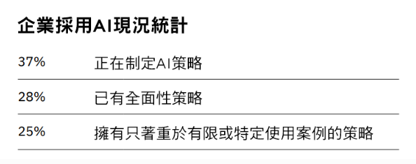
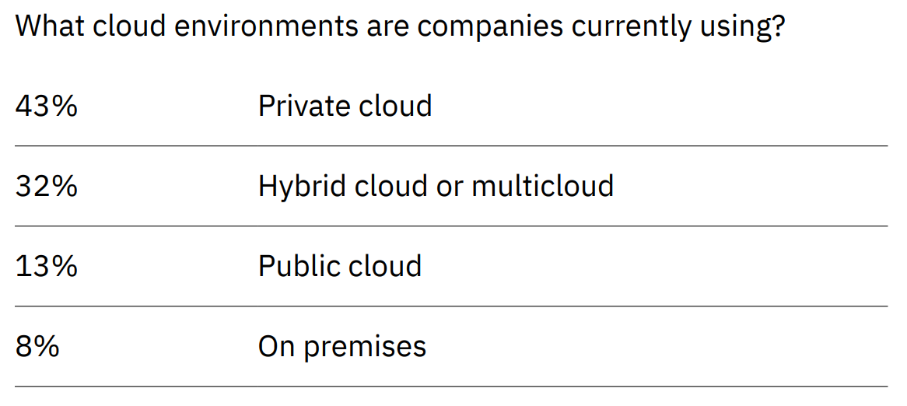
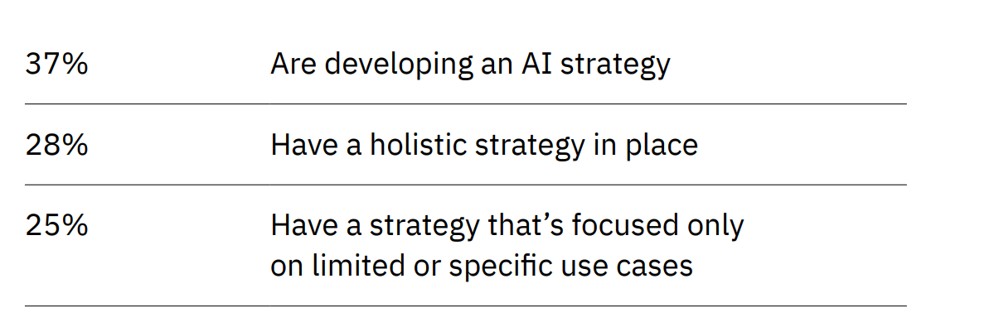
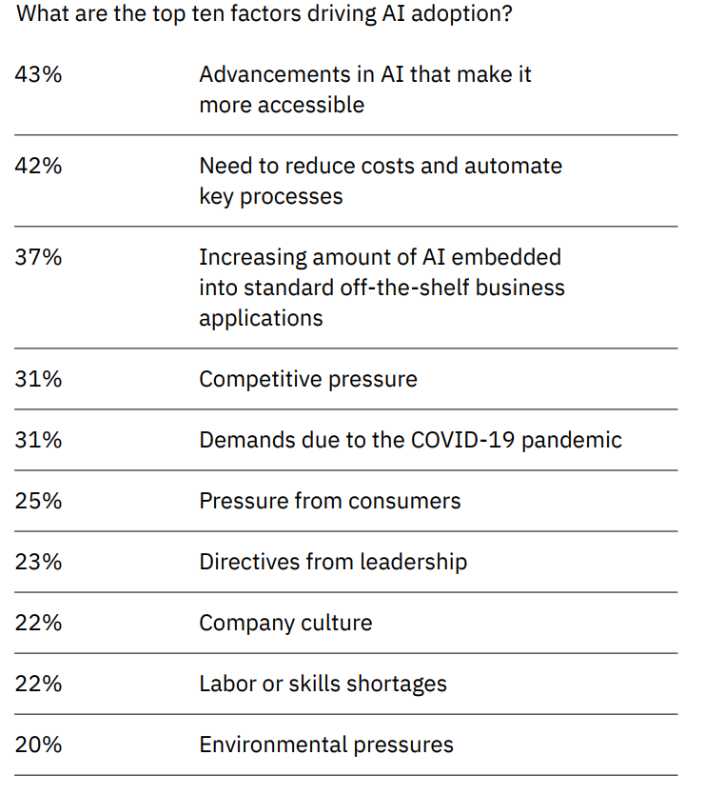
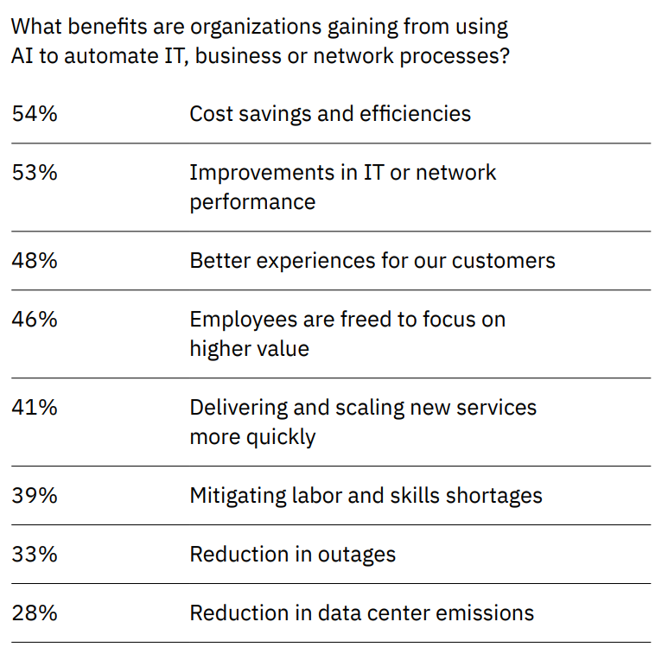
IBM Global AI Adoption Index 2022
Source ：https://reurl.cc/Ydj6Do、https://reurl.cc/rZ18kb、https://reurl.cc/10o4zY

Slide 25
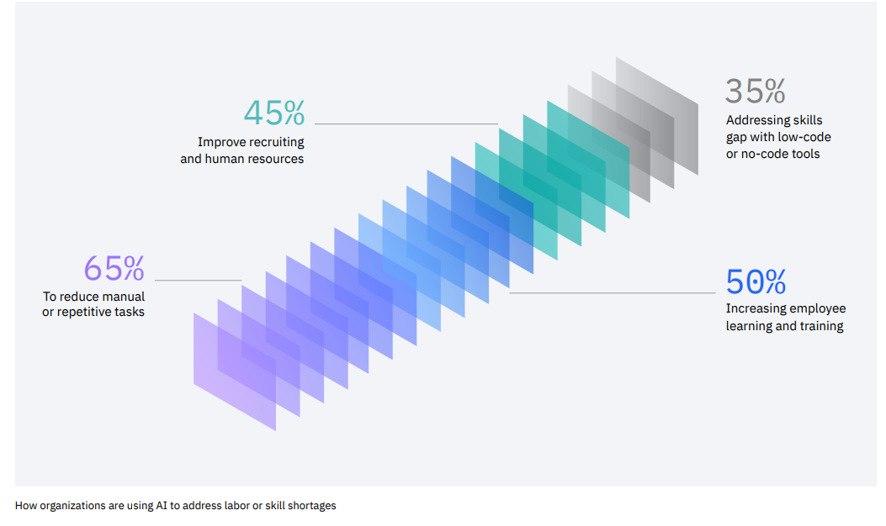
IBM Global AI Adoption Index 2022
Barriers to AI adoption remain persistent.
  The top five things that are hindering successful AI adoptions for businesses are：
    Limited AI skills, expertise or knowledge
    Price is too high
    Lack of tools or platforms to develop models
    Projects are too complex or difficult to integrate and scale
    Too much data complexity
Source ：https://reurl.cc/Ydj6Do、https://reurl.cc/rZ18kb、https://reurl.cc/10o4zY

Slide 26
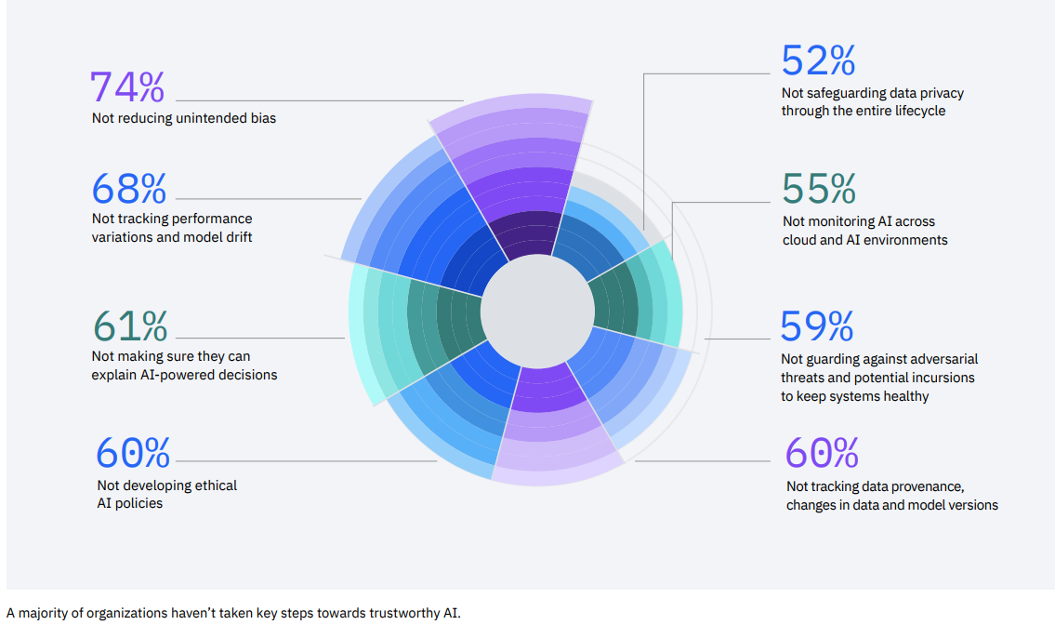
IBM Global AI Adoption Index 2022
As AI continues to have a greater impact on companies and society, it’s also becoming increasingly important to begin taking the issue of consumer trust more seriously. Companies that are deploying AI are increasingly likely to acknowledge the importance of trust with 84% of IT professionals now saying that being able to explain how their AI arrives at different decisions is important to their business. At the same time, a large majority of organizations that are using or are planning to use AI have not taken some critical steps to preserve consumer trust in the long term, for example, establishing protocols for identifying and eliminating bias.
Trustworthy, responsible AI practices and AI maturity go hand in hand. Additionally, the more likely a company is to have deployed AI, the more likely it is to value the importance of trustworthiness.
Source ：https://reurl.cc/Ydj6Do、https://reurl.cc/rZ18kb、https://reurl.cc/10o4zY

Slide 27
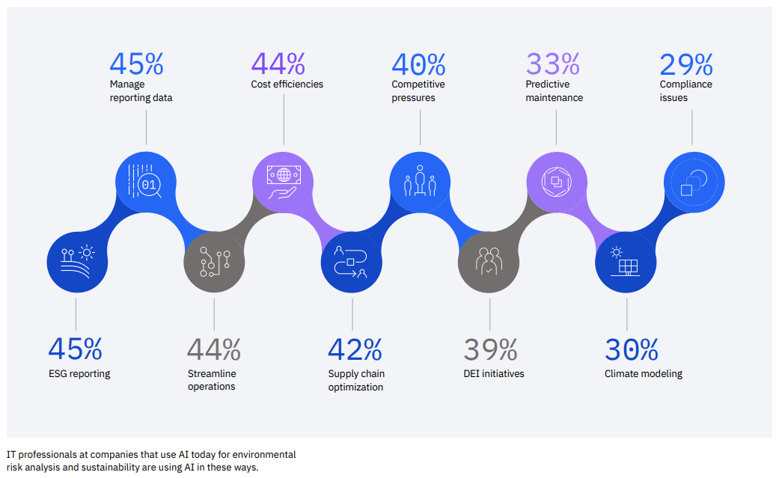
IBM Global AI Adoption Index 2022
While companies in every industry are increasing their focus on AI for sustainability, due to the diversity of the challenges they face, they are applying AI in a large variety of different ways. Companies across the board are looking to AI to reduce costs and consumption, manage reporting, and streamline their operations, but organizations in certain industries are using it for supply chain optimization (42%), predictive maintenance (33%) and climate modeling (30%).
Source ：https://reurl.cc/Ydj6Do、https://reurl.cc/rZ18kb、https://reurl.cc/10o4zY

Slide 28
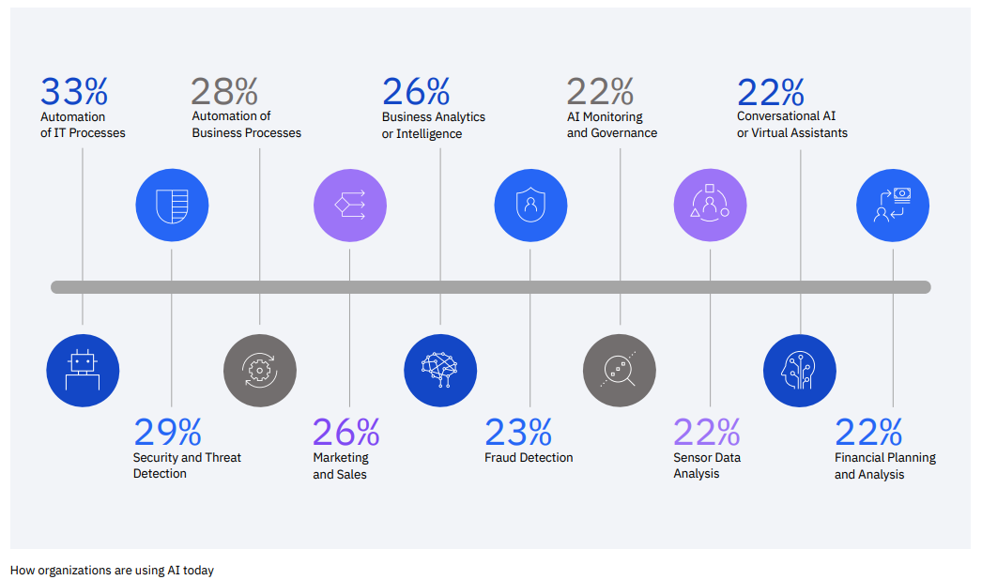
IBM Global AI Adoption Index 2022
Organizations are applying AI in a wide variety of use cases today, with the most advanced adoption happening in areas like IT operations, security and threat detection and business process automation. Today, a third of companies are already using AI to automate their IT processes—AIOps—which helps them preserve application performance while also making resource allocation more efficient. Businesses are also applying AI techniques like natural language processing (NLP) to fields like marketing, sales and customer care.
Source ：https://reurl.cc/Ydj6Do、https://reurl.cc/rZ18kb、https://reurl.cc/10o4zY

Slide 29
Industries of the Future

Slide 30
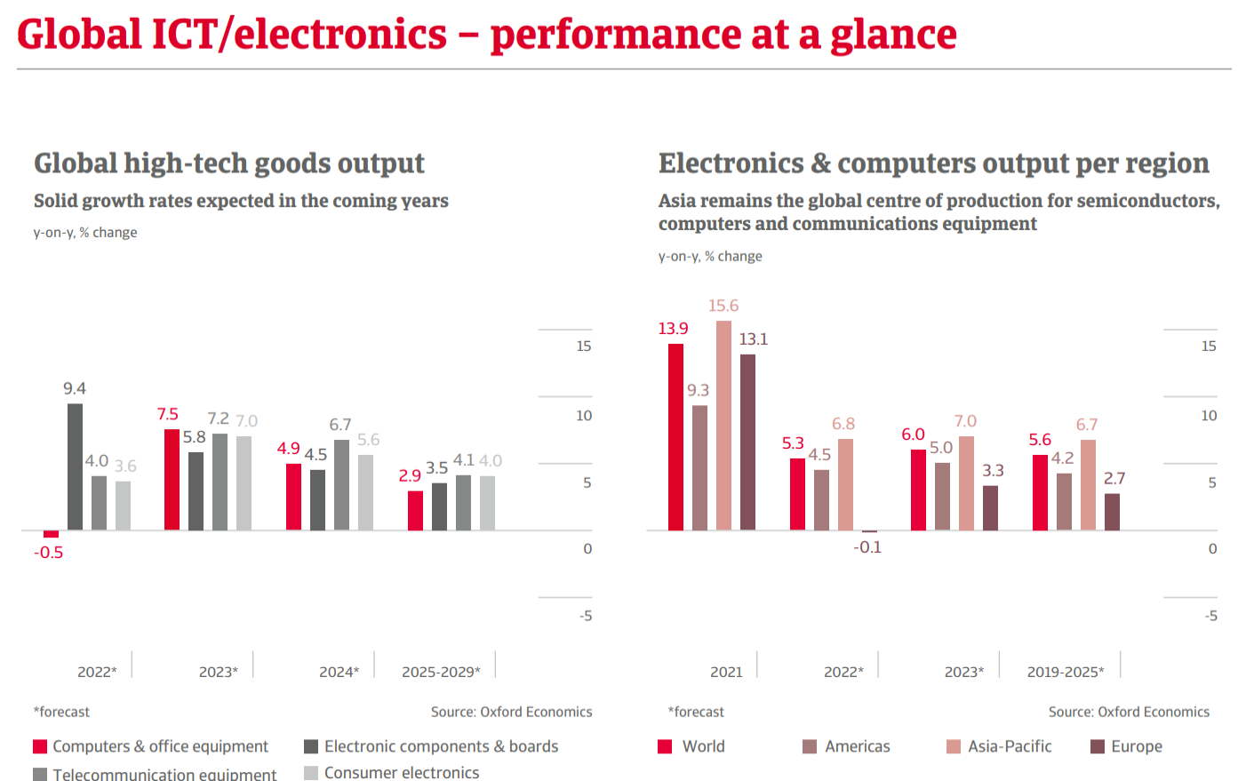
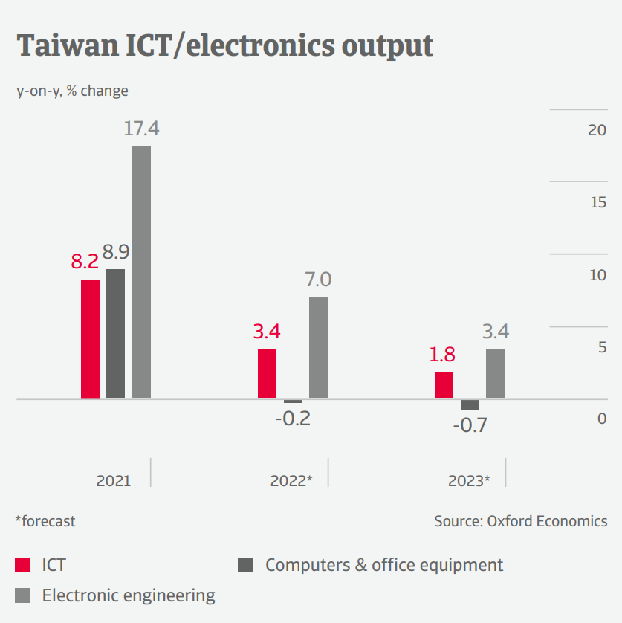
Source ：https://reurl.cc/zrWeap、https://reurl.cc/lZ5RKl、 https://reurl.cc/ymRKjM

Slide 31
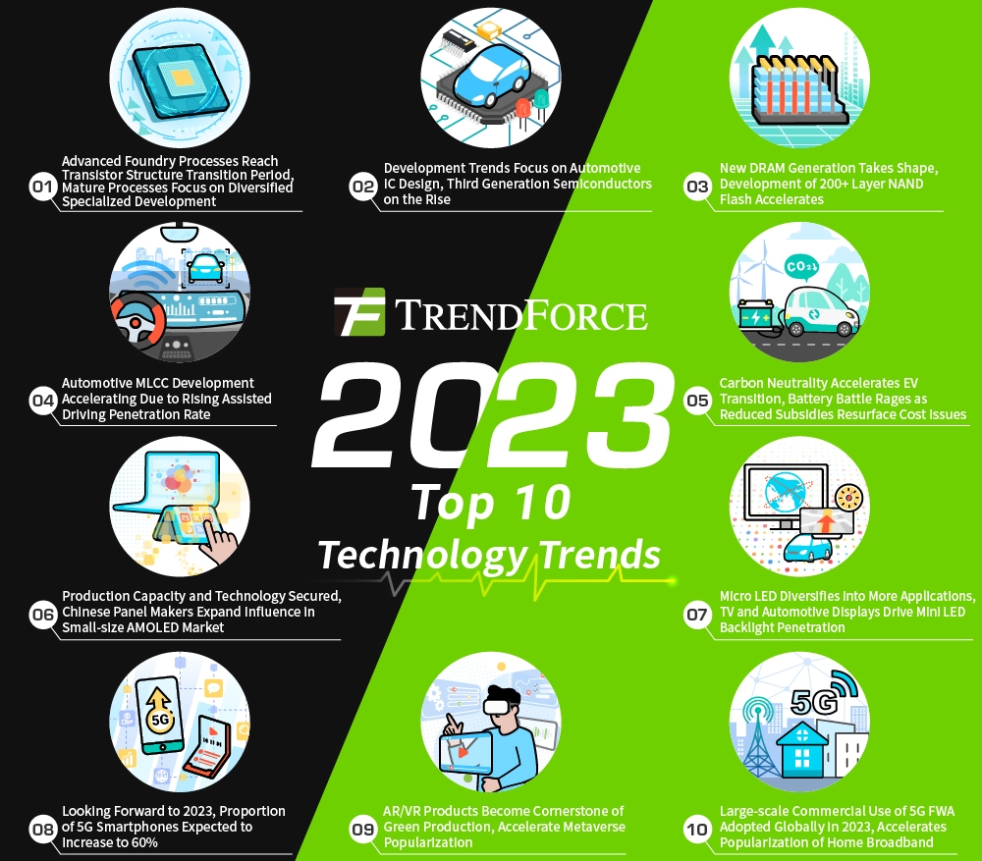
Source ：https://reurl.cc/LX7era

Slide 32
Global Device Market

Slide 33
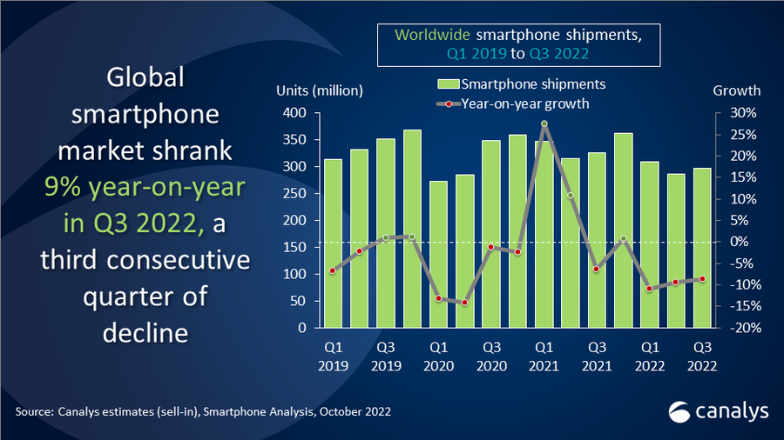
Global smartphone market fell 9% as consumers trim spending
In Q3 2022, the global smartphone market recorded its third consecutive decline this year, dropping 9% year-on-year, marking the worst Q3 since 2014.
Source ：https://reurl.cc/LX7Wg3、 https://reurl.cc/DXZjp6、 https://reurl.cc/MXkOoL

Slide 34
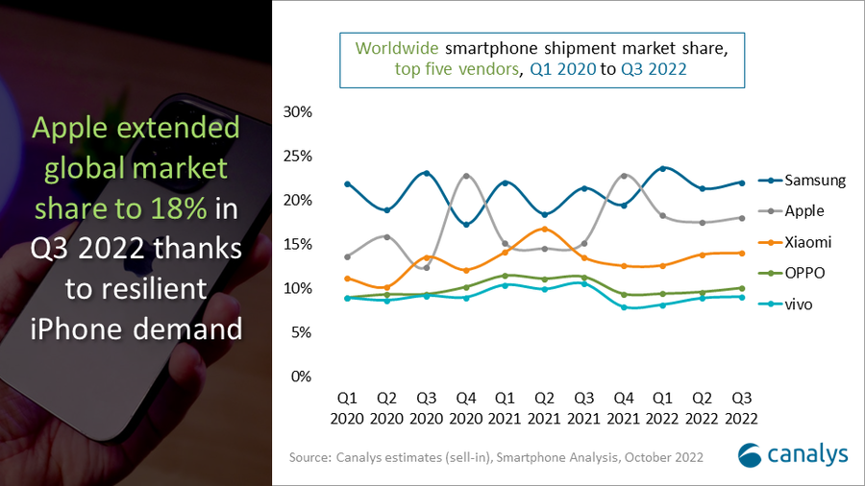
Global smartphone market fell 9% as consumers trim spending
Samsung retained its leading position with a 22% market share driven by heavy promotions to reduce channel inventory.
Apple was the only vendor in the top five to record positive growth, improving its market position further with an 18% share during the market downturn thanks to relatively resilient demand for iPhones.
While Xiaomi, OPPO and vivo continued to take a cautious approach to overseas expansion given domestic market uncertainty, retaining 14%, 10% and 9% global market shares, respectively.
Source ：https://reurl.cc/LX7Wg3、 https://reurl.cc/DXZjp6、 https://reurl.cc/MXkOoL

Slide 35
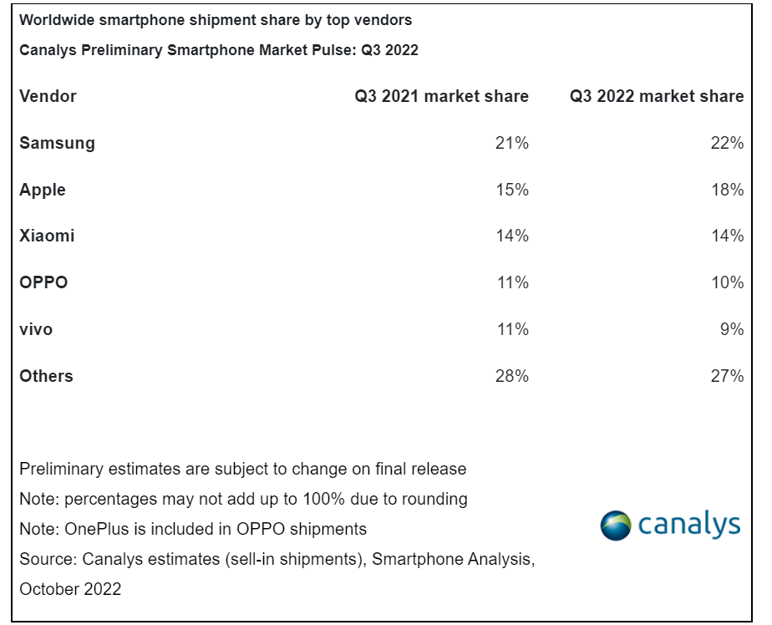
Source ：https://reurl.cc/LX7Wg3、 https://reurl.cc/DXZjp6、 https://reurl.cc/MXkOoL

Slide 36
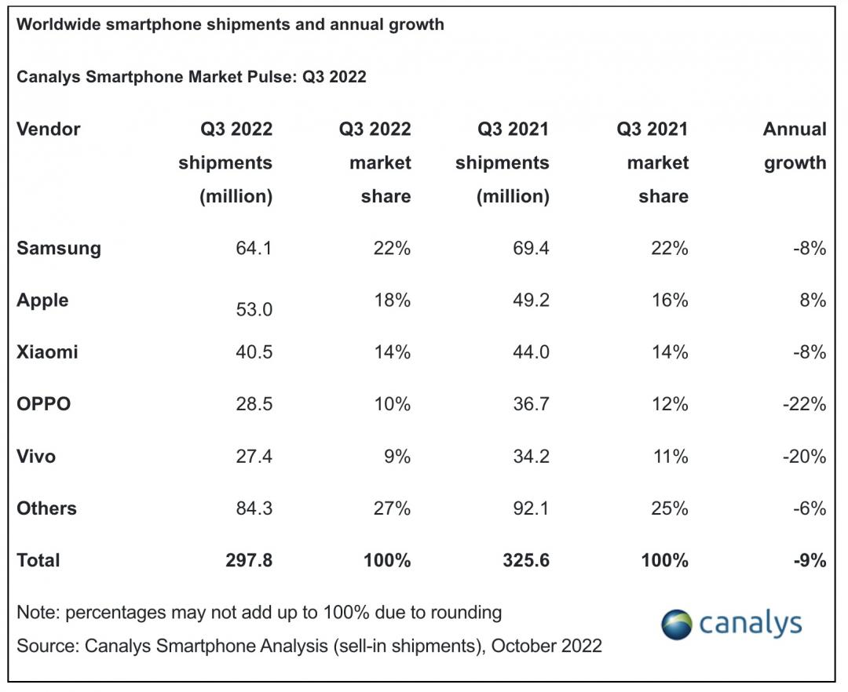
Worldwide smartphone shipments and annual growth
The latest Canalys smartphone analysis indicates weak demand in Q3 2022 caused worldwide smartphone shipments to decline by 9% year-on-year to 297.8 million units.
Samsung defended its first place in the market despite an 8% decline, shipping 64.1 million units.
Apple, the only leading vendor to increase year-on-year driven by robust demand, grew 8% and shipped 53.0 million units.
Following two quarters of double-digit declines, Xiaomi leveraged its global scale to find opportunities helping it strengthen its position to only decline 8%, shipping 40.5 million units.
OPPO and vivo took fourth and fifth place despite having over 20% declines, shipping 28.5 million and 27.4 million units respectively in Q3 2022.
Source ：https://reurl.cc/rZ19bx、https://reurl.cc/x1EabV

Slide 37
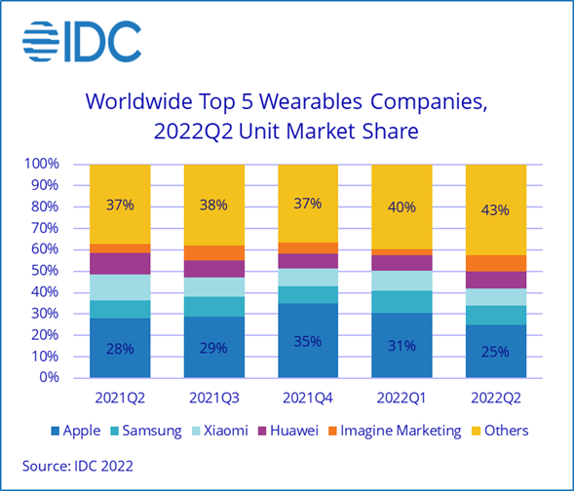
Wearables Growth Faces Challenges Through 2022
The wearables market faced another challenging period in the second quarter of 2022 (2Q22) as global shipments declined 6.9% year over year to 107.4 million units. Demand has slowed due to rising inflation, fears surrounding recession, increased spending on other non-tech categories, and the hyper growth that the wearables market has experienced in the last two years.
While the list of top 5 companies has not changed (Apple, Samsung, Xiaomi, Huawei, and Imagine Marketing), four of the top 5 experienced year-over-year declines during the second quarter. Smaller brands continue to target lower price points, putting downward pressure on average selling prices (ASPs) for the incumbents.
Source ：https://reurl.cc/GXbj6y、https://reurl.cc/aaeEXD

Slide 38
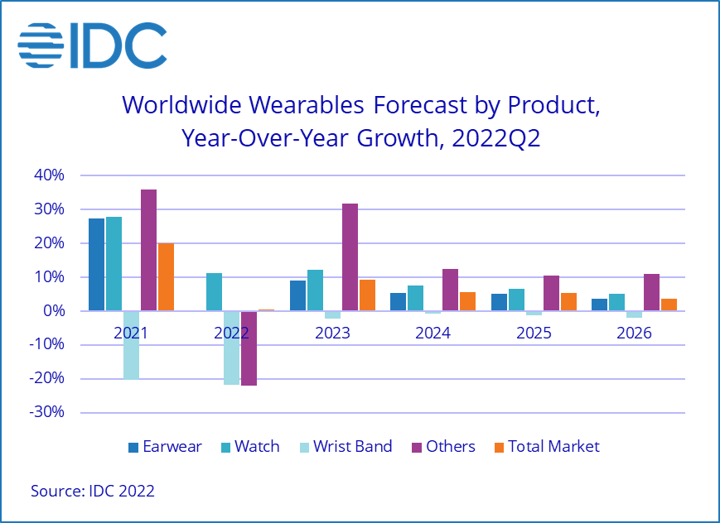
Wearables Growth Faces Challenges Through 2022
Rising prices and cooling demand have also led to a reduction in the overall outlook for wearables as IDC now forecasts shipments for the full year of 2022 to remain flat at 535.5 million units.
However, growth will return in 2023 as demand for watches and hearables is expected to return due to new buyers in emerging markets and replacements in mature markets.
Source ：https://reurl.cc/GXbj6y、https://reurl.cc/aaeEXD

Slide 39
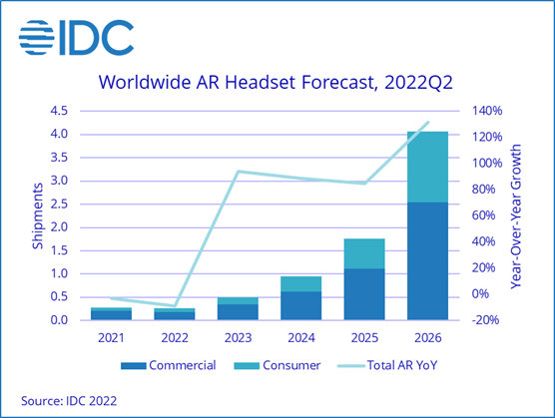
IDC Tracker Sees a Long Road Ahead for Augmented Reality Headsets
Worldwide shipments of Augmented Reality (AR) headsets are forecast to decline 8.7% year over year to nearly 260,000 units by the end of 2022. While a decline for such a nascent technology may seem abrupt, volumes have been slowing in recent quarters due to the shaky financials of some of the top companies, lack of new devices, and end-user demand being fulfilled by AR on smartphones in the short term.
In the first half of 2022, the top 5 AR headset makers were Microsoft, Rokid, Shadow Creator, Mad Gaze, and RealWear. However, the landscape is expected to shift dramatically as more companies enter the market and tech giants like Apple and Meta take more of an interest in AR. Looking ahead, despite the decline in 2022, IDC anticipates plenty of growth as the market is forecast to have a 5-year compound annual growth rate (CAGR) of 70.3%, topping out at 4.1 million units by the end of 2026.
Source ：https://reurl.cc/lZ5Qr9、https://reurl.cc/GXbjyy

Slide 40
Automotive Market

Slide 41
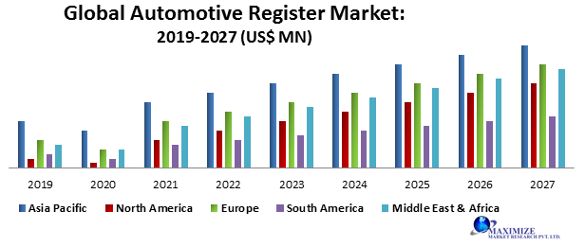
Global Automotive Register Market: Overview
Automobile industry is in the phase of new technology change and advance component adaptation. Manufacturers are installing new technologies in their vehicle to stand out in this competitive market landscape. Automation of vehicle is in demand, which is in favor of electronic system. Automobiles have various types of electronic devices like circuits, registers, IC and semiconductors for proper functioning of vehicle.
Registers are the main component in electronic equipment like processor and microcontroller to collect and store data. Owing to this, the Global Automotive Register Market has a strong future scope in autonomous as well as semi-autonomous vehicle.
Source： https://reurl.cc/lZMkGE

Slide 42
Electric Vehicle Market

Slide 43
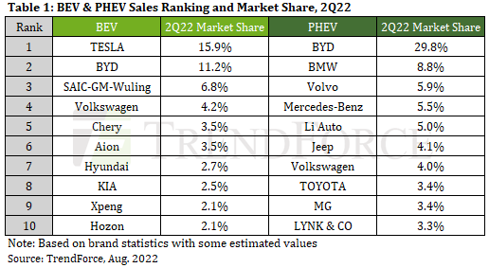
Global NEV Sales Reach 2.19 Million Units in 2Q22, TESLA Market Share Falls to 15.9%
Second-ranked BYD has provided a wealth of options in terms of car models and its global market share has risen from 9.3% in 1Q22 to 11.2%.
Chinese brands landed six of the top 10 ranks in 2Q22 due to their huge market advantages. Among the top 10 brands that do not rely on China as their most important market are Hyundai and KIA. Their primary markets for BEVs are South Korea, Europe, and North America.
In terms of PHEVs, BYD ranked 1st with sales of 173,000 units in 2Q22 and a market share of 29.8%. Contrarily, PHEVs in the European market have experienced negative annual growth for two consecutive quarters, inhibiting the growth of European brands.
PHEVs are hybrids that still emit carbon during in use, but are considered a good alternative for reducing carbon emissions in large and high-emission vehicles. Jeep, owned by Stellantis, has remained in the top 10 for four consecutive quarters after turning intently to PHEV electric vehicle technology.
Although many obstacles remain for the production processes of the automotive market, TrendForce expects conditions to gradually improve in 2H22. The growth trend of NEVs will remain unchanged and the overall sales forecast remains optimistic. The penetration rate of NEVs in the overall automotive market is expected to reach 13% in 2022.
The new car market remained under the shadow of supply chain shortages and the pandemic in 2Q22 but new energy vehicles (NEVs including battery electric vehicles, plug-in hybrid electric vehicles, and fuel cell vehicles) still outperformed gasoline vehicles and maintained positive growth, total sales of NEVs in 2Q22 reached 2.192 million units, 53.5% YoY.
Sales of battery electric vehicles (BEV) reached 1.608 million units, 64.9% YoY, and sales of plug-in hybrid electric vehicles (PHEV) were 580,000 units, 29% YoY.
In BEV brand rankings, although TESLA still tops the list, its market share has dropped sharply and the company’s single-quarter market share has dropped from 20.1% in 1Q22 to a new low of 15.9%. Due to the loss of production capacity coming from TESLA's Shanghai plant in April caused by China's lockdown measures and the fact that mass production has yet to begin at TESLA's Berlin plant and Texas plant, capacity allocation has become a headache for Tesla. At present, in addition to industriously increasing the mass production capacity of its new plants, Tesla is also upgraded its Shanghai plant in July to increase production capacity. However, TrendForce believes that it is becoming increasingly difficult for TESLA to recover greater market share as traditional automakers are narrowing the gap with TESLA including in accelerating vehicle launches, increasing the variety of models, strengthening factory manufacturing capabilities, and accelerating iterations of assisted driving systems.
Source ：https://reurl.cc/dexlzg、https://reurl.cc/qZ14DN、https://reurl.cc/QWYm4b

Slide 44
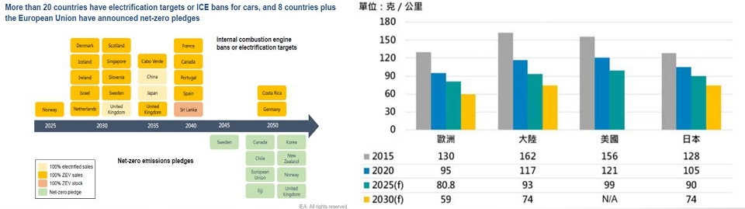
Policies to promote electric vehicle deployment
Source ：https://reurl.cc/pZx4de

Slide 45
Self-Driving Vehicles

Slide 46
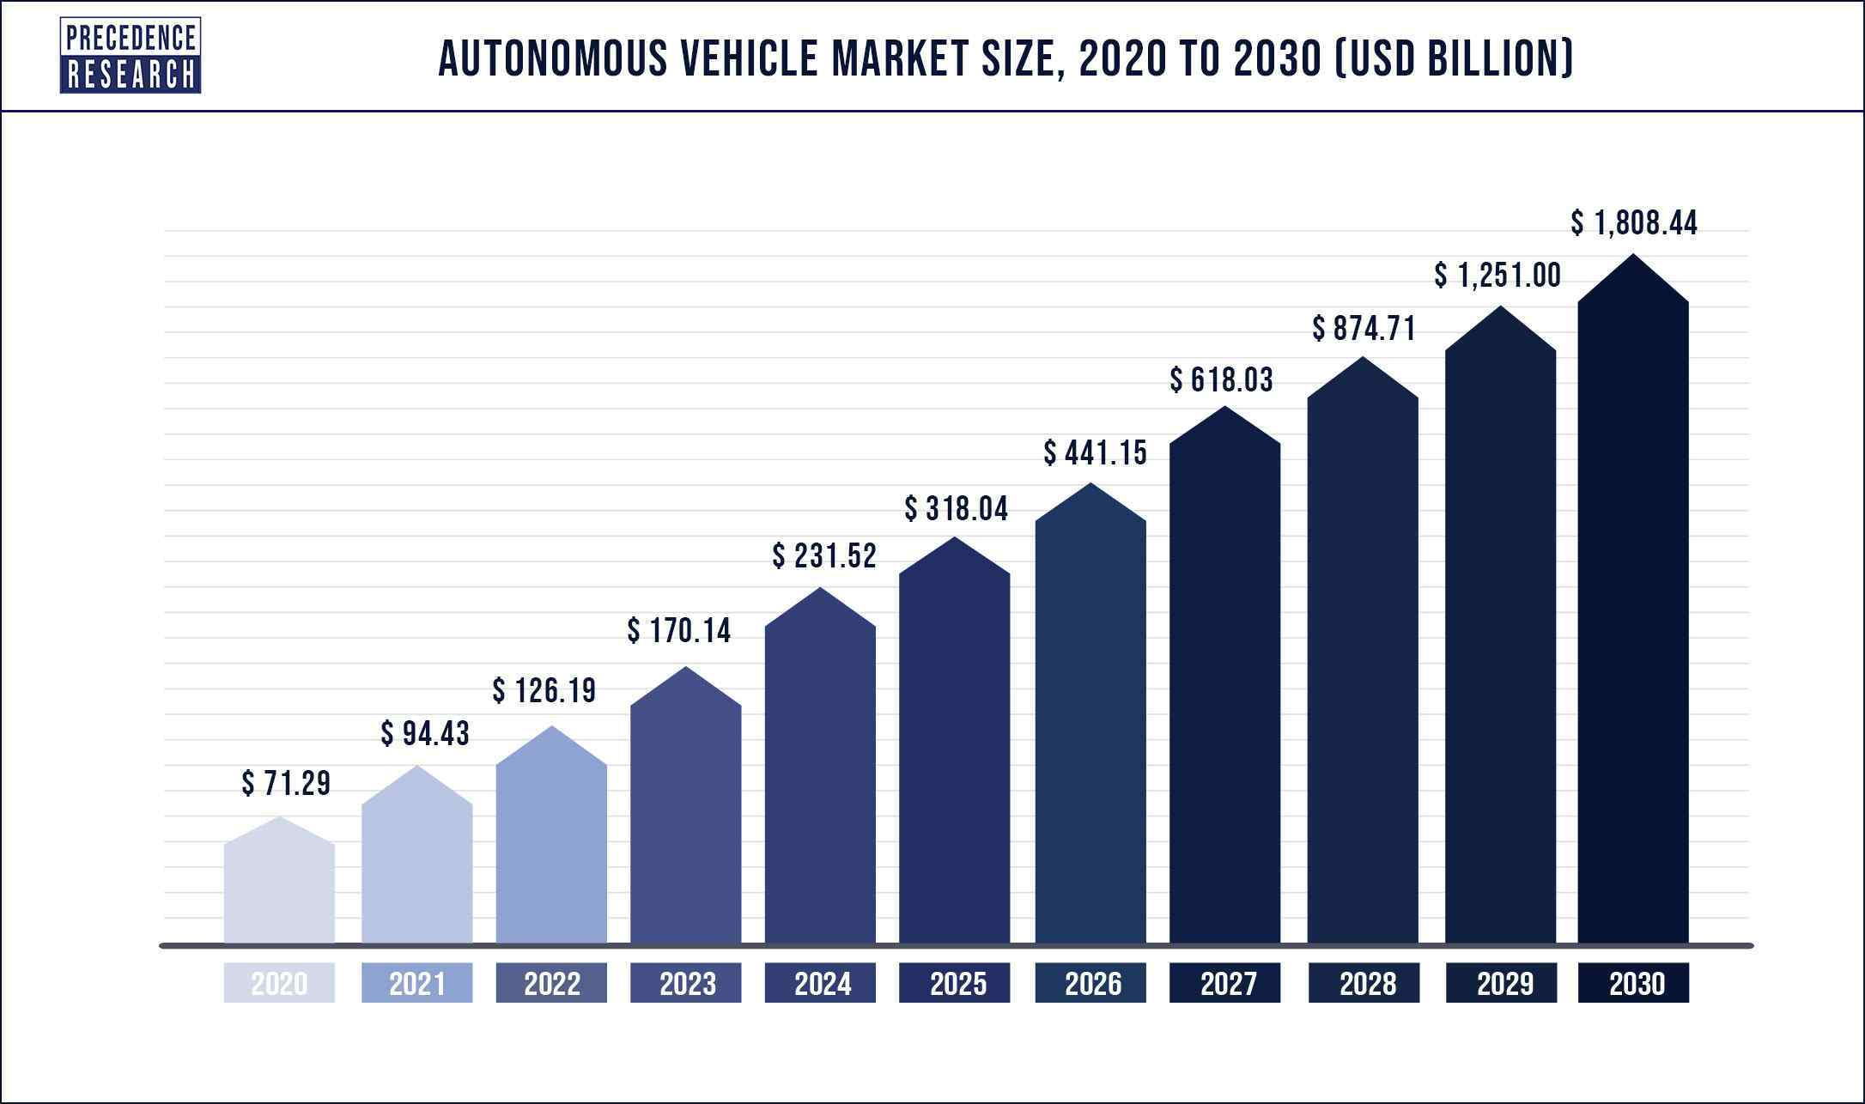
Autonomous Cars is projected to hit around USD 1808.44 billion by 2030
The global autonomous vehicle market was estimated USD 94.43 billion in 2021 and it is projected to hit around USD 1808.44 billion by 2030, poised to grow at a compound annual growth rate (CAGR) of 38.8% from 2021 to 2030.
Source ：https://reurl.cc/ROb70G

Slide 47
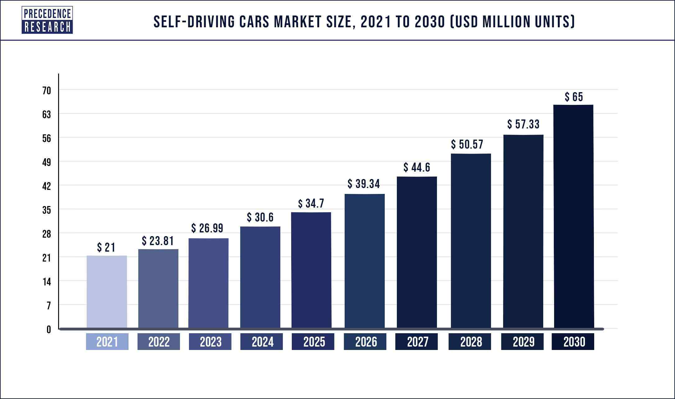
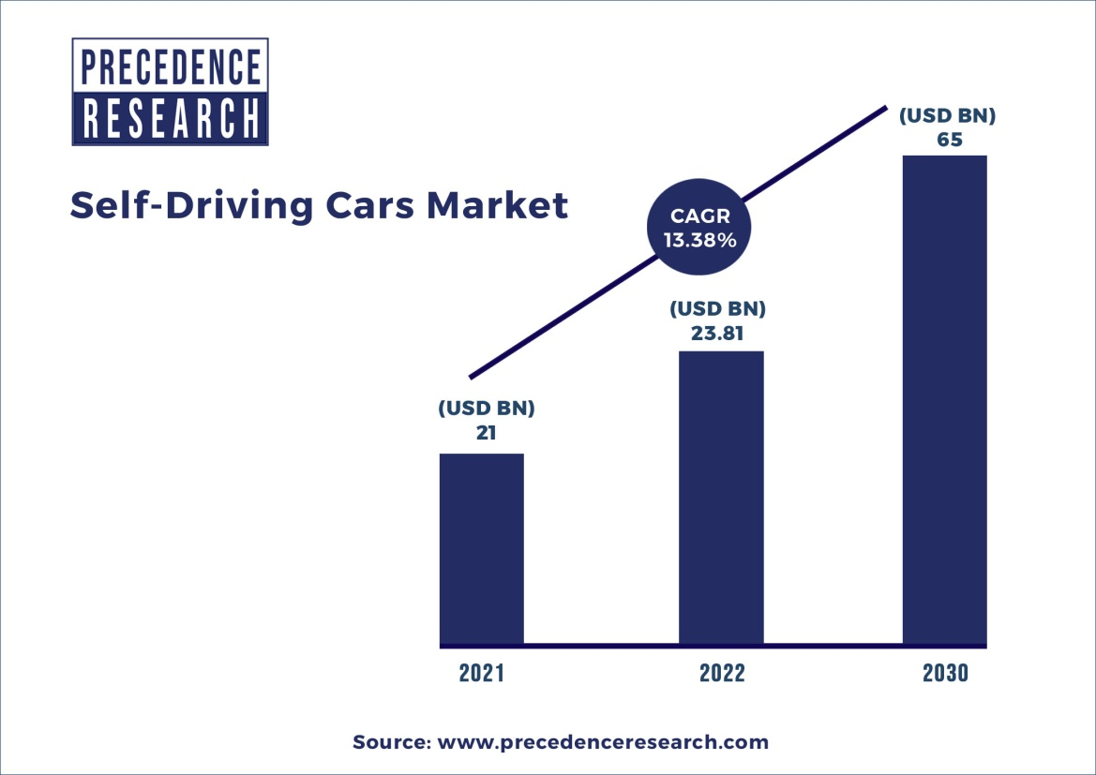
Self Driving Cars Market Size to Surpass USD 65 Million Units by 2030
The global self-driving cars market size was valued at USD 21 million units in 2021 and it is expected to reach at USD 65 million units by 2030, growing at a CAGR of 13.38% during the forecast period 2022 to 2030.
Source ：https://reurl.cc/7j3Ay9、https://reurl.cc/Ydj5OO

Slide 48
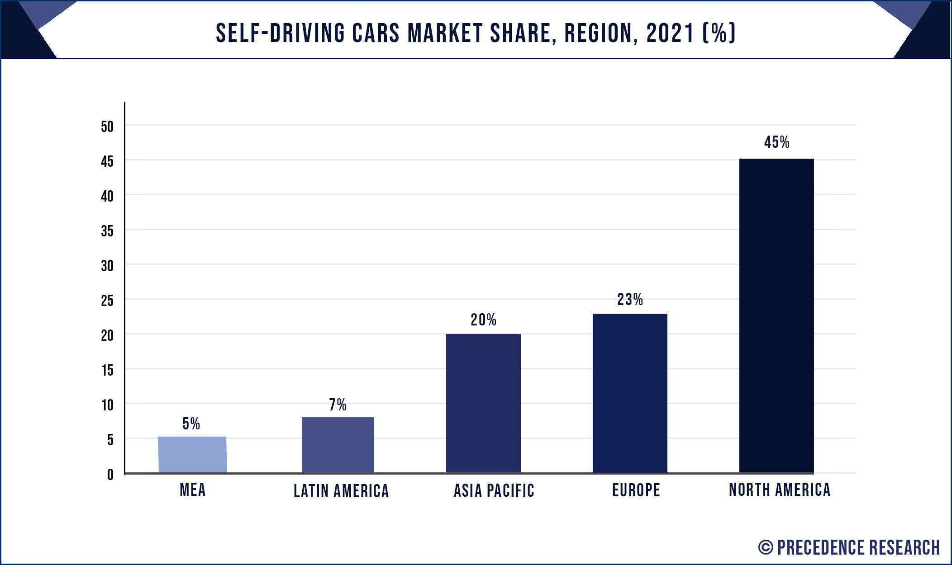
Self Driving Cars Market Share
The North America region had the largest market share till the recent years. The North American region accounted for a volume a share of about 45% till the year 2021. The growth of the self driving cars in this market is due to the amendments in the traffic regulations in the US.
Due to an increasing demand of the mobility as a service sector it is expected that the market shall grow well for the self driving cars in the future. The Department of Transport of UK had allowed the self driving vehicles on public roads without any additional permits or insurance.
Source ：https://reurl.cc/7j3Ay9

Slide 49
The current world climate on the ICT market

Slide 50

Global ICT Spending Forecast
Following years of growth, ICT spending will remain relatively flat in 2020 due to the COVID-19 pandemic. While traditional ICT spending is forecast to broadly track GDP growth over the next decade, the overall industry will be catapulted back to growth of more than 2x GDP as new technologies begin to account for a larger share of the market. The emergence of IoT is already contributing to significant market growth, and within 5-10 years new technologies such as robotics, artificial intelligence, and AR/VR will also expand to represent over 25% of ICT spending.
Source ： https://reurl.cc/DX8nWQ

Slide 51
Effects of Covid-19

Slide 52

Asia/Pacific* 2022 ICT Spending to Grow 3.8% Despite Headwinds
The ongoing supply chain constraints, geopolitical tensions, rising inflation, weakening of local currencies against the US dollar, and a resurgence of infections in pockets continue to impede economic recovery post-Covid-19.
Tightening monetary policy to manage rising inflation in the region is driving an increased risk of economic slowdown and poses solid headwinds for ICT spending growth in the next 18 months.
IDC forecasts Asia/Pacific* ICT spending to grow by over 3.8% in 2022 and is expected to reach $1.4 Trillion by 2026 with a compounded annual growth (CAGR) of 5.2% by the end of 2026.
Source ：https://reurl.cc/DXd6ER

Slide 53

Asia/Pacific* 2022 ICT Spending to Grow 3.8% Despite Headwinds
Consumer-driven sectors such as personal and consumer services, wholesale, construction, and retail have slowed down due to rising inflation or lockdowns to control infection spread, depending upon the geography in question. Industries with lesser dependence on consumer discretionary spending or which provide essential services are showing stable technology investment. These include banking, insurance, telecommunication, securities, investment, and professional services.
Source ：https://reurl.cc/DXd6ER、https://reurl.cc/aakvjQ

Slide 54

Source ：https://reurl.cc/062OeY

Slide 55
Effects of the Russo-Ukrainian War

Slide 56

Russia-Ukraine war: The Conflict will Generate a $5.5 Billion Loss for the ICT Market in 2022
The raging conflict in Eastern Europe has taken a hit on the global ICT market, and the effects of the Russia-Ukraine war will linger for years to come. According to IDC’s Worldwide Black Book: Live Edition, March 2022, the conflict will generate a loss of worldwide ICT spending worth $5.5 billion in 2022. According to IDC, ICT spending is expected to grow 4% globally, against the 5% expected in the previous update.
Source ： https://pse.is/4nnwjv

Slide 57
Current Developments

Slide 58



Ji-Haw Market Standing

Slide 59
Current status
The Russo-Ukrainian war, high inflation, and interest rate hikes, affects the economy. Pause in demand continues to affect the following year.
Sino-U.S. confrontation- high-tech intellectual property, from technology, equipment to talents to contain China's high-tech development. The confrontation is gradually intensifying.
Inventory replenishment problem in various channels
Impact of China’s lockdown on the Supply Chain
Chip shortages gradually eases
Snow ball effect towards "Net Zero Carbon Emissions”
Epidemic and vaccination rates vary widely from country to country

Slide 60
Way forward
Reinforce our strengths and mitigate our weaknesses
Improve the supply chain’s resilience, with shorter and more convenient supply chain
Follow the trend, grasp the trend, and follow up with the next mainstream
Constructing a green supply chain and introducing low carbon materials
Gradually develop an automated supply line
Seek more production bases in other regions
Shift to automotive and medical automation wires – a niche market
New business opportunities arising from block chain technology

Slide 61
Direction towards the future
Is the market increasing or decreasing - renewal and replacement
The brain’s transmission plexus that coordinates the movement of the hands and feet
Automation 4.0 market applications - the next industrial revolution in manufacturing
Due to the Sino-US confrontation, the relocation of production bases is inevitable
Trend of sustainable, green and net zero carbon emissions
ASEAN’s influence, the direction of Taiwan’s trend
Decentralization of the IC industry, geopolitical influence
Construction of a new supply chain follows the trend and races against time

Slide 62


