Slide 1
Financial Report 2022
ITE Tech. Inc.
2023/03/30

Slide 2
2022 Summary
Revenue $5.2B NTD
Gross Margin 52.3%
Net Income $1.22B NTD
EPS $7.56 NTD per Share
Dividend $6.0 NTD per Share

Slide 3
Statements of Comprehensive Income
(In thousands of NT dollars) | 2022 | 2021 | YoY
Net sales revenue | 5,212,206 | 7,184,586 | -27.45%
Cost of goods sold | 2,486,324 | 3,401,417 | -26.90%
Gross profit | 2,725,882 | 3,783,169 | -27.95%
Gross profit margin (%) | 52.30% | 52.66%
Operating expenses | 1,375,280 | 1,686,770 | -18.47%
Operating income | 1,350,602 | 2,096,399 | -35.58%
Operating profit margin (%) | 25.91% | 29.18%
Non-operating income(expenses) | 111,515 | 110,704
Income before income taxes | 1,462,117 | 2,207,103
Income tax expense | 244,425 | 401,185
Net income | 1,217,692 | 1,805,918 | -32.57%
Net income attributable to :Stockholders of the parent | 1,217,692 | 1,805,886
Net profit margin (%) | 23.36% | 25.14%
Basic earnings per share(In NT$) | 7.56 | 11.21

Slide 4
Statements of Comprehensive Income - Quarter
2022
(In thousands of NT dollars) | Q1 | Q2 | Q3 | Q4 | Q1~Q2 | Q1~Q3 | Q1~Q4
Net sales revenue | 1,610,799 | 1,372,482 | 1,083,334 | 1,145,591 | 2,983,281 | 4,066,615 | 5,212,206
Gross profit | 852,296 | 734,763 | 534,259 | 604,564 | 1,587,059 | 2,121,318 | 2,725,882
Gross profit margin (%) | 52.91% | 53.54% | 49.32% | 52.77% | 53.20% | 52.16% | 52.30%
Operating income | 458,243 | 378,968 | 248,567 | 264,824 | 837,211 | 1,085,778 | 1,350,602
Net income | 404,554 | 295,110 | 311,414 | 206,614 | 699,664 | 1,011,078 | 1,217,692
Net income attributable to :Stockholders of the parent | 404,554 | 295,110 | 311,414 | 206,614 | 699,664 | 1,011,078 | 1,217,692
Basic earnings per share(In NT$) | 2.51 | 1.83 | 1.94 | 1.28 | 4.34 | 6.28 | 7.56
2021
(In thousands of NT dollars) | Q1 | Q2 | Q3 | Q4 | Q1~Q2 | Q1~Q3 | Q1~Q4
Net sales revenue | 1,521,948 | 1,830,625 | 2,120,562 | 1,711,451 | 3,352,573 | 5,473,135 | 7,184,586
Gross profit | 773,309 | 991,802 | 1,139,296 | 878,762 | 1,765,111 | 2,904,407 | 3,783,169
Gross profit margin (%) | 50.81% | 54.18% | 53.73% | 51.35% | 52.65% | 53.07% | 52.66%
Operating income | 399,005 | 556,656 | 671,454 | 469,284 | 955,661 | 1,627,115 | 2,096,399
Net income | 374,767 | 464,973 | 556,794 | 409,384 | 839,740 | 1,396,534 | 1,805,918
Net income attributable to :Stockholders of the parent | 374,729 | 464,967 | 556,806 | 409,384 | 839,696 | 1,396,502 | 1,805,886
Basic earnings per share(In NT$) | 2.33 | 2.88 | 3.46 | 2.54 | 5.21 | 8.67 | 11.21

Slide 5
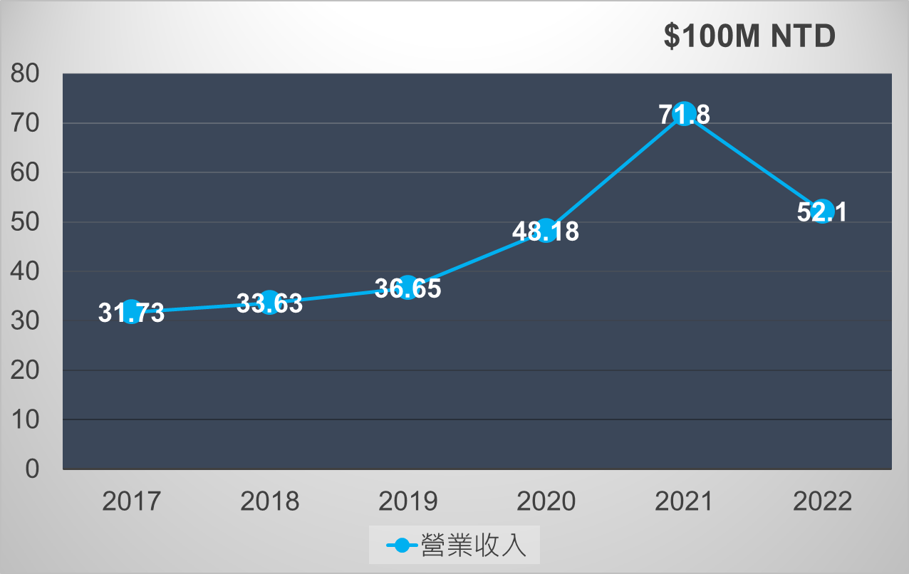
Revenue
Revenue

Slide 6
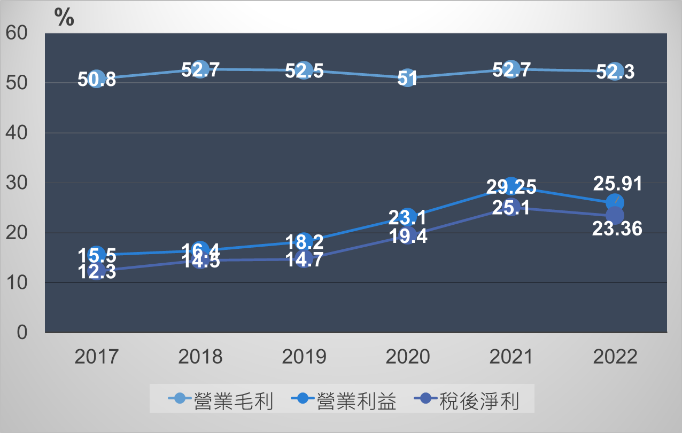
Key Indices
Gross Margin
Operating Margin
Net Margin

Slide 7
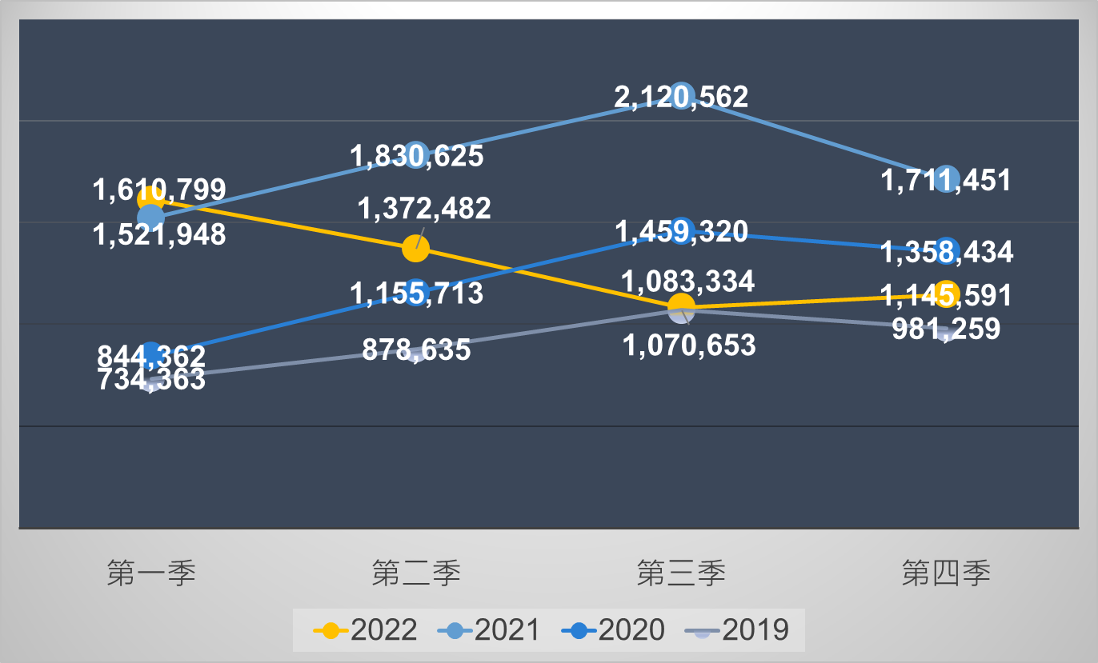
Revenue by Quarter
Q1
Q2
Q3
Q4

