Slide 1
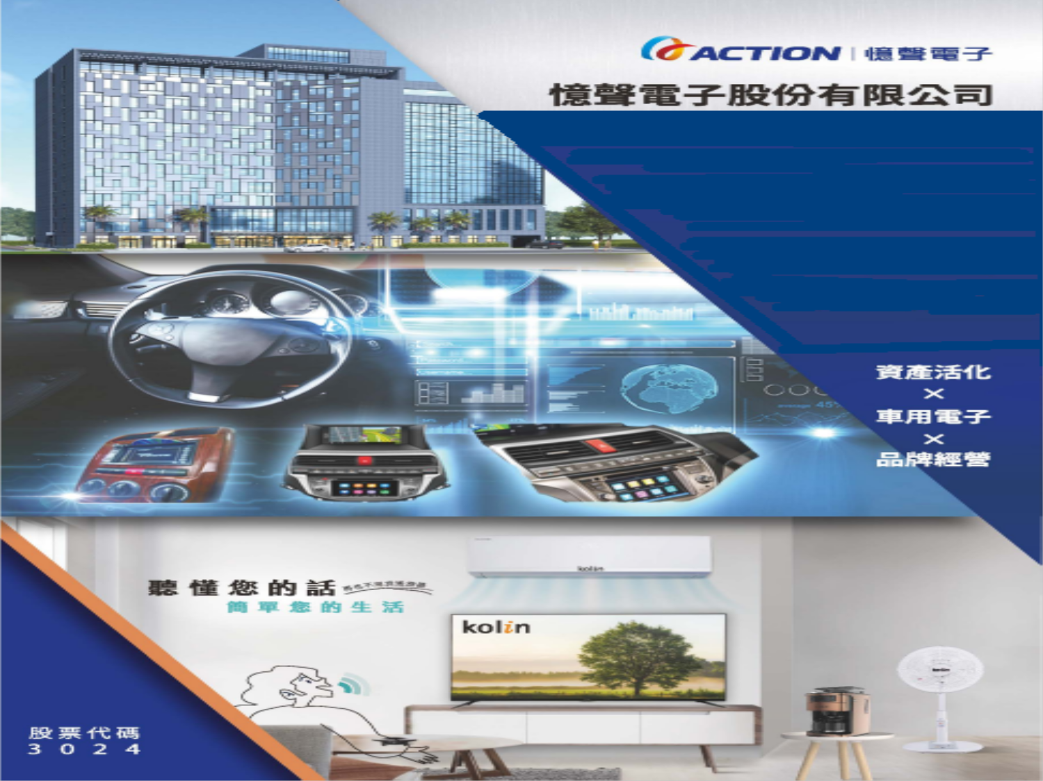
Investor Conference 2021
Speaker：Chairman

Slide 2
Disclaimer
The information may contain statements about future prospects. This type of expression is based on expectations of the current situation, and is subjected to uncertainties and known or unknown risks, so actual results may be significantly different from the expressed content.
Except as required by law, the company is not obliged to update the statements of future prospects in respond to the generation of new information or future events.

Slide 3
Agenda
2.Finance Overview
3.Operation Overview
4.Future Prospects
1.Company Profile
5.Q&A

Slide 4
1.Company Profile
Date of Incorporation | July 21,1976
IPO | August, 2002( TWSE 3024)
Capital | 2.77 Billion NT
Chairman | Iris Peng
Main Business | Sales and after service of home appliances R&D、manufacturing and sales of automotive electronic products. Assets development and rental service
Company Website | www.action.com.tw

Slide 5
2.Finance Overview
Consolidated Income Statement Unit: NT$ thousand
Item | 2021/H1 | 2020/H1 | Difference | YOY(%)
Operating Revenue | 743,096 | 632,561 | 110,535 | 17
Gross Profit from Operations | 166,024 | 153,964 | 12,060 | 8
Operating Expenses | 180,813 | 143,532 | 37,281 | 26
Operating Income | (14,789) | 10,432 | (25,221) | (242)
Profit before Tax(PBT) | 6,906 | 34,388 | 171,278 | 498
Net Profit | 186,885 | 31,319 | 155,566 | 497
EPS(NTD) | 0.68 | 0.12 | 0.56 | 496
Note : The difference between PBT and net profit is mainly due to the equity disposal of Action Technology (JIAN) Co.,Ltd

Slide 6
Revenue for main business
Main Business | 2021H1 |  | 2020H1
 | Amount(In NT thousand) | % | Amount(In NT thousand) | %
Brand Management | 405,150 | 54.5% | 384,930 | 60.9%
Automotive Electronics | 272,162 | 36.6% | 183,184 | 29.0%
Asset Development | 65,784 | 8.9% | 64,447 | 10.1%
Total | 743,096 | 100.0% | 632,561 | 100.0%

Slide 7
Consolidated Balance Sheet
Unit: NT$ thousand
Return On Equity
Item | 2021.06.30 | 2020.12.31 | 2020.06.30
Current assets | 1,911,364 | 1,403,482 | 1,360,843
Non-current assets | 2,256,136 | 2,306,222 | 2,411,772
Investments in equity method | 539,740 | 540,091 | 525,206
Property, plant and equipment | 1,172,874 | 1,354,868 | 1,295,782
Other non-current assets | 543,522 | 411,263 | 590,784
Total Assets | 4,167,500 | 3,709,704 | 3,772,615
Current Liabilities | 1,059,709 | 892,079 | 955,267
Non-current Liabilities | 353,781 | 203,401 | 235,596
Total Liabilities
Shareholders' Equity | 2,754,010 | 2,614,224 | 2,581,752
Total Liabilities & Shareholders‘ Equity | 4,167,500 | 3,709,704 | 3,772,615
ROE(%) | 6.8 | 1.7 | 1.1

Slide 8

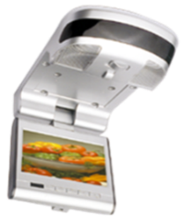
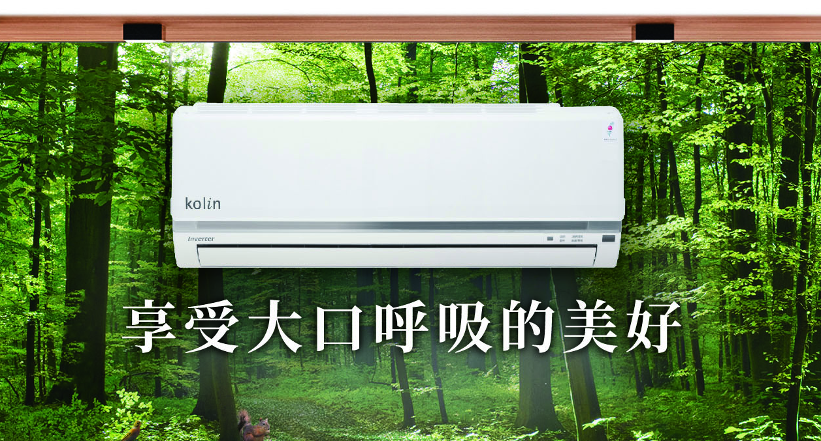
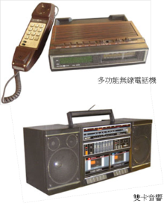
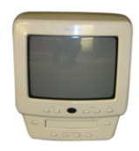
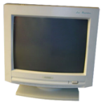
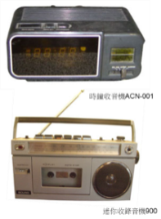
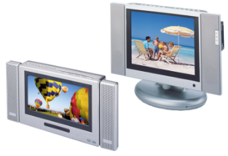
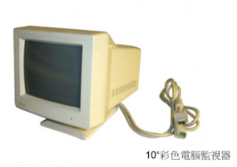
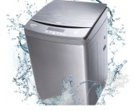
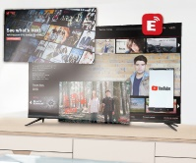
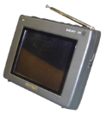
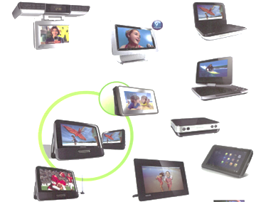


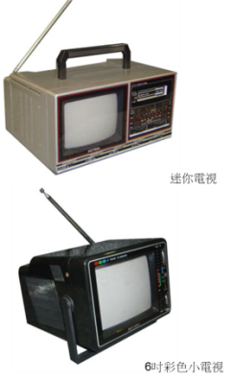
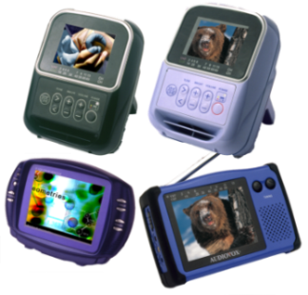
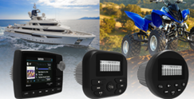

3.Operation Overview: History of Product Development for the Past 40 Years
Kolin smart consumer electronics
Automobile
electronics
Founded on:
TV products
1988-1998
1999-2012
2012~
1976-1987
8
Notes:
從這些產品檢視我們走過的發展軌跡
最早期的創業產品
奠定成功的外銷業務基礎, 受到國外客戶的肯定
1976年
開發成功時鐘收音機，首批生產壹萬台出口至澳洲。
1979年
開發迷你收錄音機，大賣100萬台。
1985年
開發雙卡音響。
世界最小體積之三合一(收音、錄音、電視)
2. 產品開始結合影像, 生產各式的多功能CRT電視機, 以及電腦監視器
3. 第三期開始為液晶各式產品的開發: LCD TV 及數位相框及車用電子, 在當時憶聲可說是移動式影音產品的領導廠商, 客戶皆為世界一級大客戶
4. 經營歌林之後 也收集了部分主要產品 歌林產品不但有大家電 近年來也開發許小家電, 設計的理念不但是針對生活的便利性, 也兼顧時尚及個性化的特性, 受到時下年輕人的喜愛喔, 除了電器行 賣場及網路也都可以買到歌林的產品
8

Slide 9
Action Group: Main Business
Action
Group
Automotive Electronics
Asset Development
Brand management
  Automotive Electronics
  Action Asia (Shenzhen) Co., Ltd.
  Action Industries (Malaysia) SDN BHD
  Action Intelligent(Shenzhen) Co., Ltd.
  Brand Management &Service
  Brand management for Kolin in Taiwan
  Realise Tech-Service
  Asset Development
  Shanghai Action Tech. Co. Ltd.
  Far Year Construction Co.,Ltd
9
Notes:
經過多年的產業淬鍊, 加上大環境的改變 以及市場經濟的洗牌, 整個集團經過重組重整,
經營範圍主要可分為三個體系,
電子製造業體系
流通服務業體系
倉儲物流體系
9

Slide 10
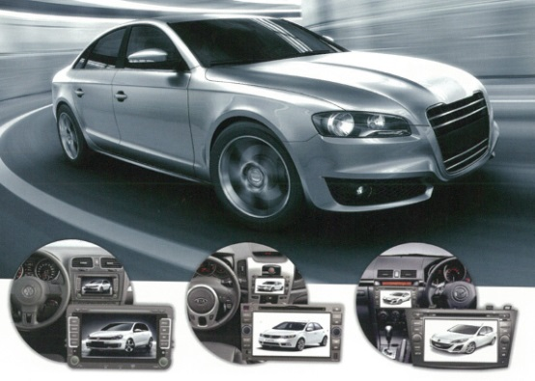
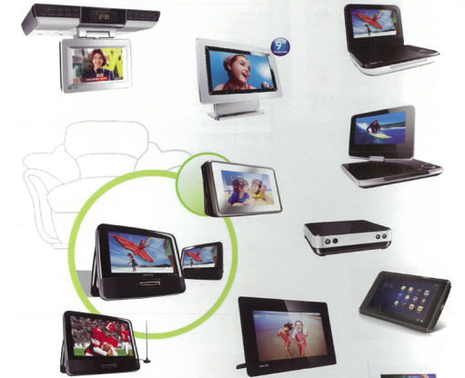
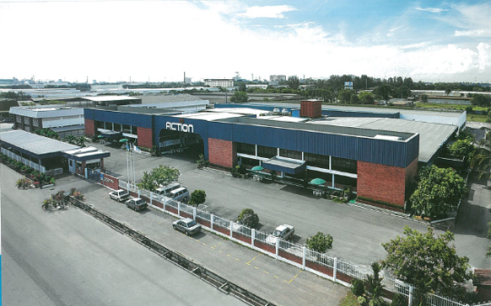
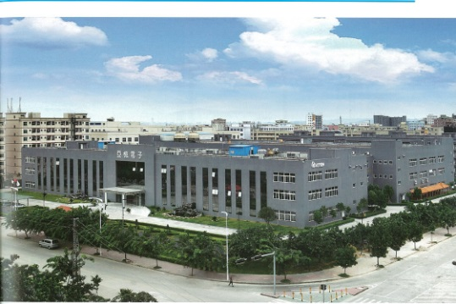
  Automotive Electronics Business
Action Industries (Malaysia) SDN BHD
Action Asia (Shenzhen) Co., Ltd.
Founded in 1987,located in Penang, Malaysia
Founded in 2005, located in industrial park in China Shenzheng
Notes:
首先是製造業體系
集團於1987開始投資海外, 在馬來西亞建廠,
2. 主要生產車用的影音產品, 用於休旅車, 大型巴士等等

Slide 11
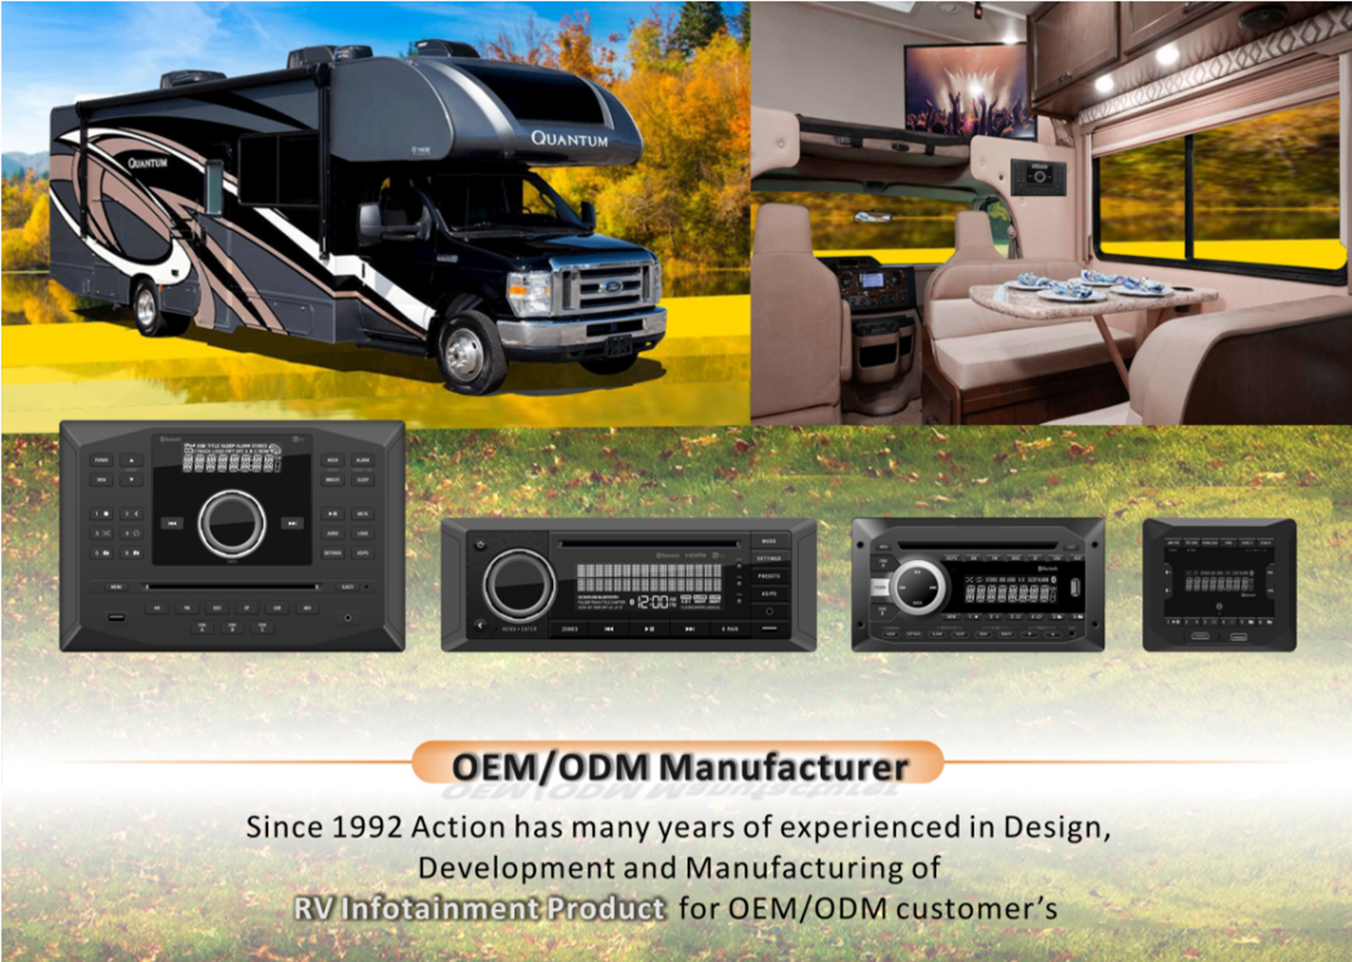
Action Group - Automotive Electronics Products

Slide 12
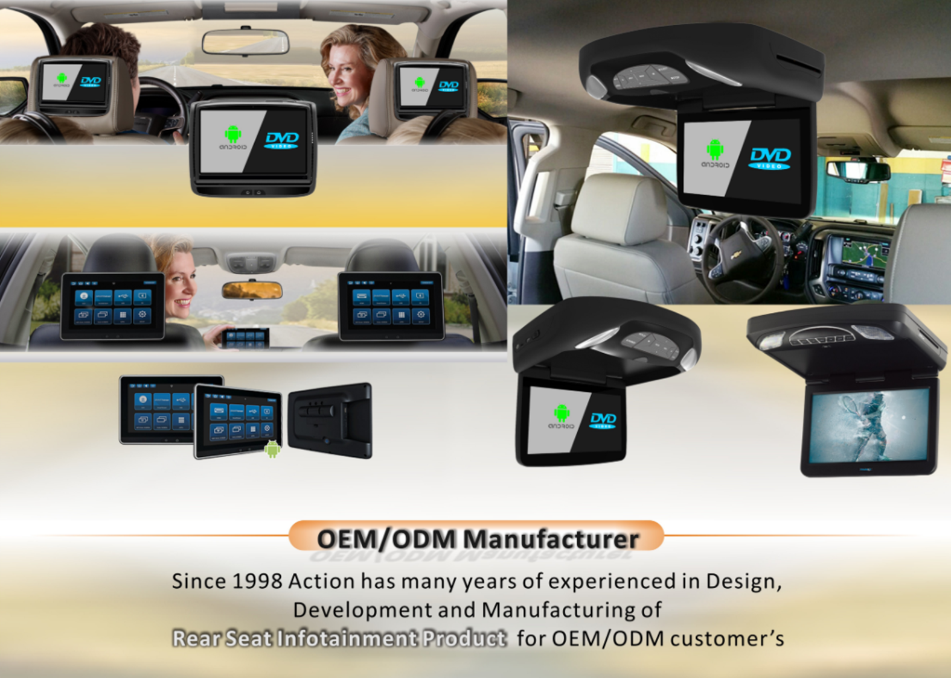
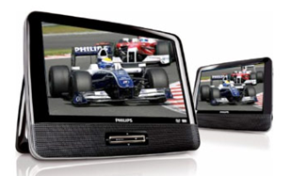
Action Group - Automotive Electronics Products
雙屏DVD
•9” 16:9 Digital LCD panel *2
•9V DC IN Battery 4 hrs
•Support -CD，VCD，DVD
•Support JPEG , Progressive JPEG MP4
•2.0 USB port front
•AV OUT AUX

Slide 13
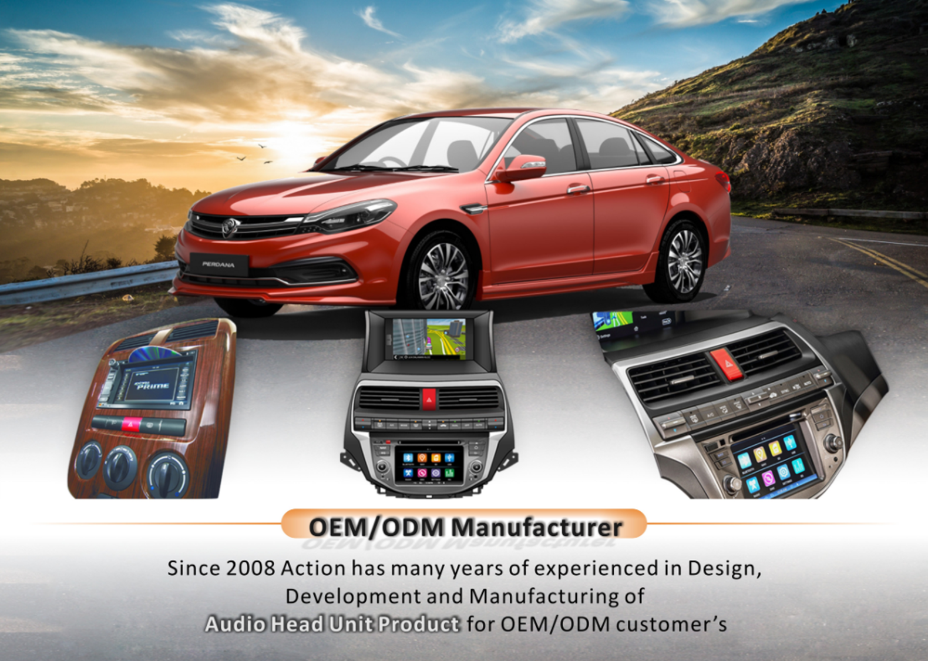

Action Group-Automotive Electronic Products

Slide 14
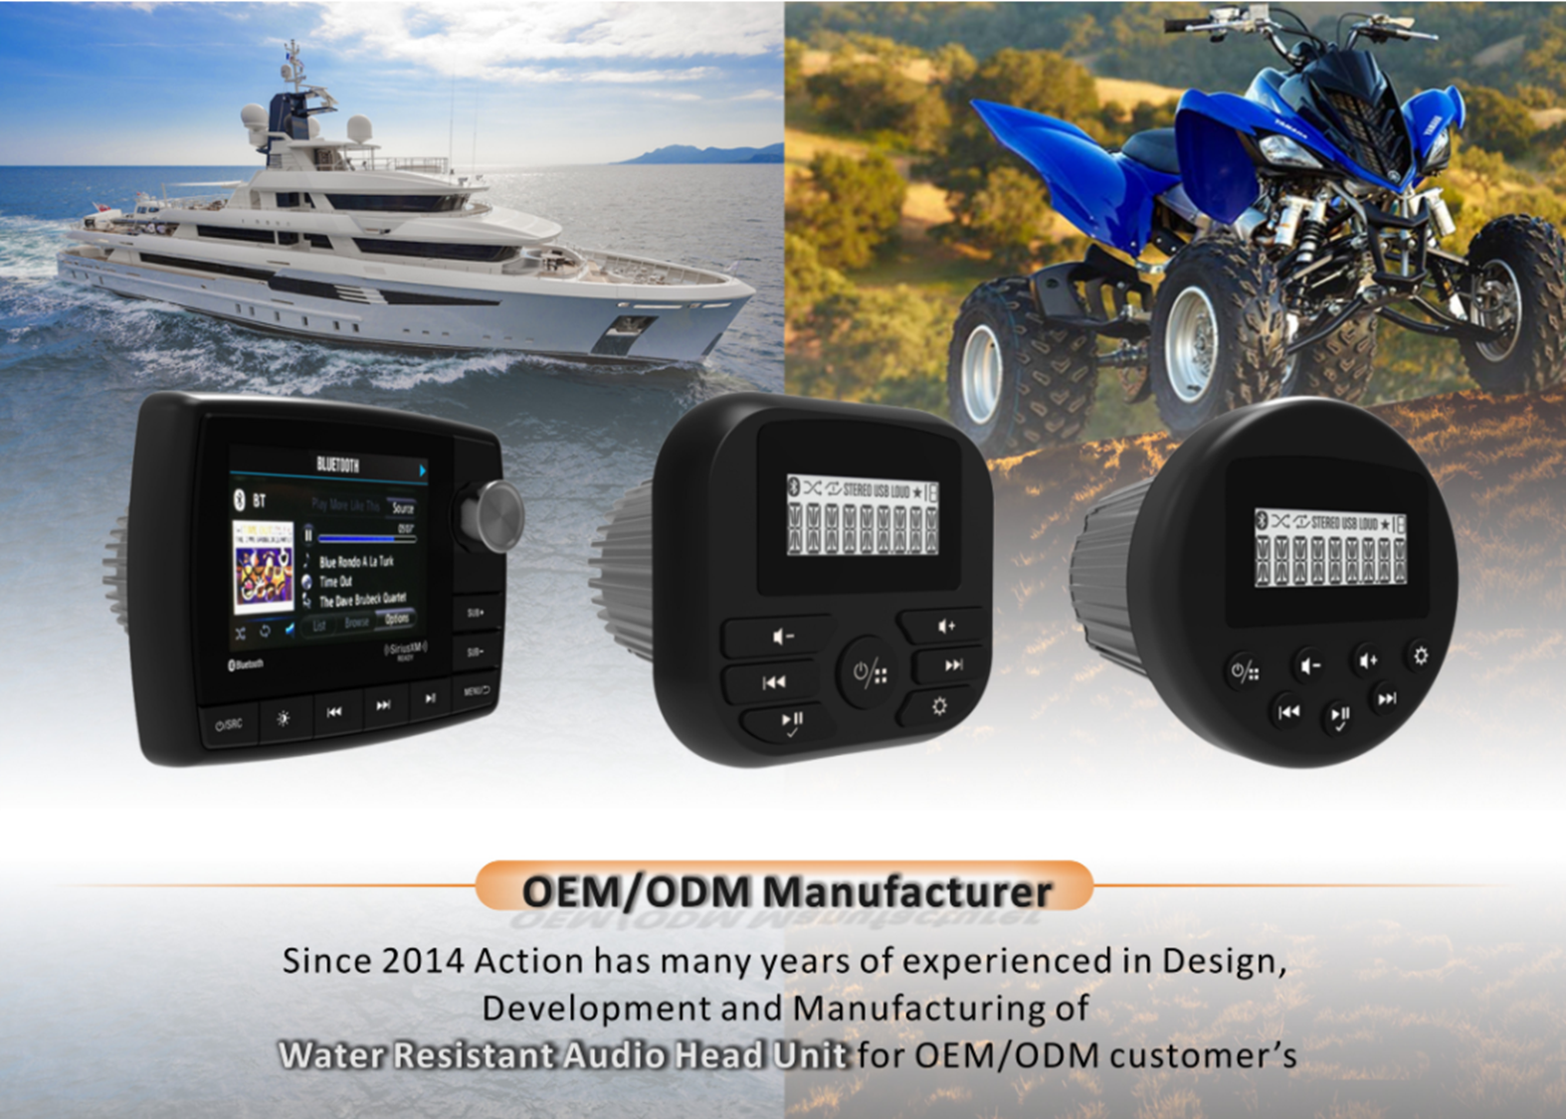
Action Group - Automotive Electronics Products

Slide 15
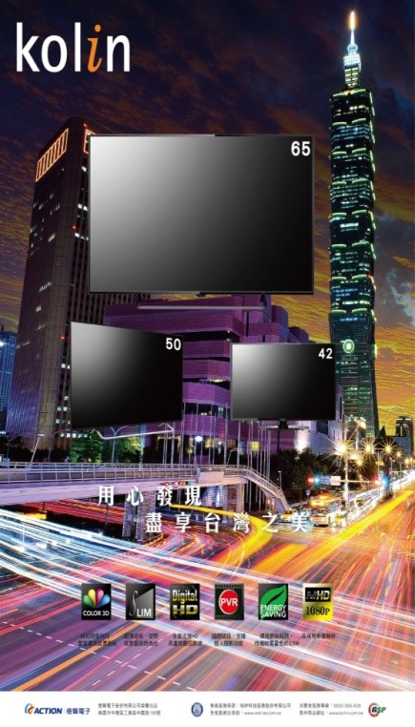
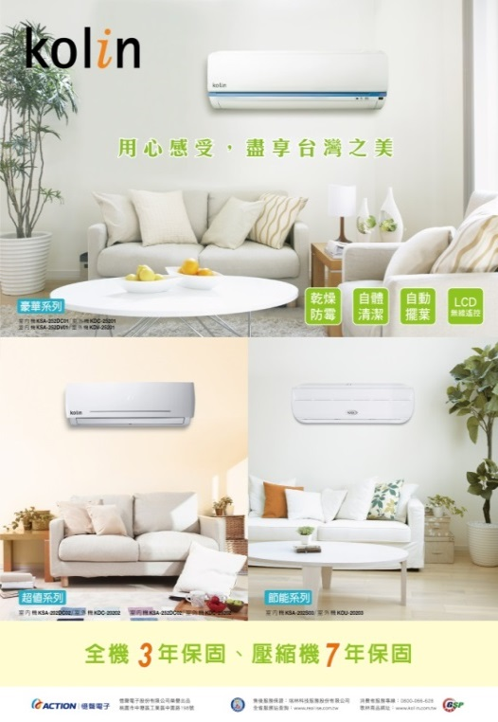
Brand Management – Kolin
Kolin brand has been operating for more than 50 years, and is the most well-known home appliance brand in Taiwan
Action Group operates the Kolin brand and plans a full range of home appliances through distributors + chain stores& Hypermarket+ online shopping platform to increase group revenue.
The ranking of many small home appliances are No.1 in Taiwan
Looking forward to the future, we commit to the integration of Action, Kolin, Realise and consumers, and strengthen the operation
Notes:
1. 經過兩年在通路業的實戰經驗, 為了擴展服務業的範圍,
2. 在2012年更進一步的標下歌林這個具有60年歷史的台灣老品牌, 進入家電產業.
3. 我們更希望結合旗下的通路, 產生互補作用, 來拉大服務業的事業經營版圖

Slide 16
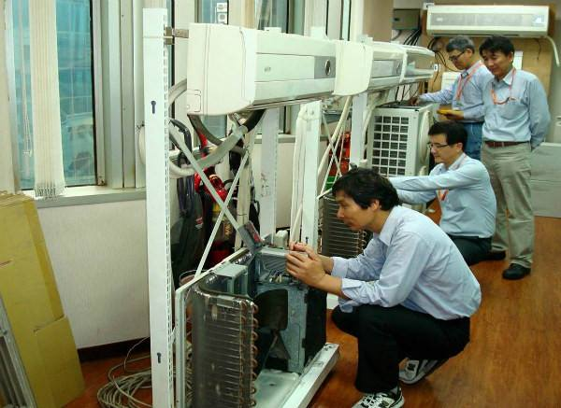

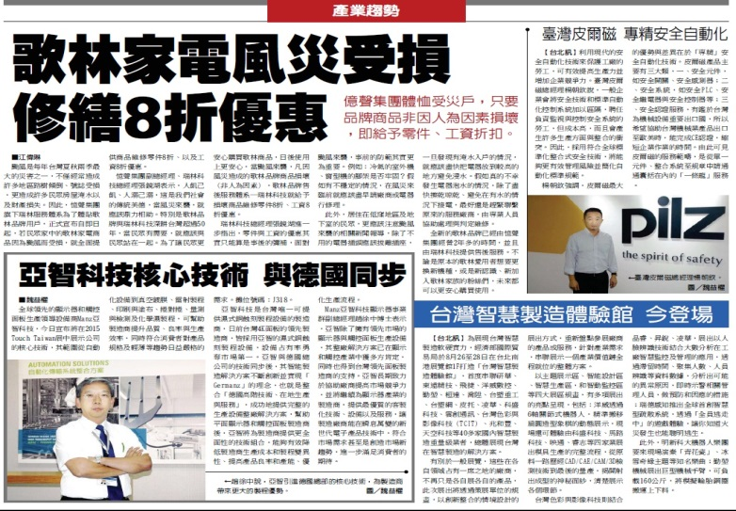
Brand Management – Realise Nationwide After Service
Realise Tech-Service Co.,Ltd
Founded in 1999
There are 22 service shops, 4 repair factories
Received the "Excellent Service Certification -“ by the Department of the Ministry of Economic Affairs

Slide 17
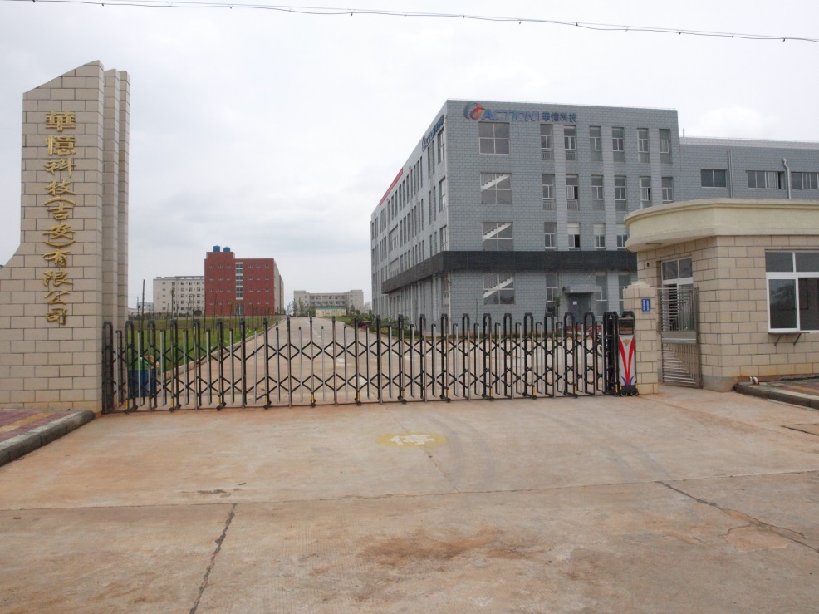
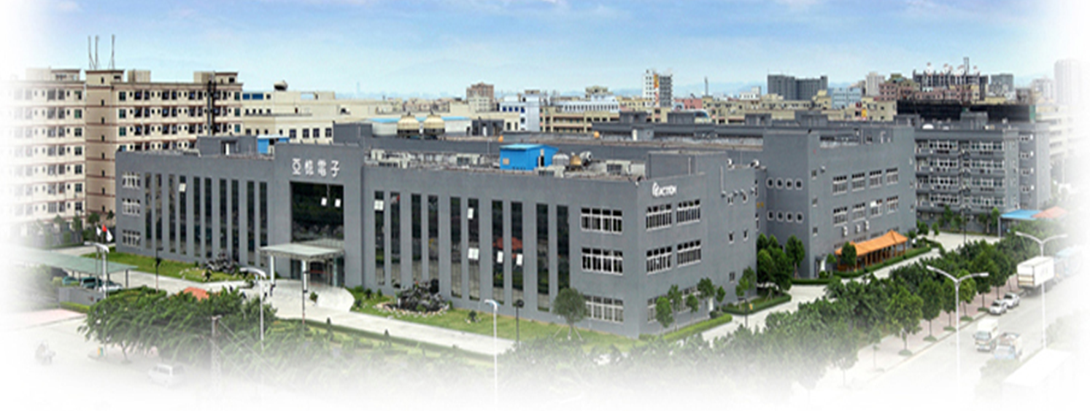
Asset Development Business

Slide 18
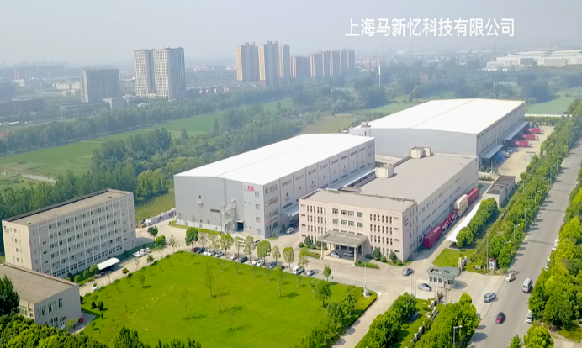
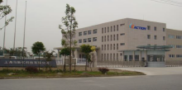
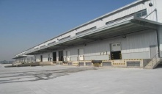
Asset Development Business –Shanghai Action Tech.
Located in Jiading, Shanghai, a satellite town to the international city of Shanghai. Situated in between the provinces of Jiangsu, Zhejiang , it is the ideal location to develop warehousing services.
Covering an area of ​​150 acres (4,500 pings) and 80 acres of green forest belts, 2011 began to invest in the construction of logistics 、warehousing and leasing business.
In 2018, the area for leasing reached 79,000 square meters, and the letting rate reaches 90%
It successfully attracts international well-known customers with advanced warehousing equipment and creates stable revenue for the Group.

Slide 19
Asset Development –Far Year Construction Co.,Ltd
1.Located next to the Zhongyu Interchange,
it is the gateway and
standard of Zhongli
Industrial Zone.It has
the development
potential in line with
the trend of Industry 4.0.
2.The lot size for construction was ​​about 4,000 pings
3.Approved for floor area ratio of 399% by IDB
4. It has started to construct in Q4/2020

Slide 20

4.Future Prospects--Strategic Guidelines
Rational stock price
Improve operating fundamentals plus adequate publicity. To benefit our shareholders with a rational stock price reflecting its value.

Slide 21
Action Group will continue to develop upward
Group continues active transformation
Create value
Deepen automotive electronic market
Aftermarket
Corresponding home appliances Trend
Strengthen R&D
Reasonable stock price
Product advantages
Understand Target audiences

Slide 22
Group’s development strategies for the future
1.Action group has been actively transformed for several years and reached significant achievements in brand operation and assets development. Especially in industry upgrading and planning the Headquarter located in Taoyuan to be a New type industrial 4.0 Industrial Park together with the full functions of R&D、maker、AI、IOT、big data and exhibition.
2.To provide customers healthy and simple life with trustworthy and affordable products and services and to provide customers more immediate service with smart technologies.
3.To provide users the best audio and video experience of automotive electronic products for different usage scenario and technology evolution and generation

Slide 23
Group’s development strategies for the future：
3.Look forward to the future, we devote ourselves to integrating the resources of three major businesses and strengthen operation and upgrade brand competition. For business management, we emphasis in introducing and fostering of talented people and enhance corporate culture and value in order to implement sustainable business operation
4.Continue to digital transformation

Slide 24
Action Group will continue to develop upward
Q & A

