Slide 1
星通資訊股份有限公司
法說會
2019年9月17日
葉茂林博士
Notes:
1

Slide 2
未來展望免責聲明
投影片中部分資訊──包含講解與投影片內容──為本公司未來展望，因未來變數過多可能與事實有所差異
上述變數包含但不限於當地與全球法規、市場需求與市場競爭狀況
上述種種因素導致展望與事實不符之處，本公司將不予通知

Slide 3
議程
公司介紹
上半年財務狀況
星通的產品與解決方案
  關鍵任務網路解決解決方案
  電信運營商市場
  企業與政府資安網路解決方案
商業與行銷策略
問答時間

Slide 4
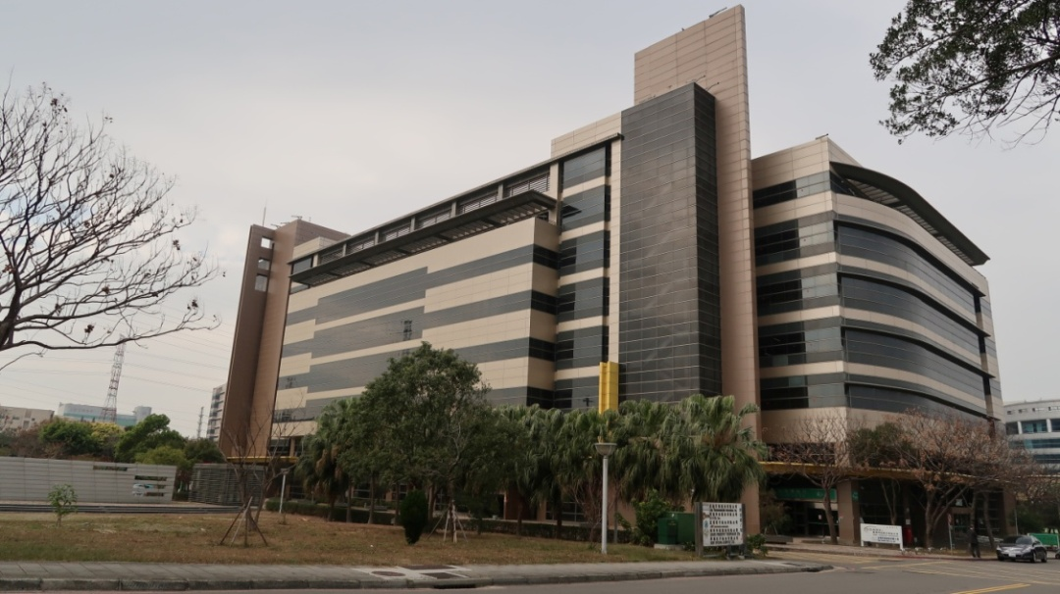

簡歷
星通資訊成立於1991年，並於2002年正式成為上市公司
全球總部：
  新竹市科學工業園區
產業範疇：
  網路接取傳輸設備研發及製造。
  跨足網管系統、IP以及光纖通訊產品的技術研發及製造。

Slide 5
產業技術
網管系統
PDH/SDH/SONET-MSTP
多工交叉連結設備
L2/L3 乙太網存取傳輸
MPLS/CE封包傳輸網路
TDM over Ethernet(TDMoE)
光纖數據多工設備(FOM)
線路擴充轉換器
WDM網路設備
NFV Based Cyber Security Solutions
IIoT Solutions

Slide 6
技術結合產品：全方位解決方案
輸電監控SCADA 系統的網路解決方案
鐵路、捷運及高鐵的解決方案
石油業的網路解決方案
電信網路: 3G/4G/5G 基地台光纖網路的解決方案
政府機關網路解決方案

Slide 7

成功案例-電信服務業
美國
印尼
奧地利
印度
巴基斯坦
澳洲
加拿大
泰國
台灣
We have 60+ successful cases
WDM
MPLS
Fiber Optical
iNET
iNMS
DACS Network
DDN Network
越南
法國
阿根廷
西班牙
…
薩爾多瓦

Slide 8


成功案例-石油及天然氣
馬來西亞
美國
阿聯酋
印尼
墨西哥
加拿大
SDH
PDH
L2/L3
CE/ MPLS
iNMS網管系統
iNET網管系統
俄羅斯
利比亞
挪威
英國
We have 30+ successful cases
印度
泰國
蒙古
…

Slide 9

成功案例-大眾運輸產業
摩洛哥
台灣
印度
波蘭
新加坡
埃及
印尼
We have 60+ successful cases
加拿大
義大利
瑞士
美國
SDH
PDH
CE/ MPLS
iNMS網管系統
iNET網管系統
巴西
俄羅斯
…
土耳其

Slide 10
成功案例-政府機關網路
西班牙
南非
俄羅斯
台灣
摩洛哥
英國
Loop’s Products in Government Networks
美國
巴西
阿根廷
秘魯
法國
加拿大
We have 100+ successful cases
香港
…
哥倫比亞
新加坡
利比亞

Slide 11

成功案例-電力產業
澳洲
挪威
台灣
巴西
阿根廷
巴拿馬
美國
SCADA
通訊網路
希臘
加拿大
祕魯
菲律賓
印度
We have 200+ successful cases
哥倫
比亞
越南
英國
智利
瑞士
…

Slide 12
議程
公司介紹
上半年財務現況
星通的產品與解決方案
  關鍵任務網路解決解決方案
  電信運營商市場
  企業與政府資安網路解決方案
商業與行銷策略
問答時間

Slide 16
議程
公司介紹
上半年財務現況
星通的產品與解決方案
  關鍵任務網路解決解決方案
  電信運營商市場
  企業與政府資安網路解決方案
商業與行銷策略
問答時間

Slide 17

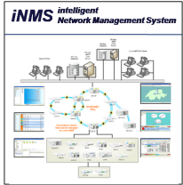








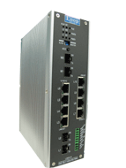



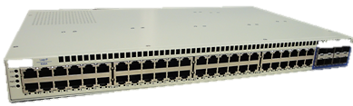





Loop’s Total Solution
60 Products in Portfolio
Multi-language
Management
(EMS/NMS)
600G SFP
WDM1800
SDH/SONET,
GbE, E1/T1
G7860A
E1/T1/E3/T3, FE/GbE, FOM
SDH/SONET, FXS/FXO/E&M
RS232/V.35/X.21, C37.94/G.703…
O9500R
TDM over Ethernet
IP6818
Eth
S D H / S O N E T
WDM
Ethernet Access
Multi-service
IIoT
ISS
Power Utility
Transportation
Carriers & Mobile Backhaul
Government
Oil & Gas
Military
m P T N
IP6828
Eth
E1/T1/E3/T3
FE/GbE, FOM
SDH/SONET
O9400R
IP7930
Eth
FXS/FXO/E&M
RS232/V.35/X.21
C37.94/G.703…
O9550
IP6340
Eth
E1/T1
FE/GbE
O9400S
IP6820
Eth, DTE
E1/T1
Ethernet
FXS/FXO/E&M
RS232/RS485
O9170
IP6830
Eth
E1/T1
Ethernet
O9150
G7820
Eth, IP, MPLS-TP
E1/T1
E3/T3
SDH/SONET
V4150
IP6320A
Eth, GbE, 10GbE
E1/T1/FOM/Eth
FXS/FXO/E&M
RS232/V.35/X.21
C37.94/G.703…
AM3440
IP6750
IP6704A
IP6702
E1/T1, FE/GbE
E1/T1, FXS/FXO/E&M
RS232/V.35/X.21
Eth, E1/T1

Slide 18
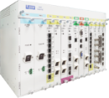

1. Traditional Model: SDH/SONET
STM-n/OC-n Protected Ring
Transport
Transport
Transport
O9400R
AM3440/O9550
Access
Access
Access
RTU
RTU
RTU
RTU
RTU
RTU
Traditional Model: Transport Unit + Access Aggregation Unit
O9400R: the Transport unit providing up to four OC48/STM16 uplinks
AM3440/O9550: Access Aggregation Unit with varieties of interface cards
RTUs are customers’ end devices

Slide 19
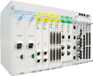
2. SDH/SONET with Combo Box
STM-n/OC-n Protected Ring
Transport
Transport
Transport
O9500R
Access
Access
O9400R
Access
AM3440/O9550
RTU
RTU
RTU
RTU
RTU
RTU
Combo Box (O9500R)= Transport Unit (O9400R) + Access Unit (AM3440/O9550)
O9400R: Transport Unit with up to four OC48/STM16 uplinks
AM3440/O9550: Access Aggregation Unit with varieties of interface cards
RTUs are customers’ end devices
Combo Box for smaller sites

Slide 20

3. L2/L3 Packet Network
N x 1GbE / 10GbE Protected Ring
Transport
Transport
Transport
Transport
G7820
VRRP
AM3440
IP6704A
IP6340
Access
Access
Access
RTU
RTU
RTU
RTU
RTU
RTU
RTU
RTU
G7820: L2/L3 Transport Unit with switching capacity of 48 x 1G + 8 x 10G uplinks
AM3440/IP6704A/IP6340: Access Aggregation Units to connect with RTUs
Protection switching time of traditional L2/L3 packet networks has notoriously high latency variations. It is thus recommended against being used as the solutions to Mission Critical Networking.

Slide 21

4. MPLS-TP Packet Network
MPLS-TP N x 1GbE / 10GbE Ring
G7860A
Transport
Transport
Transport
AM3440
IP6704A
G7820
RTU
RTU
RTU
Access
Access
Access
RTU
RTU
RTU
G7860A
Transport
Transport
Transport
MPLS-TP: Service-oriented Pseudowires and Tunnels with OAM and protection
G7860A: MPLS Transport with switching capacity of 85G and six 10G uplinks
AM3440/IP6704A/G7820: Access Aggregation to connect with RTUs

Slide 22
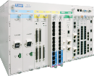
5. SDH/SONET + MPLS-TP
STM-n/OC-n + N x GbE / N x 10GbE
Transport
Transport
Transport
O9500R
Access
Access
O9400R
Access
AM3440/O9550
G7820
RTU
RTU
RTU
RTU
RTU
RTU
Integrated Transport for services required to be connected to SDH/SONET or/and MPLS via software programmable. Unified Transport will reduce OPEX and CAPEX.
O9400R and O9500R provide both SDH/SONET and MPLS Transports with four STM16/OC48 and six 10G MPLS uplinks. SDH/SONET can be used to carry latency-sensitive and most critical services. Multiple uplinks can also provide physical isolations on critical services.
AM3440/O9550/G7820 are our Access Aggregation Unit

Slide 23

6. SDH/SONET + MPLS-TP + L2/L3
SDH/SONET
Transport
SDH/SONET
Transport
SDH/SONET
Transport
Access
Access
O9500R
O9400R
MPLS
Transport
MPLS
Transport
MPLS
Transport
G7860A
L2/L3
Transport
L2/L3
Transport
L2/L3
Transport
L2/L3
Transport
G7820
For different types of services that require physically isolated networks
Critical Services: O9400R/O9500R for SDH/SONET networks
Universal Services: G7860A with MPLS for critical services or packet for general services
Packet Services: G7820 for L2/L3 networks for general services

Slide 24
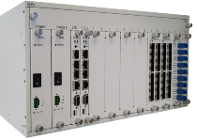
7. WDM
SDH/SONET
Transport
SDH/SONET
Transport
SFP
SFP
SFP
SFP
MPLS
Transport
SFP
SFP
SFP
SFP
MPLS
Transport
SFP
SFP
SFP
SFP
SFP
SFP
SFP
SFP
L2/L3
Transport
L2/L3
Transport
WDM1800
WDM1800
Optical wavelength multiplexing to reduce fibers used
WDM1800 provides multiple optical wavelength multiplexing with transponder, muxponder and OLP plug-in cards

Slide 25
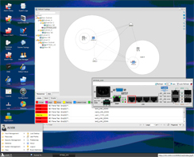
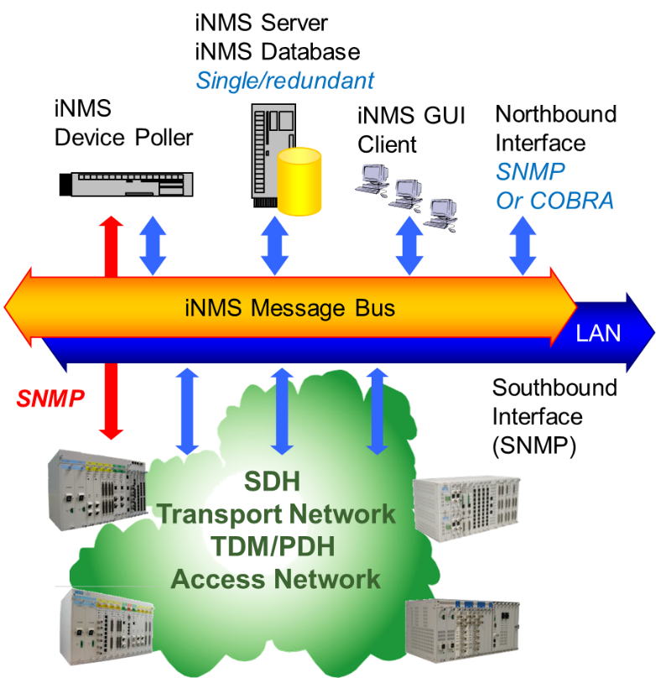
Loop’s Management family
Management of PDH, SDH, PseudoWire and Ethernet devices
iNET-LCT | Windows local craft interface with cross-connect representation
iNET-NMS | Windows scalable and modular architecture. Include GUI for Node management and Network management.
iNMS | Integrated/Intelligent Network Management System using Oracle Database on Linux or Solaris and Windows GUI stations. Support device and Network view, End-to-End automatic commissioning, several Services are available as : Clock Distribution, TDM and PW3E combined circuits, IP/PTN network management, High Disaster Recovery…

Slide 26




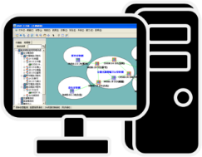








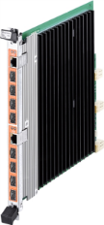














Total Solution Roadmap with Single Management Platform for Mission Critical Networking
TDM Access Services
T1/E1, A/μ, Signaling Conversion
SONET/SDH Transmission Network
Optical Quality can be in-service monitored
SONET/SDH & PTN Transmission over OTN Network
Multi-lambda OTN w/ 10G and 100G uplinks
IP / Ethernet / Pseudowire
PTN Network
10G~100G MPLS
In-Service Optical Monitoring
Single NMS Management System with Dual Sites Protection
G7860
PTN Mesh
AM3440
G7800
G7800
O95xx
OC3/12/48
O95xx
O95xxR
OTN Backbone
WDM1800
WDM1800
G.8032
CE Ring
An Excellent Solution for Critical Communication Networking in the next 10 years
G7800 10G ~ 100G MPLS Transport
Loop-iNMS
main
SONET/SDH
PTN
OC3/12/48
AM3440
O95xx
O95xxR
O95xx
G7800
G7800
WDM1800
WDM1800
PTN Mesh
Loop-iNMS
Backup
26

Slide 27
議程
公司介紹
上半年財務現況
星通的產品與解決方案
  關鍵任務網路解決解決方案
  電信運營商市場
  企業與政府資安網路解決方案
商業與行銷策略
問答時間

Slide 28



3G RAN (Radio Access Network)
Mobile Switching Center (MSC)
O9340FOM
O9340FOM
Radio Network Controller
(RNC)

Slide 29

4G 轉換到以 RRUs + BBU 的基礎架構
COAX
CELL SITE CABINET
O9340FOM
RRU
D-RoF
RRU
BBU
RRU
O9340FOM

Slide 30
4.5G從同軸電纜為基礎的RRU轉換到以光纖為基礎的RRH
RRH
RRH
COAX
RRH
CELL SITE CABINET
O9340FOM
D-RoF
IP6750CE
CELL SITE CABINET
O9340FOM
RRU
D-RoF
RRU
BBU
BBU
O9340FOM
IP6750CE
RRU
O9340FOM

Slide 31
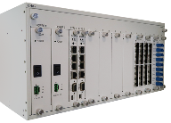
5G/5G轉換到分佈式 C-RAN (Centralized RAN)
RRH
RRH
FRONTHAUL
BACKHAUL
RRH
D-RoF
RRH
BBU
RRH
WDM1800
WDM1800
IP/MPLS
Network
RRH
Optical Distribution
Network
BBU
BBU
D-RoF
WDM1800
WDM1800
CENTRAL OFFICE

Slide 32
議程
公司介紹
上半年財務現況
星通的產品與解決方案
  關鍵任務網路解決解決方案
  電信運營商市場
  企業與政府資安網路解決方案
商業與行銷策略
問答時間

Slide 33
企業資安整體解決方案
Information Security
  Agent (Other Vendors)
  Gateway (Loop’s ISS2180)
Corporate Security Policy (Other Vendors)
Layers of Local Networking Designs (Loop’s G7820)
Physical & Environmental Security (Loop’s IOT0510)

Slide 34
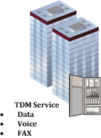
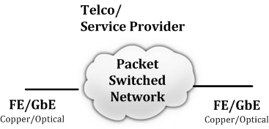




VNF (Virtual Network Function) Based Cyber Security Gateway
新的解決方案能開創性地改善今日面臨的資安威脅與困境
  也能開創新的功能及應用, 例如 Log Analysis, Deception, SIA, Proxy, …
?
?
More and more Telco are cutting TDM Leased Line Service and now offering Metro Ethernet Service because Ethernet Interface is…
Cost-effective
broadly used on networking equipment
Easy to use and deploy
Flexible
Enterprise
Service Provider
Deception
vRouter
Flow Analysis
vSecurity
vFirewall
Carrier Ethernet
Connectivity (WAN)
Enterprise
LAN
ISS2180
NID
Log Analysis
GCB Proxy

Slide 35
企業資安整體解決方案
Information Security
  Agent (Other Vendors)
  Gateway (Loop’s ISS2180)
Corporate Security Policy (Other Vendors)
Layers of Local Networking Designs (Loop’s G7820)
Physical & Environmental Security (Loop’s IOT0510)

Slide 36
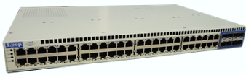
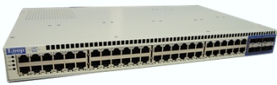
辦公室/工廠內部網路層級
Working with Master VNF such as NGFW to execute:
Carrier Ethernet
Connectivity (WAN)
PC
Note book
Trust Flow by-pass
DDoS port blocking
FW-M
PC Network PNET
Unknown
VDI
VDI
VDI
Trust
FW-C
Connected-User Policy to NGFW
Disconnected-User to NGFW
NGFW detect the threat and notify switch to block the user.
…
VDI VNET
Servers
Database
FW-C
Server SNET

Slide 37
企業資安整體解決方案
Information Security
  Agent (Other Vendors)
  Gateway (Loop’s ISS2180)
Corporate Security Policy (Other Vendors)
Layers of Local Networking Designs (Loop’s G7820)
Physical & Environmental Security (Loop’s IOT0510)

Slide 38






無線技術可完全與客戶網路隔絕
Wireless
Controller
Wired or Wireless
Environmental Security: temperature, humidity, air pressure, airflow speed, air quality, power, HVAC, water leak, etc.
Physical security: facility access privilege, IP security camera surveillance, IT assets monitoring and management, IT rack door access, etc.

Slide 39
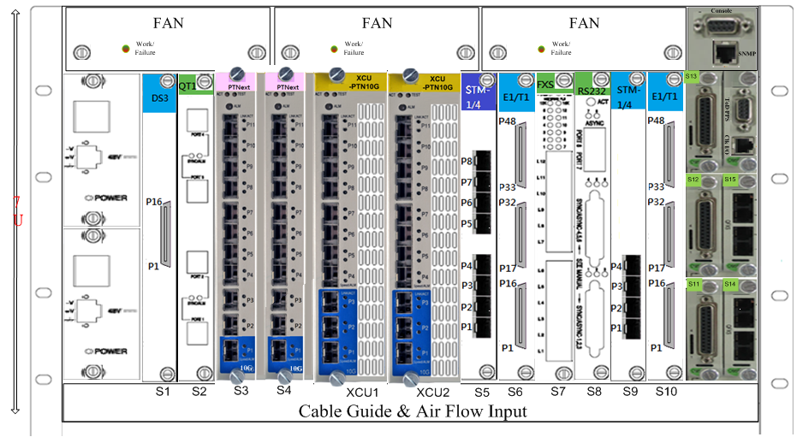





Loop’s Total Solution
60 Products in Portfolio
Multi-language
Management
(EMS/NMS)
600G SFP
G7800
WDM1800
ISS2180
CCTV0710
SDH/SONET,
GbE, E1/T1
G7860A
IOT0510
E1/T1/E3/T3, FE/GbE, FOM
SDH/SONET, FXS/FXO/E&M
RS232/V.35/X.21, C37.94/G.703…
O9500R
TDM over Ethernet
IP6818
Eth
S D H / S O N E T
WDM
Ethernet Access
Multi-service
IIoT
ISS
Power Utility
Transportation
Carriers & Mobile Backhaul
Government
Oil & Gas
Military
m P T N
IP6828
Eth
E1/T1/E3/T3
FE/GbE, FOM
SDH/SONET
O9400R
IP7930
Eth
FXS/FXO/E&M
RS232/V.35/X.21
C37.94/G.703…
O9550
IP6340
Eth
E1/T1
FE/GbE
O9400S
IP6820
Eth, DTE
E1/T1
Ethernet
FXS/FXO/E&M
RS232/RS485
O9170
IP6830
Eth
E1/T1
Ethernet
O9150
G7820
Eth, IP, MPLS-TP
E1/T1
E3/T3
SDH/SONET
V4150
IP6320A
Eth, GbE, 10GbE
E1/T1/FOM/Eth
FXS/FXO/E&M
RS232/V.35/X.21
C37.94/G.703…
AM3440
IP6750
IP6704A
IP6702
E1/T1, FE/GbE
E1/T1, FXS/FXO/E&M
RS232/V.35/X.21
Eth, E1/T1
AM3440 with Transport

Slide 40
議程
公司介紹
上半年財務狀況
星通的產品與解決方案
  關鍵任務網路解決解決方案
  電信運營商市場
  企業與政府資安網路解決方案
商業與行銷策略
問答時間

Slide 41
星通連結全球超過80個國家
Eastern Europe
Czech
Bosnia
Croatia
Macedonia
Slovakia
Slovenia
Yugoslavia
Asia
South Korea
China
Taiwan
Hong Kong
India
Pakistan
Thailand
Singapore
Indonesia
Philippines
Kazakhstan
Macau
Brunei
Malaysia
Vietnam
Turkey
Burma/Myanmar
Bangladesh
Sri Lanka
Japan
Mongolia
Western Europe
Norway
UK
France
Belgium
Spain
Netherlands
Sweden
Portugal
Luxembourg
Italy
Greece
Germany
Switzerland
Austria
Finland
Russian Federation
Poland
Romania
Ukraine
Lithuania
Bulgaria
Latvia
Hungary
North America
USA
Canada
Middle East
Lebanon
UAE
Bahrain
Jordan
Oman
Kuwait
Saudi Arabia
Central America
El Salvador
Mexico
Guatemala
Costa Rica
Panama
Africa
Egypt
Tunisia
Libya
Ghana
South Africa
Benin
Nigeria
Togo
Kenya
Algeria
South America
Columbia
Brazil
Ecuador
Peru
Argentina
Uruguay
Chile
Venezuela
Bolivia
Oceania
New Zealand
Australia
Notes:
Level 1: Germany, Sweden, Monaco, Japan, Finland, Spain, Egypt, Lebanon, Tunisia
Level 2: Poland, HK, UK, New Zealand, Holland, Norway, Italy, Portugal, Costa Rica, UAE, Korea, Philippine, Peru, Ghana, Libya, Zambia, Indonesia, Brazil, Iran
Level 3: USA, Singapore, Russia, China, France, Belgium, Romania, Ecuador, Pakistan, India, Czech, Ukraine, Kazakhstan
Level 4: Taiwan, Thailand, Columbia

Slide 42
Global Offices to Support Customers
Belgium
Chongqing
China TAC
N. A. TAC
EMEA TAC
Tianjin
Florida, US
France
SEA TAC
Taipei
ME
Tainan
INDIA
HQ: Hsinchu, Taiwan
ES-AF
TAC
CSA TAC
HQ
Australia
Branch Offices
TAC center

Slide 43
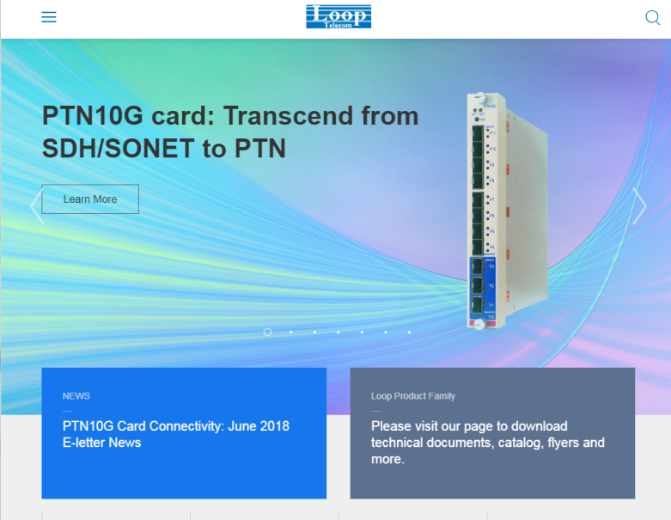
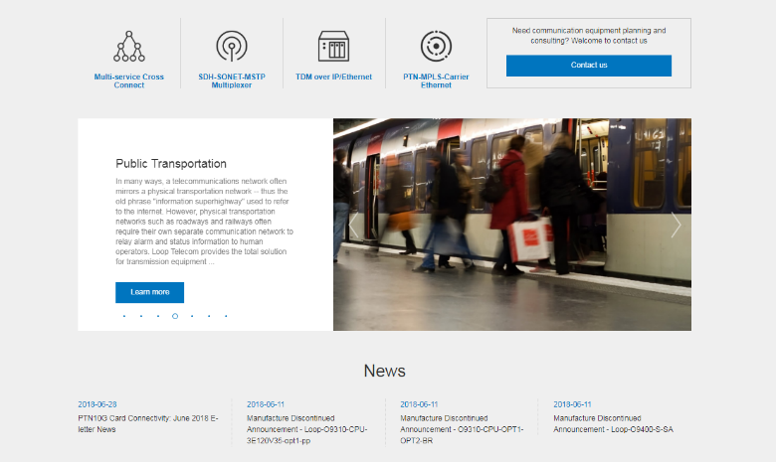
www.looptelecom.com

Slide 44
議程
公司介紹
上半年財務狀況
星通的產品與解決方案
  關鍵任務網路解決解決方案
  電信運營商市場
  企業與政府資安網路解決方案
商業與行銷策略
問答時間

Slide 45


