Slide 1
2017 Investor Conference

Slide 2
Safe Harbor Notice
This presentation is based on information obtained from various sources which the Company believes to the reliable. Part information, affected by uncertained future factors, causes results to different statement for prospect of the Company. Therefore, please refer to information on MOPS website as main basis if any changes or adjustment has been made.

Slide 3
OUTLINE
Company Introduction
  ZERONE History
  Operation Beachheads
Operation Model
  Operation Model
  Product & Service
  Strategy for Business Development
2017 3Q Operation Result
Operation Prospect
2016 Awards for ZERONE Teams
Financial Report

Slide 4
Company Introduction

Slide 5
ZERONE History
Foundation：1980
Date of OTC Listed：2000
Date of TWSE Listed：2002
Capital：NT$1.223 billions
Employees：200 persons(2017)
Business Partner：Over 1000
Business Amount：NT$5.932 billions(2016)

Slide 6
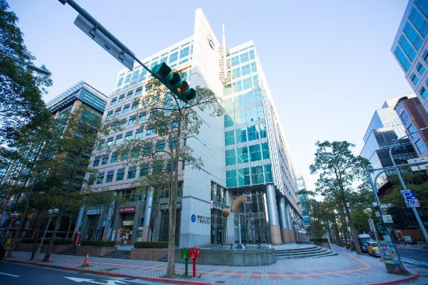
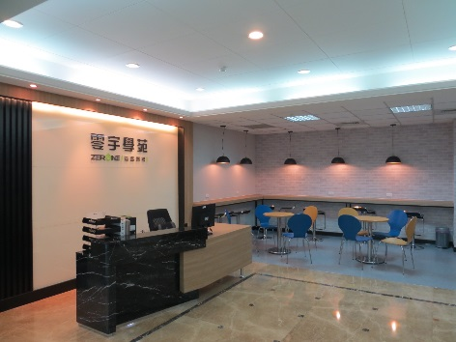
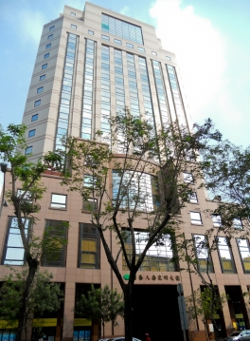
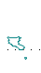
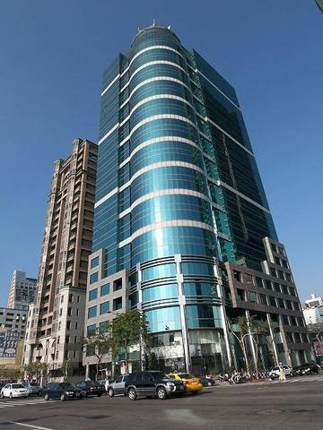
Operation
Beachheads
Taipei Headquarter
ZERONE
Education Training Centre
Taichung Branch
Kaoshiung Branch
6

Slide 7
Operation Model

Slide 8



Operation Model
  Enterprise Customers
Product
Distribution
  Business Partners
Education & Training
Sale
Consulting
Display
Service
Marketing
Customer
Service

Slide 9























Product
&
Service
Technique
Team
Artificial Intelligence
Big Bata
Information
Security
Display
Consulting
Internet
Integration
Backup
Cloud
System Management
Save
Video Surveillance System
視訊監控
Training Centre
Sales Team

Slide 10
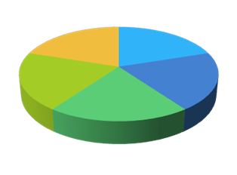
Strategy for Business Development
Value-added Service
Agency Plan
Business Expansion
Making Customer Experience Better
Technique Adoption
Market Trend
Procedure Optimization
Well-Entrenched
Creation Consolidation
Application Service

Slide 11
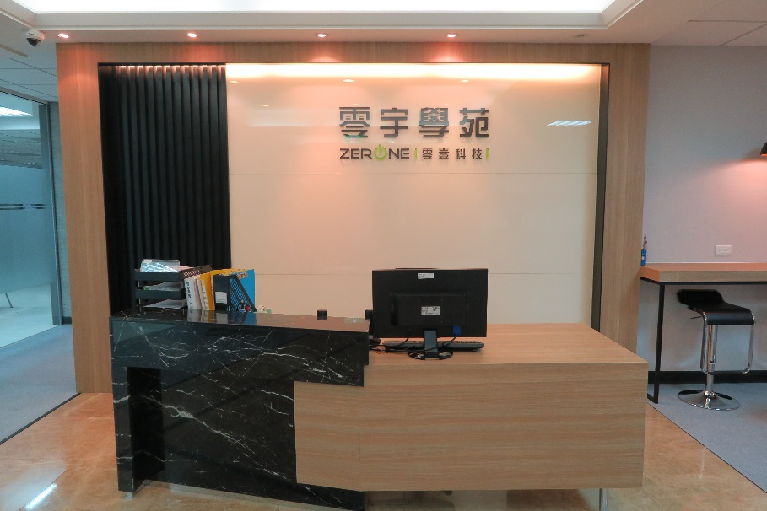
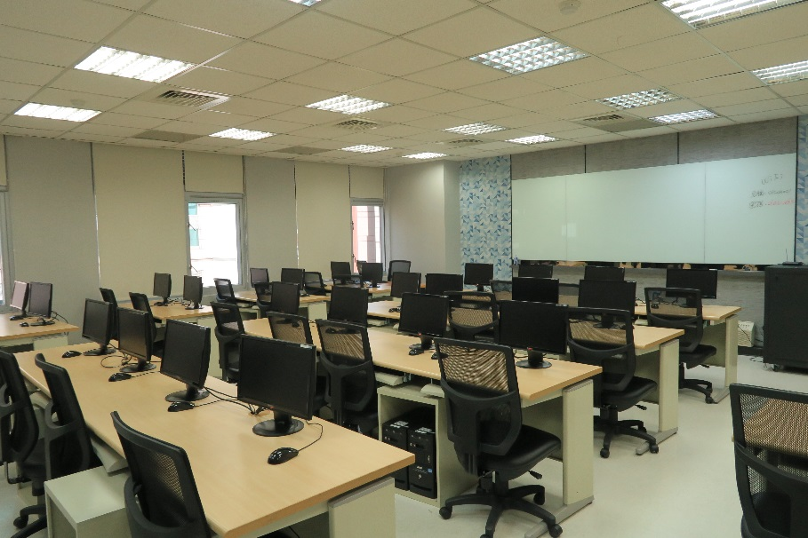
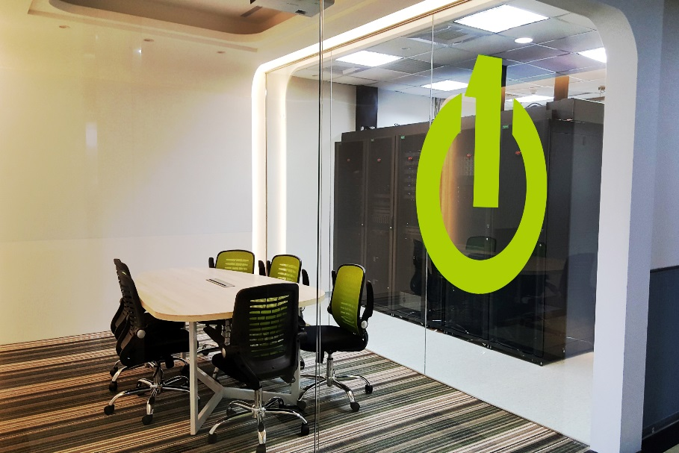
Solution Centre/ ZERONE
Education Training Centre

Slide 12
2017 3Q Operation Result

Slide 13
2017 Q3 Operation Result
Notes:
IT基礎架構類 :
網路設備暨應用 : CISCO & F5 & iPSWITCH
儲存設備 : NetAPP & QNAP & Synology & Tintri
雲平台暨應用類 : Akamai & MicroSoft & Nutanix & VMware
大數據暨應用類 :
大數據分析 : NVIDIA & Splunk
智慧影音應用 : Aimetis & AXIS & Jabra & VIVOTEK
資訊安全類 : Carbonite & FireEye & gemalto & Symantec & Trend Micro & TrustView & Veeam & Veritas

Slide 14
Operation Prospect

Slide 15
Operation Prospect
Keep going to be Solution
Service Provider
Becoming best value-added distributor, with which business partners build a potential relationship

Slide 16

2016 Awards for ZERONE Teams

Slide 17
nVIDIA
Akamai
F5
2015Distributor Award
2016Asia Pacific Distributor for Solution Service Provider
2015Distributor Award
2016Distributor Award
NetApp
ZERONE
iPSWITCH
2016Distributor Award
Best Distributor
for Sales Service
CommonWealth Magazine of the Year-Top 2000 Service Overall：
2015 ：231
2014 ：259
2013 ：271
2016Distributor－
Best Performance
VEEAM
Symantec
2015Distributor － Business Excellence Awards
2016Distributor Award
Aimetis
2015 Asia Pacific Distributor of the Year

Slide 18
Financial Report

Slide 19
OPERATING REVENUE & NET PROFIT
3,873
144

Slide 20
Financial Structure

Slide 21
Financial Index Analysis
Analysis Subject | Year | 2012 | 2013 | 2014 | 2015 | 2016 | 2017/Q3
Financial Structure | Debts ratio(%) | 45.13 | 54.59 | 58.42 | 41.07 | 41.61 | 40.57
Liquidity Analysis | Current Ratio(%) | 183.46 | 154.12 | 187.11 | 217.57 | 216.56 | 218.76
 | Quick Ratio(%) | 147.25 | 126.04 | 151.12 | 184.28 | 184.13 | 191.59
Operating Performance | Average Collection Days Average Inventory Turnover Days Average Payables Days | 91.94 40.33 90.35 | 97.33 38.30 79.69 | 104.58 40.02 77.17 | 102.53 36.5 80.22 | 95.05 29.39 73.44 | 99.79 27.23 77.49

Slide 22
2012

