Slide 1

立萬利創新股份有限公司
LIWANLI Innovation Co., Ltd.
2024年第三季 法人說明會
Presentation for the third quarter of 2024
股票代碼(Stock Code)：3054

Slide 2
免責聲明 Disclaimers
本公司並未發佈財務預測，但本簡報所作有關本公司業務面、財務面及Q&A之說明，若涉及本公司對未來公司經營與產業發展上之見解，可能與未來實際結果存有差距。此差距其造成之原因可能包括市場需求變化、價格波動、競爭行為、國際經濟狀況、匯率波動、上下游供應鏈等其他各種本公司所不能掌握之風險因素。
本簡報是建立於本公司從各項來源所取得之資訊。未來若有變更或調整時，請以公開資訊觀測站公告資訊為主要依據。
LIWANLI Innovation Co., Ltd. does not release any financial forecast. However, the statement of the company’s business, finance condition and Q&A in this presentation may differ from future actual results. This causes from market demand, prices fluctuations, competitions behavior, global economic situations, exchange rate fluctuations, supply chain and other factors or risks beyond the company’s control.
This presentation is based on the information obtained from various sources which the Company believes to be reliable. please refer to the information on MOPS website as the main basis if any adjustment has been made.

Slide 3
大 綱 Agenda
公司概況 (Corporate Overview)
營運概況 (Business Overview)
財務概況 (Financial Overview)
未來展望 (Future Vision)

Slide 4
壹、公司概況 Corporate Overview
董 事 長(Chairman):陳立青 (Jason Chen)
公司成立(Date of Established):1991年 6月 (June, 1991)
股票上市(Date of listing in TWSE ):2002年11月 (November, 2002)
股票代號(Stock Code): 3054
實收資本額(Capital):新臺幣8.34億元 (NTD 834 Million)
營業項目:
1.保健食品相關產品的開發與銷售(Development and sales of healthy food related products)
2.電子產品貿易銷售(Electronic products trading sales)

Slide 5
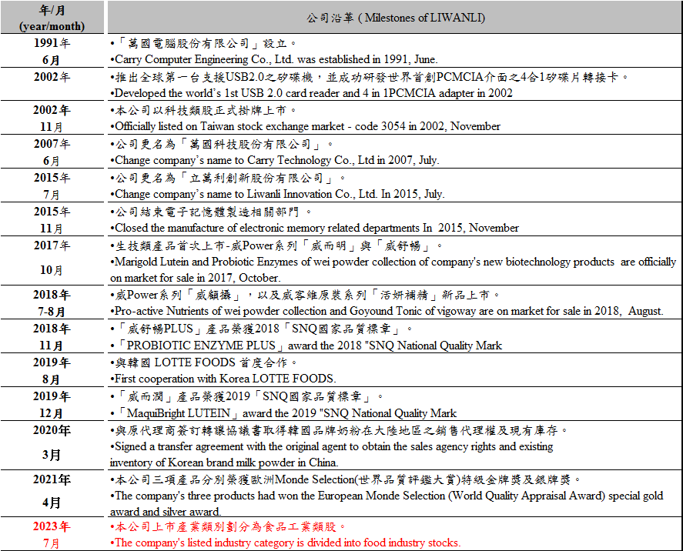
壹、公司概況 Corporate Overview
(Continuing)

Slide 6
壹、公司概況 Corporate Overview
(Continuing)
立萬利創新股份有限公司於自1991年創立以來，一直以秉持著[創新、價值、服務、品質]作爲永續經營之基礎。
Since its establishment in 1991, LIWANLI Innovation Co., Ltd. (the Company) has been basing on its principle of " Innovation, Quality, Service, and Value " for its sustainable development.
立萬利創新股份有限公司原從事電子產品之研發、生產製造、銷售、代工服務及其他事業等全方位及多角化經營方式，但因近年來，電子記憶體相關產業環境持續低迷，為考量未來營運發展及股東權益，並積極開拓新事業及新產品，故於2015年底陸續結束電子記憶體製造等效益毛利不佳之事業並調整組織人力結構。
The Company is operation in electronic products research and development, manufacturing, sales, OEM services and other businesses, such as all-round and diversified management mode. But over the years, electronic memory-related industrial environment continued to slump, To consider future operation and development and shareholders' equity, actively explore new business and new products. Therefore, by the end of 2015, the company decided to end the department of poor profit margins such as manufacturing of electronic memory, at the same adjust the organizational manpower structure.
立萬利創新股份有限公司2021年度起專心致力於積極開發保健食品事業體，以期完全轉型跨足保健食品及生技產業；並於2023年7月份轉型至食品工業類股。
From 2021, Liwanli Innovation Co., Ltd. will devote itself to actively developing a new health product business unit with a view to complete transformation across the health food and biotechnology industry, and in July 2023, it transitioned to food industry stocks.

Slide 7
近年來公司主要產品項目及營業比重
(Items and ratio of main products of the Company)
貳、營運概況 Business Overview
產品別 Category | 主要產品項目 Main Products | 2022 | 2023 | 2024Q3
儲存裝置 Storage products | 包括DRAM及FLASH等相關記憶體產品。 DRAM and FLASH of Memory products related. | 0.31% | 12.31% | 66.70%
其他 other | 保健食品及其他產品。 Healthy food products and others. | 99.69% | 87.69% | 33.30%
合 計 |  | 100% | 100% | 100%

Slide 8



生技類產品介紹 Biotechnology products-威客維專科系列
貳、營運概況 Business Overview (Continuing)
威舒益PLUS酵母益生菌粉包
ibSium-HST Probiotic
威舒暢PLUS+益菌酵素粉包
Probiotic Enzyme PLUS+
威舒孅PLUS
Probiotic Enzyme PLUS

Slide 9



貳、營運概況 Business Overview (Continuing)
生技類產品介紹 Biotechnology products-威客維專科系列
威而潤PLUS智利酒果粉包
MaquiBright Lutein
易舒眠粉包
E-Soothing
威護伸 接骨木莓粉包
Black Elderberry

Slide 10
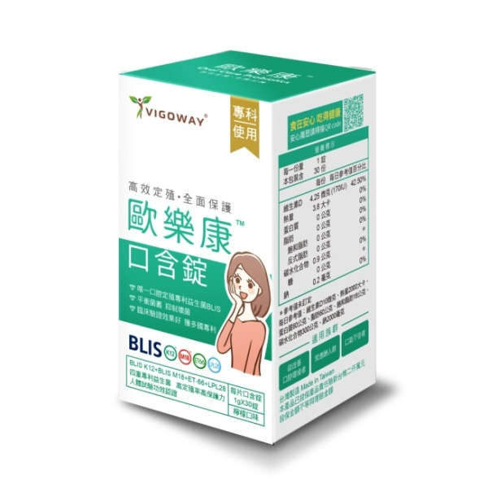

貳、營運概況 Business Overview (Continuing)
生技類產品介紹 Biotechnology products-威客維專科系列
歐樂康口含錠
Oral Care Probiotics
威護節軟膠囊
Shea Butter Oil with
Patented Type II Collagen Softgels

Slide 11



貳、營運概況 Business Overview (Continuing)
生技類產品介紹 Biotechnology products-威客維機能系列
黃金蟲草子實體粉包
Cordyceps Militaris Powder
NAD+青春賦能粉包
New Anti-aging Desire+
威攝士膠囊
Pro-Active Nutrients

Slide 12



貳、營運概況 Business Overview (Continuing)
生技類產品介紹 Biotechnology products-威客維三麗鷗聯名系列
威敏暢酵素益菌粉包
Kids Probiotic Enzyme Powder
滴D優滴液
DHA D3 drops
護晶明咀嚼錠
Hello Kitty
Extra Bright Bilberry Tablets

Slide 13



貳、營運概況 Business Overview (Continuing)
生技類產品介紹 Biotechnology products-威客維美妍系列
醇萃活鐵補精
GoyoungFe Essence
白藜蘆醇美妍精華飲
Red Grape Extract
contains Resveratrol
享速孅膠囊
Superburn 6X

Slide 14



貳、營運概況 Business Overview (Continuing)
生技類產品介紹 Biotechnology products-滴滴鮮養生系列
滴滴鮮 滴雞精
DDDrops Essence of Chicken
滴滴鮮 彈力膠原滴雞精
DDDrops Essence of Chicken
With Beauty Collagen
滴一鮮 仁蔘精華飲
DEDrops Ginseng Tonic Drink

Slide 15
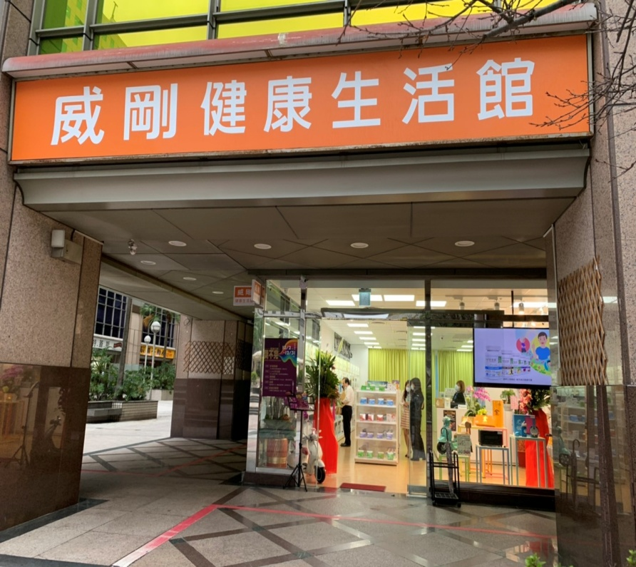
貳、營運概況 Business Overview (Continuing)
銷售通路 Sales Channels
門巿資訊 Store Information
威剛健康生活館—旗艦館
新北市中和區中正路728號
實體通路 Brick-and-mortar Store
康是美藥妝店
大樹連鎖藥局
躍獅連鎖藥局
美康健保藥局(雙北桃園區域連鎖)
全球連鎖(桃園區域)
唯新婦嬰藥妝
電商平台 Online Shop
Vigoway 官方網站
蝦皮商城 Vigoway官方焹站
東森購物
大樹健康購物網
i郵購-Postmall

Slide 16
參、財務概況 (Financial Overview)
合併營收
Revenue of consolidation
單位：新台幣仟元
Unit: NT$ thousand

Slide 17
參、財務概況 (Financial Overview) (Continuing)
合併營業毛利
Gross profit of consolidation
單位：新台幣仟元
Unit: NT$ thousand

Slide 18
參、財務概況 (Financial Overview) (Continuing)
合併營業淨損
(Operation loss of consolidation)
單位：新台幣仟元
Unit: NT$ thousand

Slide 19
參、財務概況 (Financial Overview) (Continuing)
合併本期淨利(損)
(Net Income of consolidation)
單位：新台幣仟元
Unit: NT$ thousand

Slide 20
財務結構
Financial Analysis -Consolidated
參、財務概況 (Financial Overview) (Continuing)
2023/9/30 2023/12/31 2024/9/30
2023/9/30 2023/12/31 2024/9/30

Slide 21
參、財務概況(Financial Overview) (Continuing)

Slide 22
參、財務概況(Financial Overview) (Continuing)

Slide 23
公司展望 Future Vision
立萬利創新股份有限公司以開發保健食品之買賣為主要營業收入外，未來業務拓展:
The Company mainly trades the trading of health food products as its main business revenue, the main objectives of future business development are as follows
擴展國內外市場以增加公司營業收入，目前規劃海外市場布局
(Expansion of domestic and foreign markets to increase operating income. Currently planning the Overseas market layout)
積極開發更多保健食品並取得相關認證
(Actively develop more health foods and obtain relevant certification)
自行研發更多保健類產品，以取得市場之優勢
(Health food research and development products to gain the market advantage)

Slide 24
歡迎各位指教
Q & A

Slide 25
簡報完畢~
Thank you

