Slide 1
Company Presentation
DEC, 2019

Slide 2
Disclaimer
This presentation and release contain “forward-looking statements” which may include projections of future results of operations, financial condition or business prospects based on our own information and other sources.
Our actual results of operations, financial condition or business prospects may differ from those expressed or implied in these forward-looking statements for a variety of reasons, including but not limited to market demand, price fluctuations, competition, international economic conditions, supply chain issues, exchange rate fluctuations and other risks and factors beyond our control.
The forward-looking statements in this release reflect the current belief of G-Tech as of the date of this release. G-Tech undertakes no obligation to update these forward-looking statements for events or circumstances that occur subsequent to such date.

Slide 3
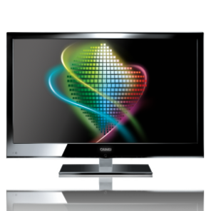
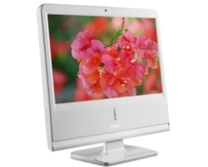
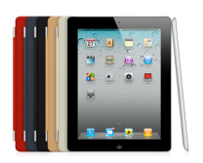

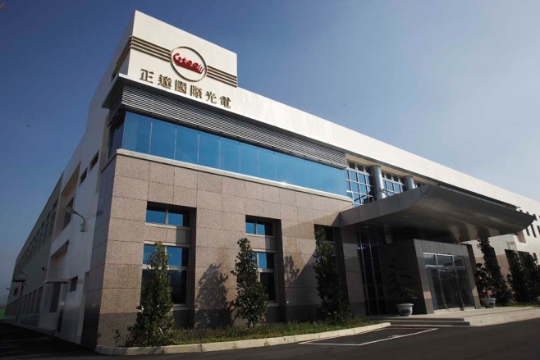
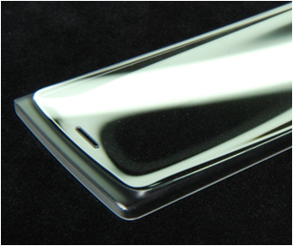
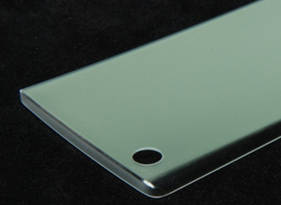
Company Outline
Company Name： G-Tech Optoelectronics Corp.
Capital：2.06 billion NTD ( 67.69million USD )
President：Mr. Tony Chung
General Manager：Mr. Tony Chung
Product Lines：
1) Glass Slimming
2) Chemical Strengthening
3) Glass Coating (ITO / AR / AG / AS)
4) Cover Glass (TV / Monitor / Notebook / Tablet PC / Mobile Phone)
5) 3D Glass Forming
6) Touch Module
7) Green Architecture Glass
Notes:
3

Slide 4
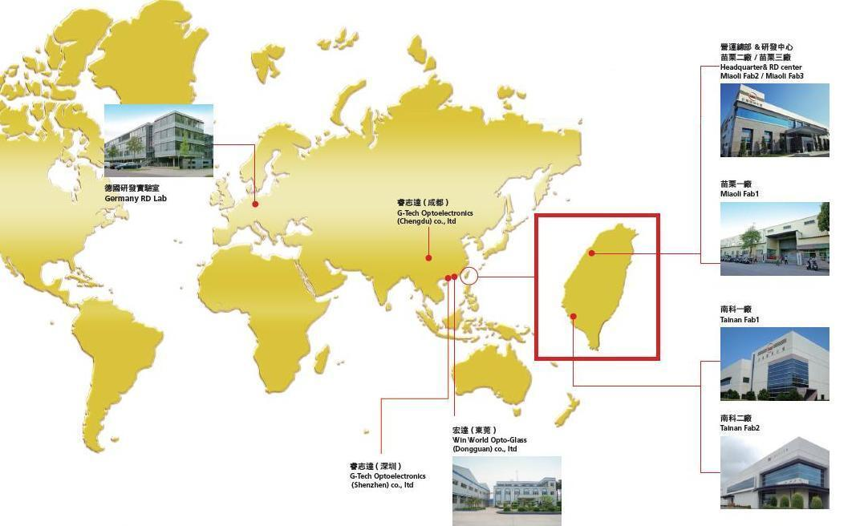
Worldwide Locations
營運總部&研發中心
苗栗二廠 / 苗栗三廠
Headquarter & RD center
Miaoli Fab2 / Miaoli Feb3
德國研發實驗室
Germany RD Lab
睿志達(成都)
G-Tech Optoelectronics
(Chengdu)
宏達(東莞)
Win World Opto-Glass
(Dongguan)
南科二廠
Tainan Fab2

Slide 5
GTOC within HonHai Group
Gtoc’s Products
Glass
Processing
Manufacturing
Integration
Touch Sensor
Glass
Coating
Glass
Slimming Glass
3D Forming Glass
Processed
Arch. Glass
Cover Glass
Touch Sensor
GIS, Innoulux
LCD
Panel
Innolux, CTC
Module
Assembly
GIS, Innolux etc.
Component Assembly
FAiBG etc.
System Integration
Honhai / Foxconn / FIH etc.

Slide 6
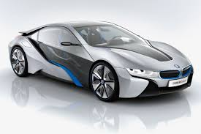


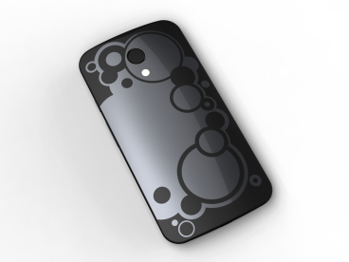
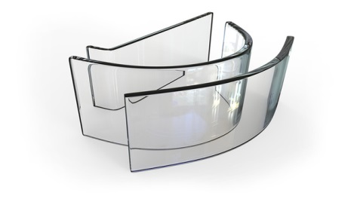
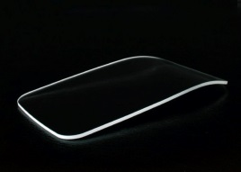
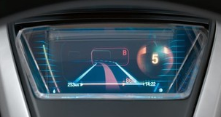
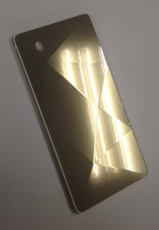
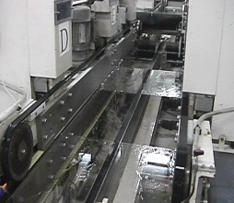
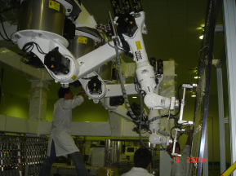
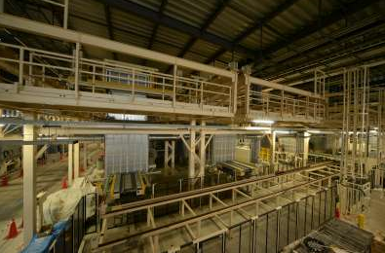
Glass Total Solution
3C /
Auto /
Mobile
Products
3D
Glass
OEM
Auto Glass Component
Integration
Protection
Decoration Glass
Cutting
CNC Polishing
Strengthen
Coating
AR / AG
ITO
3D
Glass
Forming
Processing
Printing
& Surface Treatment
Glass
Slimming
/ Etching
Applications
Project Developing
Gtoc Process

Slide 7
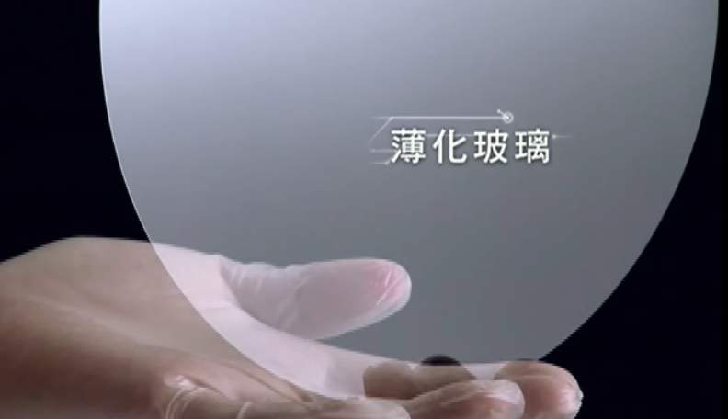
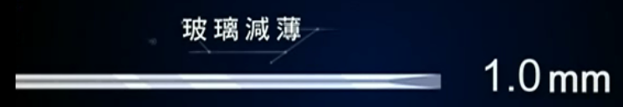
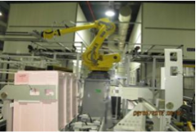


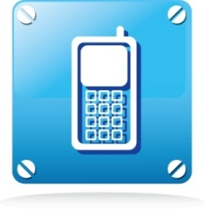

Applications of GTOC products
- TFT Thinning
LCD Panel Slimming
* Size : Max G5 * Thickness : min 0.3mm
Notes:
7

Slide 8
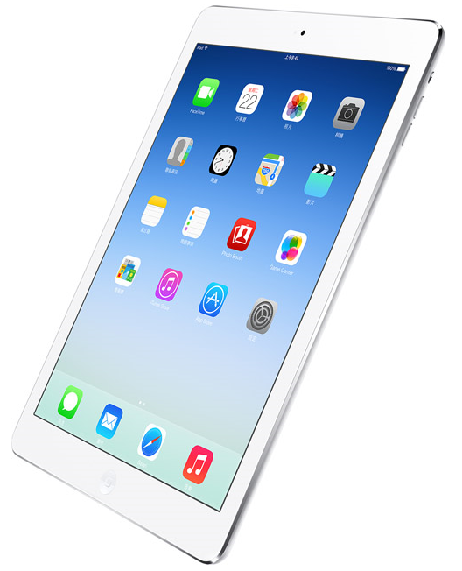
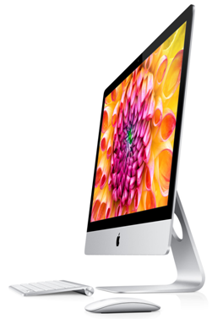
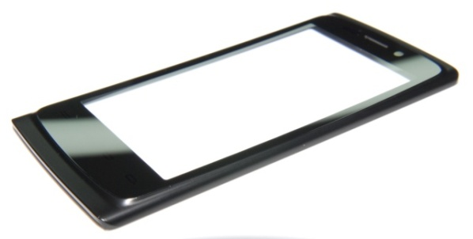




Applications of GTOC products
- Cover Glass
Cover Glass ( 2D / 3D )
Size : 7”~16.4” & 21” ~70”
Notes:
8

Slide 9
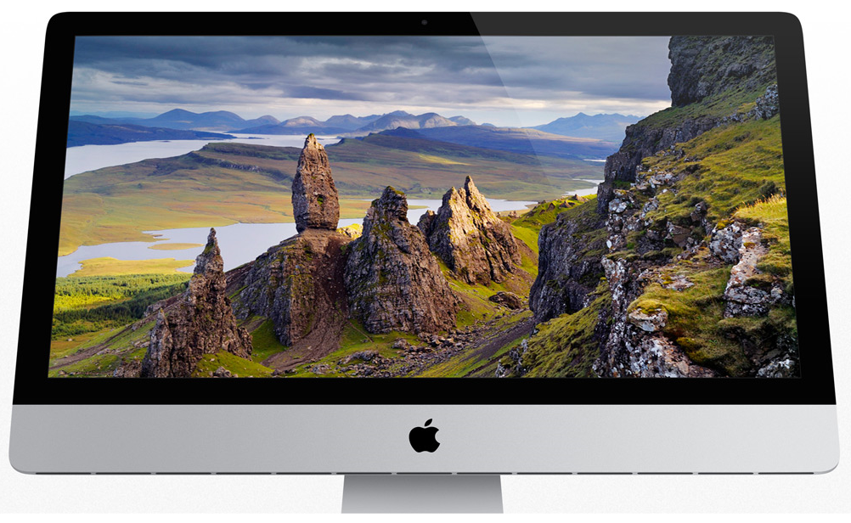
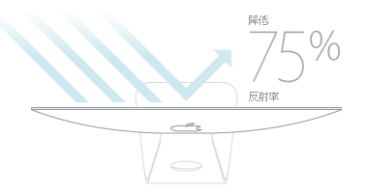
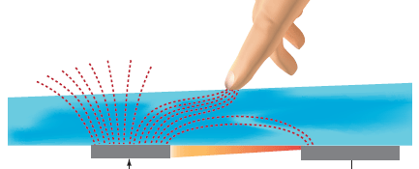
IMITO / AR / AG Coating
ITO/AR Coated Glass
* 40~500 Ω/□ , T 90%~96% , Index Matching
Notes:
9

Slide 10
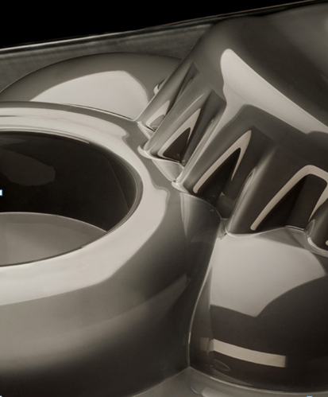
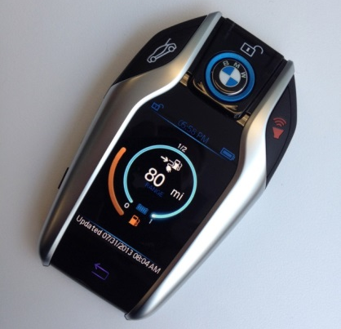
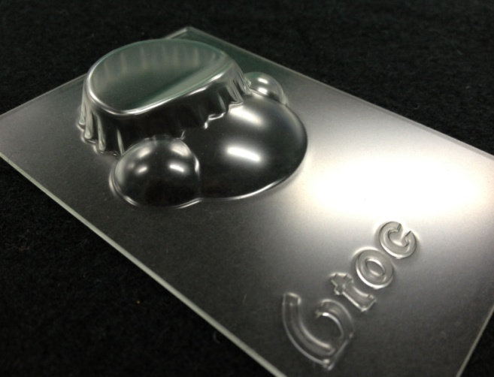





3D Cover Glass
3D Formed Glass & Deco. Front CG/ Back CG
Custom Design
Notes:
10

Slide 11
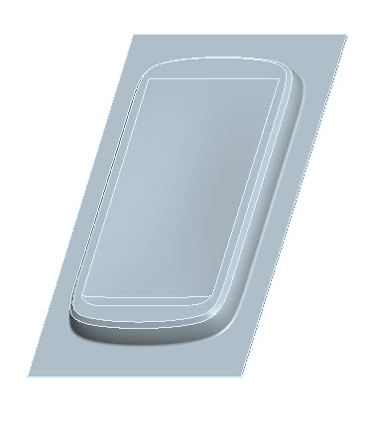
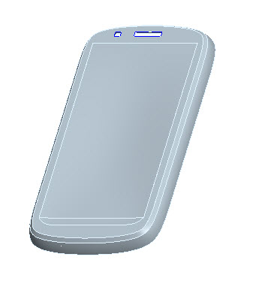

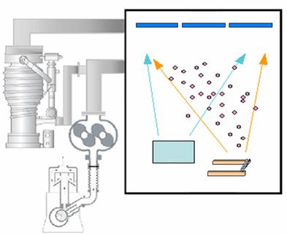
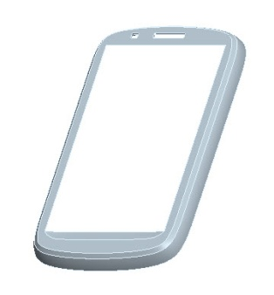
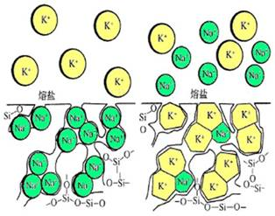
3D Cover Glass
(1) Sheet Glass
(2) Thermal Forming
(3) Polishing (optional)
(4) Trimming & CNC processing
(7) Surface Treatment
(6) Printing/Decoration
(5) Chemical Strengthening

Slide 12
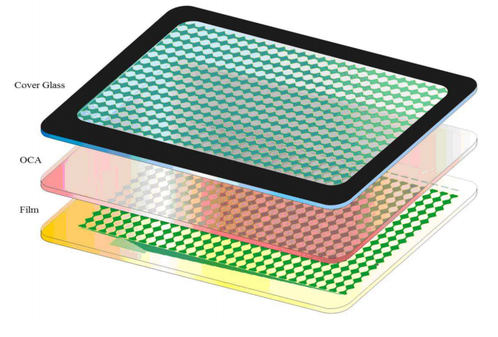
Touch Module
G1F / GG Projective Capacitive
Touch Module Solutions
Notes:
12

Slide 13


Low-E Glass
Low-E Glass is used pyrolytic CVD coating technology.
Advantages：
High Transmittance
Anti-Reflection
Anti-Infrared
Excellent Heat Insulation
➔ Best choice for Energy-saving
purpose.
Stop Heat & High transmittance
in Summer
Keep Warm in Winter

Slide 14
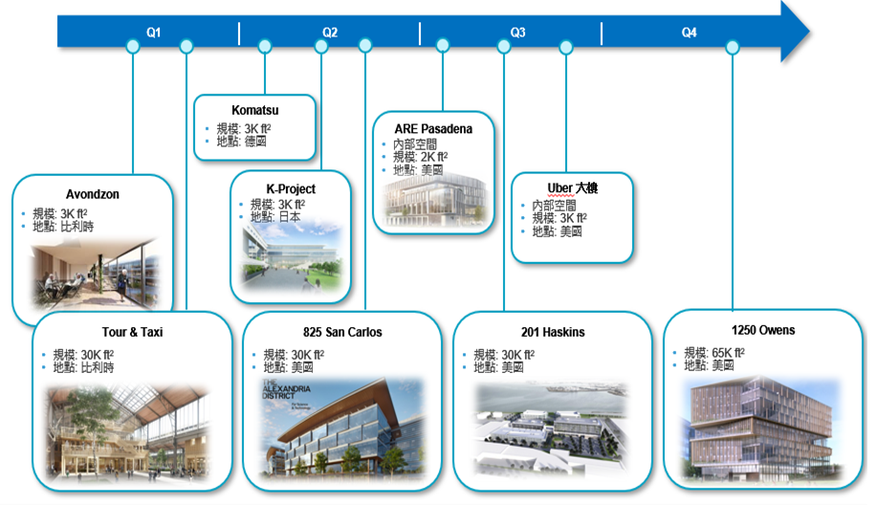
smart-tinting glass

Slide 15
















Valued Customer

Slide 16
Balance sheet (2019年)
Concise Balance Sheet(4 quarters)
The data is provided by G-TECH Optoelectronics Corporation Company (Listed company)
Unit: NT$ thousand
 | 2019/03/31 | 2019/06/30 | 2019/09/30 | 2019/12/31
Total current assets | 1,731,999 | 1,900,809 | 1,514,989 | -
Total non-current assets | 2,701,659 | 2,542,215 | 2,456,565 | -
Total assets | 4,433,658 | 4,443,024 | 3,971,554 | -
Total current liabilities | 2,315,770 | 2,384,301 | 1,481,430 | -
Total non-current liabilities | 521,459 | 468,510 | 933,856 | -
Total liabilities | 2,837,229 | 2,852,811 | 2,415,286 | -
Total capital stock | 2,063,936 | 2,063,936 | 2,063,936 | -
Total capital surplus | 269,239 | 40,528 | 40,528 | -
Total retained earnings | -913,770 | -688,612 | -715,425 | -
Total other equity interest | 177,024 | 174,361 | 167,229 | -
Treasury shares | - | - | - | -
Total equity attributable to owners of parent | 1,596,429 | 1,590,213 | 1,556,268 | -
Equity attributable to former owner of business combination under common control | - | - | - | -
Non-controlling interests | - | - | - | -
Total equity | 1,596,429 | 1,590,213 | 1,556,268 | -
Number of share capital awaiting retirement | 0 | 0 | 0 | -
Equivalent issue shares of advance receipts for ordinary share | 0 | 0 | 0 | -
Number of shares in entity held by entity and by its subsidiaries | 0 | 0 | 0 | -
The Net Asset Value of Each Share | 7.73 | 7.70 | 7.54 | -

Slide 17
Income Statement (2019年)
Concise Statement of Comprehensive Income(4 quarters)
The data is provided by G-TECH Optoelectronics Corporation Company (Listed company)
Unit: NT$ thousand
 | 2019/03/31 | 2019/06/30 | 2019/09/30 | 2019/12/31
Total operating revenue | 716,729 | 1,381,935 | 2,133,200 | -
Total operating costs | 733,613 | 1,424,729 | 2,164,417 | -
Gains (losses) on initial recognition of biological assets and agricultural produce | - | - | - | -
Gain (losses) arising from change in fair value less costs to sell of biological asset | - | - | - | -
Gross profit (loss) from operations | -16,884 | -42,794 | -31,217 | -
Unrealized profit (loss) from sales | - | - | - | -
Realized profit (loss) on from sales | - | - | - | -
Gross profit (loss) from operations | -16,884 | -42,794 | -31,217 | -
Total operating expenses | 42,738 | 94,462 | 145,246 | -
Net other income (expenses) | - | - | - | -
Net operating income (loss) | -59,622 | -137,256 | -176,463 | -
Total non-operating income and expenses | 64,267 | 139,826 | 152,220 | -
Profit (loss) from continuing operations before tax | 4,645 | 2,570 | -24,243 | -
Total tax expense (income) | -1,167 | 311 | 311 | -
Profit (loss) from continuing operations | 5,812 | 2,259 | -24,554 | -
Total profit (loss) from discontinued operations | - | - | - | -
Profit (loss) | 5,812 | 2,259 | -24,554 | -
Other comprehensive income, net | -53,317 | -55,980 | -63,112 | -
Total comprehensive income | -47,505 | -53,721 | -87,666 | -
Profit (loss), attributable to owners of parent | 5,812 | 2,259 | -24,554 | -
Profit (loss), attributable to former owner of business combination under common control | - | - | - | -
Profit (loss), attributable to non-controlling interests | - | - | - | -
Comprehensive income, attributable to owners of parent | -47,505 | -53,721 | -87,666 | -
Comprehensive income, attributable to former owner of business combination under common control | - | - | - | -
Comprehensive income, attributable to non-controlling interests | - | - | - | -
Total basic earnings per share | 0.03 | 0.01 | -0.12 | -

Slide 18
Thank You

