Slide 1


2019
Powertech Industrial Co., Ltd
Investor Conference
股票代號：3296

Slide 2
Safe Harbor Notice
The information in this document was acquired from sources available to the company and is subject to change. The information from Powertech Industrial Co.,Ltd shall take precedence in case of discrepancies.
Powertech’s statements of its current expectations are forward looking statements subject to significant risks and uncertainties and actual results may differ materially from those contained in the forward-looking statements.
Except as required by law, we undertake no obligation to update any forward-looking statement, whether as a result of new information, future events, or otherwise.

Slide 3
Agenda
1．Company Overview
4．Ｑ＆Ａ
2．Operation Report
3．Product & Developmental Treads

Slide 4
Company Overview

Slide 5

Company Overview
Established Date：2000/11/14
IPO Listed Date：2007/12/31
Headquarters：Taipei, Taiwan
Factory ：China( Dongguan) & Southeast Asia
Chairman：Yi Xiong, Zhou
Capital：9.8 Billion TWD dollars
Major Products for Business ：
Surge Protection /DC CHARGER
IOT / SMART POWER SYSTEM
AV PROTECTOR/ SMART PDU
國際系統認證：ISO9001, ISO14000, OHSAS18001
Quality Certified ：ISO9001, ISO14000, OHSAS18001
Safety Standard：UL/cUL、FCC、CE、NF、SAA、RCM、PSE、ETL、CCC、
DEKRA、VDE、ASTA
Patent Certification：With over 480 worldwide patents

Slide 6








Company Profile－Glory note
2007
2010
2012
2016
2017
2018
2019
TW LISTED COMPANY
German Red Dot Design Award
American CES Innovation Award
USB Smart Surge Protector
Flipower / USB Smart Surge Protector
American CES Innovation Award
Ultra Slim Power Tap
American CES Innovation Award
Flexible Extension of Modular
German Red Dot Design Award
Taiwan Information Month Top 100 Innovation Awards
U-Power
Charging Pal
German Red Dot Design Award
Magic Cube
German Red Dot Design Award
Smart Wall Electronic Outlet Cover
6

Slide 7
Operation Report
－2019 Q3

Slide 8
合併資產負債表與財務比率
單位：新台幣千元 | 108年09月30日 | 107年12月31日 | 107年09月30日
Cash | 923,749 | 816,089 | 700,430
Account Receiveable | 581,059 | 809,938 | 814,001
Inventory | 317,172 | 349,602 | 334,060
Other current assets | 124,834 | 177,617 | 129,882
Investment | 10,539 | 13,491 | 70,845
Fixed assets | 284,186 | 225,610 | 233,288
Other Assets | 97,295 | 56,117 | 42,357
Total Assets | 2,338,834 | 2,448,464 | 2,324,863
Current liabilities | 780,750 | 816,582 | 769,729
Non-Current liabilities | 44,681 | 21,174 | 22,553
TOTAL Liability | 825,431 | 837,756 | 792,282
Equity | 1,513,403 | 1,610,708 | 1,532,581
Current Ratio | 249 | 264 | 257
Quick Ratio | 202 | 209 | 200
Debt Ratio | 35% | 34% | 34%

Slide 9
108年前三季營運表現
單位：新台幣千元 | 108年前三季 |  | 107年前三季 |  | 增(減) | %
Net Revenue | 2,115,226 | 100.00% | 2,220,761 | 100.00% | -105,535 | -4.75%
Gross profit | 368,356 | 17.41% | 299,663 | 13.49% | 68,693 | 22.92%
Operating net profit | 59,334 | 2.81% | -8,221 | -0.37% | 67,555 | 821.74%
Other income / loss | -27,678 | -1.31% | 38,240 | 1.72% | -65,918 | -172.38%
Pre-tax net benefit | 31,656 | 1.50% | 30,019 | 1.35% | 1,637 | 5.45%
Net Income | 27,464 | 1.30% | 29,423 | 1.32% | -1,959 | -6.66%
EPS | 0.28 |  | 0.30 |  | -0.02 | -6.67%
(註)資料來源: 合併綜合損益表

Slide 10
Product & Developmental Treads
－2020 forecast

Slide 11
2020-Business strategy
New production base in Southeast Asia
New product
New technology
Expansion of new markets and new channels

Slide 12
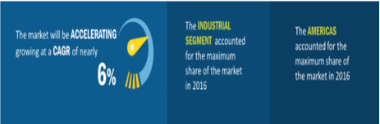
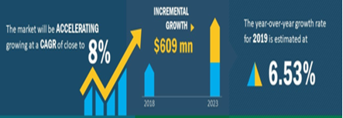
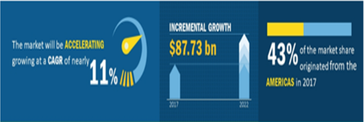
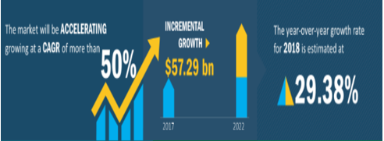
Future product mix changes will drive profitable growth
USB charger market compound growth rate of 6%; by the end of 2025 will reach 37.9 billion US dollars
Hybrid Power Hybrid Power Protector & Fast Charge Battery Charging
Compound annual growth rate of 50%
IOT applications and smart power systems
The compound growth rate of PDU for IT is about 8%; the estimated market value growth for 5 years is US $ 609M
Smart AV Power &
High-end cabinet power adapter
Pro AV compound annual growth rate of 11%; 5 years market value growth is estimated at US $ 87.7 billion
Home entertainment audio power equipment & full-featured gaming power supply
2020 product mix change will drive profitable growth

Slide 13
Ｑ＆Ａ
13

Slide 14


