Slide 1



GMI 1Q19 Earnings Release
May 28th, 2019

Slide 2

Safe Harbor Statements
GMI’s forward-looking statements, which may include statements regarding its results of operations, financial condition or business prospects, are subject to significant risks and uncertainties and are based on GMI’s current expectations.
Actual results may differ materially from those expressed or implied in these forward-looking statements for a variety of reasons, including, among other things: the cyclical nature of our industry; our dependence on introducing new products on a timely basis; our dependence on growth in the demand for our products; our ability to compete effectively; our dependence on key personnel; general economic and political conditions; possible disruptions in commercial activities caused by natural and human-induced disasters, including terrorist activity and armed conflict; and fluctuations in foreign currency exchange rates.
In addition, any financial information contained here within is presented in conformity with International Financial Reporting Standards (IFRSs).
Except as required by law, our release of financial forecasts and forward-looking statements at any particular time does not create any duty of disclosure, and we expressly disclaim any obligation to publicly update or revise any forecasts or forward-looking statements, whether as a result of new information, future events or otherwise.
  I. 公司本體部分
  II. 代理產品部分

Slide 3
Agenda
Company Brief
Financial Update
Business Outlook
Q&A

Slide 4

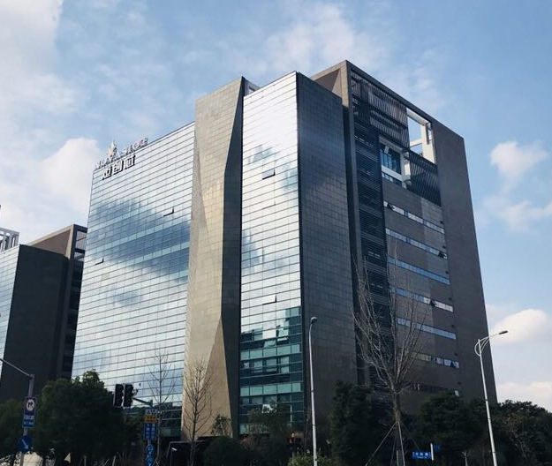




Company Overview
Established in 1995
Capital Amount: NTD$1.1 Billion
Headquarter in Taipei
10 service locations are located
China 、Hong Kong、Taiwan
Listed at OTC in 2005
Listed at TWSE in 2010
#3312
Over 180 employees

Slide 5

Financial-Consolidated operating income
(In NT$ Thousands)
QoQ
-13.3%
YoY
+20.5%

Slide 6
Financial-Consolidated operating gross profit margin
YoY
-0.03pt
QoQ
+0.40pt

Slide 7
Financial-Consolidated earnings per share
(In NT$)
QoQ
+0.01
YoY
-0.13

Slide 8
Financial-Consolidated income statement (Quarter)
(In NT$ Thousands)
Items |  | 1Q19 |  | 4Q18 |  | 1Q18 |  | Q-Q |  | Y-Y
Net Sales |  | 2,482,099 |  | 2,861,558 |  | 2,060,013 |  | (13.26%) |  | 20.49%
Operating costs |  | 2,369,575 |  | 2,743,303 |  | 1,966,082
Gross profit |  | 112,524 |  | 118,255 |  | 93,931 |  | (4.85%) |  | 19.79%
Selling expenses |  | 54,195 |  | 25,856 |  | 49,377
Administration expenses |  | 29,822 |  | 55,392 |  | 22,437
R&D expenses |  | 4,871 |  | 4,171 |  | 5,248
Expected credit gain |  | (6,336) |  | 0 |  | (356)
Operating expenses |  | 82,552 |  | 85,419 |  | 76,706
Operating income |  | 29,972 |  | 32,836 |  | 17,225 |  | (8.72%) |  | 74.00%
Net non-operating income and expenses |  | (69) |  | (451) |  | (2,078)
Net income before income tax |  | 29,903 |  | 32,385 |  | 15,147
Income tax expense(income) |  | 4,625 |  | 7,873 |  | (21,883)
Net income |  | 25,278 |  | 24,512 |  | 37,030 |  | 3.13% |  | (31.74%)
EPS attributable to the parent(NT$) |  | 0.23 |  | 0.22 |  | 0.36

Slide 9
Financial-Consolidated balance sheet
(In NT$ Thousands)
Items | 1Q19 |  | 4Q18 |  | 1Q18 |  | Q-Q |  | Y-Y
Cash and cash equivalents | 520,991 |  | 466,194 |  | 435,512 |  | 11.75% |  | 19.63%
Accounts receivable | 2,193,984 |  | 2,465,796 |  | 1,794,642 |  | (11.02%) |  | 22.25%
Inventories | 629,950 |  | 545,543 |  | 615,101
Other current assets | 275,014 |  | 287,839 |  | 290,003
Other non-current assets | 74,998 |  | 43,267 |  | 41,057
Total assets | 3,694,937 |  | 3,808,639 |  | 3,176,315
Short-term loans | 812,375 |  | 652,927 |  | 728,473 |  | 24.42% |  | 11.52%
Accounts payable | 1,345,311 |  | 1,671,228 |  | 1,100,156 |  | (19.50%) |  | 22.28%
Other current liabilities | 145,554 |  | 128,582 |  | 99,609
Total non-current liabilities | 31,823 |  | 22,006 |  | 52,292
Total equity | 1,359,874 |  | 1,333,896 |  | 1,195,785

Slide 10







Application Field
Consumer Electronic
TV│Tablet │BT Earphone
Communication/Networking
Smart Home│Telecomm and Networking Equipment
IoT
Smart Wear│Drone│Smart Light
Computer Peripherals
Server │ NB │ MB │Industrial PC
Automotive Electronics
Car Entertainment │ Car Safety
Industrial electronics
Medical Equipment │ Security System

Slide 11




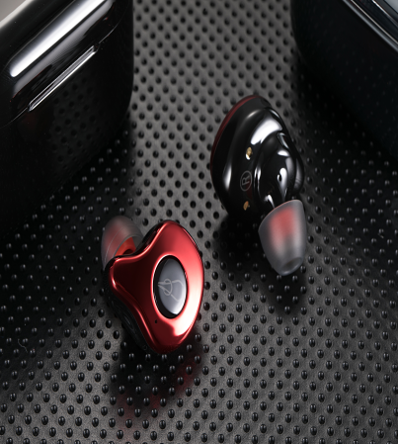

Growth kinetic energy field
True wireless bluetooth headset
  Sales exceeded 4.3 million wafers in the first quarter of 2019
  Accounting for 8.6% of overall revenue
New product line agent
  Intel I Chip MEMS MIC
  IDM Gas sensor
  antenna
  lithium polymer battery

Slide 12
New product line agent│IDM
MEMS Gas sensor
Application
Public Safety
Petrochemical
medical health
Wisdom
Livestock farming
Mobile wear
Food Testing
Odour recognition
IDM was founded in Suzhou in 2014 by NASA's original nano-gas sensor R&D team. It focuses on the development, production and establishment of artificial olfactory platform for advanced smart gas sensors.
MEMS gas sensor types: carbon monoxide, methane, formaldehyde, TVOC, hydrogen sulfide, ethanol, nitrogen oxides, ammonia, etc.
Product features: small size, low power consumption, integration and intelligence
空气质量检测模组

Slide 13
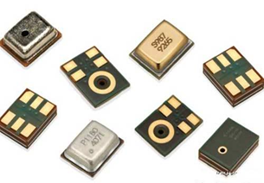
New product line agent│Intel I Chip
Intel I Chip ：Committed to MEMS smart sensing products and modules
Intel I Chip Microelectronics was founded in 2018 by the Microelectronics R&D team of Sun Yat-sen University in Guangzhou Technology Enterprise Accelerator.
With wafer design, package testing, acoustic applications, this multi-year experience team features: small size, low power, integration and intelligence
Annual production capacity of 60 million
Air pressure sensor
Car
Drone
e-cigarette
Wearable product
MEMS microphone
Headphone
Mobile phone
Notebook
Wearable product
空气质量检测模组

Slide 14
New product line agent │EML
Focus on the production of small and medium-sized micro-capacity lithium batteries
Others
Wearable
Mobile
Networking
Video
Industrial
High Power
GPS &Tracker
鋰電池
Headquartered in Hangzhou, the investment in plant, equipment, R&D and testing exceeds RMB 500 million.
Designed and manufactured from the battery core to the battery pack, the monthly production capacity exceeds 3 million pcs.
Customized design is high, and it has design capabilities such as high temperature resistance and fast charge system.
Product certification is complete, targeting high-end customers。

Slide 15

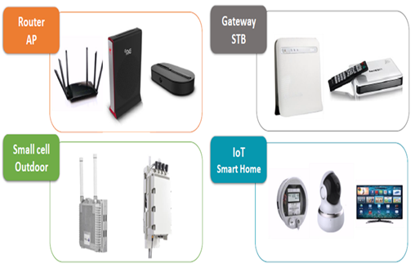
New product line agent │ ANGEEI
Antenna professional supplier
Headquarters and factory located in Zhangjiagang, Suzhou, designed and produced by itself, with a number of product design patents
The factory has passed ISO14001/IATF16949 certification.
Through Hongyi International's years of hard work in the communication network market, we provide customers with more comprehensive solutions.

Slide 16
Q & A

