Slide 1


GLOBAL MOBILE INTELLIGENCE(3312)
3Q19 Result Briefing

Slide 2


Disclaimer
Except for historical information contained herein, the matters set forth in this presentation are forward looking statements that are subject to risks and uncertainties that could cause actual results to differ materially, including the impact of competitive products and pricing, timely design acceptance by our customers, timely introduction of new technologies, ability to ramp new products into volume, industry wide shifts in supply and demand for semiconductor products, industry overcapacity, availability of manufacturing capacity, financial stability in end markets, and other risks.

Slide 3

Company Introduction
1
Company Profile
04
Financial
2
Financial Result
07
Operational
3
Outlook
13
Q & A
4
Q&A
17

Slide 4






Company Introduction
Company profile
Since 1995
Capital 1.18 billion
Headquarter: Taipei
12 locations in China,
Hong Kong, Taiwan
IPO in 2010 #3312
>180 employees

Slide 5
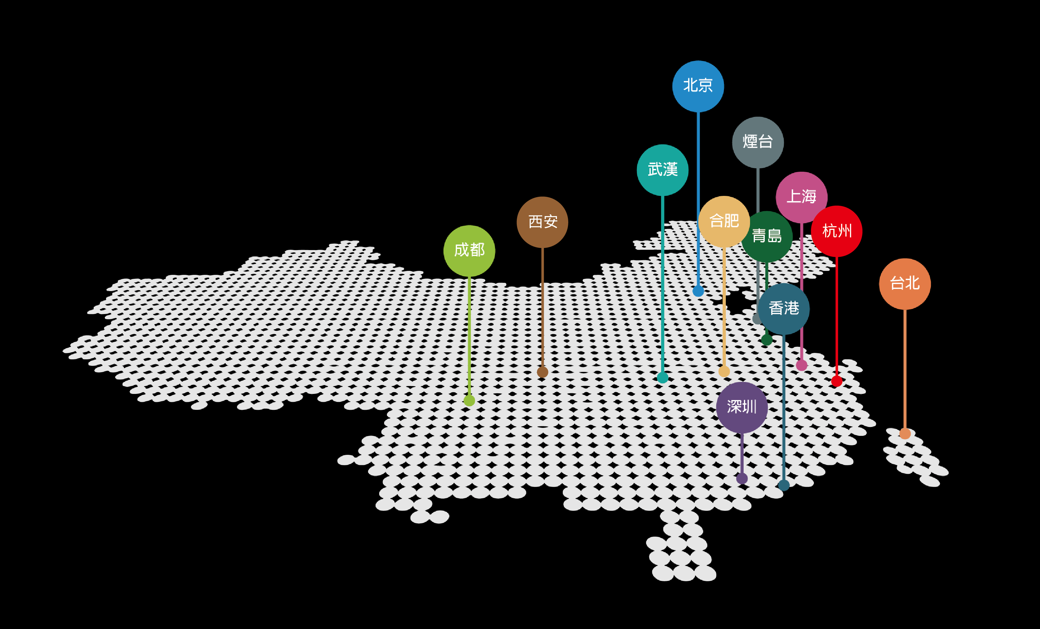
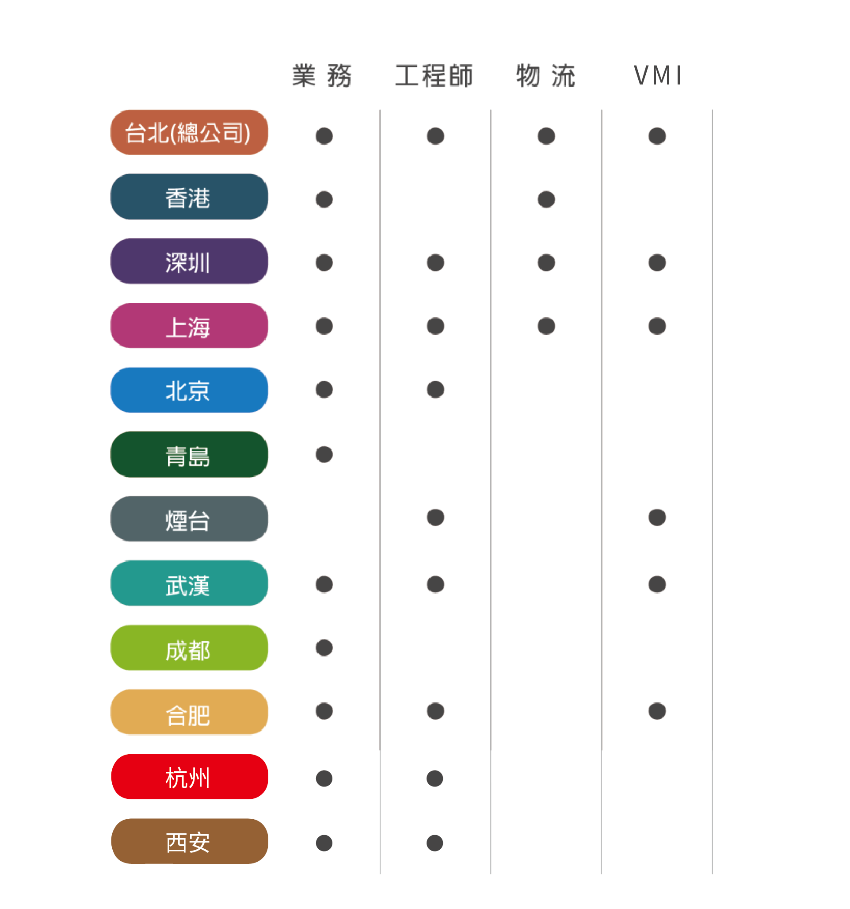
Locations

Slide 6
Company Introduction
1
Company Profile
04
Financial
2
Financial Result
07
Operational
3
Outlook
13
Q & A
4
Q&A
17

Slide 7
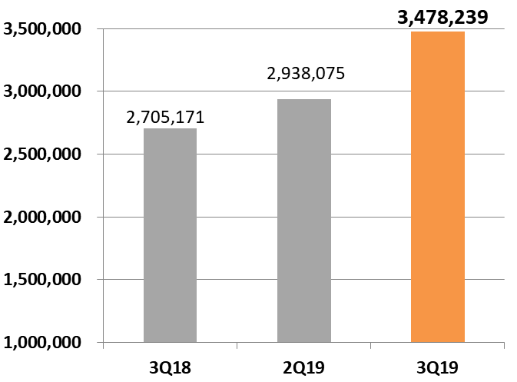
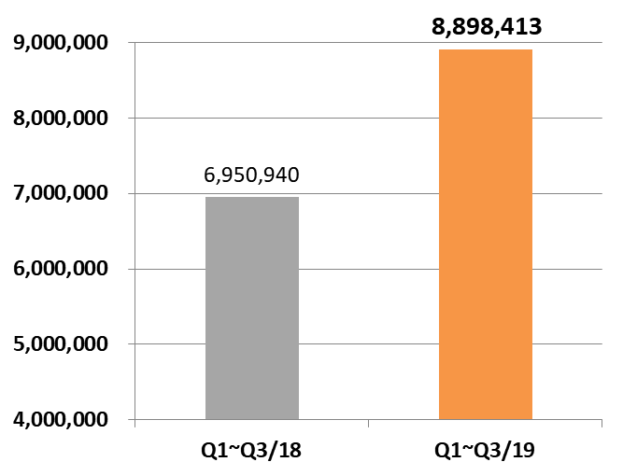
Financial-Consolidated Revenue
(In NT$ thousands unless otherwise noted)
YoY
28.58%
QoQ
18.38%
YoY
28.02%

Slide 8
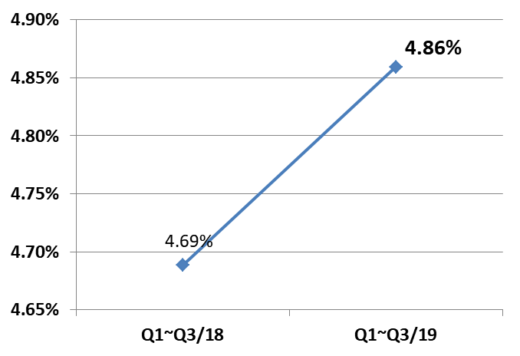
Financial-Gross Margin
QoQ
-0.51pt
YoY
+0.17pt
YoY
+0.28pt

Slide 9
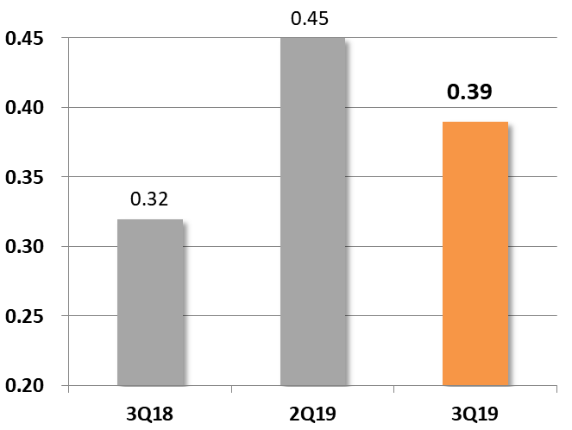
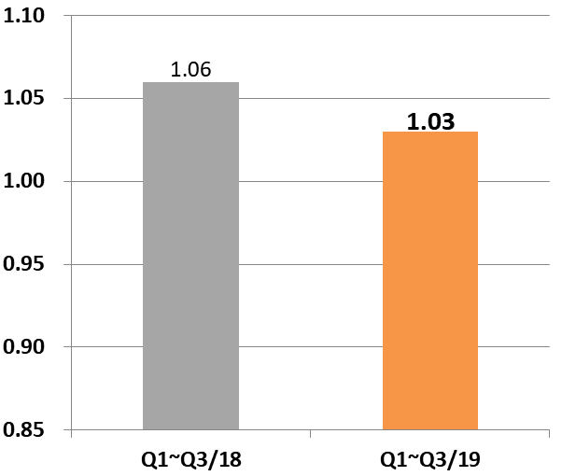
Financial- Consolidated Earnings Per Share
(In NT$ thousands unless otherwise noted)
QoQ
-0.06
YoY
-0.03
YoY
+0.07

Slide 10
Financial- Consolidated Income Statement- Quarterly
(In NT$ thousands unless otherwise noted)
 |  | 3Q19 |  | 2Q19 |  | 3Q18 |  | QoQ |  | YoY
Net Sales |  | 3,478,239 |  | 2,938,075 |  | 2,705,171 |  | 18.38% |  | 28.58%
Operating costs |  | 3,312,946 |  | 2,783,481 |  | 2,584,349
Gross Profit |  | 165,293 |  | 154,594 |  | 120,822 |  | 6.92% |  | 36.81%
Selling expenses |  | 59,821 |  | 55,777 |  | 26,453
Administrative expenses |  | 32,039 |  | 27,352 |  | 48,750
R&D expenses |  | 4,504 |  | 5,170 |  | 4,413
Expected credit gain |  | 919 |  | 1,978 |  | (4,398)
Operating expenses |  | 97,283 |  | 90,277 |  | 75,218
Operating income |  | 68,010 |  | 64,317 |  | 45,604 |  | 5.74% |  | 49.13%
Net non-operating income |  | (3,787) |  | (1,125) |  | 2,214
Net income before income tax |  | 64,223 |  | 63,192 |  | 47,818
Income tax expense (income) |  | 17,717 |  | 13,668 |  | 12,544
Net profit |  | 46,506 |  | 49,524 |  | 35,274 |  | (6.09%) |  | 31.84%
EPS |  | 0.39 |  | 0.45 |  | 0.32

Slide 11
Financial-Consolidated Income Statement - Yearly
(In NT$ thousands unless otherwise noted)
 |  | Q1~Q3/19 |  | Q1~Q3/ 18 |  | YoY
Net Sales |  | 8,898,413 |  | 6,950,940 |  | 28.02%
Operating costs |  | 8,466,002 |  | 6,625,039
Gross Profit |  | 432,411 |  | 325,901 |  | 32.68%
Selling expenses |  | 169,793 |  | 123,069
Administrative expenses |  | 89,213 |  | 94,837
R&D expenses |  | 14,545 |  | 14,523
Expected credit gain |  | (3,439) |  | ( 18,598)
Operating expenses |  | 270,112 |  | 213,831
Operating income |  | 162,299 |  | 112,070 |  | 44.82%
Net non-operating income and expenses |  | (4,981) |  | (2,758)
Net income before income tax |  | 157,318 |  | 109,312
Income tax expense(benefit) |  | 36,010 |  | (4,637)
Net Income |  | 121,308 |  | 113,949 |  | 6.46%
EPS |  | 1.03 |  | 1.06

Slide 12
Financial-Consolidated Balance Sheet
(In NT$ thousand unless otherwise noted)
Item | 2019 3Q |  | 2019 2Q |  | 2018 3Q |  | QoQ |  | YoY
Cash and cash equivalents | 653,962 |  | 475,580 |  | 368,534 |  | 37.51% |  | 77.45%
Account receivable | 2,956,574 |  | 2,455,226 |  | 2,351,738 |  | 20.42% |  | 25.72%
Inventories | 659,255 |  | 699,805 |  | 635,035
Other current assets | 323,474 |  | 295,980 |  | 317,482
Other non-current assets | 64,584 |  | 68,284 |  | 38,746
Total Assets | 4,657,849 |  | 3,994,875 |  | 3,711,535
Short term loans | 854,398 |  | 594,629 |  | 772,830 |  | 43.69% |  | 10.55%
Account payable | 2,046,025 |  | 1,750,201 |  | 1,480,752 |  | 16.90% |  | 38.17%
Other current liabilities | 346,315 |  | 279,971 |  | 119,656
Total non-current liabilities | 14,102 |  | 16,024 |  | 32,292
Total Liabilities | 3,260,840 |  | 2,640,825 |  | 2,405,530
Total Equity | 1,397,009 |  | 1,354,050 |  | 1,306,005

Slide 13
Company Introduction
1
Company Profile
04
Financial
2
Financial Result
07
Operational
3
Outlook
13
Q & A
4
Q&A
17

Slide 14



Outlook│Growth drivers
True Wireless Earphones
  Represent 5~7% of 3Q19 revenue
  4Q19 revenue better than previous quarters in 2019
  MEMS MIC start shipping
  New projects
      In-Ear Test P-Sensor
      Gravity Test G-Sensor
      Ceramic Antenna Chip-Antenna
New product distribution
  OPNOUS
    ToF (Time of Flight) Sensor
  Actnano
    Coating Solution
  Suzhou Huiwen Nano S&T gas sensor
    TVOC, 甲醛, 甲烷, 一氧化碳, 硫化氫, 氨氣, 酒精

Slide 15
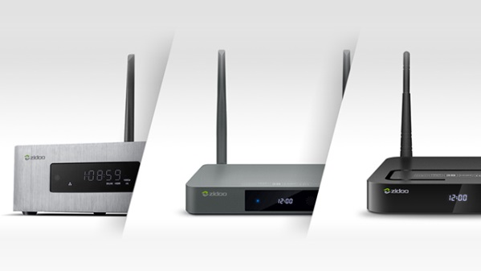


Outlook│Growth drivers
  Overseas OTT BOX Market
  GMI distribute key wireless chips
  Represent 10~13% of 3Q19 revenue.
  New product launches in 4Q19
Spectrum auction market
  Expect WIFI business started to generate revenue since end of 3Q19
  4Q19 Revenue better than 3Q19
  GPON shipment on track

Slide 16
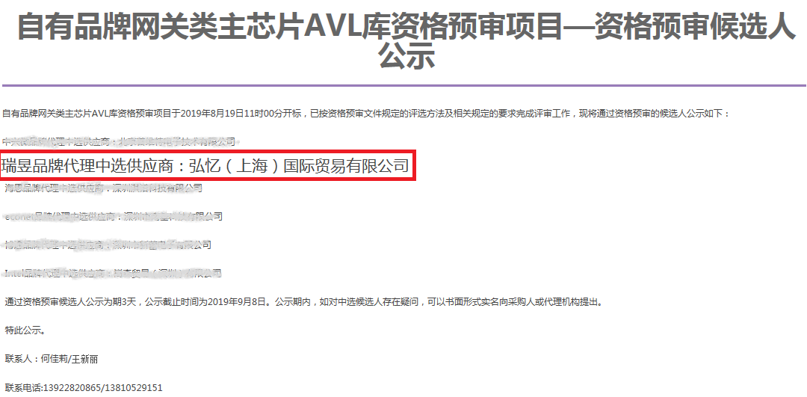
Outlook│Growth drivers
GMI being selected as China Mobile’s chip supplier (announced on August 19, 2019)
Source: https://b2b.10086.cn/b2b/main/viewNoticeContent.html?noticeBean.id=593681&from=singlemessage&isappinstalled=0

Slide 17
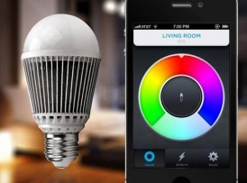
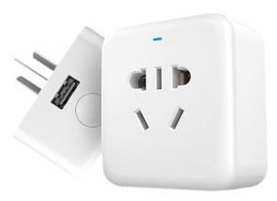
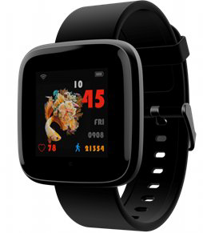
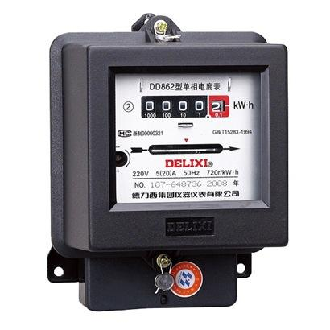
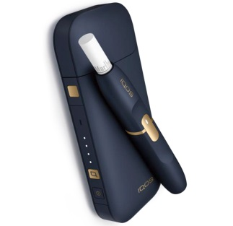
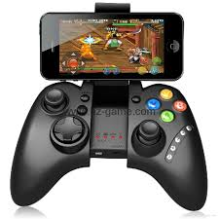
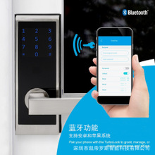
Outlook│Growth drivers
  Bluetooth
  Smart speaker peripherals
  Wearables - health
  Electric Meter Market
  E-cigarette: Est. 3bn units in 2019
  Gamepad
  Smart lock

Slide 18

ＴＨＡＮＫ ＹＯＵ！
Q & A

