Slide 1

GMI Technology(3312)
2021 Second Quarter Earnings Conference
Mana Chiang, Head of sales / Peggy Yeh, Manager Office Operator
Ivan Liu, CEO / Jason Lin, CFO
Date: 2021/08/20

Slide 2
Safe Harbor Notice
Except for historical information contained herein, the matters set forth in this presentation are forward looking statements that are subject to risks and uncertainties that could cause actual results to differ materially, including the impact of competitive products and pricing, timely design acceptance by our customers, timely introduction of new technologies, ability to ramp new products into volume, industry wide shifts in supply and demand for semiconductor products, industry overcapacity, availability of manufacturing capacity, financial stability in end markets, and other risks.

Slide 3
1
2
Outlines
Company Profile
Financials
3
4
Operation Overview
Q&A

Slide 4






Company introduction
Founded in 1995
Capital NTD 1.25Billion
Based in Taipei
12 Operating locations across China, HK and Taiwan
Listed in Taiwan since 2010,
Ticker 3312 TT
Over 190 employee
4

Slide 5
Company introduction_Major Events
According to CHINA CREDIT INFORMATION SERVICE, LTD.’s 2021 survey:
Ranked 18th in Neihu Science and Technology Park Revenue survey
Ranked 19th in Distributor survey
Ranked 119th in Service Industry survey
Ranked 312nd in Public and Private Enterprise survey
Ranked 388th in Service Industry Performance survey
Ranked 894th in Enterprise Overall Performance survey
Notes:
依據中華徵信所 2021年版「台灣地區大型企業排名 TOP5000」
台北內湖科技園區營收淨額排名 : 第18名
電子零組件批售業 : 第19名
服務業營收淨額排名 : 第119名
公民營企業混合排名 : 第312名
服務業經營績效排名 : 第388名
企業經營績效混合排名 : 第894名

Slide 6
2
Financial Result

Slide 7
(In NT$ thousands)

Slide 9
Financial- Consolidated Earnings Per Share
(In NT$ )
QoQ +0.42
YoY +0.71
YoY +1.02
9

Slide 10
Financial- Consolidated Income Statement- Quarterly
(In NT$ thousands)
10

Slide 11
Financial-Consolidated Income Statement - Yearly
(In NT$ thousands)
11

Slide 12
Financial-Consolidated Income Statement - Yearly
(In NT$ thousands)
12

Slide 13
3
Operation Overview
Outlook

Slide 14
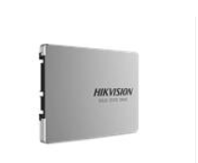
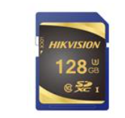

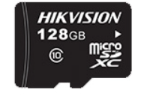
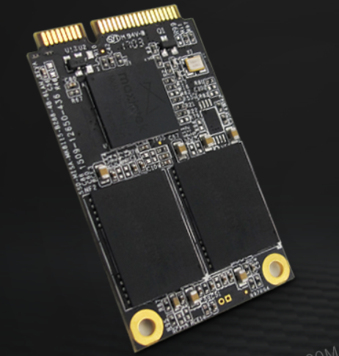
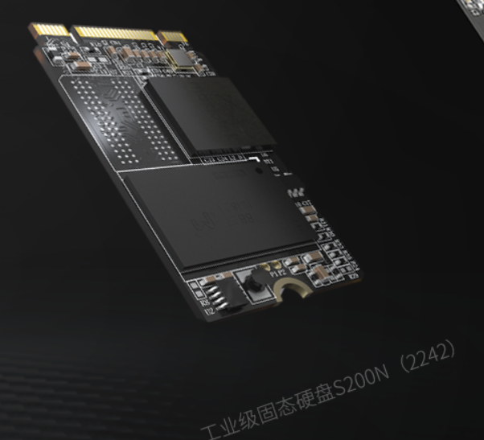
NIKVISION
RMB 100M
May 2017
NIKVISION Hangzhou a Subsidy of NIKVISION. Thanks to decades of hard work, NIKVISION Hangzhou is devoted to Smart Storage product and Flash Memory applications.
NIKVISION product is compatible to Industrial control systems, data center solutions and CCTV solutions.
2020 Revenues RMB1.4Bn，2021 estimated Revenue RMB2.1Bn
GMI provide service to Industrial peripheral companies、Web Security companies. GMI service also include SSD Solutions.
GMI Automobile department provides card solutions and Navigation Solutions
GMI provide service to Set-top box companies, GMI service also include EMMC solution.

Slide 15

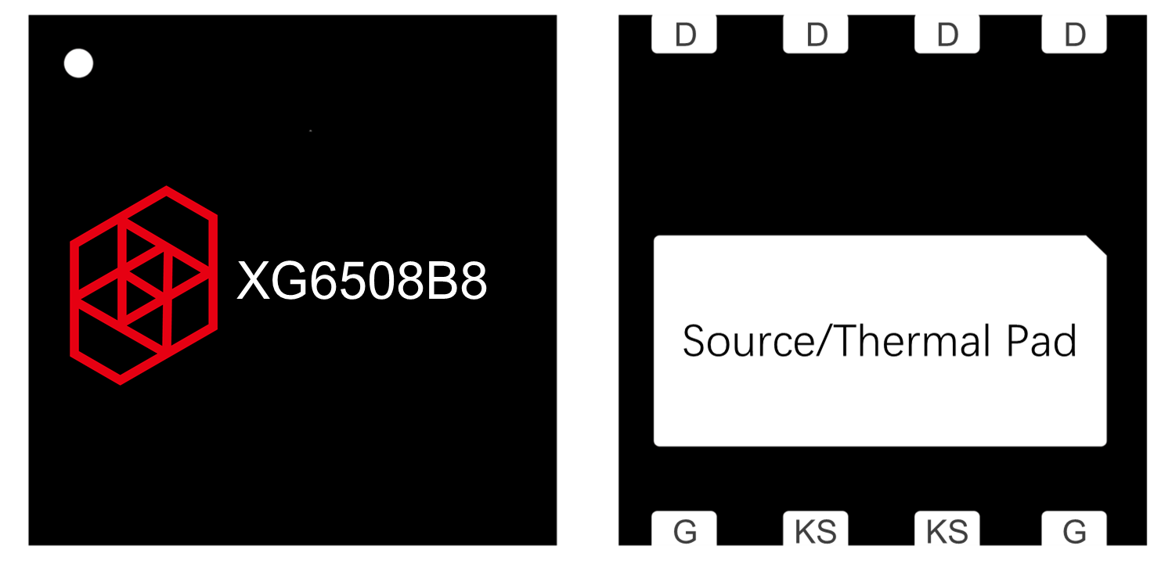
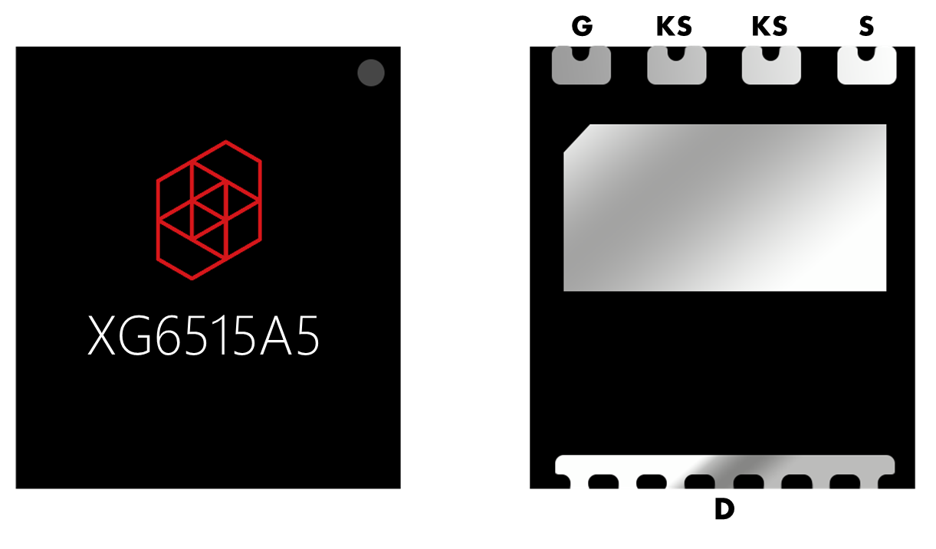
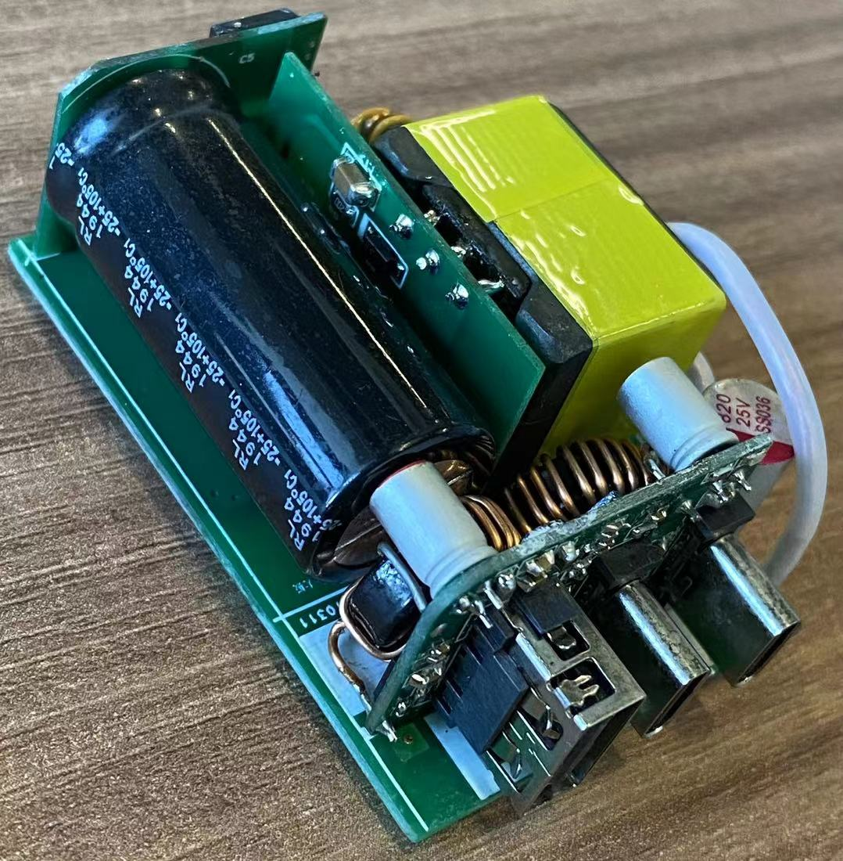
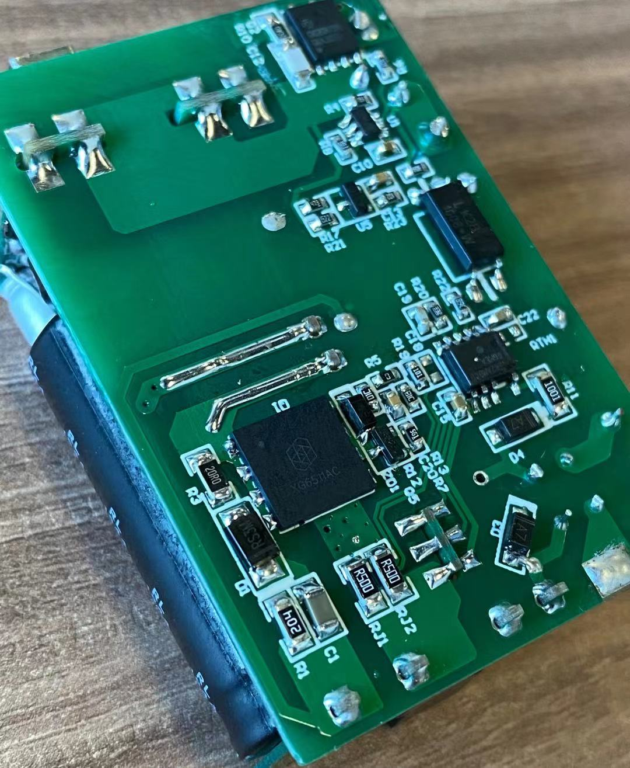
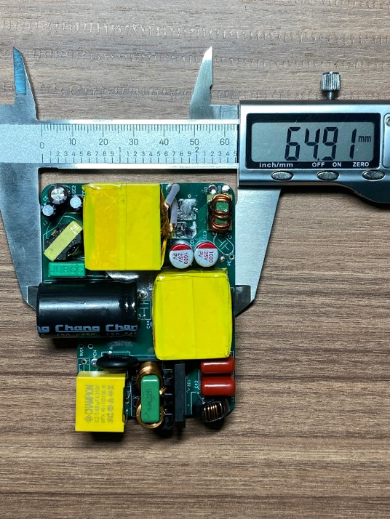
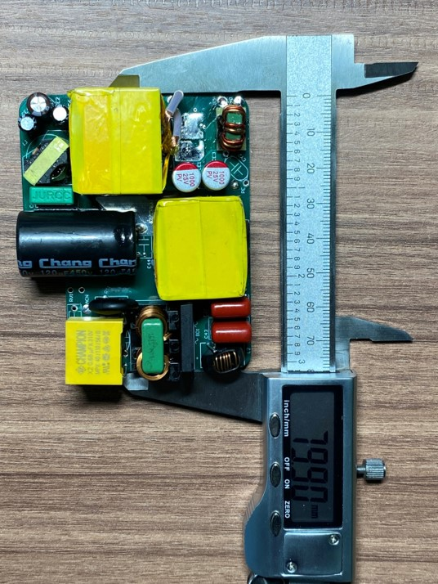
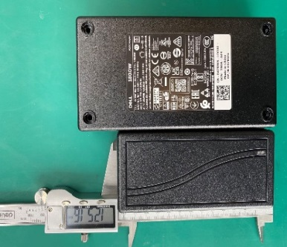
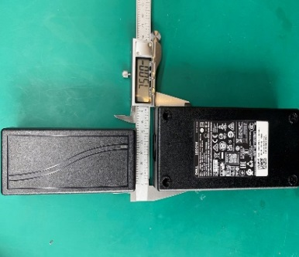
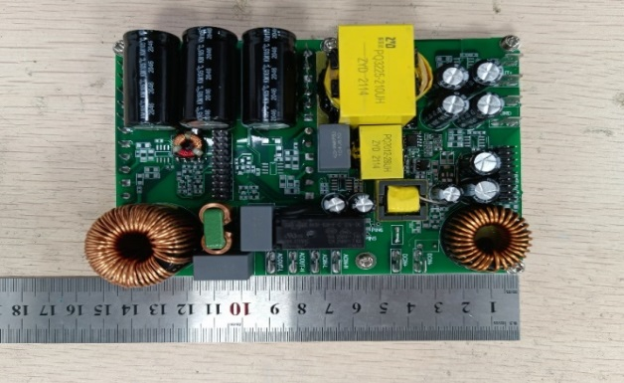
Xin Kan Xian Nanjing Inc. (X-IPM)
RMB 10 Million
OCT 2020
Xin Kan Xian is devoted to Power semiconductor solutions.
(Fabless+IDH) tape out at TSMC and Sanan Optoelectronics Co.
Self R&D GaN MOS & SiC-SBD.
Provide a more integrated solitons thanks to power module
XPC180G
Computer Power Adapter、Server、PC power application
Solar power storage、Energy storage、UPS、5G network station power
XPC180G

Slide 16




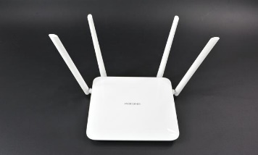


CREOTECH
RMB 14.26 Million
2012
RF IC Design House
Quantity: 10M/Year
Product include WiFi-5、WiFi-6、4G、5G
WiFi Product、Small Network Stations、Smart home
Consumer product、Drone
GMI has successfully entered the operator and open-bid market.

Slide 17
Zbit (NOR FLASH):Taiwan Design house provided 1000 million of shipment over the past two decades.
CREOTECH (FEM): plan to mass production in 3Q21
StorArt (Storage Controller Chip): Design House founded in China has launched 1.1 million shipment over the last two decades.
APEC (MOSFET): Shipment launched since June 2021 and has shipped 3 million shipment.
PSAP Market: Client is currently mass producing over 600 shipment. GMI awaits result.
Bluetooth wearable chips has launched 3.4 million shipments over the past two decades.
IOT shipment mounted over 13 million shipment over the past two decades.
WIFI-6 end customer has entered mass production phase and has shipped over 2 million shipment over the past two decades.
2.5GbE shipment has launched 1.1 million shipment over the past two decades.

Slide 18

Operator and Open-bid market
IPTV/AP Router/XPON/XDSL/IP-CAM
2Q21 Sales account for 22~25% of total revenue
47%YoY Growth
Laptop and Desktop
2Q21 sales account for 13~15% of total revenue
28% YoY growth

Slide 19
Major Suppliers’ production capacity is still tight. The industry is likely to hold an optimistic yet careful attitude over the supply & demand in 2H21
Wireless Wifi→ Consumer product, IOT and open-bid market contribute a large amount of revenue. On the other hand, WIFI6 computer and router penetration rate reached over 30%, which has a high growth momentum
Ethernet→ Fast Ethernet, Gigabit Ethernet, 2.5GbE demand over supply imbalance trend is likely to continue in 2H21
Computer and peripheral application→ Strong demand continues and major supplier are adjusting rolling order
Wifi Product→ Major client in China direct shipment remain strong, thus revenue contribution continues.

Slide 20
Q&A
GMI Technology（3312）
http://www.gmitec.com
THANK YOU!

