Slide 1
融程電訊(3416)
Company Presentation
9th Jan 2018

Slide 2
2017 1~3Q Income Statement
Consolidated；NT$ ‘Thousands
項目＼年度 | 2017 Q3 | % | 2017/1-3Q | % | 2016/1-3Q | % | YoY
Revenue | 344,393 | 100.00% | 1,027,979 | 100.00% | 985,569 | 100.00% | 4.30%
Gross Margin | 115,939 | 33.66% | 352,014 | 34.24% | 388,373 | 39.41% | -9.36%
Operating Expenses | 78,304 | 22.74% | 231,096 | 22.48% | 217,619 | 22.08% | 6.19%
Operating Income | 37,635 | 10.93% | 120,918 | 11.76% | 170,754 | 17.33% | -29.19%
Non-operating Income | - 1,072 | -0.31% | - 13,502 | -1.3% | - 4,516 | -0.46% | 298.98%
Pre-Tax Income | 36,563 | 10.62% | 107,416 | 10.45% | 166,238 | 16.87% | -35.38%
Net Income | 31,567 | 9.17% | 91,014 | 8.85% | 142,568 | 14.47% | -36.16%
EPS (元) | 0.52 |  | 1.51 |  | 2.37
2

Slide 3


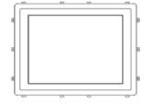

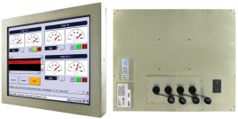
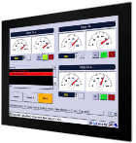
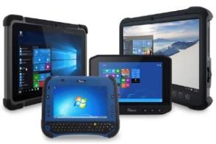
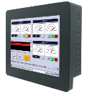
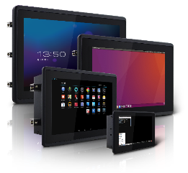
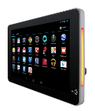
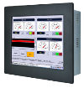
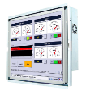
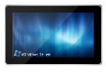
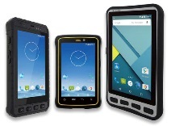
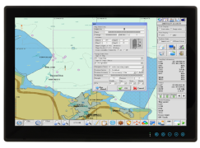


Product Category 2017
Touch /Industrial Display Rugged Display
Industrial PC
Embedded Computing
高階特殊工業用
液晶顯示應用模組
嵌入式系統模組
Display
Panel PC
Mobile
17.79%
NT$ 252M
77.78%
NT$ 1,100M

Slide 4
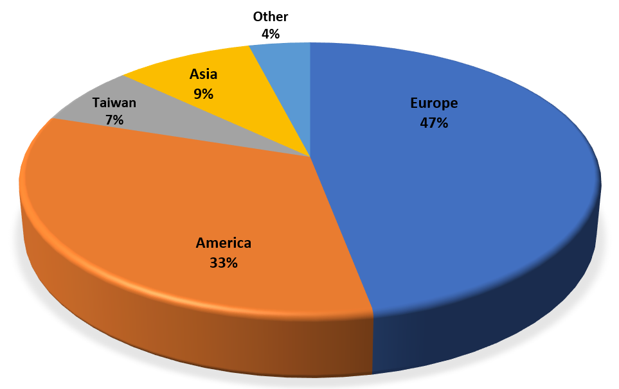
Sales by Region 2017
2017 sales NT$ 1,415M
YoY 5.07%
4

Slide 5

Financial Ratio cash rich and good payout
NT$ Thousands | 2015 | 2016 | 2017
 | Year end | Year end | Q3
Cash quivalents | 939,928 | 885,837 | 726,083
Debt ratio | 13.83% | 15.94% | 14.68%
AR | 133,109 | 119,946 | 128,633
DSO(days) | 41 | 34 | 33
Inventory | 181,024 | 236,159 | 261,346
DOH(days) | 76 | 92 | 101
AP | 114,707 | 147,931 | 104,003
days | 43 | 58 | 51
NI % | 13.96% | 13.69% | 8.85%
Payout ratio | 99.43% | 98.04% | n.a.
5

Slide 6

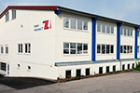
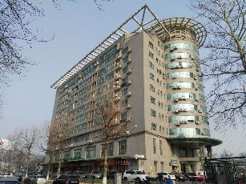

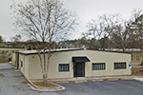
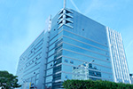

Global Presence
TTX -Toronto
European Service Center – Munich
Beijing
Winmate US
/ Service Center – Atlanta
Winmate HQ
Winmate’s Office
& Service Center
Winmate’s Partners

Slide 7

2018 Focus Industries & Markets
Warehouse & Logistics
(20%)
Industrial Automation
(18%)
Vehicle Diagnostic ,
Electric Car
(12%)
Medical application
(13%)
Field Service / Oil & Gas / Heavy Duty Vehicles (22%)
Military/ Marine/ Aviation
(15%)

Slide 8










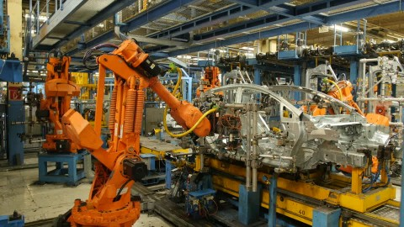
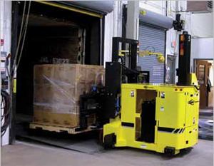
Winmate Industrial Mega Trends
Cloud Analytic & Preventive computing
iIoT (Industrial IoT)
Industry 4.0
Digital Logistics

Slide 9
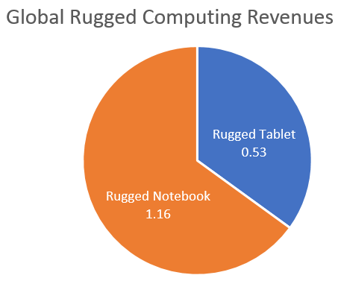
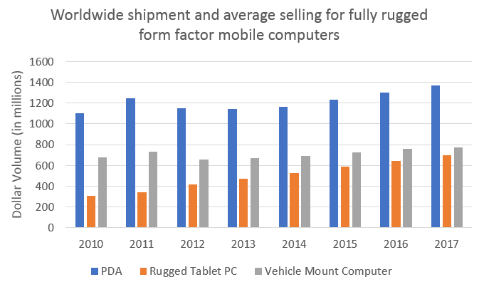
Growing Rugged Mobile Computing Market
Global revenues for Rugged Computing are estimated to be $1.7 billion (2016)
Rugged notebook revenues: $1.16 billion
Rugged tablet revenues: $530 million
Growth Rate (CAGR) for this market is expecting 5% - 10% until 2020
Source VDC 2016 Report

Slide 10
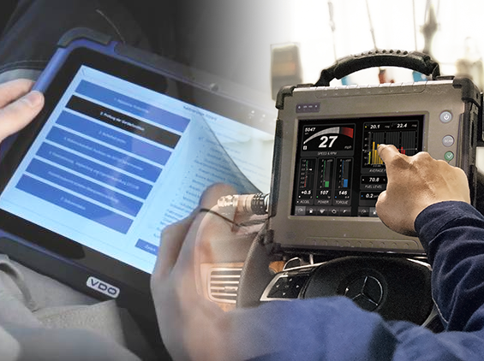
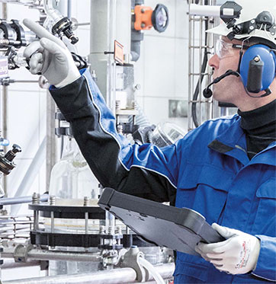
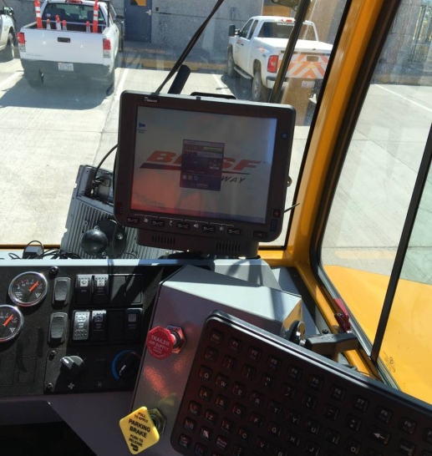
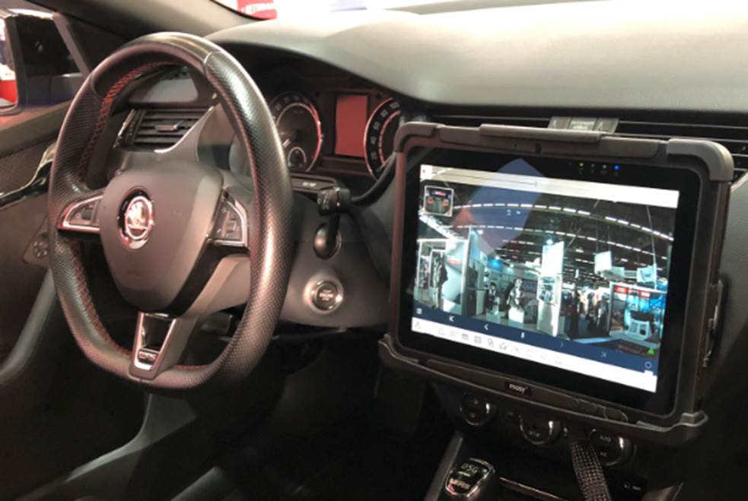



Mission Critical and Industrial Applications
Vehicle Diagnostic
For Smart Car Manufacturing
Oil & Gas
Special Zone Use
Logistics & Warehousing Computer
Forklift / Vehicle Mount Computer
135 Developers
& System Engineers
Certified ATEX & Medical (ISO13845) quality production
Global Domain Know-How & Service Centers

Slide 11



Q & A
11

