Slide 1
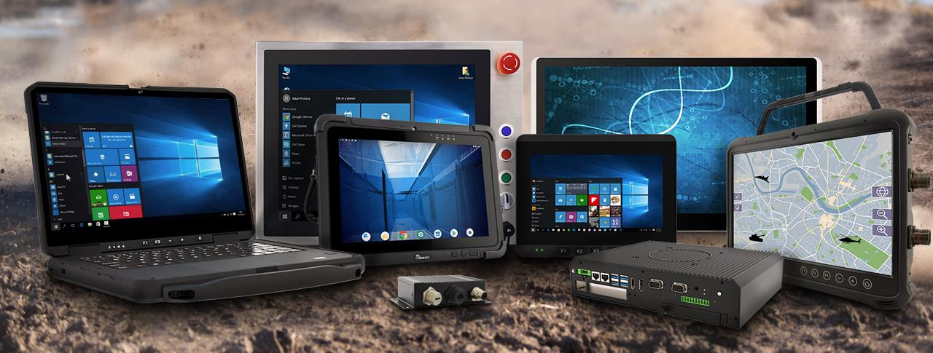

WINMATE INC
Enabler of Enterprise Mobility
3416 TT
2021Q2 INVESTOR PRESENTATION
Notes:
Welcome to Winmate

Slide 2



Company Snapshot
Winmate Inc. (3416 TT)
We are a pioneer in rugged mobile computing technology, particularly in rugged tablet.
We have provided business leaders with reliable, mobile, rugged solutions made for the most challenging industrial conditions worldwide.
2020 Total sales: USD65m
2020 Gross margin: 35%
2020 ROE: 12%
2020 Net cash: USD35m
Net cash to equity: 46%
400+ Employees Worldwide
150+ R&D Engineers
50+ Distribution Channels
(ODM, OEM, Direct, SI)
Market Cap: USD198m

Slide 3
Business Outlook
Strong Order Momentum in Automotive Continues. Orders in Warehouse Logistics and Healthcare will also be Promising
Enterprise Mobility
Rugged Tablet
New Product Line
Outlook
Rapid Multi-Year Growth Trend
Driving Growth in 3 Fast-Growing Verticals (Automotive, Warehouse Logistics and Healthcare)
Entering the Rugged Laptop Market
Confident to Deliver Multi-Year Revenue Growth with Stable Profitability
3
Notes:
Operational Vision:
We continue to have very strong growth momentum for 2021 in the Automotive and Warehouse logistics with huge orders from Daimler and Honeywell, and we have begun to produced in large quantities Medtronic's medical tablets in Q1 2022, that’s for the healthcare industry.
Our four majority orders, including DAIMLER car diagnostics tablet, the warehouse tablet, medical coma index tablet and BOSCH car diagnostics inspection tablet.
Besides we are about to launch a new product , the rugged laptop , Defense , public safety and automotive .
We have a very positive outlook with confidence in delivering stable growth and profits for the next 5 years.

Slide 4




Key concept: Enterprise Mobility
Industry Outlook
Who we are & What we do
Growth Strategy
Commitment to Sustainability
Financial Performance
AGENDA

Slide 5


ENTERPRISE
MOBILITY

Slide 6
Key Concept: Enterprise Mobility
01
Enterprise Mobility is an approach to work in which employees can do their jobs from anywhere using a variety of devices and applications.
02
Commonly refers to the use of mobile devices, such as smartphones and tablets.
MORE MOBILITY NEEDED FROM THE INDUSTRIAL SPACE
Early adaptors of Enterprise Mobility in the industrial space are the Utilities, Mining, Oil & Gas, and Field Service industries due to their widely dispersed workforce. Rugged tablets have become indispensable due to their portability. mobility.
03
04
As the smart manufacturing transformation takes hold, more and more manufacturing companies are using rugged tablets for enhanced mobility on the production line, as well as in warehouses and service centers.
6
Notes:
Enterprise Mobility is an approach to work in which employees can do their jobs from anywhere using a variety of devices and applications.
Commonly refers to the use of mobile devices, such as smartphones and tablets.
Early adaptors of Enterprise Mobility in the industrial space are the Utilities, Mining, Oil & Gas, and Field Service industries due to their widely dispersed workforce. Rugged tablets have become indispensable due to their portability.
As the smart manufacturing transformation takes hold, more and more manufacturing companies are using rugged tablets for enhanced mobility on the production line, as well as in warehouses and service centers.

Slide 7

INDUSTRY
OUTLOOK

Slide 8
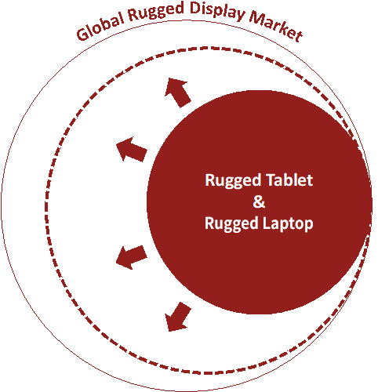
Rugged Tablet Offers The Most Mobility
in Enterprise Mobility
We look only at the industrial segment (global rugged display market) under Enterprise Mobility, the market size is about US$7.5bn with growth of 6-7% per annum.
The Global rugged display market encompasses rugged display, rugged PDA, rugged tablet, and rugged Laptop;
Within the industrial space, the Enterprise Mobility transformation is causing a demand shift towards rugged tablet and rugged Laptop, from traditional PC’s
The shift to rugged tablet is especially apparent.
8
Source: Market study report, Winmate estimates
Notes:
Due to the impact of the COVID19 pandemic, companies have increasingly higher demand for mobility devices. More and more manufacturing industries are using rugged tablet computers to meet the needs of production lines such as warehousing and logistics.
Rugged devices including displays, tablets, laptops, and PDAs. The global rugged display market is about 7.5 billion U.S. dollars, with an annual growth rate of 6-7%.
Within the industrial space, the Enterprise Mobility transformation is causing a demand shift towards rugged tablet and rugged Laptop, from traditional desktop PCs .
Winmate expects double-digit YoY growth within the rugged tablet and rugged notebook segment and its market size could double in 5 years.

Slide 9
Enterprise Mobility –
Rugged Tablet The Biggest Beneficiary
US$2bn
US$1bn
Winmate expects double-digit YoY growth within the rugged tablet segment and its market size could double in 5 years;
Winmate believes that its overall sales can grow at around 20-30% per year on the back of the Enterprise Mobility Transformation and market share gain versus industry peers
9
Notes:
Winmate expects double-digit YoY growth within the rugged tablet segment and its market size could double in 5 years;
Winmate believes that its overall sales can grow at around 20-30% per year on the back of the Enterprise Mobility Transformation and market share gain versus industry peers

Slide 10
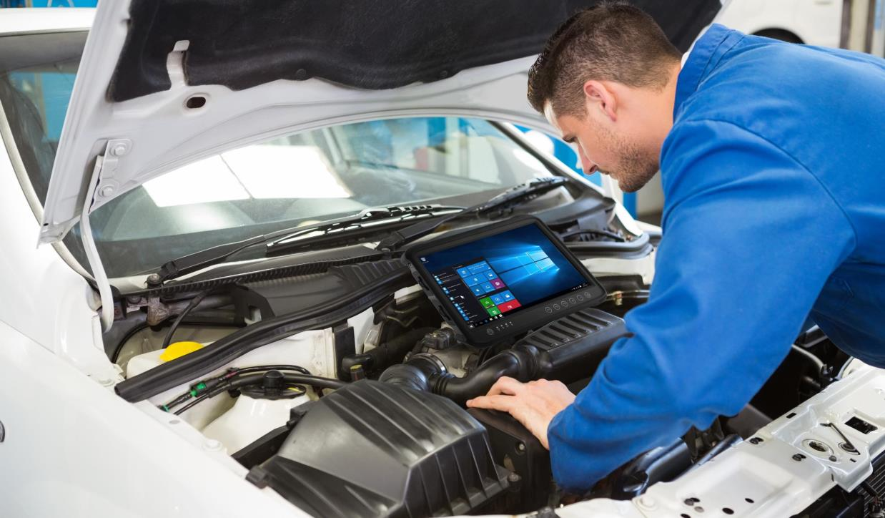
WHO WE ARE &
WHAT WE DO

Slide 11

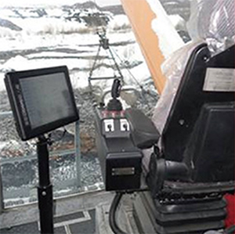
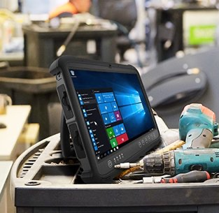

What is a Rugged Tablet?
Rugged tablets are designed to withstand hard knocks, long drops, high or low temperatures, moisture, dust and even explosions (for oil rigs or mining usage), yet still provide a great user experience.
Rugged tablets have been put through rigorous testing to make sure they can survive extreme conditions. A few examples of mission-critical uses are oil and gas, marine, mining, aerospace, and medical.
Other key rugged tablet use cases are production lines, field service, logistics and warehouses.
11
Notes:
Rugged tablets are designed to withstand hard knocks, long drops, high or low temperatures, moisture, dust and even explosions (for oil rigs or mining usage), yet still provide a great user experience.
Rugged tablets have been put through rigorous testing to make sure they can survive extreme conditions. A few examples of mission-critical uses are oil and gas, marine, mining, aerospace, and medical.
Other key rugged tablet use cases are production lines, field service, logistics and warehouses.

Slide 12

Milestones & Transformation
Bid for Mercedes Benz worldwide service centers rugged tablet orders (large quantity) but failed
Transformation into an IPC company
Apple launched 1st generation iPad
1996
2008
2019
2005
2010
2014
Started out as Touch panel (ELO) distributor in Taiwan
Winmate was one of the first to successfully develop rugged tablets
First major breakthrough with Mercedes Benz (small order)
Five years later, Winmate beat all other vendors and won a multi-year contract to supply Mercedes Benz service centers globally
Many new order inquiries soon followed…

Slide 13
Sales by Product Type
1H21 Sales by Region
NT$m
1,846
1,666
1,565
1,196
13
Notes:
The proportion of product sales:
85% tablet computer industrial computer
13% industrial displays.
The proportion of sales area in the first half of the year:
48% Europe
30% Asia
19% USA.

Slide 14

GROWTH STRATEGY

Slide 15
Rugged Tablet: Focus on 3 Verticals
(2021 Target Revenue Mix)
37%
Other
31%
Vehicle Diagnostics
Electric Vehicles
(including field service, heavy duty vehicles, oil & gas, public safety, industrial automation, marine, aviation, and other)
7%
Healthcare
Applications
25%
Warehouse & Logistics
15
Notes:
Our major well-known clients
31%in vehicle diagnostics/electric vehicles: Mercedes, Continental, Maserati
25%in warehousing logistics: Honeywell, Crown
37% in Field Service/Heavy Load Engineering/Oil and Gas/Public Safety/Factory Automation/Ship/Aviation: Bartec and DR Group
7%in Healthcare: Medtronic

Slide 16
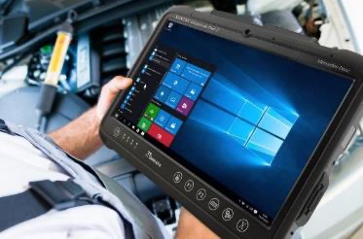
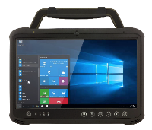
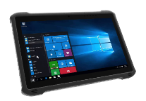
Rugged Tablet:
Strong Order Momentum in Automotive Continues
Received many inquiries of vehicle diagnostics rugged tablets from global luxury car brands
Vehicle Diagnostics
2019
2021
2020
Won a multi-year contract to supply the global service network of a top European car brand
Won rugged tablet orders from a leading global supplier of vehicle diagnostics equipment (will start to ship from next year)
8”~14.1”
Ultra Rugged Tablet Series
16
Notes:
The automotive industry has momentously continued to be stronger force.
In 2019: 50,000 units of car inspection tablets for Daimler in 5 years contract.
In 2020: Successfully acquired orders for vehicle inspection tablet for different segmentations like Ferrari, Maserati, and Porsche.
In 2021: We obtain tier account orders from BOSCH, the global leader in vehicle inspection equipment.

Slide 17


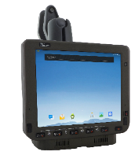
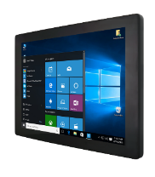
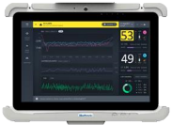
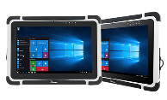

Rugged Tablet:
Orders in Warehouse Logistics & Healthcare are Promising
Orders for a leading global medical equipment manufacturer to enter mass production
Warehouse & Logistics
Healthcare
2020
2022
Won a long-term contract to supply rugged tablets to a top US supplier of warehousing and logistics solutions
7”~10.1”
Vehicle Mounted Computer Series
4.3”~13.3”
Healthcare Grade Rugged Mobile Devices
17
Notes:
Warehousing logistics and Healthcare
In 2020, a long-term order for rugged tablet from Honeywell, one of the world leaders in warehousing logistics company of United States.
In 2022, a large number shipment begun for global medical equipment for Medtronic.

Slide 18
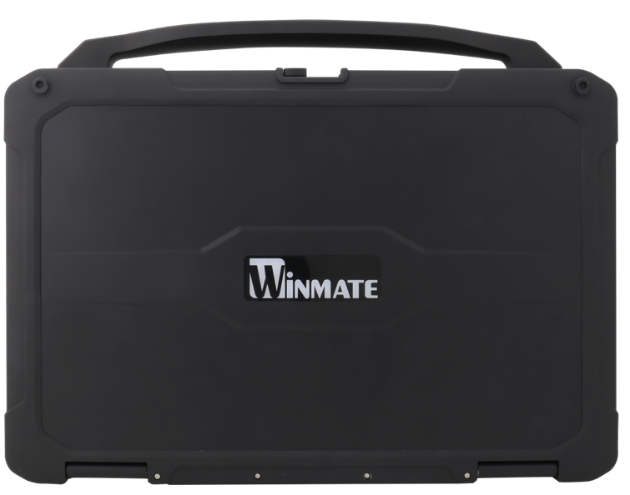
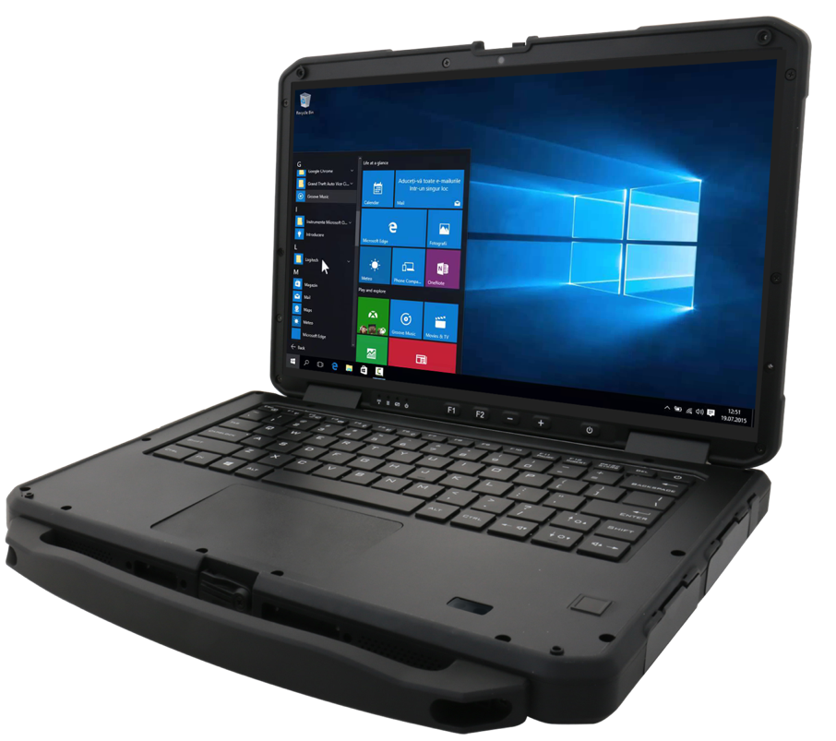
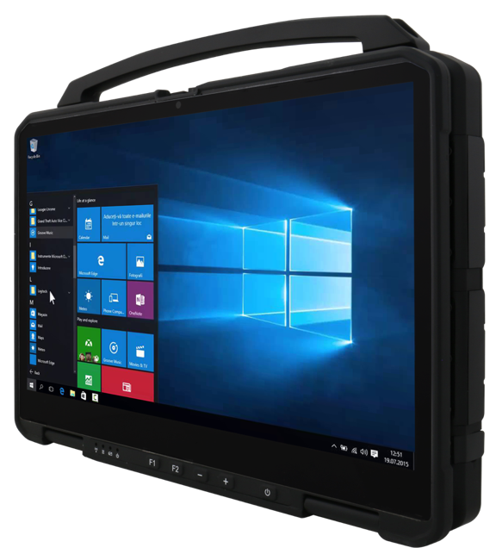
Entering The Rugged Laptop Market
Rugged Laptop Industry – Oligopoly industry dynamic with a TAM of about US$1.6-2bn.
We know this market – Some of our rugged tablet customer base overlaps with that of rugged Laptop.
We already own rugged laptop design know-how for rugged enclosures, thermal dissipation, internal structure, testing and certifications.
Will start shipping from 4Q21 and expect to begin contributing to revenue growth from 2Q22.
18
Notes:
Rugged Laptop Industry – Oligopoly industry dynamic with a TAM of about US$1.6-2bn.
We know this market – Some of our rugged tablet customer base overlaps with that of rugged Laptop.
We already own rugged laptop design know-how for rugged enclosures, thermal dissipation, internal structure, testing and certifications.
Will start shipping from 4Q21 and expect to begin contributing to revenue growth from 2Q22.

Slide 19
Confident to Deliver Multi-Year Revenue Growth with Stable Profitability
Revenue Growth
2021: Expect revenue to grow quarter by quarter this year. Aim to achieve a revenue growth of 20-30%, driven by strong demand from the vehicle diagnostics, warehouse logistics, and healthcare industries.
2022-2025: Aim to achieve a revenue growth of 20-30% per year till 2025 through the Enterprise Mobility Transformation and increased market share relative to our industry competitors.
Profitability
2021: Target to keep gross margin at 34% at least, factoring in:
  Strong topline growth on a large scale, in combination with improved production efficiency .
  Supply chain remains tight due to structural changes in customers’ inventory policies
19
Notes:
Overall We are confident in long-term revenue growth and stable profitability in the future.
2021: Expect revenue to grow quarter by quarter this year. Aim to achieve a revenue growth of 20-30%, driven by strong demand from the vehicle diagnostics, warehouse logistics, and healthcare industries. acquiring customers like Panasonic as well as Daimler and Honeywell orders also the large numbers production shipments to Medtronic medical equipment of next year
2022-2025: Aim to achieve a revenue growth of 20-30% per year till 2025 through the Enterprise Mobility Transformation and increased market share relative to our industry competitors.
Furthermore, the company will actively expand its operating footprint and focusing on the rugged notebook market. We aim to maintain a 20-30% annual growth of revenue for the next five years continue.
2021: Target to keep gross margin at 34% at least, factoring in:
Strong topline growth on a large scale, in combination with improved production efficiency .
Supply chain remains tight due to structural changes in customers’ inventory policies

Slide 20
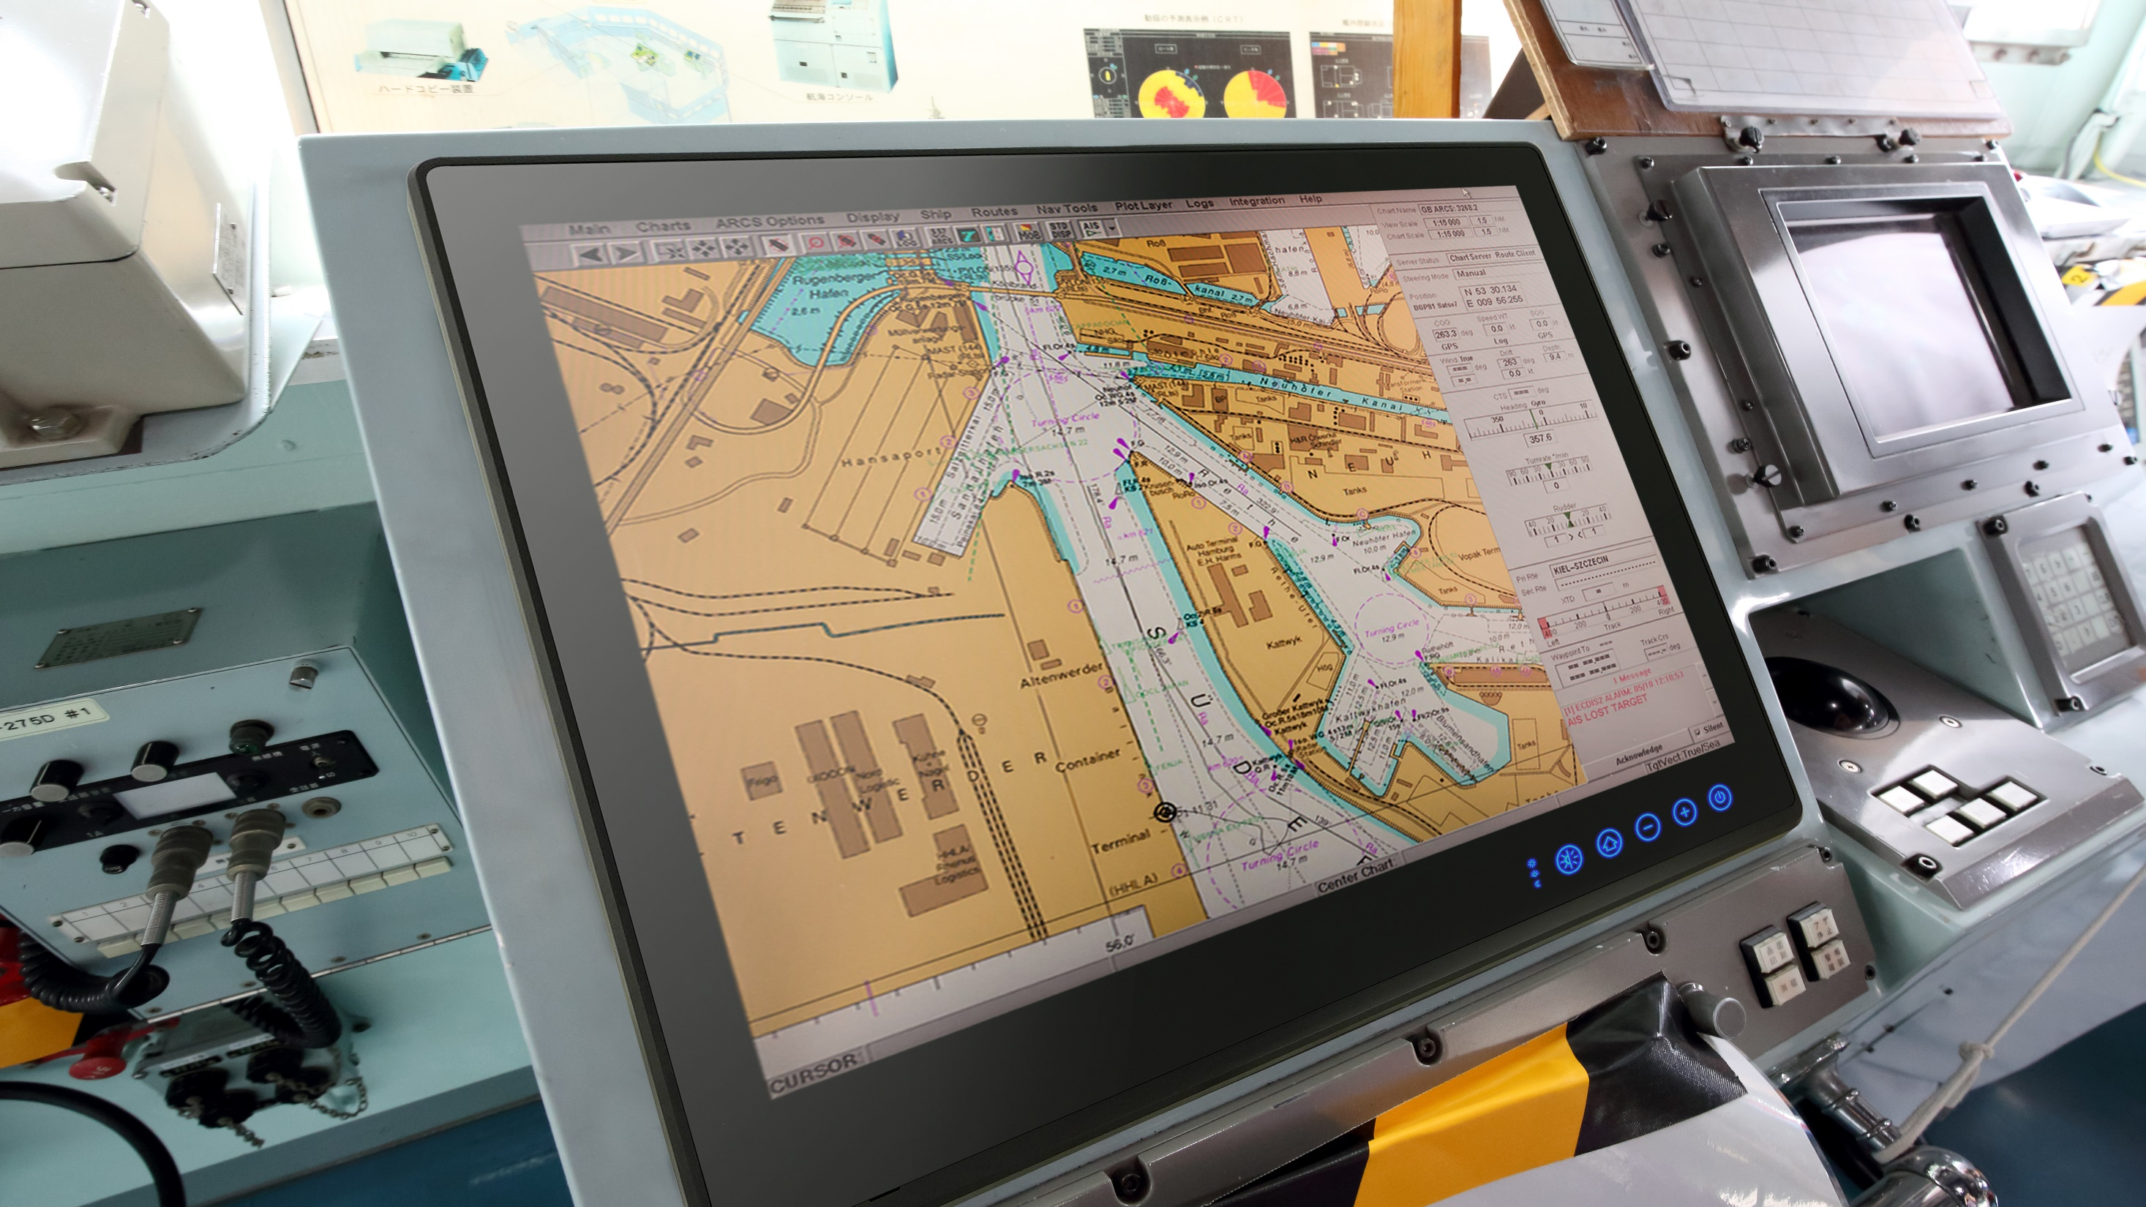
COMMITMENT
TO
SUSTAINABILITY

Slide 21






Continued ESG Efforts
  Materials Sourcing:
Adopted IECQ/QC 080000:2017 Hazardous Substance Management System
Comply with RoHS, REACH and regulations of SVHC
Prohibit use of conflict materials
  Green Manufacturing:
Adopt ISO 14001:2015 Environmental Management System Certification and ISO 14064 Greenhouse Gas Inventory
CO2 emission intensity has decreased 16.28% in 2019 compared to the base year in 2016.
  Employee Diversity:
As of December 2019, the number of employees was 353, with 45% female staff members.
  Supply Chain Management:
Supplier evaluation system implemented
Follow the Code of Conduct of the Responsible Business Alliance (RBA)
  Employee Health & Safety:
Occupational health and safety committee consists of 10 members, 6 of which are workforce representatives.
No fatal occupational accidents in 2019, and only two minor incidents.
  Customer Privacy Protection:
Regularly conduct annual customer satisfaction surveys to ensure that we judiciously incorporate feedback and maintain strong relationships.
Vigilant in protecting customer privacy and customer information.
21

Slide 22
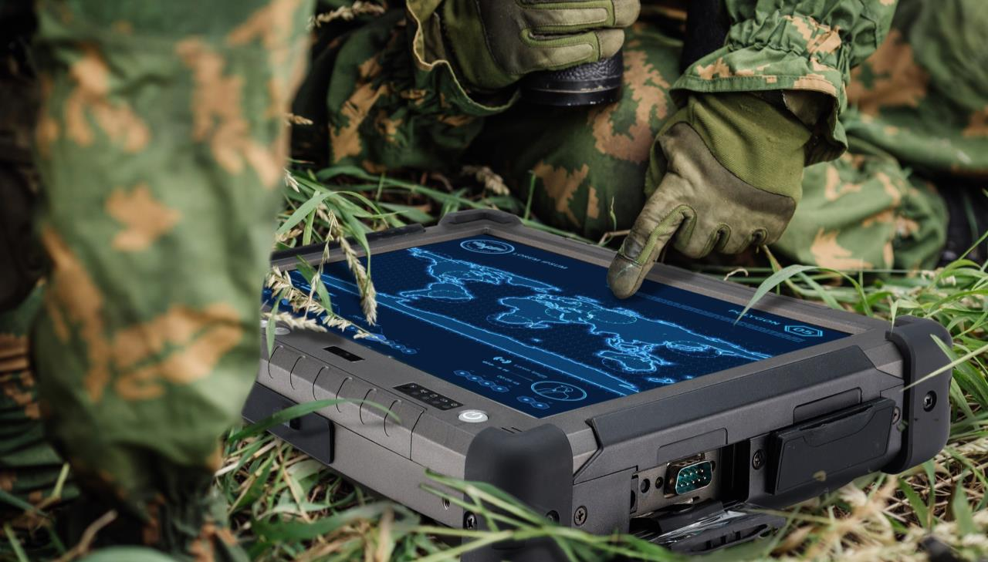
FINANCIAL
PERFORMANCE

Slide 23
Financial Highlights
NT$m
NT$m
NT$
23
Notes:
Financial performance:
• Revenue has gradually grown since Q2 2020.
• The gross margin is between 32%-38%.
•The EPS is 1.33 dollarreached a record high.

Slide 24
Consolidated Income Statement – 2Q21
NT$ million | 2Q21 | 1Q21 | 2Q20 | QoQ (%) | YoY (%)
Net Revenue | 611 | 585 | 371 | 5 | 65
Gross Profit | 210 | 201 | 143 | 4 | 47
Gross Margin | 34.3% | 34.3% | 38.4%
Operating Expenses | 102 | 96 | 81 | 6 | 25
Opex % of Sales | 16.7% | 16.5% | 21.9%
Operating Income | 108 | 104 | 61 | 3 | 76
Operating Margin | 17.6% | 17.8% | 16.5%
Net Non-Operating Income (Loss) | (6) | (2) | (2)
Pre-Tax Income | 102 | 102 | 60 | (1) | 70
Income Tax Expense | 6 | 20 | 2
Minority Interest | 0 | 0 | 0
Net Income to Parent | 96 | 82 | 58 | 17 | 67
Net Margin | 15.7% | 14.0% | 15.5%
EPS (NT$) | 1.33 | 1.13 | 0.80 | 18 | 66
ROE (annualized) | 17.5% | 14.5% | 10.9%
Depreciation & Amortization | 14 | 14 | 8
CAPEX | 3 | 5 | 12
24
Notes:
Return on Equity – ROE
The ROE increased from 10.9% to 17.5% in the second quarter.
Highest in record for Net Margin , Net Revenue and ROE
EPS – 18 % for QoQ , and 66 % YoY

Slide 25
Consolidated Income Statement – 1H21
NT$ million | 1H21 | 1H20 | YoY (%)
Net Revenue | 1,196 | 721 | 66
Gross Profit | 410 | 279 | 47
Gross Margin | 34.3% | 38.7%
Operating Expenses | 198 | 161 | 23
Opex % of Sales | 16.6% | 22.3%
Operating Income | 212 | 118 | 79
Operating Margin | 17.7% | 16.4%
Net Non-Operating Income (Loss) | (8) | 8
Pre-Tax Income | 204 | 126 | 62
Income Tax Expense | 26 | 15
Minority Interest | 0 | 0
Net Income to Parent | 178 | 110 | 62
Net Margin | 14.9% | 15.3%
EPS (NT$) | 2.46 | 1.53 | 61
ROE (annualized) | 16.5% | 10.5%
Depreciation & Amortization | 27 | 16
CAPEX | 8 | 18
25
Notes:
In the first half of the year, consolidated the revenue was $1.196 billion dollar by increase of 66% YoY. The gross margin was 34.3% and the operating profit margin was 17.7% which was the highest point in the same period over the past five years.
After-tax net profit was 178 million dollars, increased by 62% YoY also reached a new high by the same period.
The EPS was 2.46 dollars and that is the highest point in the same period over the past 11 years.

Slide 26
Consolidated Balance Sheet – 2Q21
NT$ million | 2021/6/30 |  | 2021/3/31 |  | 2020/6/30
 | $ | % | $ | % | $ | %
Cash and Cash Equivalents | 598 | 17 | 838 | 25 | 496 | 18
Notes and Accounts Receivable, Net | 337 | 10 | 333 | 10 | 169 | 6
Inventories | 488 | 14 | 451 | 14 | 377 | 14
Other Current Assets | 961 | 28 | 620 | 19 | 601 | 22
Fixed Assets | 947 | 28 | 952 | 29 | 957 | 36
Other Long-term Assets | 103 | 3 | 92 | 3 | 85 | 3
Total Assets | 3,434 | 100 | 3,286 | 100 | 2,686 | 100
Notes and Accounts Payable, Net | 252 | 7 | 210 | 6 | 186 | 7
Other Current Liabilities | 573 | 17 | 282 | 9 | 438 | 16
Non-Current CB Payable | 482 | 14 | 480 | 15 | 0 | 0
Other Non-Current Liabilities | 18 | 1 | 16 | 0 | 13 | 0
Total Liabilities | 1,325 | 39 | 987 | 30 | 638 | 24
Common Stock | 725 |  | 725 |  | 722
Total Equity | 2,109 | 61 | 2,298 | 70 | 2,048 | 76
Book Value per Share (NT$) | 29.1 |  | 31.7 |  | 28.4
Key Indices
Current Ratio ( Current Assets / Current Liabilities) | 289% |  | 456% |  | 263%
Net Cash to Equity | 48% |  | 41% |  | 51%
26
Notes:
Net cash to Equity

Slide 27
Financial Highlights
NT$m
NT$
NT$
27

Slide 28
Income Statement Highlights
NT$ million | 2016 | 2017 | 2018 | 2019 | 2020 |  | YoY (%)
 |  |  |  |  |  |  | 2016 | 2017 | 2018 | 2019 | 2020
Sales Revenue | 1,347 | 1,415 | 1,565 | 1,666 | 1,846 |  | (11.2) | 5.1 | 10.6 | 6.4 | 10.8
Gross Profit | 517 | 487 | 553 | 615 | 645 |  | (11.0) | (5.7) | 13.6 | 11.2 | 4.8
Operating Profit | 212 | 163 | 203 | 272 | 291 |  | (15.8) | (23.0) | 24.2 | 34.2 | 7.1
Net Non-Operating Income (Loss) | 4 | (11) | 39 | 15 | 16 |  | 339.7 | (397.7) | - | (60.8) | 6.2
Pretax Income | 216 | 152 | 242 | 287 | 308 |  | (14.6) | (29.3) | 58.7 | 18.8 | 7.1
Net Income | 184 | 134 | 205 | 241 | 256 |  | (13.0) | (27.0) | 52.4 | 17.6 | 6.2
EPS (NT$) | 3.06 | 2.18 | 2.84 | 3.34 | 3.55 |  | (13.1) | (28.8) | 30.3 | 17.6 | 6.3
Gross Margin | 38.4% | 34.4% | 35.3% | 36.9% | 34.9%
Operating Margin | 15.7% | 11.5% | 12.9% | 16.3% | 15.8%
Net Margin | 13.7% | 9.5% | 13.1% | 14.5% | 13.9%
ROE | 11.3% | 7.2% | 9.8% | 11.3% | 11.7%
28

Slide 29
Balance Sheet Highlights
NT$ million | 2016 | 2017 | 2018 | 2019 | 2020 |  | Percent of total assets (%)
 |  |  |  |  |  |  | 2016 | 2017 | 2018 | 2019 | 2020
TOTAL ASSETS | 1,929 | 2,473 | 2,502 | 2,485 | 2,765 |  | 100.0 | 100.0 | 100.0 | 100.0 | 100.0
Cash | 617 | 1,096 | 762 | 433 | 426 |  | 32.0 | 44.3 | 30.5 | 17.4 | 15.4
NR & AR | 120 | 157 | 210 | 194 | 234 |  | 6.2 | 6.3 | 8.4 | 7.8 | 8.5
Inventory | 236 | 281 | 289 | 254 | 443 |  | 12.2 | 11.3 | 11.6 | 10.2 | 16.0
Fixed Assets | 511 | 496 | 495 | 487 | 955 |  | 26.5 | 20.0 | 19.8 | 19.6 | 34.5
TOTAL LIABILITIES | 307 | 367 | 405 | 326 | 563 |  | 15.9 | 14.8 | 16.2 | 13.1 | 20.4
NP&AP | 148 | 197 | 182 | 84 | 255 |  | 7.7 | 8.0 | 7.3 | 3.4 | 9.2
TOTAL EQUITY | 1,621 | 2,106 | 2,097 | 2,159 | 2,202 |  | 84.1 | 85.2 | 83.8 | 86.9 | 79.6
A/R turnover days | 34 | 36 | 43 | 44 | 42
Inventory turnover days | 92 | 102 | 103 | 95 | 106
A/P turnover days | 58 | 68 | 68 | 46 | 52
Cash conversion cycle | 68 | 70 | 77 | 92 | 97
29

Slide 30
Dividend Payout & Capex
NT$ million | 2016 | 2017 | 2018 | 2019 | 2020
Net profit | 184 | 134 | 205 | 241 | 256
Dividend Paid | 181 | 180 | 188 | 217 | 290
DPS (NT$) | 3.0 | 2.5 | 2.6 | 3.0 | 4.0
Payout ratio (%) | 98% | 134% | 92% | 90% | 113%
Dividend yield (%) | 4.9% | 4.4% | 4.7% | 4.9% | 5.1%
Capex | 49 | 18 | 12 | 488 | 30
Capex/Sales (%) | 3.6% | 1.3% | 0.8% | 29.3% | 1.6%
Note: 2016-2020 Yield calculated using market cap on the day prior to ex-dividend date.
30
Notes:
We have high dividend policy of 90%~100%.
$4 dollars cash dividend will be distributed this year;the dividend payout rate is 113%.

Slide 31
Safe Harbor Statement
The following presentation contains projections and statements related to future business performance developments involving Winmate Inc. that may be seen as forward-looking statements. Actual events and results may differ materially from what is projected in the forward-looking statements and are subject to several risks and uncertainties what are beyond Winmate's control.
The forward-looking statements in this report reflect the views of Winmate as of the date they are made. Winmate Inc. does not intend, nor are obligated to revise or update these forward-looking statements in light of new events or information.
31

