Slide 1
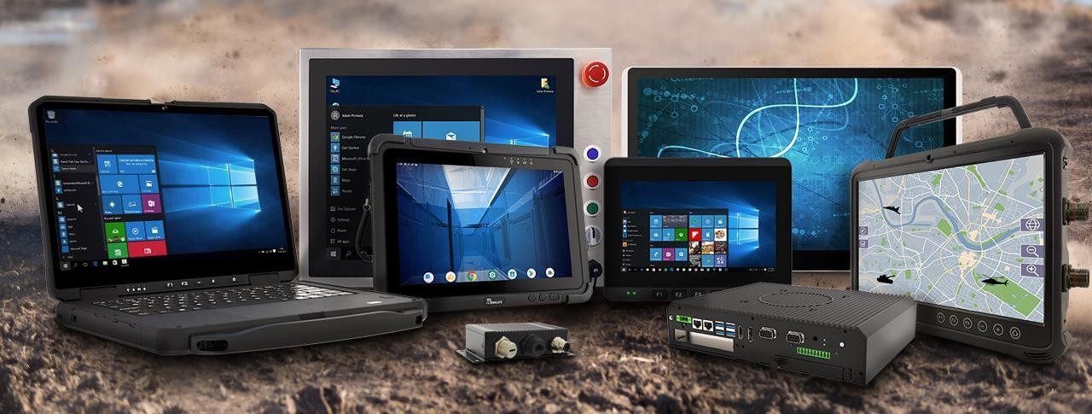

WINMATE INC
Enabler of Enterprise Mobility
3416 TT
2023Q4 INVESTOR PRESENTATION
April 2024

Slide 2



COMPANY SNAPSHOT
Winmate Inc. (3416 TT)
We are a pioneer in rugged mobile computing technology, particularly in rugged tablet.
We have provided business leaders with reliable, mobile, rugged solutions made for the most challenging industrial conditions worldwide.
2023 Total sales: USD92m
2023 Gross margin: 40%
2023 ROE: 19%
2023 Net cash: USD36m
Net cash to equity: 38%
500+ Employees Worldwide
169+ R&D Engineers
52+ Distribution Channels
(ODM, OEM, Direct, SI)
Market Cap: USD357m

Slide 3
2023 Results Highlights
Revenue for the quarter reached a record high level of NT$700 million, up 15.7% QoQ and up 11.8% YoY.
Revenue reached a record high level of NT$2,599 million.
Gross margin was 40.0% versus 35.4% in the same period last year.
Operating margin was 22.2% versus 18.7% in the same period last year.
Net margin was 19.5% versus 17.0% in the same period last year.
Net income to parent also hit a record high level of NT$506 million, up 11.8% YoY.
EPS was NT$6.62.
3

Slide 4
Sales by Product Type
4Q23 Sales by Region
NT$m
2502
2659
2599
1666
1846
4

Slide 5
Financial Highlights
NT$m
NT$m
NT$
5

Slide 6
Consolidated Income Statement– 4Q23
NT$ million | 4Q23 | 3Q23 | 4Q22 | QoQ | YoY
Net Revenue | 605 | 679 | 701 | -11 | -14
Gross Profit | 257 | 278 | 273 | -8 | -6
Gross Margin | 42.5% | 40.9% | 39.0%
Operating Expenses | 120 | 125 | 118 | -4 | 1
Opex % of Sales | 19.8% | 18.4% | 16.9%
Operating Income | 137 | 153 | 155 | -10 | -11
Operating Margin | 22.7% | 22.5% | 22.1%
Net Non-Operating Income (Loss) | -27 | 42 | -11
Pre-Tax Income | 110 | 195 | 143 | -43 | -23
Income Tax Expense | 22 | 36 | 33
Minority Interest | 0 | 0 | 0
Net Income to Parent | 88 | 158 | 110 | -45 | -20
Net Margin | 14.5% | 23.3% | 15.7%
EPS (NT$) | 1.15 | 2.05 | 1.52 | -44 | -24
ROE (annualized) | 16.3% | 29.4% | 20.4%
Depreciation & Amortization | 8 | 9 | 9
CAPEX | 115 | 51 | 19
6

Slide 7
Consolidated Income Statement – 2023
NT$ million | 2023 | 2022 | YoY (%)
Net Revenue | 2,599 | 2,659 | (2)
Gross Profit | 1,039 | 942 | 10
Gross Margin | 40.0% | 35.4%
Operating Expenses | 461 | 446 | 3
Opex % of Sales | 17.7% | 16.8%
Operating Income | 578 | 496 | 17
Operating Margin | 22.2% | 18.6%
Net Non-Operating Income (Loss) | 41 | 68
Pre-Tax Income | 619 | 564 | 10
Income Tax Expense | 113 | 111
Minority Interest | 0 | 0
Net Income to Parent | 506 | 452 | 12
Net Margin | 19.5% | 17.0%
EPS (NT$) | 6.62 | 6.23 | 6
ROE (annualized) | 25.6% | 25.4%
Depreciation & Amortization | 35 | 38
CAPEX | 255 | 163
7

Slide 8
Consolidated Balance Sheet – 4Q23
NT$ million | 2023/12/31 |  | 2023/9/30
 | $ | % | $ | %
Cash and Cash Equivalents | 707 | 18 | 639 | 17
Notes and Accounts Receivable, Net | 399 | 10 | 458 | 12
Inventories | 483 | 12 | 498 | 13
Other Current Assets | 706 | 18 | 684 | 18
Fixed Assets | 946 | 24 | 942 | 25
Other Long-term Assets | 640 | 16 | 541 | 14
Total Assets | 3,881 | 100 | 3,763 | 100
Notes and Accounts Payable, Net | 256 | 7 | 238 | 6
Other Current Liabilities | 539 | 14 | 504 | 13
Non-Current CB Payable | 0 | 0 | 0 | 0
Other Non-Current Liabilities | 19 | 0 | 23 | 1
Total Liabilities | 815 | 21 | 765 | 20
Common Stock | 782 |  | 768
Total Equity | 3,066 | 79 | 2,998 | 80
Book Value per Share (NT$) | 39.2 |  | 39.0
Key Indices
Current Ratio ( Current Assets / Current Liabilities) | 288% |  | 307%
Net Cash to Equity | 38% |  | 38%
2022/12/31
$ | %
508 | 13
450 | 12
636 | 17
824 | 22
951 | 25
397 | 11
3,765 | 100
356 | 9
854 | 23
0 | 0
15 | 0
1,226 | 33
726
2,539 | 67
35.0
200%
32%
8

Slide 9
Dividend Payout & Capex
NT$ million | 2018 | 2019 | 2020 | 2021 | 2022 | 2023
Net profit | 205 | 241 | 256 | 365 | 452 | 506
Net margin (%) | 13.1% | 14.5% | 13.9% | 14.6% | 17.0% | 19.5%
EPS (NT$) | 2.84 | 3.34 | 3.55 | 5.03 | 6.23 | 6.62
DPS (NT$) | 2.6 | 3.0 | 4.0 | 4.5 | 5 | 5.2
Payout ratio (%) | 92% | 90% | 113% | 90% | 80% | 80%
Capex | 12 | 488 | 30 | 89 | 163 | 255
Capex/Sales (%) | 0.8% | 29.3% | 1.6% | 3.6% | 6.1% | 9.8%
Note: 2018-2023 Yield calculated using market cap on the day prior to ex-dividend date.
9

Slide 10
Dividend Policy
10

Slide 11
Business Outlook
Strong Order Momentum in Automotive, warehouse logistic, healthcare market Continues. Coming new market GCS application will bring the new growth engine
Enterprise Mobility
Rugged Tablet /rugged Notebook/GCS
Market Penetration
Outlook
Rapid Multi-Year Growth Trend
Driving Growth in 6 Fast-Growing Verticals (Automotive, Warehouse Logistics, Healthcare, Agriculture, and Defense)
Entering the Rugged Notebook and GCS application market
Vehicle mounted computer industry
Confident to Deliver Multi-Year Revenue Growth with Stable Profitability
11

Slide 12
Winmate to See Rapid Multi-year Growth from The Enterprise Mobility Trend
Key Concept: Enterprise Mobility
Covid-19 has accelerated digital transformation. Enterprise mobility is an essential step in implementing Industry 4.0, edge computing and smart manufacturing, and Winmate’s products allow clients to accelerate the process of rolling out these advanced technologies.
Rugged Tablet is the Biggest Beneficiary under Enterprise Mobility
Global rugged display market size is about US$7.5bn with growth of 6-7% per annum.
Within the industrial space, the Enterprise Mobility transformation is causing a demand shift towards rugged tablet and rugged NB, from stationary products such as rugged display and Embedded PC.
Winmate expects double-digit YoY growth within the rugged tablet segment and its market size could double in 5 years.
12

Slide 13
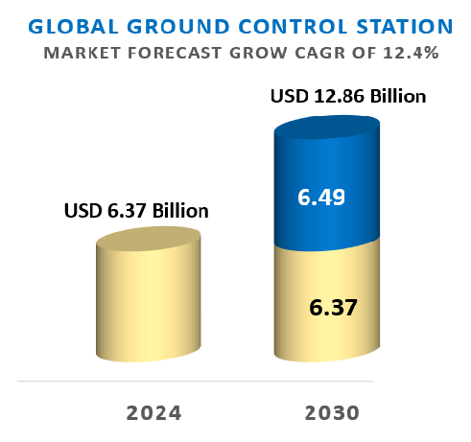
Seeing The Rapid Multi-year Growth from The GCS Trend
Key Concept: GCS Mobility
GCS solution with the diverse applications such as defense & security, industrial automation, agriculture, search & rescue operations, environmental monitoring, mapping & surveying, and transportation & logistics. GCS market size with growth of 12.4% per annum.
Rugged Tablet is the Biggest Beneficiary under Enterprise Mobility
Global ground control station(GCS) market size with growth of 12.4% annually.
Within the industrial space, the Enterprise Mobility transformation is causing a demand shift towards rugged tablet, rugged NB, and Computer with joystick design from stationary products such as rugged display and Embedded PC.
Winmate expects double-digit YoY growth within the rugged tablet segment and its market size could double in 5 years.
13

Slide 14
Rugged Mobile Computers(Tablet/Laptop/PDA): Focus on 3 Verticals
(2024 Target Revenue Mix)
42%
Other
23%
Vehicle automatics
Electrics
(including GCS, Defense, heavy duty vehicles, oil & gas, public safety, industrial automation, marine, aviation, and other)
12%
Healthcare
Applications
23%
Warehouse & Logistics
14

Slide 15
Confident to Deliver Multi-Year Revenue Growth with Stable Profitability
Revenue Growth
2024: Aim to achieve its goal of stable sales growth, driven by strong demand from the vehicle diagnostics, defense, energy, warehouse logistics, AI edge computer, and healthcare industries.
2024-2026: Aim to maintain a stable and high revenue growth rate per year till 2026 on the back of the Enterprise Mobility Transformation / Accelerated Digital Transformation and market share gain versus industry peers.
New GCS application coming , drivering the industry by 2 digital growing Trend. Winmate solution also benefits with this trend.
Profitability
2024: Targets to maintain a full year gross margin remaining stable at the same level of 2023, factoring in:
  The end-market has weakened amid impact from inflation and the Russia-Ukraine conflict, but recovery still unclear
  2024F GM expansion supported by rugged computer/healthcare /defense industries
  US infrastructure and national defense procurements accelerate in 2H22 following the outbreak of Russia-Ukraine conflict
15

Slide 16
Safe Harbor Statement
The following presentation contains projections and statements related to future business performance developments involving Winmate Inc. that may be seen as forward-looking statements. Actual events and results may differ materially from what is projected in the forward-looking statements and are subject to several risks and uncertainties what are beyond Winmate's control.
The forward-looking statements in this report reflect the views of Winmate as of the date they are made. Winmate Inc. does not intend, nor are obligated to revise or update these forward-looking statements in light of new events or information.
16

