Slide 1

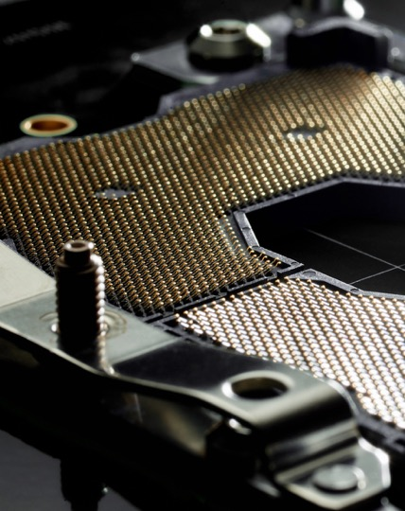

嘉澤端子工業股份有限公司
Always
Connecting
2019.11.21

Slide 2
Agenda
議程
Company Profile
Business Outlook
Financials at Glance
Q & A
公司簡介
營運概況
財務概況
問答交流

Slide 3
Company profile
公司簡介
3

Slide 4
About LOTES
關於 LOTES
LOTES specializes in the design and manufacture of inter-connection solutions including connectors and cables. According to Bishop & associate, LOTES rank no.6 in computer and peripherals and no.30 worldwide.
Top 3 officially qualified CPU sockets supplier in the world with an aggregate market share of over 25%.
Fully integrated processes in house including design, tooling, molding, stamping, electro-plating and automation assembly.
LOTES owns over 3200 patents applied worldwide, top 2 among Taiwan connector makers.
With ISO17025 certification, LOTES reliability test lab is capable of providing industry standard test reports and also meeting customers’ test requirements.
Certified with ISO 9001, IATF 16949, ISO 13485, AS 9100, ISO 14001, OHSAS 18001, QC 080000, and ISO 14064.
LOTES為一專業連接器／連接線製造商。依Bishop統計在電腦暨週邊連接器廠商中全球排名第六，不分行業別排名全球排名第三十。
全球前三大中央處理器插座供應商，市佔超過25％
全製程整合，包括產品設計、模治具及自動化設備開發、射出成型、金屬沖壓、電鍍、組裝等
LOTES在全球擁有超過3,200件連接器／連接線專利
LOTES信賴性實驗室已取得 ISO 17025 實驗室認證，可出具行業標準報告，亦可依客戶規範進行測試。
已取得 ISO 9001, IATF 16949, ISO 13485, AS 9100, ISO 14001, OHSAS 18001, QC 080000 及 ISO 14064等品質系統認證

Slide 5

Geographic profile of LOTES 全球佈局
斯圖加特
奧瑞岡
Stuttgart, Germany
蘇州
Beaverton, OR
Suzhou, China
聖荷西
休士頓
San Jose, CA
Houston, TX
廣州
LINTES Taipei
Guangzhou, China
Keelung, Taiwan (HQ)
嘉澤 ＆ 嘉基
Singapore
新加坡
Manufacturing Sites
工廠
Sales / Eng support
服務據點
5

Slide 6
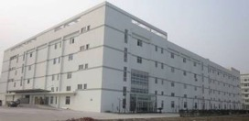
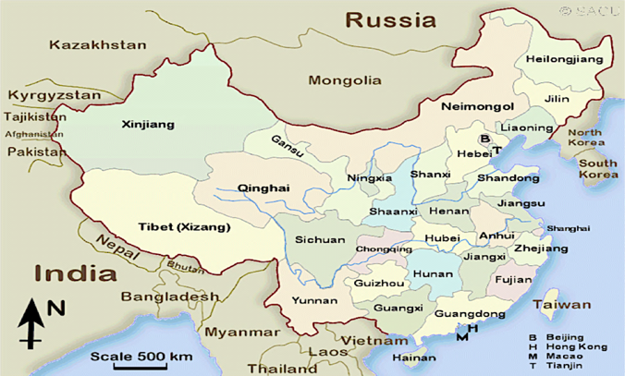
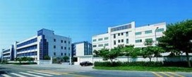
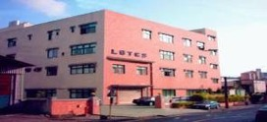
Geographic profile in China
Suzhou蘇州
Established: 2004
Employees: 1200
Function: Product Design, Tooling, Molding, Stamping, Eletro-Plating and Assembly
LINTES中和
Hangnan湖南
Established in 2011
Employees : 400
Products: Thunderbolt, Type C, High Speed Cable, Active Optical Cable
Established: 2010
Employees : 1000
Function: Tooling Center, Cable Assembly
Established: 1993
Employees : 6000
Function: R&D, Tooling, Molding, Stamping, Electro-Plating and Assembly
Guangzhou廣州
Established: 1986
Employees : 100
Function: R&D, Sales, Finance
LOTES基隆

Slide 7
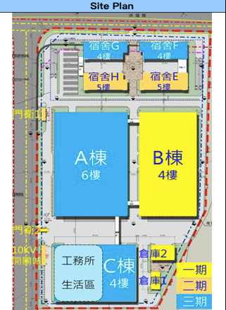
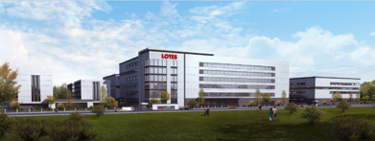
Zhongshan 中山廠
New plant in Zhongshan: 140,000 sqm
No CPU socket and LM parts move until at least Phase 3 is complete

Slide 8
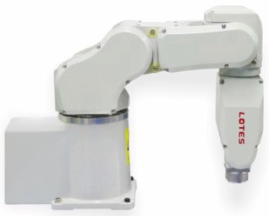
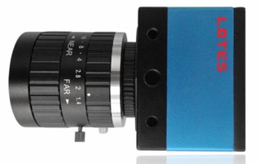
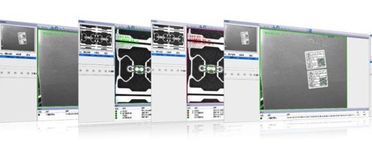
LOTES’ Core Competence 核心競爭力
Stamping Die
沖壓模具
Injection Mold
塑膠模具
100% of design and fabrication in house
100% 自行設計及製造
Assembly Jigs
組裝治具
Automation Machines
自動機
8

Slide 9
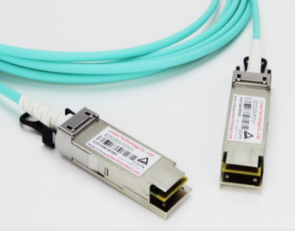
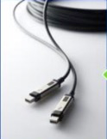
LINTES’ Competiveness 嘉基核心競爭力
AOC 主動式光纖
High Speed Socket Design Capability
高速連接器設計
Precision Micro Lens design capability
高精度光學鏡片設計
High Speed Cable高速線纜
(Optical / Electrical / Active / Passive)
Precision Die/Wire Bond Capability
高精密固晶打線製程
Electrical/Optical Cable HVM
電子／光纖線量產能力
ACC 主動式銅線
9

Slide 10
Business overview
經營概況

Slide 11
Sales Revenue 營收走勢
Million USD
-New product launch (DDR4)
-Strategic customers start to contribute
Laptop CPU on board started
New product launches
-Server SKT R
-Desktop SKT H
-Laptop SKT G
New product launches
-Mechanical parts for Purley
-LINTES TBT3 cable series
Gain market share from competitors

Slide 12
Financial Data
LOTES

Slide 13
Income Statement 損益表
Unit: million NTD
 | 2014 | 2015 | 2016 | 2017 | 2018 | 2019.1-9
營業收入 | 8,304 | 8,197 | 8,863 | 10,482 | 13,311 | 11,017
營業毛利 | 2,834 | 2,765 | 2,817 | 3,390 | 4,348 | 3,826
營業費用 | 1,730 | 1,985 | 2,090 | 2,170 | 2,366 | 1,976
營業淨利 | 1,104 | 780 | 728 | 1,220 | 1,982 | 1,849
本期淨利 | 1,078 | 796 | 690 | 956 | 1,608 | 1,473
每股盈餘(NT$) | 11.53 | 8.52 | 7.38 | 10.23 | 17.21 | 14.28
每股股息 (NT$) | 5.5 | 4.5 | 4 | 5.5 | 8.7 | -
配息率(%) | 47.70% | 52.82% | 54.20% | 53.76% | 50.55% | -
毛利率(%) | 34.13% | 33.73% | 31.79% | 32.34% | 32.67% | 34.73%
營業淨益率(%) | 13.30% | 9.52% | 8.21% | 11.63% | 14.89% | 16.79%
淨益率(%) | 12.98% | 9.71% | 7.79% | 9.12% | 12.08% | 13.37%
EBITDA(NT$/Share) | 17.84 | 14.99 | 13.55 | 19.94 | 31.02 | -
股東權益報酬率(%) | 14.87% | 10.00% | 8.67% | 11.54% | 16.92% | -

Slide 14
Balance Sheet 資產負債表
Unit: million NTD
 | 2014 | 2015 | 2016 | 2017 | 2018 | 2019.09.30
資產總計 | 10,500 | 10,857 | 10,478 | 11,753 | 13,790 | 15,675
現金 | 1,396 | 2,041 | 1,465 | 1,319 | 1,448 | 2,338
應收帳款 | 3,015 | 3,263 | 3,736 | 4,293 | 5,291 | 6,044
存貨 | 1,192 | 1,277 | 1,557 | 1,790 | 2,228 | 2,021
不動產、廠房及設備 | 2,272 | 2,193 | 2,528 | 2,875 | 3,350 | 3,505
負債總計 | 2,664 | 2,769 | 2,503 | 3,321 | 3,918 | 4,056
短期借款 | 591 | 416 | 108 | 600 | 919 | 286
應付帳款 | 1,213 | 1,352 | 1,447 | 1,701 | 1,743 | 1,881
權益總計 | 7,776 | 8,039 | 7,897 | 8,285 | 9,506 | 11,213
普通股股本 | 935 | 935 | 935 | 935 | 935 | 1,035
資本公積 | 2,362 | 2,366 | 2,383 | 2,410 | 2,466 | 3,766
保留盈餘 | 4,060 | 4,346 | 4,616 | 5,196 | 6,296 | 6,869
流動比率(%) | 297.40% | 281.06% | 287.80% | 239.92% | 246.79% | 321.53%
負債比率(%) | 25.36% | 25.50% | 23.38% | 27.91% | 28.41% | 25.88%
每股淨值 | 83 | 86 | 84 | 89 | 102 | 108
應收帳款周轉天數 | 138 | 140 | 144 | 140 | 132 | -
存貨周轉天數 | 84 | 91 | 97 | 99 | 93 | -

Slide 15
Consolidated Cash Flows Statement 現金流量表
Unit: million NTD
(NT$ M) | 2016 | 2017 | 2018 | 2019.09.30
營業活動之現金流入 | 879 | 1,026 | 1,508 | 2,456
投資活動之現金流入 | (390) | (1,137) | (1,419) | (1,083)
籌資活動之現金流入 | (637) | 186 | 96 | (355)
匯率變動對現金及約當現金之影響數 | (428) | (221) | (55) | (126)
本期現金及約當現金之增加數 | (576) | (146) | 129 | 890
期末現金及約當現金餘額 | 1,465 | 1,319 | 1,448 | 2,338
註: | 2016 | 2017 | 2018 | 2019.09.30
資本支出 | 527 | 1,045 | 1,308 | 937

Slide 16
Q&A

