Slide 1
MACHVISION, INC.
(3563 TT)
Supervisor : David Yen
2018 / 04 / 11

Slide 2
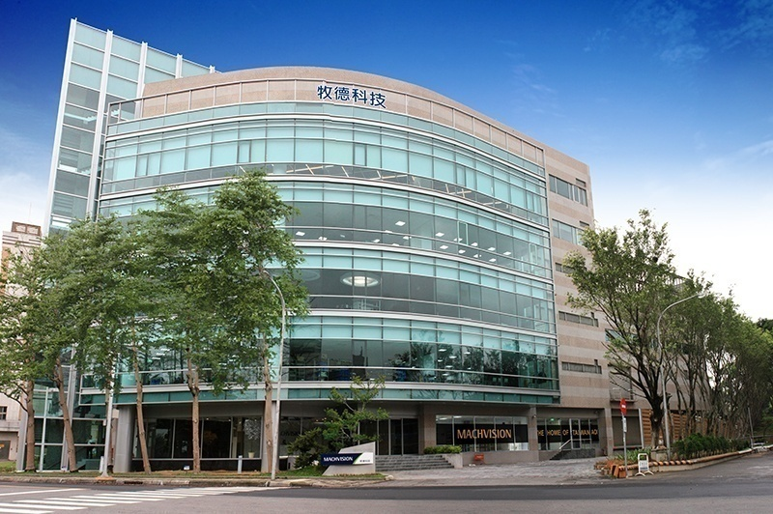
Safe Harbor Notice
MACHVISION’s statements of its current expectations are forward looking statements subject to significant risks and uncertainties and actual results may differ materially from those contained in the forward-looking statements.
Except as required by law, we undertake no obligation to update any forward-looking statement, whether as a result of new information, future events, or otherwise.

Slide 3
Agenda
Company Overview
Business Update
Financial Performance

Slide 4
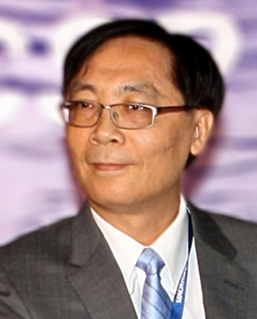
Company Overview
Founded in 1998.6.9
Main Products：Automated Optical Inspection (AOI)
2015 April：Awarded the 3rd Excellent Enterprises as Backbones in Taiwan
2017/2016：Continuously awarded the Corporate Governance Excellence in Taiwan (top 3% of TW-listed firms)
Founder: Dr Collin Wang - PhD in Industrial Engineering at Penn State University
Research expertise – Image Processing / R&D Management

Slide 5
Company Overview
Human Resources
By Departments
By Education
Finance
4%
MIS
4%
Others
10%
PhD
2%
Sales
9%
R&D
33%
Master
35%
Admin.
13%
Customer
Service
15%
Production
22%
Bachelor
53%

Slide 6
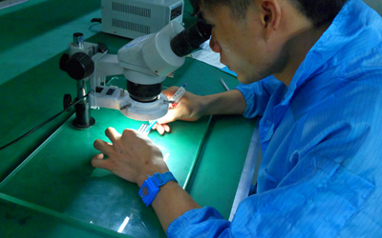
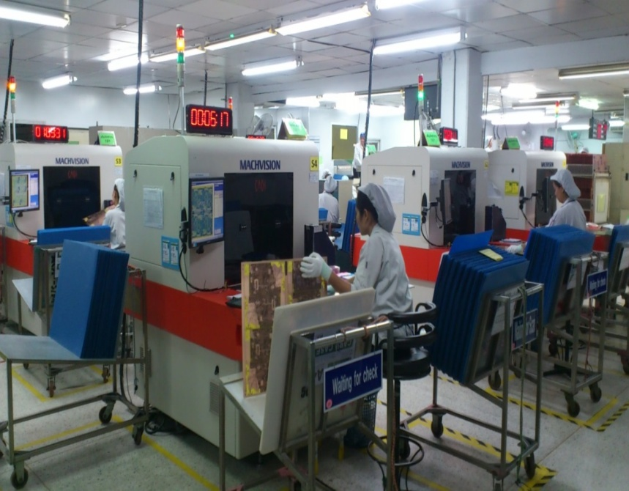
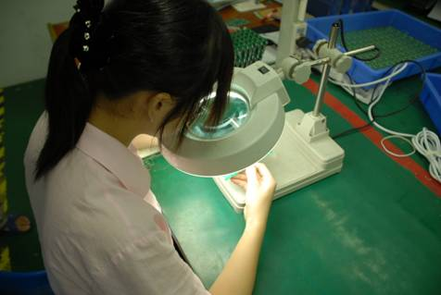
Company Overview
Automated Optical Inspection (AOI)

Slide 7
Company Overview
AOI Technology can be applied in many industries:
IC、PCB、PCBA、FPD、Passive、LED、Solar、 Textile、Auto、Medicine…etc.
Taiwanese listed AOI Companies | Machvision | TRI | Utech | Favite
Ticker | 3563 | 3030 | 3455 | 3535
Key Industries | PCB, IC | PCBA | FPD, PCB | FPD
2016 GM% | 61.7% | 54.7% | 49.07% | 22.76%
Major Competitors | Orbotech Rudolph | Omron Kohyoung | Takano Kubotek | Takano Kubotek

Slide 8
Company Overview
AOI markets used to be pioneered by developed countries
International AOI Peers | Orbotech | Camtek | Screen | Takano
Country | Israel | Israel | Japan | Japan
Key industries | PCB、FPD | PCB、IC | PCB | FPD
International AOI Peers | Rudolph | Topcon | KLA-tencor | KohYoung
Country | US | Japan | US | Korea
Key industries | IC | IC | IC | PCBA

Slide 9
Company Overview
New Market Assessment
Hole AOI
Market Size
Sufficient Capability
Circuit AOI
AVI
1stStage
4thStage
PCB
Others
2D/3D Measuring
Circuit Inspection
AVI
FPCB AVI
COF
AVI
2ndStage
3rdStage
FPCB
IC Substrate
IC Packaging
Bumping
Inspection
Wafer
AVI
3D
Inspection

Slide 10
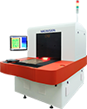
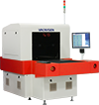
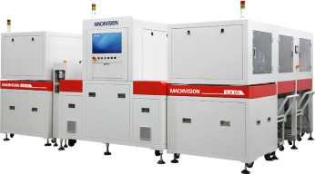

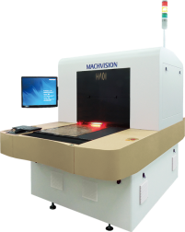
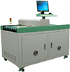
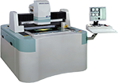
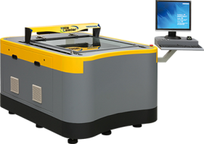
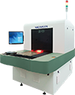
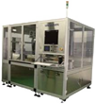
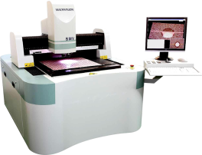
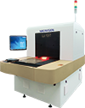
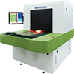
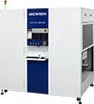
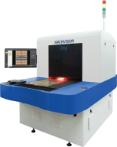
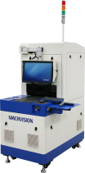
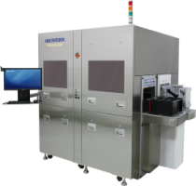


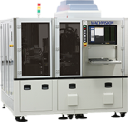
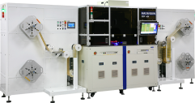
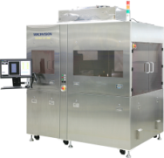
Our Products
Third Arrow
Fifth Arrow
Circuit AOI Series
AOI 4.0
Circuit AOI
Artwork AOI
LineGauge
Fourth Arrow
Drilling & Routing
Measuring Series
Hole AOI
Hole Doctor
EZ3D
Final Leader
First Arrow
IC Substrate & HDI
Measuring Series
3D AOI
FC CSP Bump Inspection
Solid Measuring Viewer
LaserVia AOIM
Dimple AOI
Second Arrow
AVI Series
Auto Final Inspection
FPCB AVI
FC AVI
CSP AFI
COF AVI
Wafer AVI
Wafer AVI

Slide 11

Growing Records
130%
156%
181%
19
151%
87%
88%
18
17
16
53%
15
65%
14
63%
73%
13
12
56%
65%
11
30%
10
64%
100%
9
8
7
6
Monthly revenue of 2016
5
4
Monthly revenue of 2017
3
Monthly revenue of 2018
2
1
UNIT : NTD Ten Million
1
2
3
4
5
6
7
8
9
10
11
12
(month)
Investor Conference
Investor Conference
Cont. 15 Months
MOM Growth
Cont.11 Months Record Created
5 Qs
Record Created

Slide 12

Business Update
“Three Arrows” are First Proposed in Investor Conference in 2016
The demand for FPCB inspection is increasing
Huge potential for IC inspection
PCB firms are willing to replace human visual inspection

Slide 13
Business Update
First Arrow: Flexible PCB
Europe
2%
America
2%
The demand for FPCB inspection is increasing
Breakdown of Global FPCB Production
Korea
18%
Others
16%
Machvision’s share
In 2016
Taiwan14%
Taiwan14%
China
38%
Machvision’s share
in 2017
Japan
10%
Source：Prismark

Slide 14

Business Update
Second Arrow: IC Inspection
Huge potential for IC inspection
Qualified by leading manufacturer
Channel Deployment
2015.June
Wafer AVI 1
Launched
2016.March
First shipment
2017.Jan.
Qualified by
leading manufacturer
2017.Mar.
Wafer AVI 2
2017.June
Wafer AVI 3
2017.Dec.
Wafer AVI 4

Slide 15
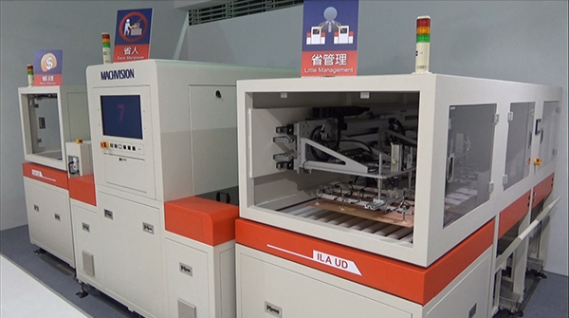
Business Update
Third Arrow: Automated Inspection（Stage1 : Grayscale CCD）
PCB shops are willing to replace human visual inspection
Replacement Demand
1 AOI 4.0 = 7 Traditional AOI + 21 Manpower + 6 Maintenance Cost

Slide 16
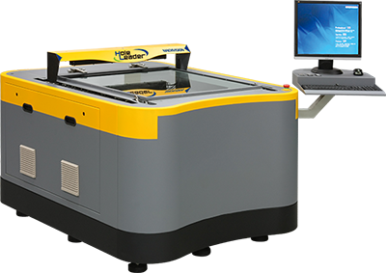
Business Update
Launched in 2018 March
Fourth Arrow：Final Leader
Automated measurement requirement for FPCB and PCB
Market Size：about 100 units per year
Qualified by leading manufacturer
Channel Development
2017. Feb.
Developed
2017. Oct.
Launch at TPCA
2018. Mar.
First Shipment

Slide 17

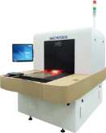
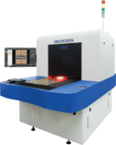


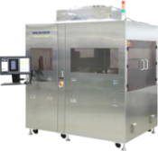
Business Update
Fifth Arrow: New Deployment of Expanding Chinese-Funded PCB Shops
Launch new products for Chinese-Funded PCB Shops
Launching new products with reducing 10% manufacturing cost, and the gross margin
of new products will still be kept more than 55% even if reducing 20% listing price.
2017 October launched the products to occupy the market.
2017. Q4
launched

Slide 18
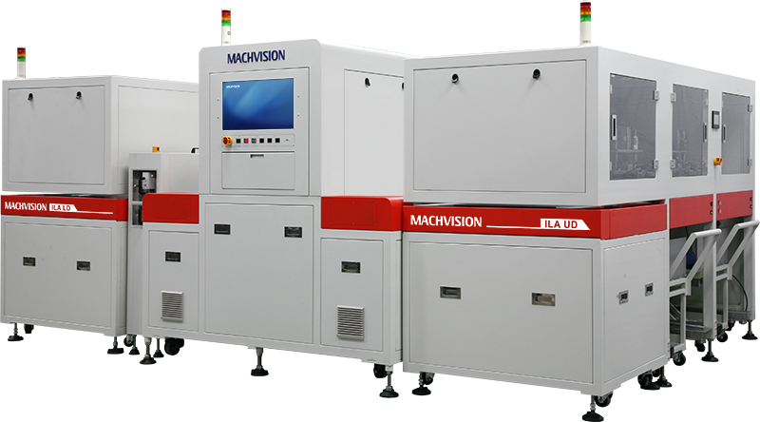
Business Update
Evolution of The Third Arrow: Automated PCB ( Stage 2：Colored CCD + AI )
PCB shops are willing to replace human visual inspection
Increase Capability &
AOI for4.0⁺
Reduce the Manpower to Review

Slide 19
Business Update
Traditional Review Equipment and Manpower
1 Traditional AOI
2 VRS

Slide 20
Business Update
AOI 4.0 vs. AOI 4.0⁺
1
AOI 4.0
1
AOI 4.0⁺
vs
vs

Slide 21
Business Update
Benefit
Reduce 23,600,000 per year
4 Months to Payback
AOI 4.0 Reduce 21 Manpower and 6 Equipments Maintenance Costs
Recheck Equipmet Reduce 21 Manpower & 7 Equipments Maintenance Costs
AOI 4.0⁺
Reduce 42 Manpower & 13 Equipments Maintenance Costs

Slide 22
Business Update
Revenue from Three Arrows
2017
Units：NTD million
700
600
39%
37%
500
400
19%
300
200
5%
100
0
First Arrow
FPCB
Second Arrow
IC Inspection
Third Arrow
Automated
Inspection
Others excluding
Three Arrows

Slide 23
Business Update
Revenue from Five Arrows
2017-2018.3
Units：NTD million
43%
800
700
32%
600
500
400
16%
300
200
4%
5%
100
0%
0
First Arrow
FPCB
Second Arrow
IC Inspection
Third Arrow
Automated
Inspection
Fourth Arrow
Final Leader
Fifth Arrow
Deployment
of China
Founded Customers
Others excluding
Five Arrows

Slide 24
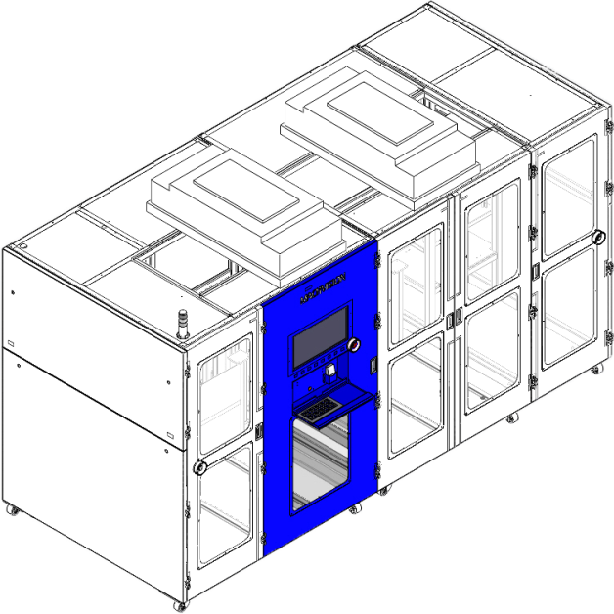
2018 New Products
RTR FPCB Circuit AOI
FPCB AOI 4.0
Launch FAOI to Reduce FPCB manpower

Slide 25
2018 New Products
Double-Sided 25cm FPCB AOI Capacity Comparison
14
1
VS
Single Equipment + Manpower
Double-Sided FAOI

Slide 26
2018 New Products
Double-Sided 50cm FPCB AOI Capacity Comparison
21
1
VS
Single Equipment + Manpower
Double-Sided FAOI

Slide 27
2018 New Products
Benefit
Reduce 47,600,000 per year
8 Months to Payback
25cm FPCB AOI 4.0 Reduce 42 Manpower and 14 Equipments Maintenance Costs
Recheck Equipmet Reduce 42 Manpower & 14 Equipments Maintenance Costs
25cm FPCB AOI
Reduce 84 manpower and 28 Equipments Maintenance Costs

Slide 28
2018 New Products
Benefit
Reduce 68,600,000 per year
9 Months to Payback
50cm FPCB AOI 4.0 Reduce 63 Manpower and 21 Equipments Maintenance Costs
Recheck Equipmet Reduce 63 Manpower & 21 Equipments Maintenance Costs
25cm FPCB AOI
Reduce 126 manpowers and 28 Equipments Maintenance Costs

Slide 29
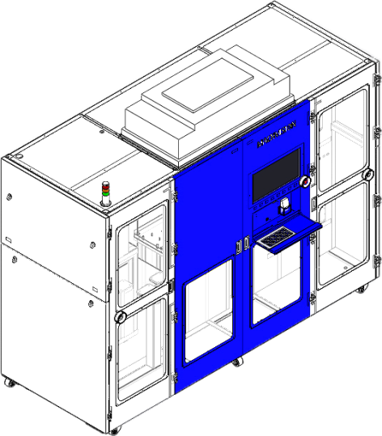
2018 New Products
RTR COF AOI
RTR COF AOI
Applying AVI & AOI Technology for the Rapid Development of COF Market

Slide 30

Business Update
New Target Markey Size：2018 New Products
2 billion
Market of COF:
1 billion per year
Market of FPCB:
1 billion per year

Slide 31
Financial
Unit：NTD K
項目 | 2017 (Q1~Q4) | 2016 (Q1~Q4) | Change | %
Revenue | 1,420,888 | 809,631 | 611,257 | 75%
Gross Profit | 909,603 | 499,269 | 410,334 | 82%
Gross margin% | 64.02% | 61.67% |  | 2%
OP Profit | 566,258 | 246,184 | 320,074 | 130%
Non-OP | 462,744 | 198,785 | 263,959 | 133%
Net Profit | 10.86 | 4.67 | 6.19 | 133%

