Slide 1

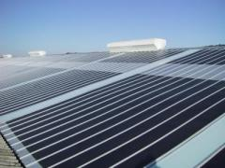
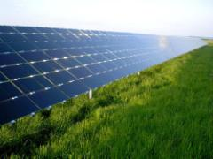
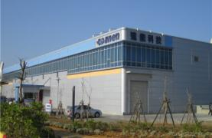
DANEN Technology
Investor Conference
Stock code : 3686-TW Nov. 23 2018
1

Slide 2
Legal Disclaimer
This document is for informational purposes only and is not an offer to buy or the solicitation of an offer to sell any securities.
DANEN’s statements that are not historical facts are forward-looking statements that indicate actions or results of actions that may occur in the future, based on current available information and underlying assumptions.
DANEN does not warranty their accuracy, reliability and completeness. There are a number of factors such as economic conditions, firms abilities, industry environment that could cause actual results and developments to differ materially from those expressed or implied by forward looking statements. Investors should not place undue reliance on them.
2

Slide 3

Outline
Global Solar Market
Technology Challenge & Trend
Outlook of DANEN
Q & A
3

Slide 4
Global Market Outlook
4

Slide 5
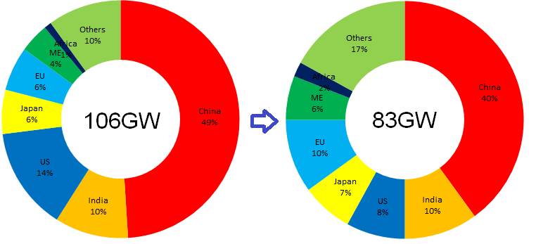
Global installation declines over 20% in 2018
Overall demand decreases in all major markets
  The installation demand impacted dramatically by June 1st policy of China and market forecast could decline up to 40% of the year.
  US market could decreases in coming 5 years due to policy change and trade war between US and China.
  Japan installation demand decreases continuously owing to Fit cut as well as India market drops due to 25% safeguard duty.
Global PV Demand Forecast in 2017(A)~2018(E)
5
Source: PV InfoLink, Aug. 2018

Slide 6
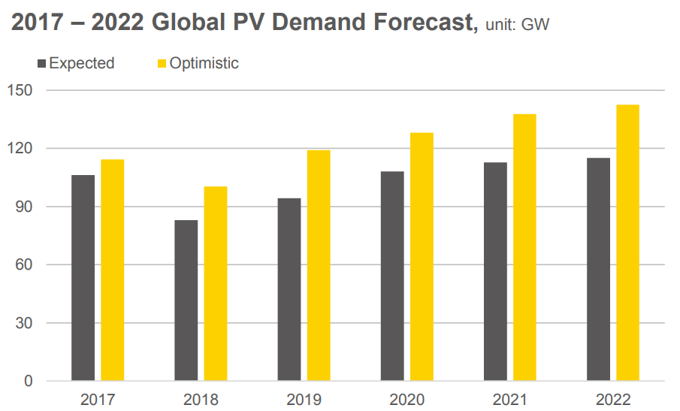
Demand could recover from 2H 2019
Weak market demand in 1H 2019 due to trade war and FiT adjustment.
Could bring market installation back to 100GW in 2020 by stable demands in China/EU/US/Japan and optimistic growth in new emerging markets.
6
Source: PV InfoLink, Aug. 2018

Slide 7
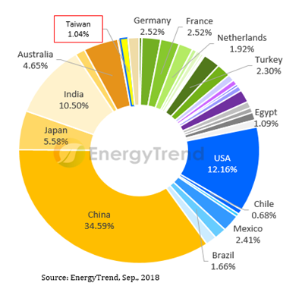
Solar installations will reach 20GW in Taiwan
The installation target of solar energy will reach 20GW by 2025 with new energy policy of Taiwan, which could lead and enhance the development of local supply chain competence through such volume scheme.
Taiwan’s solar energy installation volume accumulated to 2.24GW by June 2018. Forecasted up to 950MW system installation in 2018, which is a new record and counted as over 1% system installation in worldwide statistic base.
Global PV Installation Forecast in 2018

Slide 8
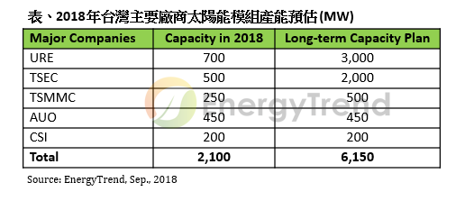
PV players focus on module /system
With vigorous policy support in recent years, major PV players have invested in module production scale for system business growth.
  URE (merged by NSP, Gintech and Solartech) involved in system installation business and module capacity expansion.
  TSEC and TSMMC (Motech) intend to invest in module capacity expansion.
Module capacity expansion plan of Taiwan PV companies

Slide 9
Key take away of solar market
Overall global demand could recover from 2H/2019
  Global installation demand could decline more than 20% in 2018 due to weak demand conditions from major markets.
  Possible recovery to 100GW in 2020 by stable demands in China/EU/US/Japan and optimistic growth in new emerging markets.
The whole PV supply chain of Taiwan were strongly impacted by the weak demand and unreasonable price cut since June 2018, further consolidation and capacity cut among the solar companies are expected.
With vigorous policy support of the recent years and weaker solar cell demand , many PV players in Taiwan have invested heavily in module production capacity and system business.
9

Slide 10
Technology
Trend & Challenge
10

Slide 11
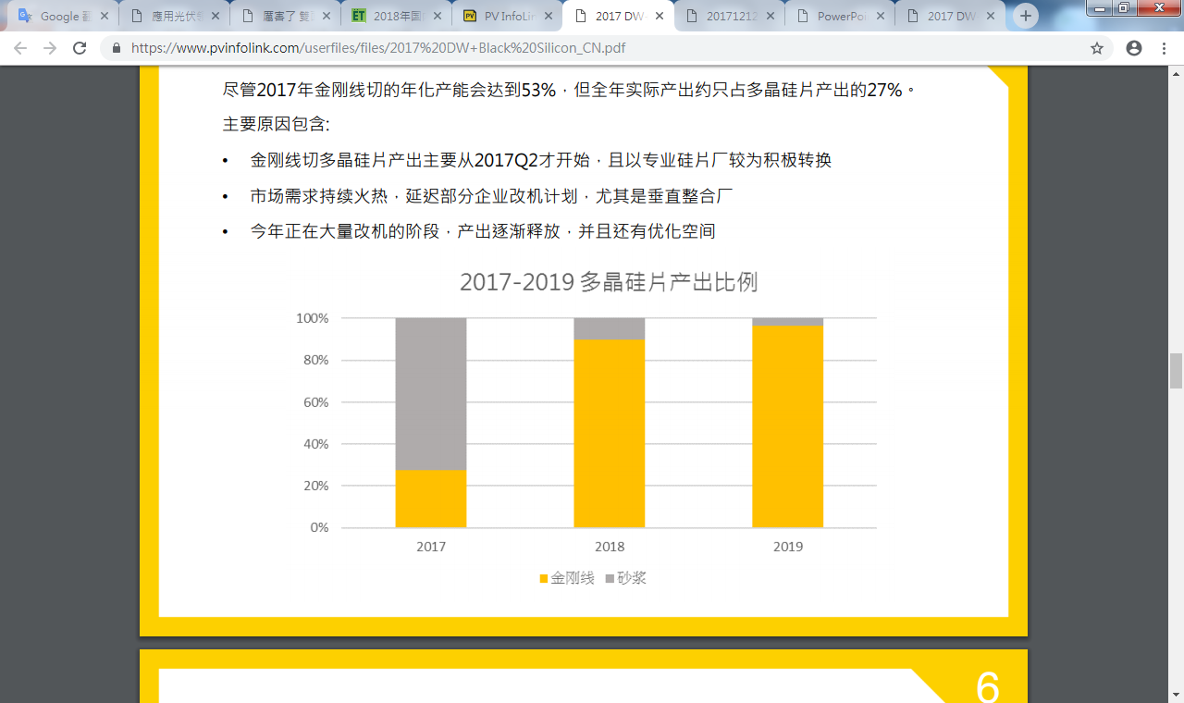
Diamond wire slicing for wafer process
The process of diamond wire slicing became the main stream process in both multi-Si and mono –Si wafers due to lower cost and higher throughput, although minor conversion efficiency loss may happen in cell performance level.
DW process completely replaced the slurry process of multi wafer slicing due to market price dropped significantly at 1H,2018.
2017-2019 Wafer slicing conversion of multi-Si wafer
DW
Slurry
11
Source: PV InfoLink, Sep. 2017

Slide 12
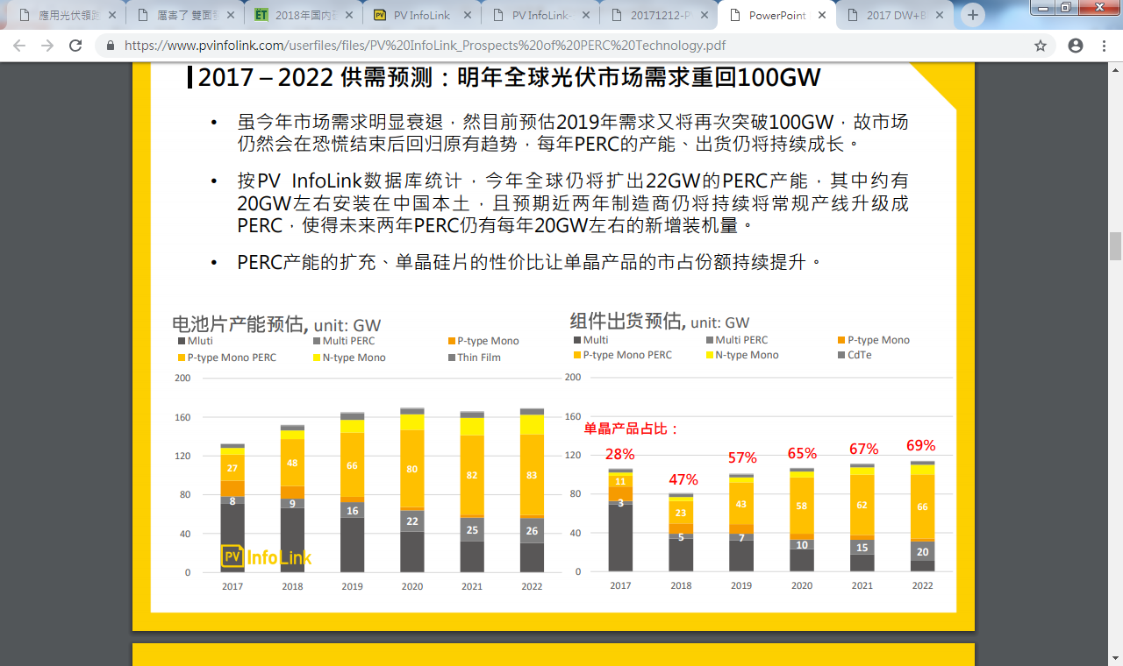
Market share : mono vs. multi wafer
Mono wafer share kept less than 30% until 1H, 2018, but the mono wafer market share increased to 50% at 2H, 2018 due policy driving and cost effective competition , mono wafer capacity expansion and crystal growing technology improvement are main contribution factors.
Module shipment forecast ( mono vs. multi ), unit: GW
Mono Product Ratio:
12
Source: PV InfoLink, Aug. 2018

Slide 13
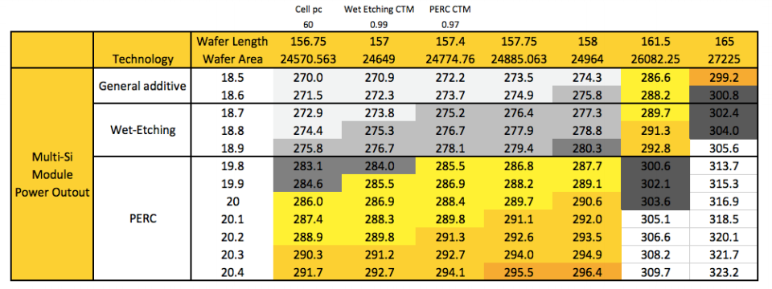
Further challenges of solar technology
The final judgment of PV system is cost effectiveness
  Cost reduction by thinner wafer, kerf loss reduction and push wafer size increasing and various cost reduction approaches .
  Power output improvement by PERC, MBB and bi-facial in cell process, with half-cut, overlap in module process plus material (white EVA/LCR..) efficiency.
Source: PV InfoLink, Jun. 2018
13

Slide 14
Outlook of DANEN
14

Slide 15
Finance report of Q3, 2018
Q3 revenue - NT$ 38M, which decreased significantly due to cash loss control.
EPS loss had reduced to NT$ -0.51/share compared to previous quarter, mainly contributed by lowering operating scale
15

Slide 16
Poor but stable financial condition
Return on asset/equity performance is poor.
Debt ratio keeps at low level while current ratio and quick ratio are 484% and 381%, respectively.
16

Slide 17
Market outlook from our view
Forecast of global installation demand could decline to 83GW in 2018 due to weak demands from major markets.
Current market price is unable to bring back utilization rate of value chain shortly unless a big policy change, otherwise a demand/supply balance is not possible. Overall demand may not be able to cover till 2H,2019, and expecting back to 100GW in 2020 hopefully.
With vigorous policy support in recent years, PV players have changed to put resources on module and system business.
Cost effectiveness is always the driving force of PV industry chain, while government policy support and environment protection trend would be helpful forces for overall PV industry development.
17

Slide 18
Messages to take
First time of solar market declined during decade - Conservative business operation
Mono crystal takes ruling position – Closely watch on market dynamic.
Healthy financial status - Low operating risk to respond the market challenge.
Future business strategy :
  Cash is King: Conservative business operation to keep cash on hand.
  Invested biochip technology company and looking for high growth potential field to create long-term business performance.
18

Slide 19


THANK YOU
DANEN TECHNOLOGY CORP.
No. 599, Huan-Nan Rd., Taoyuan High-Tech Industrial Park,
Guanyin Shiang, Taoyuan County 328, Taiwan, R.O.C
19

