Slide 1

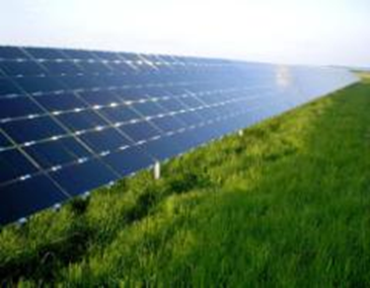

DANEN Technology
Investor Conference
Stock code : 3686-TW Dec. 21 2022
1

Slide 2
Legal Disclaimer
This document is for informational purposes only and is not an offer to buy or the solicitation of an offer to sell any securities.
DANEN’s statements that are not historical facts are forward-looking statements that indicate actions or results of actions that may occur in the future, based on current available information and underlying assumptions.
DANEN does not warranty their accuracy, reliability and completeness. There are a number of factors such as economic conditions, firms abilities, industry environment that could cause actual results and developments to differ materially from those expressed or implied by forward looking statements. Investors should not place undue reliance on them.
2

Slide 3

Outline
Operating overview of DANEN
Global Market of E-Drive
Market summary & Outlook of DANEN
Q & A
3

Slide 4
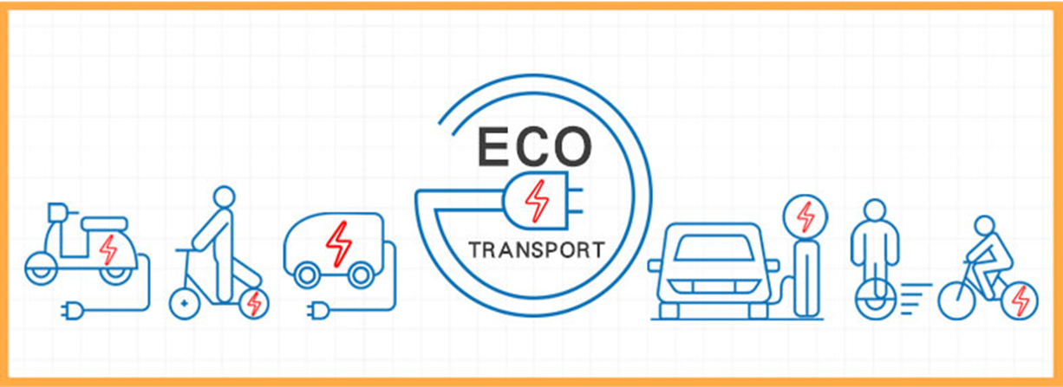
Operating overview of Danen
In 2022, the global economy was greatly affected by Russo-Ukrainian War and the policy of Chinese Pandemic lockdown. As a result, Taiwan’s development prospects for various domestic industries were also greatly affected by the unsettled COVID-19 epidemic and the uncertain international economy. The impact of the issue has prompted DANEN Technology to be more cautious in the process of transformation assessment.
In recent years, DANEN has evaluated the possibility of investing in the development of the green energy industry value chain. During the evaluation period, it has evaluated the power plant management and maintenance related businesses of solar power generation. Due the investment return period is long, which could have a great impact on the company's financial planning. After a further re-evaluation, the company plans to choose the electric drive vehicle (E-Drive) market as it's new target , Because it has great development potential. We look forward to collaborating with premium partners in energy-saving and environmental protection industry value chain to open up new opportunities of green energy, involving in carbon reduction, electric drive and other related industries.

Slide 5
Global market outlook
of E-Drive
5

Slide 6




What is E-Drive ?
E-Drive: Generally refers to an electric load that is powered by equipment outside the traffic vehicle (such as batteries, solar panels or generators) through a power collection system to supply power to one or more electric motors or traction motors, also known as EV. Due to the wide variety of markets, this market overview firstly focuses on EV , E-moto, and E-Bike .
E-BUSES
E-CAR
E- DRIVE
E-BIKE
E-Moto
Source : The pictures are all licensed by CC on the Internet

Slide 7
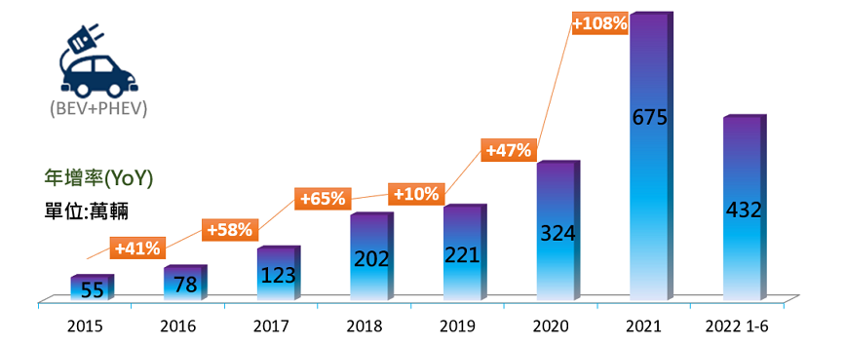
Global E-Drive Market
Global sales of EV were growing gradually , It has reached 6.7 million in 2021, and it is estimated to reach 9.5 million in 2022. The main reason is that the continuous increase of subsidies and incentive policies has also prompted the automobile manufacturing industry to continue to increase the production of electric vehicles and launch new models.
Future outlook of EV: Currently, more than 120 countries around the world have announced the goal of "net-zero carbon emissions" by 2050. In addition, major car manufacturers have also announced that they will launch compliant models and promise to reduce carbon emissions in the supply chain.
Challenges of EV development in the future : (1) The supply of automotive chips is still tight due to the disruption of the COVID-19 (2) The direction of government subsidy policies (3) Improvements in technology and services, such as charging efficiency improvement and after-sales service...
Global EV Sales
Source: Summary by ARTC . 2022

Slide 8
E-Drive Industry Development Status (Domestic)
8

Slide 9
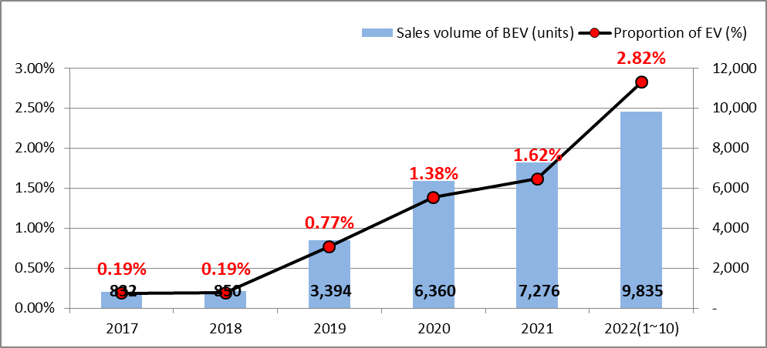
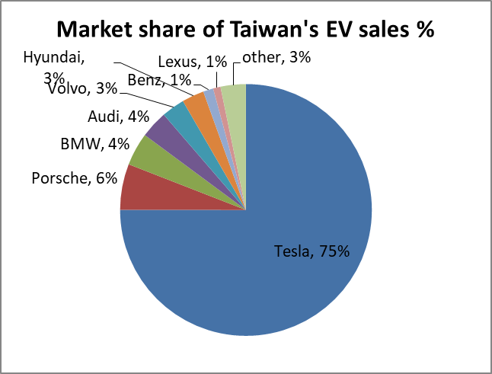
Taiwan EV Market Overview
Policy : In 2025, the market value of electric vehicles in Taiwan will be 600 billion. MOEA expects that electric vehicles will account for 100% of new vehicles sold in 2040. The goal is to subsidize local production and development of key components, and strive to enter the international supply chain and drives the domestic EV market.
Domestic EV market status:
  Sales: Cumulative sales up to September 2022 achieved 9,800 units, expected to double that of 2021.
  Plans of domestic automakers: The complete vehicle part is achieved by FOXCONN (with actual experience in the development of pure electric vehicles), and the commissioned production part, such as Ford , Toyota, Mitsubishi, SYM Hyundai, etc.
Opportunity and Challenges
  <Opportunity> Policies support the electric vehicles. The establishment of the hardware and software platform, the alliance between FOXCONN and Yulon to establish the MIH platform alliance, will be the key to Taiwan's global plan of the electric vehicle market.
  <Challenge> The power shortage problem has always existed, as the market expands, stable electricity will be very important.
The growth trend of EV in Taiwan
Source: Data from MOT, summary by danen. 2022
Source: Data from MOT, summary by danen. 2022

Slide 10
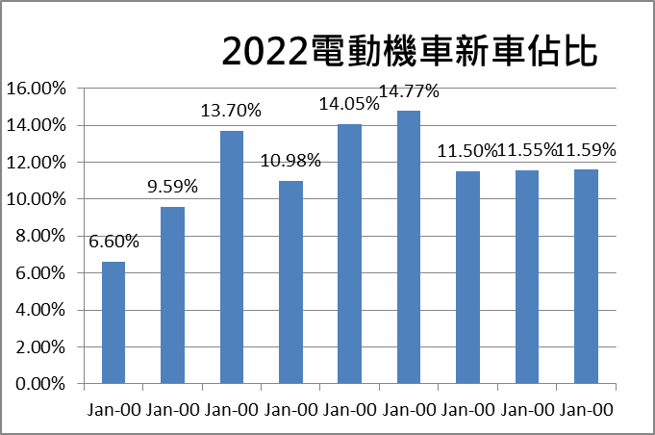
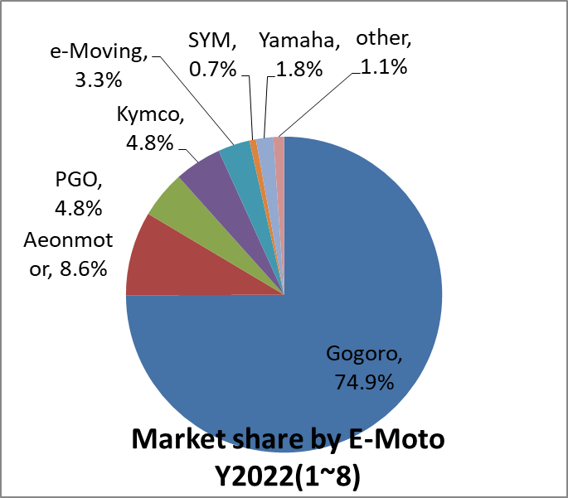
Taiwan E-Moto Market Overview
Domestic market status:
  Demand: According to the statistics of the General Directorate of Highways, as of August 2022, the total number of registered motorcycles in Taiwan is as high as 14.34 million. It is estimated that electric vehicles account for about 20% of the total power vehicle market this year, and the market value is estimated to reach NT 7.7 billion. This represents market growth can be expected.
Opportunity and Challenges
  <Opportunity> At present, the proportion of electric vehicles is only less than 20%, and the replacement market will be big enough for the growth in the future.
  <Challenge> The key impact of government subsidy policies, because policies can also change the ecology of the industry,
  <Challenge> To improve the user environment and improve the convenience and willingness of the public circumstances.
Source: Data from ITRI, summary by danen. 2022
Source: Data from ITRI, summary by danen. 2022

Slide 11
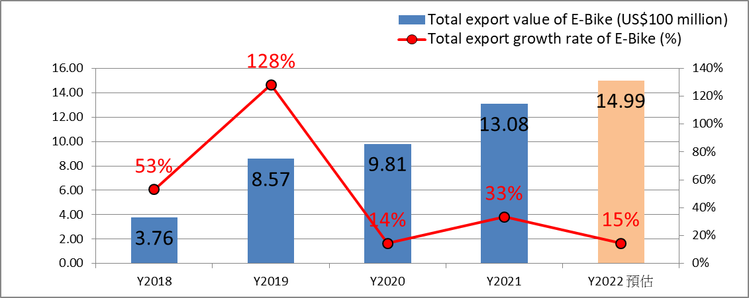
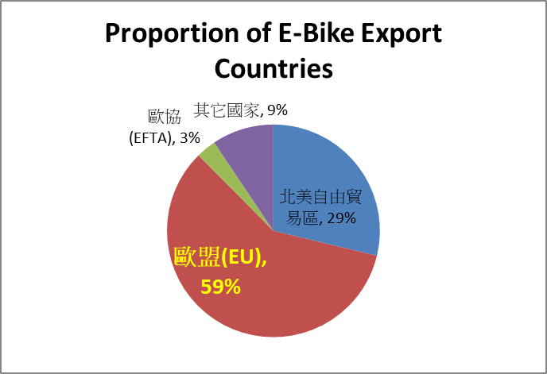
Taiwan E-Bike Market Overview
  Domestic market status:
    Exports have grown with double digits for five consecutive years, and the export will exceed conventional bike before 2025.
    The major domestic manufacturers such as GIANT , MERID, DARFON, IDEAL, etc. are actively expanding the major Euro &US market。
  Opportunity and Challenges
    <Opportunity> Excellent ride ability and convenience are niches for future demand growth, and Taiwan's E-Bike manufacturers with good technique occupy an excellent position.
    <Challenge>The selling price is still on the high side, and it is not easy to expand into markets outside Europe and America in the short term.
    <Challenge> The key components are still controlled by international manufacturers. short-term supply shortage and inventory control will challenge the operation of each manufacturer.
E-Bike export value growth rate
Source: Reference from TBA and summary by Danen Oct. 2022
Source: Reference from TBA and summary by Danen Oct. 2022

Slide 12
Market summary & Outlook of DANEN
12

Slide 13
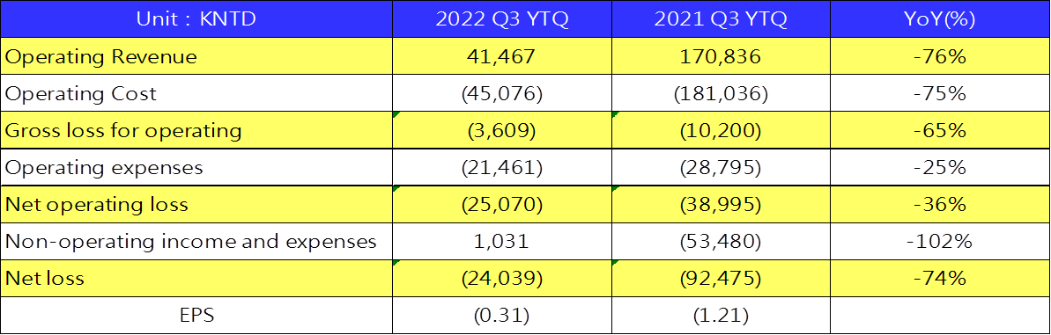
Operating loss reduced, moving positive
In 2022, the company adjusted its operating strategy, aiming toward stable operation and reducing losses. Although the revenue of the first three quarters has declined, compared with the same period last year, the operating loss has been greatly reduced and the expected operating results have been achieved.
EPS -0.31, the loss was mainly due to the write off of a one-time investment appraisal impairment.
In Q4 , the company added E-Bike related components into the business , which is expected to reflect the preliminary operating results of the company transformation.

Slide 14
E-Drive Market summary
With the trend of emphasizing energy saving and carbon reduction round the world, the electrification of transportation vehicles has been listed as one of the twelve important policy indicators for net zero carbon emissions in 2050, and the subsidy policies of various countries will continue to support it extensively.
There will be more manufacturers investing in the E-Drive industry supply chain, and the technology will be more mature and perfect gradually.
In the future, with the introduction of intelligence, it will provide more development opportunities for the whole industrial supply chain.

Slide 15
Outlook of DANEN
  The green energy and carbon reduction industry has been listed as the company's key transformation direction. The company will strictly choose strategic collaboration partners and establish an excellent and qualified team for the company.
  DANEN will invest in part of the E-Drive supply chain according to its own financial ability, and move towards the planned development direction through new collaboration opportunities.
  DANEN's financial structure is solid: The company will proceed with the disposal fund of factory assets in 2021,and should be sufficient to meet the capital required for initial transformation investment.
  Fulfill corporate responsibilities and move forward with strategic actions drawn up in the direction of ESG.

Slide 16


THANK YOU
DANEN TECHNOLOGY CORP.
19F-8, No. 118, Ciyun Rd., East Dist., Hsinchu City 300196,
Taiwan (R.O.C.)

