Slide 1
2021 Investor Conference
28th December, 2021

Slide 2
Core Development
USB/MIPI Cam
Camera Module
NB automation
Flip Chip
AA
3D Sensing algorithm
Image Recognition algorithm
3D Sensing
(TX & RX Module)
AzureWave
IoT
Automotive Cam
Consumer
Module
Wi-Fi
BT
System on Module
Wireless
Module
IoT
Wireless Module
2

Slide 3
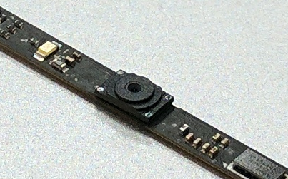
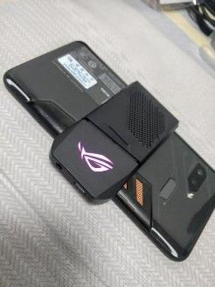
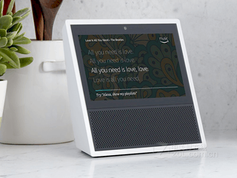
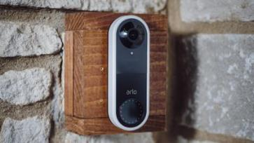
Products
Ultra-Slim NB Camera
IOT Camera
  Gaming Phone 24M FF Camera
  DoorBell 2M FF Camera
  AI speaker series 5M AF& HD Camera
3

Slide 4
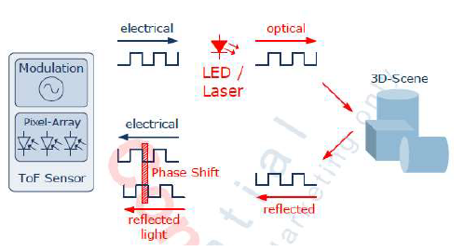
Products
3D Depth Camera
ToF (Time of Flight) : introduction
A time-of-flight camera (ToF camera) is a range imaging camera system that resolves distance based on the known speed of light, measuring the time-of-flight of a light signal between the camera and the subject for each point of the image.
4

Slide 5
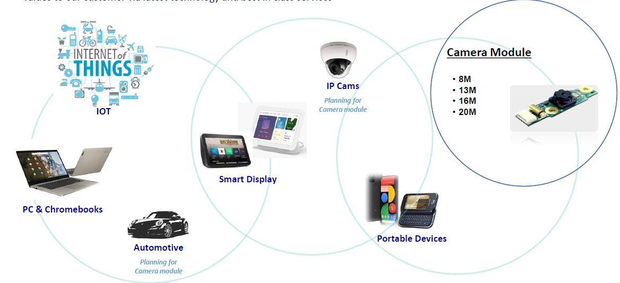
Camera Module Applications
5

Slide 6
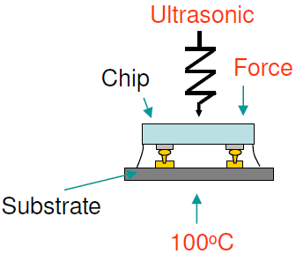
Technology
Ultra Slim NB Camera by Flip Chip technology
Flip Chip Technology
sensor
glue
Bump
glass
6

Slide 7
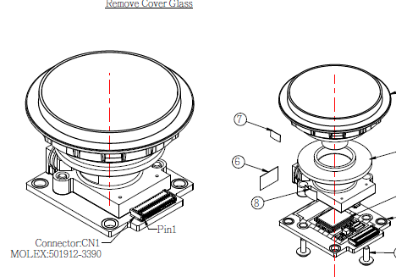
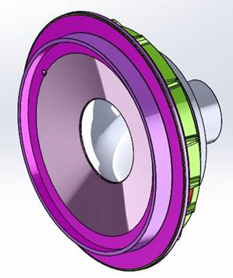
Technology
Wide Angle Camera by AA (Active Alignment) technology
Lens: 6G
7

Slide 8
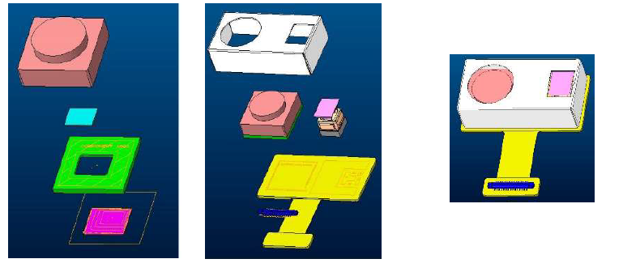
Technology
3D Reflowable ToF Camera application by Flip Chip technology
8

Slide 9
9

Slide 10
Wi-Fi Standard Comparison
Wi-Fi Standard |  |  | Wi-Fi 5 | Wi-Fi 6 | Wi-Fi 6E
IEEE Specification |  |  | 802.11ac | 802.11ax | 802.11ax
Frequency |  |  | 5 GHz | 2.4 / 5 GHz | 2.4 / 5 / 6 GHz
Number of Channels | Channel Bandwidth (MHz) | 20 | 25 | 28 | 87
 |  | 40 | 12 | 13 | 42
 |  | 80 | 6 | 6 | 20
 |  | 160 | 2 | 2 | 9
Access |  |  | OFDM | OFDMA | OFDMA
Maximum Antennas |  |  | MU-MIMO (4 x 4) | MU-MIMO (8 x 8) | MU-MIMO (8 x 8)
Modulation |  |  | 256 QAM | 1024 QAM | 1024 QAM
Maximum Data Rate |  |  | 3.5 Gbps | 9.6 Gbps | 9.6 Gbps
10

Slide 11
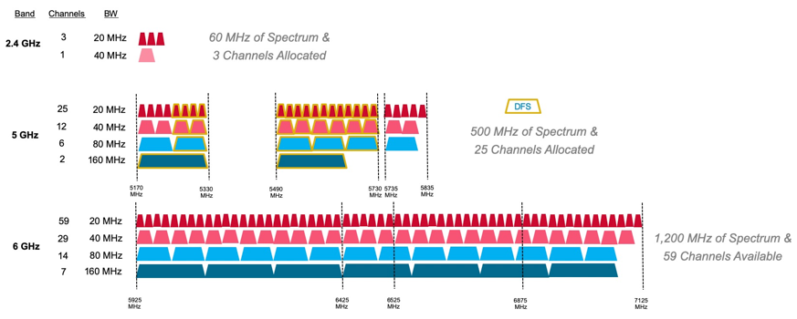
2.4GHz、5GHz and 6GHz Channels Comparison
11

Slide 12
Wi-Fi 6E Advantage
High Speed
7 additional 160MHz channels
Low Latency
Low Interference
1200MHz exclusive spectrum
75% lower than Wi-Fi 5
12

Slide 13
Wi-Fi 6E Worldwide Shipment Forecast
13

Slide 14
Wi-Fi 6E Module Major Applications
PC
Game
IOT
14

Slide 15
Wi-Fi 6E Module Formfactors
M.2 2230 Module
M.2 1216 Module
LGA Module
SiP Module
15

Slide 16
Q&A
16

Slide 17
Thank you!

