Slide 1
YungShin Global Holding Corporation
Investor Conference
Provide the best products
to improve human health
Dec. 26, 2024
1/24

Slide 2
Disclaimers
This presentation is based on the information obtained from various sources which the Company believes to be reliable. But at some point in the future, there are a variety of factors which could cause actual results to differ materially from those statements. Therefore, please refer to the information on MOPS website as the main basis if any adjustment has been made. (http://mops.twse.com.tw/mops/web/index)
2/24

Slide 3

Table of Contents
YungShin Group Overview
Operational Results for Q1-Q3 of year 2024
Business Strategy
3/24

Slide 4



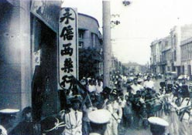

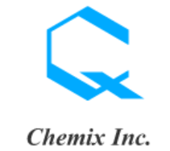


Introduction of YungShin Group
A pharmaceutical Group have been established over 60 years, looking forward being a-century enterprise.
1952~1970
1970~1990
1990~2010
2010~2021
1985
1987
1994
2016
1965
Yung Shin(Hong Kong)
Yung Shin(Malaysia)
1990
Yung Zip (Shanghai)
Yung Shin (Kunshan)
Vetnostrum (Taiwan)
Carlsbad (U.S.A.)
2011
1952
Yung Shin(Taiwan)
2004
YungShin Global Holding
Yungshin Pharmacy
(Taiwan)
1978
Yung Shin (Indonesia)
YSP SAH (Malaysia)
Yung Zip (Taiwan)
2007
Yung Shin (Vietnam)
2013
Chemix (Japan)
1993
Listing of YSP
2004
2011
2000
Listing of YSP SAH
Listing of YSH
Listing of YZC
4/24

Slide 5
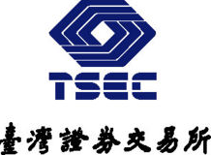


Listing History
Three subsidiaries list in TW, CN and MY.
1993- Listing of Yungshin Pharmaceutical, Taiwan
2000-Listing of Yung Zip Chemical, Taiwan
2004-Listing of Y.S.P. Southeast Asia Holding, Malaysia
2011-Listing of YungShin Global Holding, Taiwan
2023-Listing of Vetnostrum, Taiwan emerging stock market
5/24

Slide 6
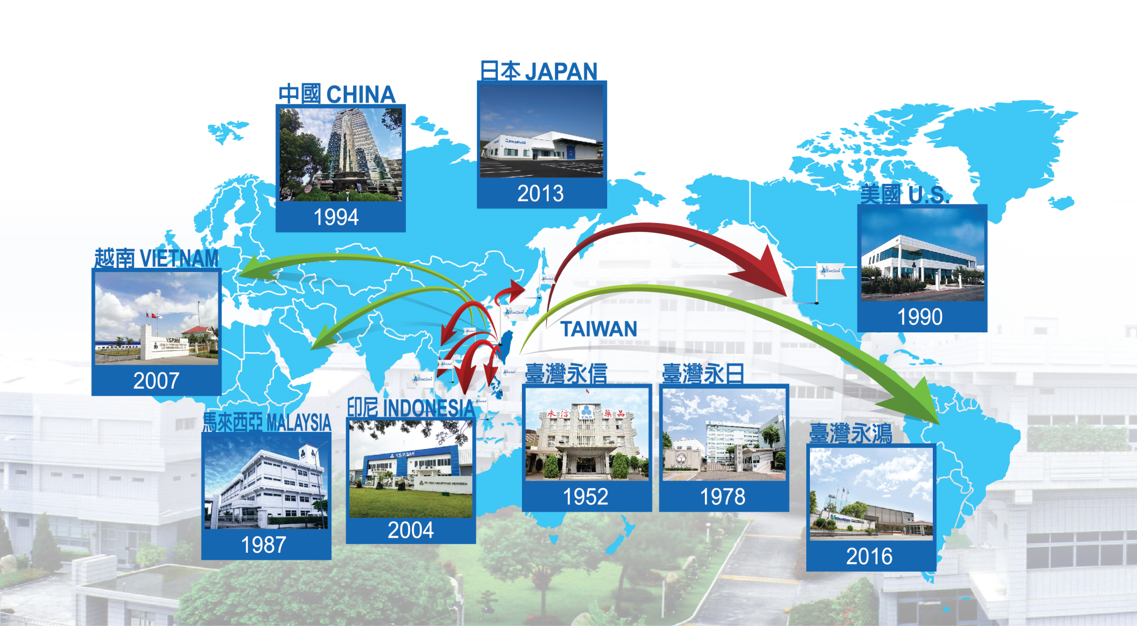
R&D and Production Planning Worldwide
Night manufacturing and operating bases cross US, CN, JP and South Asia.
6/24

Slide 7

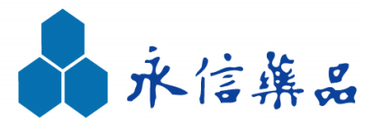
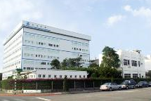
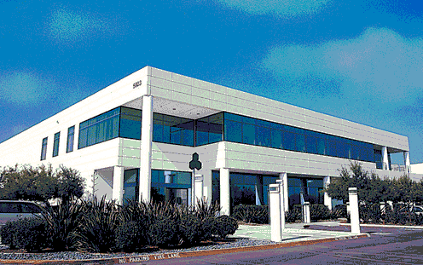
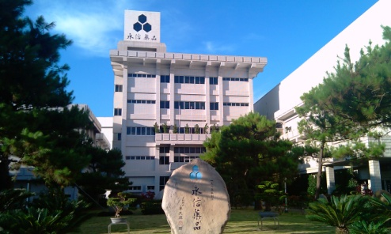





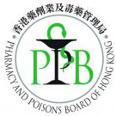





YungShin Group Main Production Bases(1/2)
Subsidiaries in TW and US have been certified by USFDA.
Production bases of YSG have covered 5 continents and products sold over 35 countries.
1990
Yung Zip
(Taiwan)
1998
Carlsbad
(USA)
2004
YungShin
(Taiwan)
7/24

Slide 8
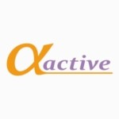



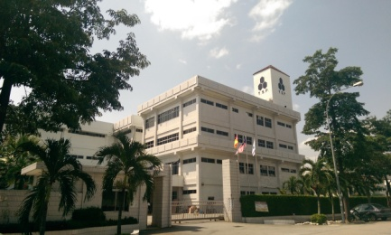
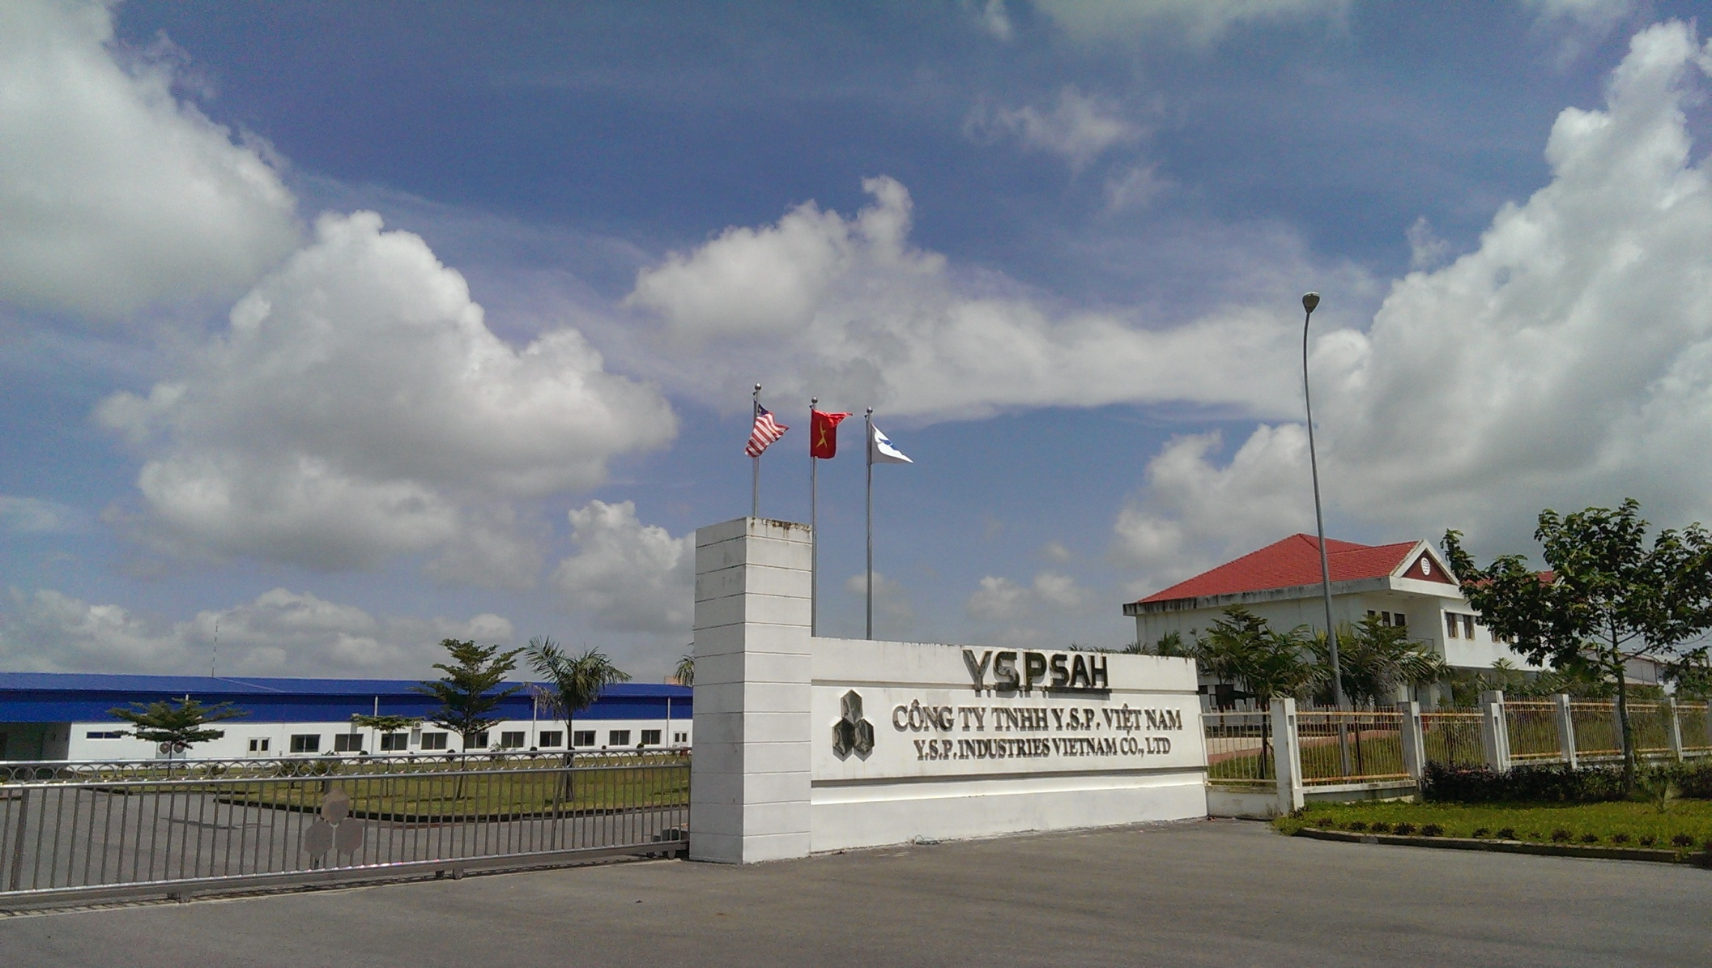
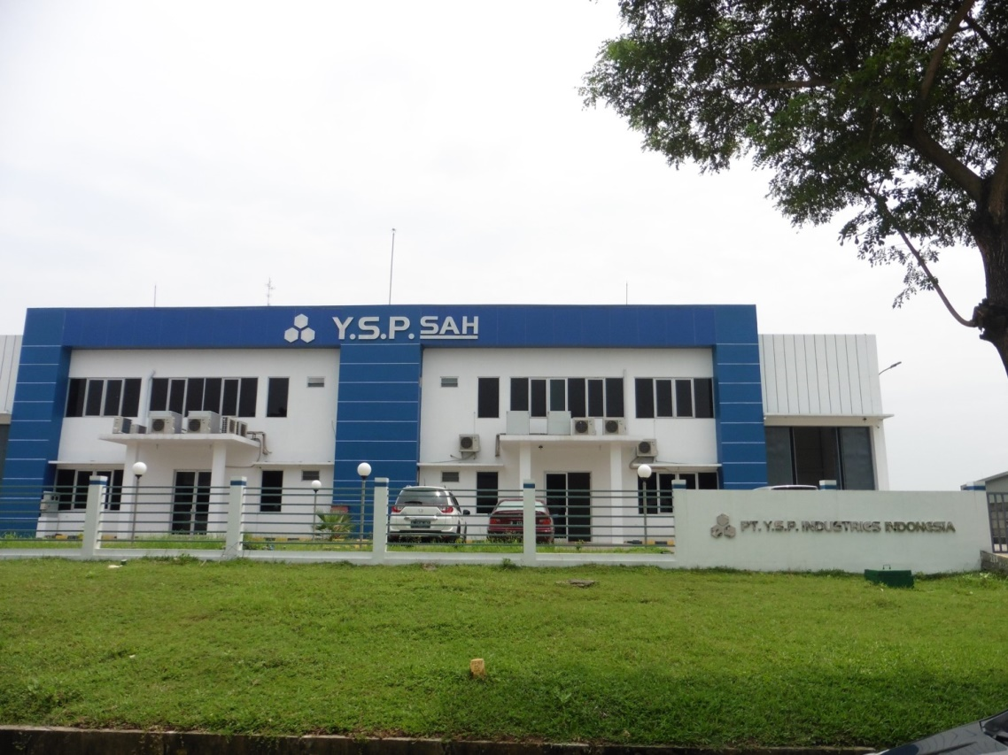
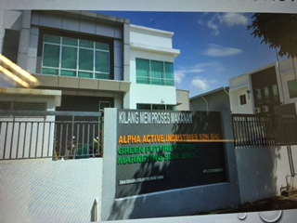






YungShin Group Main Production Bases(2/2)
MY, VN and IN sites have exported to Southeast Asia, middle East, North Africa and Oceania.
(Malaysia)
(Vietnam)
(Indonesia)
(Malaysia)

Slide 9
YSH Stable Business
Stable payout dividend in every economy cycle
NT/Share
2017 2018 2019 2020 2021 2022 2023

Slide 10
Operational Results for the year of 2024Q1-Q3
Provide the best products
to improve human health
10/24

Slide 11
YSH Consolidated Statements of Income
Operating revenue increased by 15.60% and
Profit for the period increased by 38.93%% from Jan to Sep for the year 2024 and 2023.
(Expressed in millions of NTD)
11/24

Slide 12
YSH Consolidated balance sheet (1/2)
Comparing total assets increased by 17.26% in 2024 and 2023.
(Expressed in millions of NTD)
12/24

Slide 13
YSH Consolidated balance sheet (2/2)
Comparing total shareholder's equity increased by 22.00% in 2024 and 2023.
(Expressed in millions of NTD)
13/24

Slide 14
YSH Consolidated Operating Revenue by area Comparing consolidated revenue increased by 15.59% from Jan to Sep for the year 2024 and 2023.
(Expressed in thousands of local currency)
The list the revenues of companies that YSH holding only more than 50% shares.
Operating revenue by area is based on financial report, and the growth rate is calculated in local currency.
14/24

Slide 15
Business Strategy
Provide the best products
to improve human health
15/24

Slide 16

Operating Strategy of YSH
Eight aspects to accomplish steady investment and pragmatic operation for creating the best interests of shareholders.
A1
A2
B
C1
D
Quality , Production , Industrial Safety and Purchase
Unity ＆ Communication
Investment ＆ Operation
Financial ＆ Accounting
Talent Development
YSH Strategy Committee
Functional group
Unity ： selfless sharing and support
Mutual trust ：Appropriate information transparency
Time accumulation, Results sharing
United factory inspection annually
Functional group
Connect meeting
According to the affiliate’s investment amount and profitability for segmental management ：
1. Counseling period
2. Growth period
3. Maturity period
Evaluating new investment
Increase or decrease investment of affiliate according to operating results
Middle and senior managers development
A3
E
C2
IT system sharing
Legal Representative
ESG
Administrative Operating System
Quality Control System
Participating operation of affiliate and associate through legal representative appointment
Carbon Tracking
Social balance
16/24

Slide 17



Business Strategy of YSH
Internal investment management and external M&A for strengthening group efficiency
The strategy will balance short, medium and long term group development and shareholders' equity
Internal investment management
External M&A
Production
Cross company platform communication and production experience optimization
Marketing
Search, supply, marketing promotion transnationally
Personnel(ESG)
Integrate experiences communication of joint factory inspection for national laws and regulations
R&D
Project coordination, R&D technology transfer reducing investment
Finance
Supervising by YSH, apply endorsement and guarantee to
reduce financial burden and increase investment efficiency
New business
Obtaining factories, products and technologies and enter into the market of feed additives by merger and acquisition of Pfizer Inc.(Hsinchu plant)
Multi-angle consideration relating to health industry
New market
Entering into OEM business by merger and acquisition of Alpha-Active and Taiwan Wa- Chein Ind. Co., Ltd.
New market evaluation such as in Europe…etc.
New product/technology
Obtain manufacturing technology from GlyTech Inc.
Evaluating biological medicine, cell therapy and other fields.
17/24

Slide 18
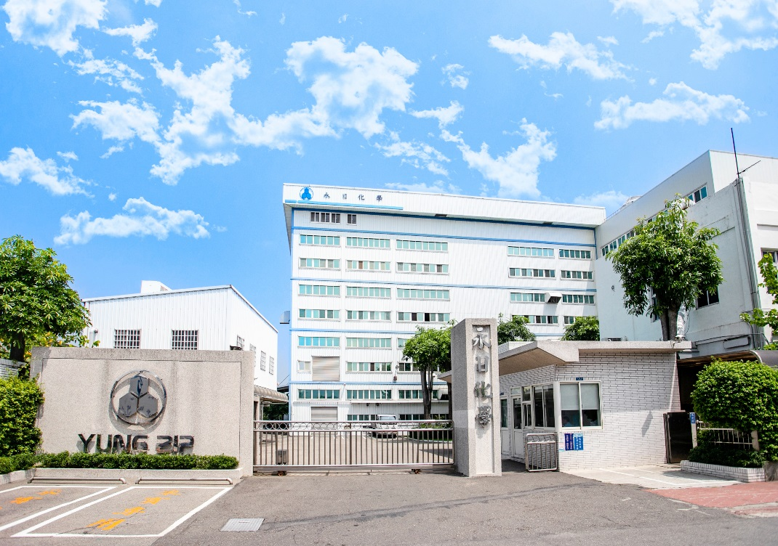
Yung Zip Chemical IND CO., LTD
Book in financial report from Jun 2024
Founded on June 8, 1978, and rooted in the active pharmaceutical ingredient industry for over 40 years, we are the first domestic pharmaceutical ingredient manufacturer to obtain GMP certification from the Taiwan Department of Health. We have also successively passed international certifications from US FDA, MHRA, PMDA, KFDA, HALAL, and KOSHER.
In response to changing international circumstances, the company is seeking growth and transformation opportunities to build a continuous growth engine.
Development
1. Focus on core business The revenue from API and excipients accounts for 58.5%.
4.Food Subsidiary- Revenue account for 14.5%。
3. Specialty chemicals and international trade
Revenue account for 0.2%。
2.CMO：。
Revenue account for 26.8%。
2024/01~2024/09 Revenue NT481,424Thousand
18/24

Slide 19
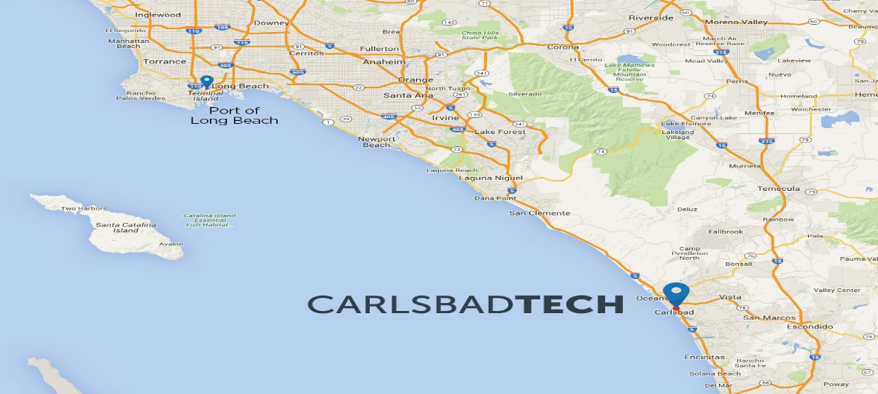
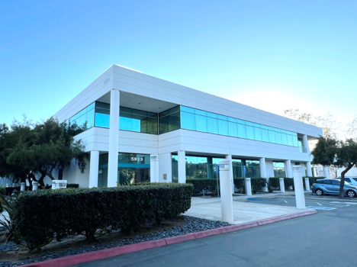
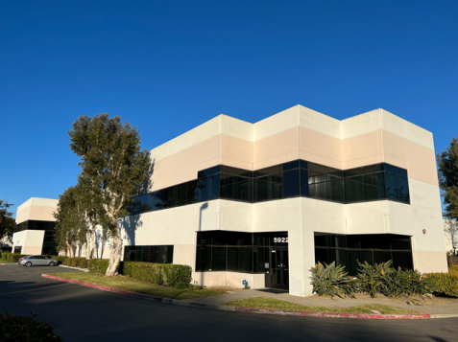
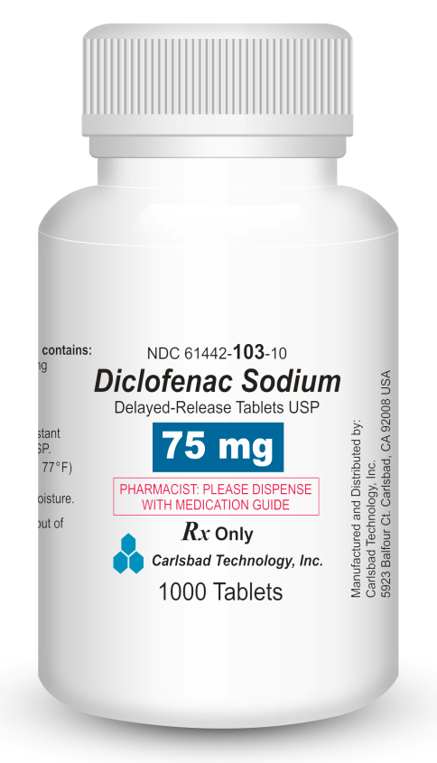
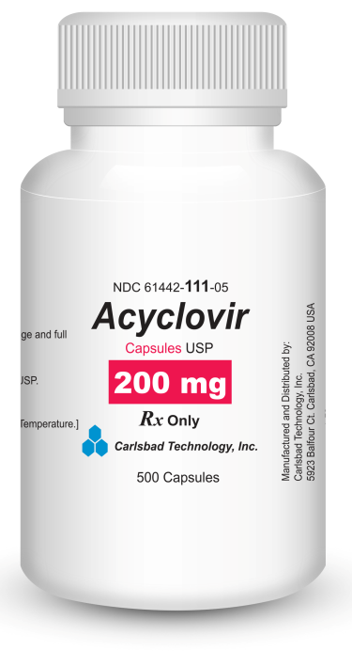
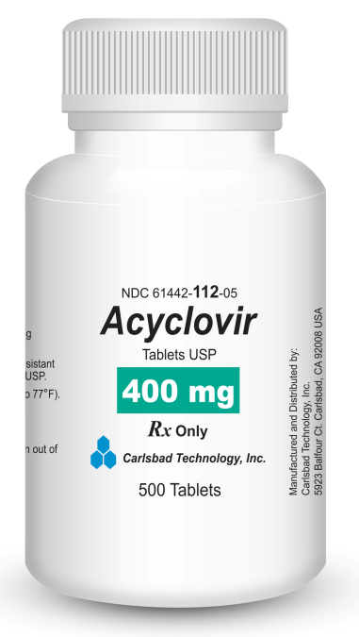
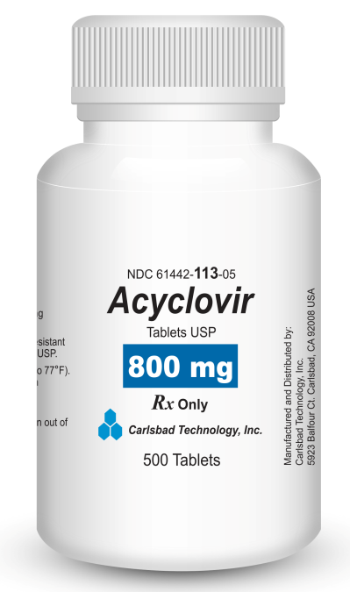
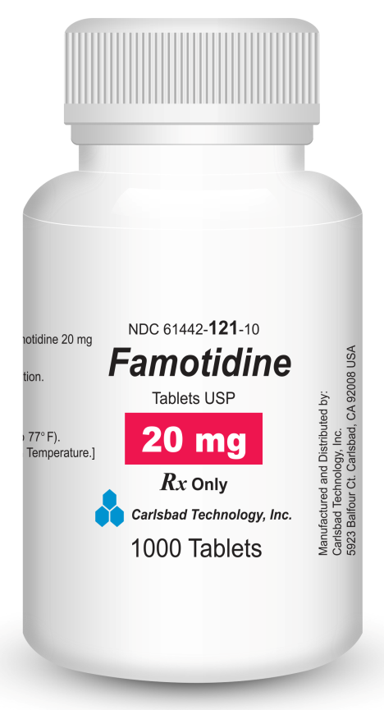
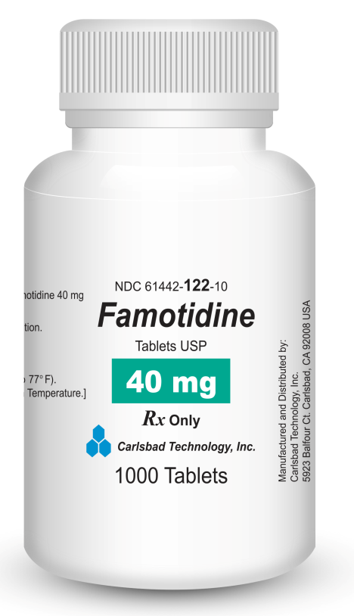
CarlsbadTech (YungShin US)
Total solution from production to marketing as window for Asia company to enter US market.
History:
Company started in 1990 and facility operated in 1998.
Location:
Located 30 miles north of San Diego, 130 miles south of LAX, 90 miles from Port of Los Angeles.
Space:
cGMP compliance solid dosage form manufacturing facility (Approx. 21,000 sq.ft.).
Production Capability:
About 800mio to 1,000mio tabs capacity per year.
Customer:
Cover US 96% customers in sales channel with 50 stats selling permit.
Production
Labatory
OWN BRAND、CMO、CDMO、PACKING、RA
US market total solution

Slide 20







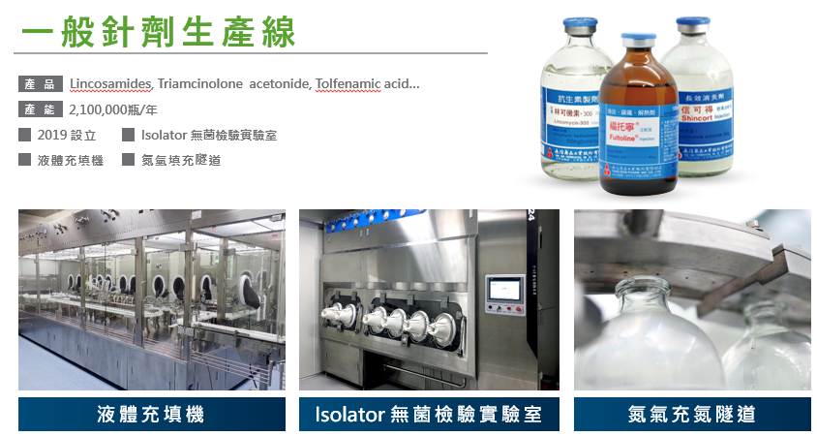
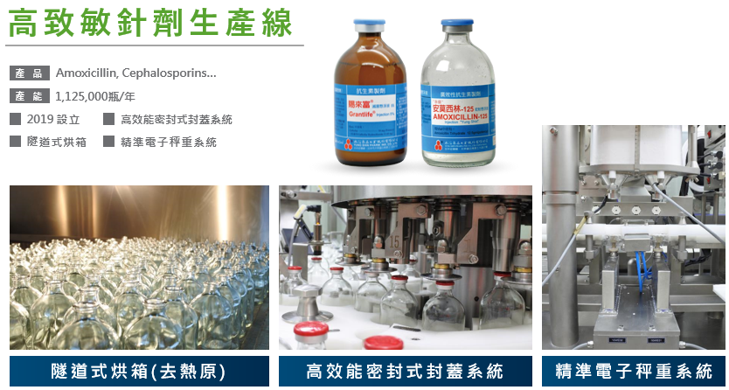
Create New Value for Share Holder Enter Capital Market
Be approval of listing in Q2 2025
Cyanamid
Wyeth
Pfizer
Zotis
Vetnostrum
1960 built
1994
Wyeth acquire Cyanamid
2010
Pfizer acquire Wyeth
2014
Zoetis independent from Pfizer
2017 Vetnostrum merge YSP animal division
2023Q3
IPO apply
2016
YSP acquire Zoetis TW to build Vetnostrum
2020
Launch new brand
TW only high potency and general inj. Manufacture
20/24

Slide 21

Maximize Value Chain Based on Product
Strengthen the competitiveness of the group through vertical integration and horizontal expansion
Vertical integration : Maximize Production Value Chain
Vertical integration of main products through manufacturing and marketing of intermediate, API and FDF.
Master raw material intermediate suppliers through investment and contract manufacture.
Local production reduce the risk of trade barriers.
Sharing R&D resource from in Taiwan and Malaysia lab.
Continually strengthen product line competitiveness (integrate value chain and expand production batch size)
Maximize Value Chain
Horizontal expansion : Maximize Sales Value Chain
Future product lines drive from market orientation
Deep development of digestive tract, pain, hypersensitivity and anticancer fields.
Increasing investment benefit through Integration product lines in various countries, mutual distribution, technology transfer, and development together.
Expansion of four major business: API, FDF, OTC and animal drugs
21/24

Slide 22
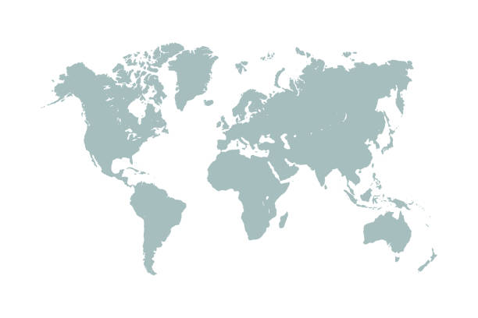










YungShin group CDMO
Business cover from API, Originator, Brand, Food supplement and Vet Drug
22/24

Slide 23
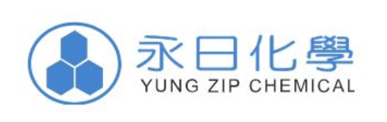
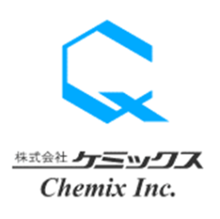

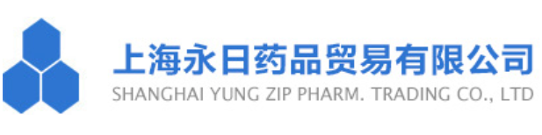


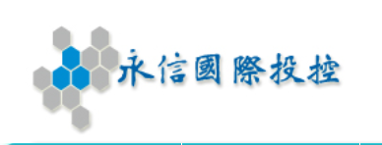

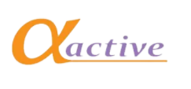
Diversified Business Map
Expansion and exposure new business based on core health care relative business
API
Small molecule prescription drugs
CRO clinical trials
Pet health products
Protein medicine
Feed additives
Cell therapy
Vaccine
Animal medicine
OTC
Laboratory equipment or consumables
Functional food products
Household medical device
Hospital test reagents
Hospital Medical device
23/24

Slide 24
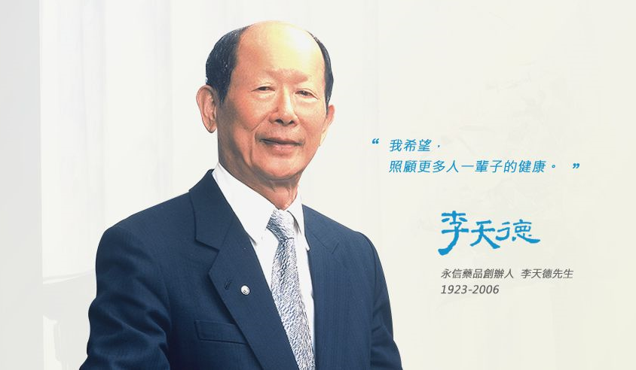
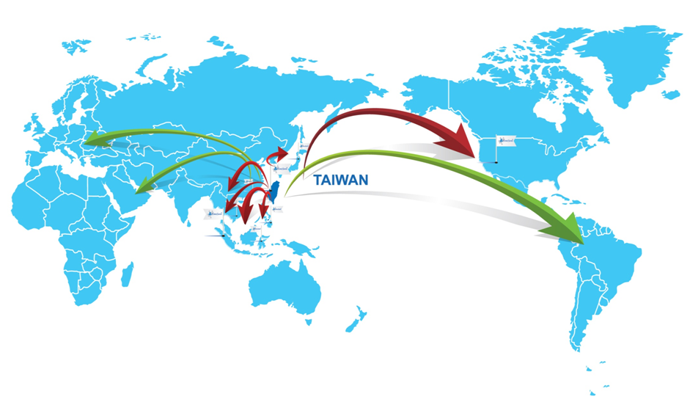
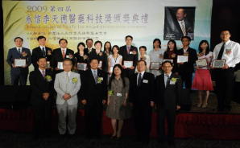
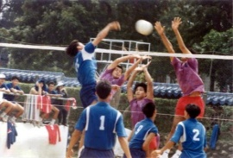
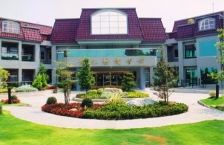
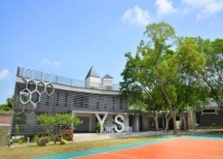
Core Value of YungShin Group
Provide the best products to improve human health from Taiwan
Spirit of YungShin Group：
We produce medicine that we would give it to our own families.
We establish Nursing Home that our elders would love to go to.
Social welfare covered by cooperate social responsibility
24/24

Slide 25
Q&A
Provide the best products
to improve human health

