Slide 1
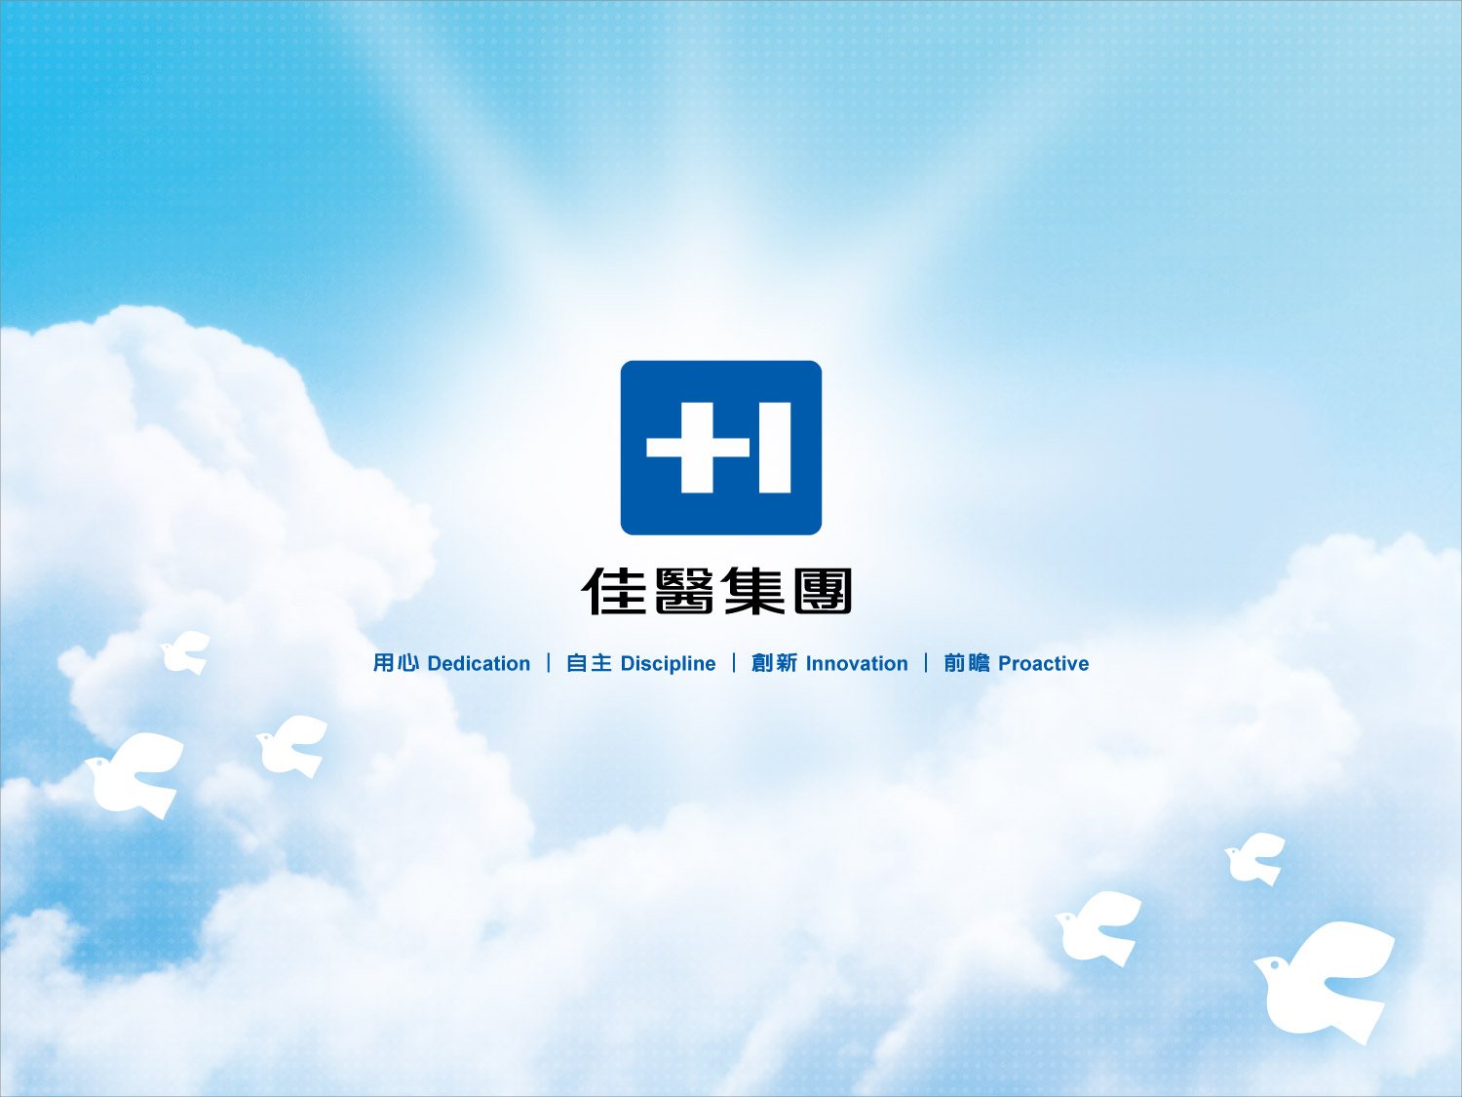
Excelsior Medical Co., Ltd.
Investor Conference
2022/9/27

Slide 2
Disclaimer
This presentation is prepared according to the audited or reviewed financial statements by CPA and the financial figures hereby are based on IFRS, please refer to the published financial statements for full content.
The presentation may contain forward-looking information and may differ materially from the actual results. Excelsior does not warranty as to the accuracy or completeness of such information and nor assume any undertaking further information becomes available or in light of changing circumstances. You shall not place undue reliance on any forward-looking information.
The presentation and its contents may not be reproduced to a third party without the prior written consent by Excelsior.
2

Slide 3
Table of Contents
1.公司概況(Corporate Overview)
P.4
2.市場概況(Market Overview)
P.8
3.營運概況(Business Overview)
P.11
4.財務概況(Financial Overview)
P.14
5.轉投資概況(Investment Overview)
P.17
6.策略及展望(Strategies and Outlook)
P.23
7.補充資料(Appendix)
P.26

Slide 4
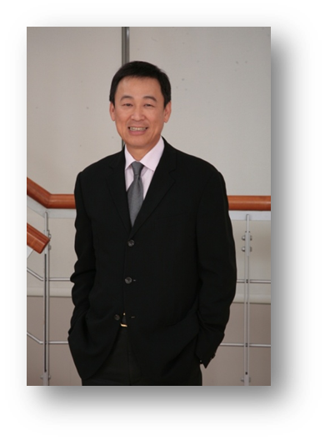
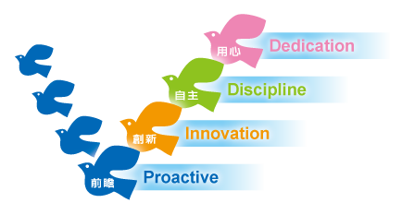
Corporate Overview
Chairman
Group President
Tony Fu
“Dedication, Discipline, Innovation, Proactive” are the core values of Excelsior.
“Human Healthcare” is the basis of medical service industry.
Therefore, “Dedication” to our service target is what matters the most.
We focus on public healthcare, using the innovative management model,
providing the most suitable product and service to the market.
Meanwhile, achieve our vision of becoming
the most valuable total healthcare solution provider among Asia with exceptional
investing and operating teams !

Slide 5

The Most Valuable Total Healthcare Solution Provider
among Asia with Exceptional Investing and Operating Teams！
Excelsior Medical Co., Ltd. was established in 1988, Excelsior started with the distribution of hemodialysis equipments and supplies. Gradually transformed into integrated medical services channel provider.
In 2001 “Enfield Medical Co., Ltd.“ successfully listed on the OTC. With the success in integration and diversification, Enfield became a listed company in Taiwan Stock Exchange (TSE) in 2007. Enfield was later renamed as Excelsior in 2009.
Up to now the Group has three listed companies ( Excelsior : listed at TSE ,stock code 4104. Dynamic and Arich : listed at OTC, stock code 4138 and 4173).
In the future, Excelsior will continue to expand its investment and operation in biotechnology and medical industries, in the Southeast Asia region and countries around the world.

Slide 6
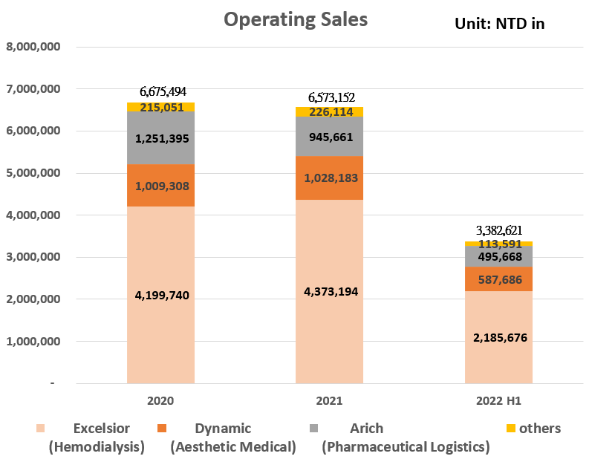
Revenue structure
Excelsior yearly consolidated sales is more than NT $ 6.5 billion in 2021, the primary revenue comes from Excelsior (Hemodialysis), Dynamic (Aesthetic Medical), Arich (Pharmaceutical Logistics) and others.
According to the company’s function, the business type can be characterized as a trading business, medical service provider and pharmaceutical logistic.

Slide 7
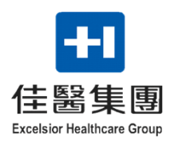
The Business Types
Hemodialysis
Aesthetic Medical
Trading Business
Medical Devices
Medical Consumables
Home Appliances
Product
Planning
Information
Analysis
Sales
Promotion
Hemodialysis channel
Pharma. Sales and Promotion
Market
Management
Creative
Development
Aesthetic Medical channel
Pharma. Distribution and Logistics
Long-term Care channel
Medical Service
Provider
Pharmaceutical
logistics
Medical Supplies Distribution
District Hospital channel
GMP/GDP/ISO Certification
Orthopedic/Cardiovascular
Professional Maintenance

Slide 8
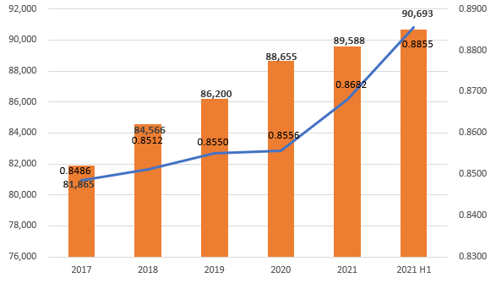



Market Overview
Excelsior(Hemodialysis)
Taiwan benefited from the implementation of the national health insurance system in 1995 and the hemodialysis technology and quality gradually mature, the patient's survival rate has gradually increased. According National Health Insurance Administration
, as of the 2nd quarter of 2022, the total number of Taiwan hemodialysis and peritoneal dialysis populations has reached 90,693 people.
Hemodialysis brand
Data Source: National Health Insurance Administration

Slide 9












Dynamic(Aesthetic Medical)
According to the Asian-Pacific Market Study issued by Medical Insight, Inc. in Mar. 2022, total Asian sales of all aesthetic products and equipment reached US$2.7 billion in 2020 and are expected to increase by 16.4% per year through 2025. Furthermore, aesthetic medical market can be divided into 4 sections: Energy-Based Device, Body Shaping and Skin Tightening ,Dermal Filler and Neurotoxin, and DMT’s distributed products cover all of the sections.
Product Portfolio
Percentage of sales in Asian

Slide 10
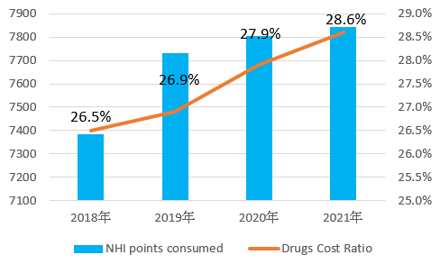

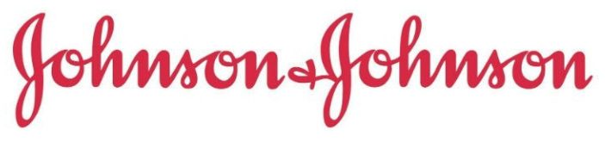


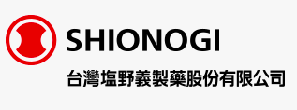
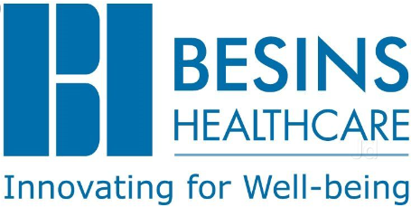

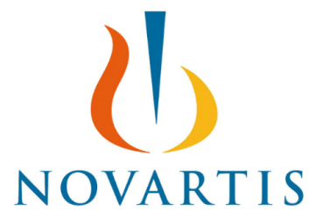

Arich (Pharmaceutical Logistics)
Medicines cover cost approximately 1/4 of National Health Insurance expenditures. In Taiwan, although demand for medication is growing, but the prices approved/reimbursed by NHI are declining. Consequently the multinational pharmaceutical companies keep on outsourcing, for the sake of cost down, the distribution/logistic service more and more.
國際原廠客戶
Data Source: National Health Insurance Administration

Slide 11
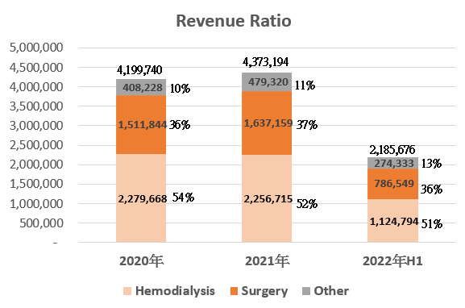
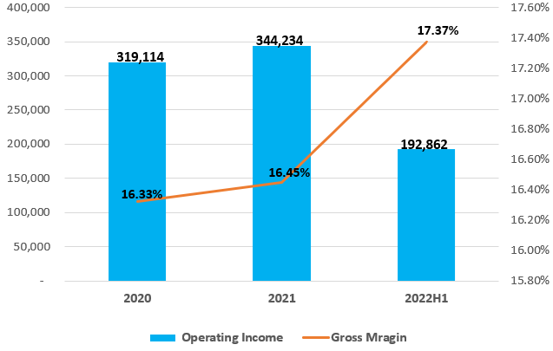
Business Overview
Excelsior(Hemodialysis)
Unit: NTD in thousands
Excelsior’s operating income was NT $ 344,234 thousands in 2021 and NT $ 319,114 thousands in 2020; the growth rate was 7.9%. The operating income in 2022 H1 than which of 2021 H1 is increased because of the increase in sales of high-margin products and the depreciation in the import exchange rate.
Unit: NTD in thousands
In 2022 H1, Excelsior’s hemodialysis products accounted for 51% of its operating revenue, the surgical products accounted for 36%, the other products (blood bags, ostomy, preventive healthcare and home appliances) accounted for 13%.
The greater revenues of 2022 H1 than which of 2021 H1 is due to the increase in sales of hemodialysis and home appliances.
In 2021 the sales of hemodialysis products decreased by 1%, meanwhile the sales of surgical products increased by 8.3%. The overall operating revenue increased by 4.1%.

Slide 12
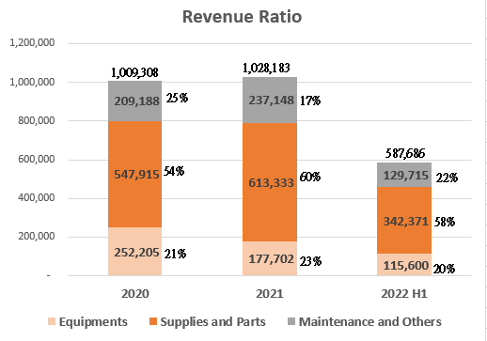
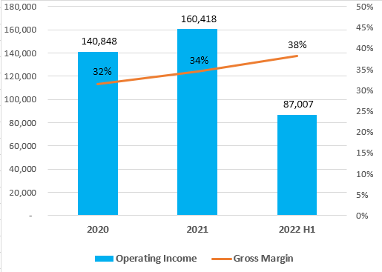
Dynamic(Aesthetic Medical)
Unit: NTD in thousands
Dynamic’s operating income were NT $ 160,418 thousands in 2021 and NT $ 140,848 thousands in 2020; the growth rate was 13.9%. The operating income in 2022 H1 than which of 2021 H1 is increased because the new products were launched and the gross profit margin was improved through a diversified product sales mix. Although the expenses of ad and expansion increased, the overall operating income still increased compared with the same period last year.
Unit: NTD in thousands
In 2022 H1, Dynamic’s equipments accounted for 20% of the revenue, supplies and parts accounted for 58%, maintenance and others accounted for 22%.
The greater revenues of 2022 H1 than which of 2021 H1 is due the steady growth of new machines, neurotoxic and dermal filler, as well as the growth of beauty treatment revenue driven by the expansion of beauty shops.
In 2021 the sales of equipments decreased by 29.5%, meanwhile the sales of supplies and parts increased by 11.9% and maintenance and others increased by 13.4%. The overall operating revenue increased by 1.9%.

Slide 13
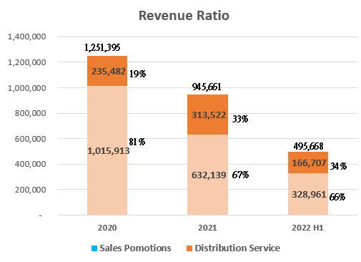
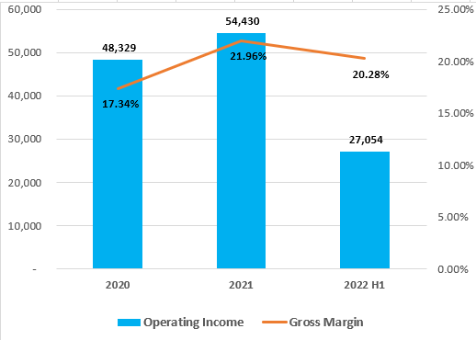
Arich (Pharmaceutical Logistics)
Arich’s operating income was NT$ 54,430 thousands in 2021 and NT$ 48,329 thousands in 2020; the growth rate was 12.6%. Mainly due to the decrease in sales and promotion revenue and the impact of the COVID-19 in 2021, but the increase in distribution and logistics revenue, resulting in the increase in gross profit.
The decrease in margin in 2022 H1, is mainly due to inflation that increased operating costs. However, the operating income is increased in 2022 H1 by retrenching expenses.
Unit: NTD in thousands
Unit: NTD in thousands
In 2022 H1, Arich’s sales and promotion revenue accounted for 66% of ARICH’s operating revenue; distribution and logistics revenue accounted for 34% of ARICH’s operating revenue.
The greater revenues of 2022 H1 than which of 2021 H1 is due to the collaboration with new principals.
Affected by COVID-19, Arich’s operating revenue in 2021 was lower than 2020.
Notes:
待改

Slide 14
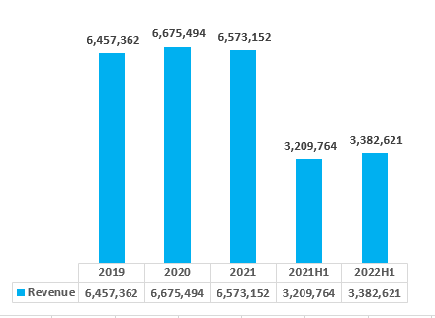
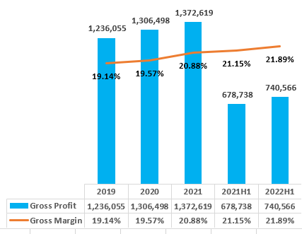
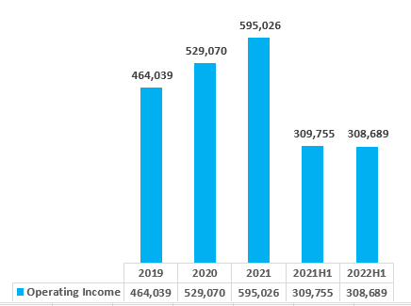
Financial Overview
Consolidated revenue
Unit: NTD in thousands
Consolidated gross profit
Unit: NTD in thousands
Consolidated operating Income
Unit: NTD in thousands

Slide 15
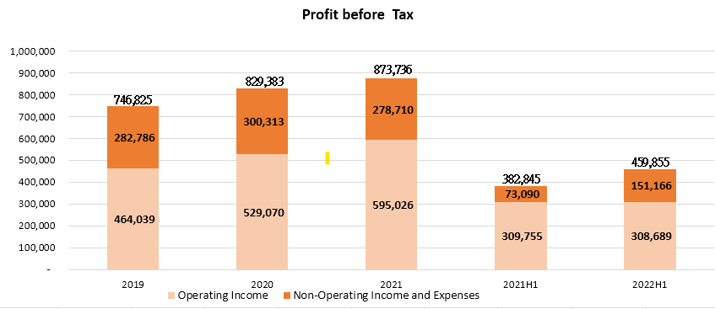
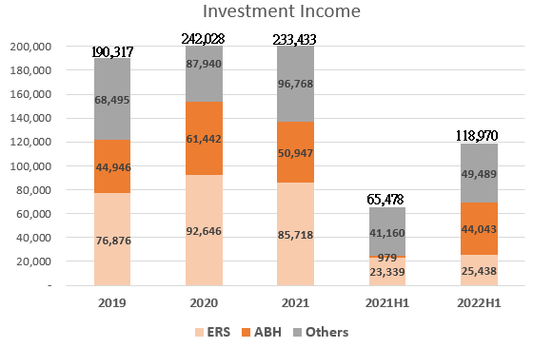
Unit: NTD in thousands
Unit: NTD in thousands

Slide 16
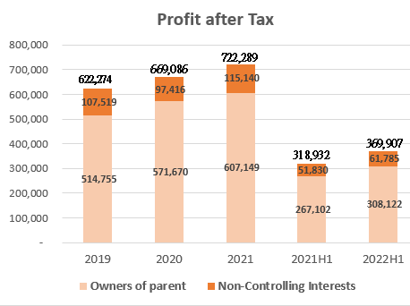
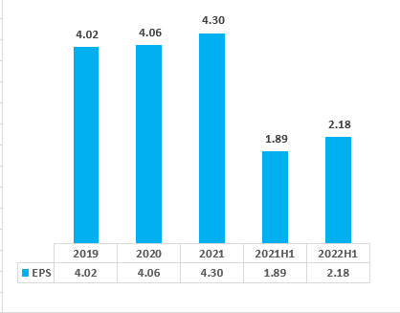
Unit: NTD in thousands
Unit : NTD in Dollars

Slide 17
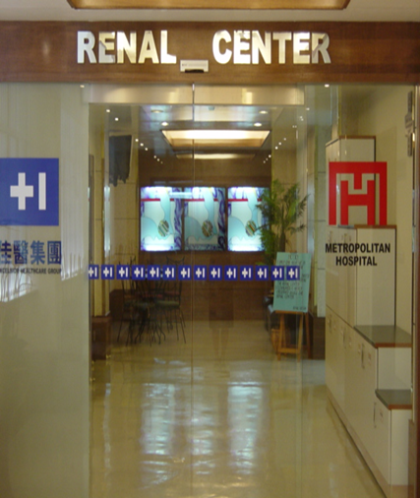
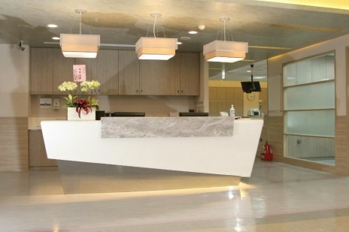
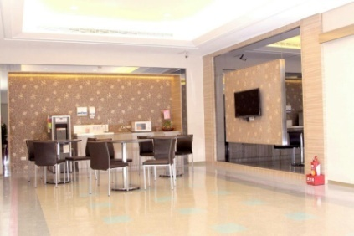
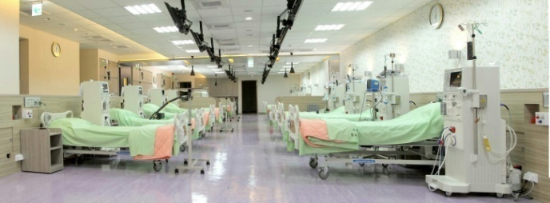
Investment Overview
Hemodialysis channel – Excelsior Renal Service Co., Limited
NephroCare Limited
Cardinal Medical Services Ltd.
【 Hemodialysis channel Introduction 】
Excelsior has entered into a joint venture with Fresenius which is the world's largest manufacturer of dialysis products, and has established long-term cooperative relationship with more than 100 Hemodialysis Centers, Excelsior acquire the 49% shares of NC and CMS, also ERS is the largest professional medical management services provider. Excelsior’s professional hemodialysis team counsels dialysis Centers management, provides dialysis equipment and consumables with the highest quality, professional training, and medical advisory team to help medical staff to provide the best care to patients with quality care and nutrition services.
17

Slide 18
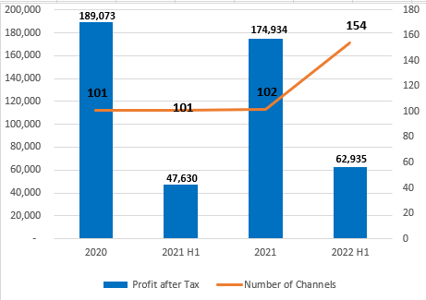
Hemodialysis channel – Excelsior Renal Service Co., Limited
NephroCare Limited
Cardinal Medical Services Ltd.
Profit after Tax
(NTD in thousands)
Number of channels
<Note>In 2022 H1, the hemodialysis channel increased due to NephroCare Limited
and Cardinal Medical Services Ltd..
18

Slide 19
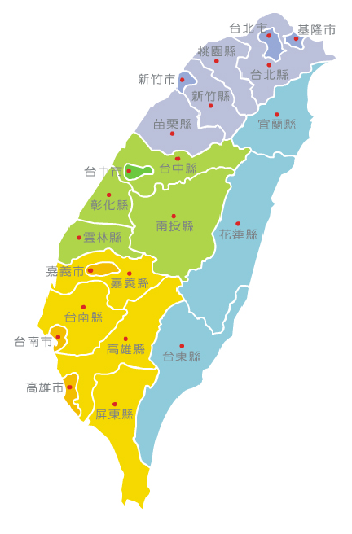

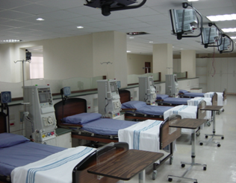
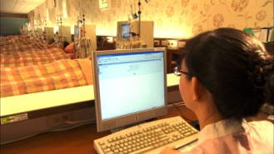
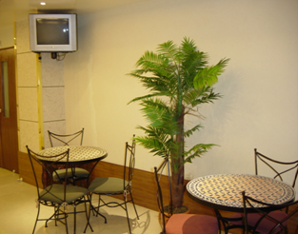
Area | Total channels | ERS/NC/CMS channels | %
North | 296 | 59 | 19.9%
Central | 205 | 64 | 31.2%
South | 197 | 29 | 14.7%
other | 38 | 2 | 5.3%
Total | 736 | 154 | 20.9%
Taipei
keelung
New Taipei City
Taoyuan
Hsinchu
Miaoli
Taichung
Yilan
Changhua
Yunlin
Hualien
Chiayi
Tainan
Nantou
Kaohsiung
Pingtung
Hemodialysis channels

Slide 20
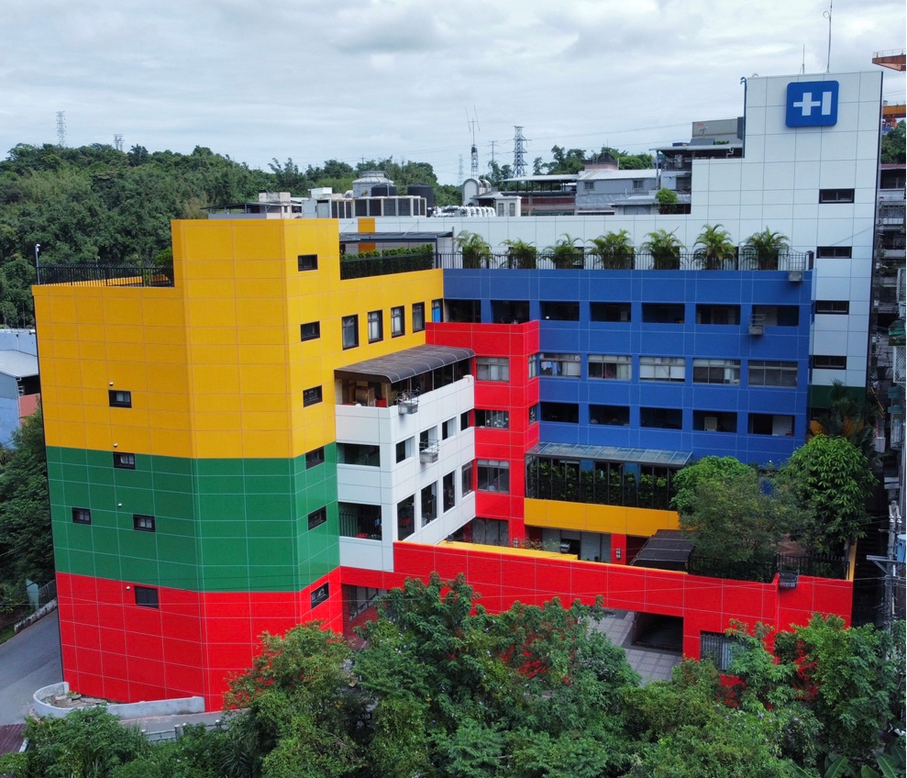
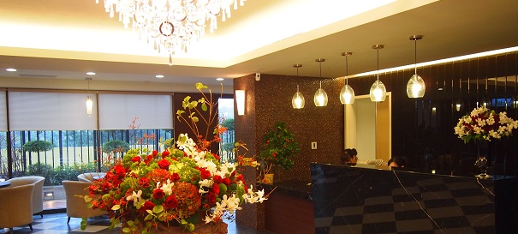
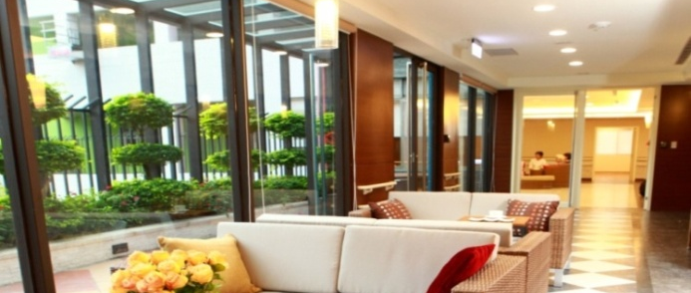
Long-Term Care Channels– Asia Best Healthcare Co., Ltd.
Xizhi Nursing Home
內部配置
【 Long-Term Care Channels Introduction 】
Excelsior combines the experiences and advantages in the medical industry, with innovative concepts to build higher service standards of long-term care channels. We provide Long Term Care Facility Services and also provided Home-Based Care with professional medical care. Moreover, along with the implementation of the Ten-Year Long-term Care Program, we are now actively setting up a legal entity for long-term care. Together with daycare centers and medical clinics, we provide fine care for residents’ health. Not only to enhance grading of care service for different levels, but we are also providing a care pattern that combines medical service with daily care. Furthermore, Excelsior Group have established a strengthening system with regional hospitals and medical centers to protect the residents of emergency medical requirements.
招大廳
20

Slide 21
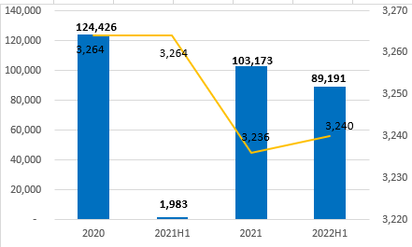

Long-Term Care Channels– Asia Best Healthcare Co., Ltd.
ABH’s Profit after tax
(NTD in thousands)
Number of ABH Beds
招大廳
21

Slide 22
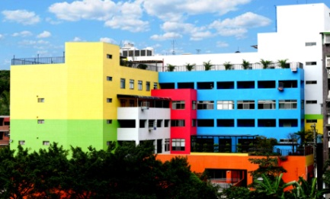
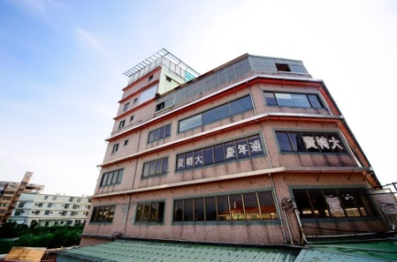
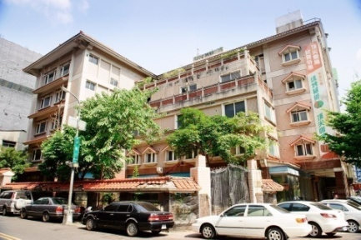
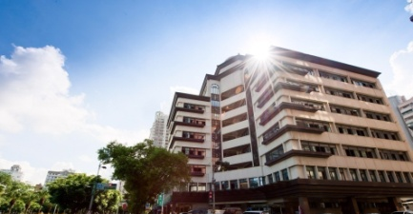
Long-term care channels
Hospital/long-term care | Beds
Hospital | 508
Long-term care | 2,732
Total | 3,240
Xizhi
keelung
Taoyuan
Taipei
Ping-zhen
New Taipei City
Taichung
Taichung
Changhua
Yunlin
Kaohsiung
Nantou
Tainan
Kaohsiung
22

Slide 23
Strategies and Outlook
Excelsior(Hemodialysis)
Short-Term Plan
Mid-Term Planning
Long-Term Planning
Backward integration of the hemodialysis business through acquisition of a hemodialysis solution factory in Malaysia. After the follow-up inspection of the factory, the customer base will be expanded, and we will proceed to focus on Southeast Asia and follow the government’s “The New Southbound Policy”.
Externally, the Company will integrate medical resources, introduce competitive new products related to medical and health care, seek strategic partners, continue to expand medical channels.
Internally, we will simplify the organizational structure to reduce various administrative and marketing expense and increase operation performance.
To expand the channel of hemodialysis , the Company invested in NC and CMS, we will actively pursue agency for other medical products needed by other medical fields to develop diversified products.

Slide 24
Dynamic(Aesthetic Medical)
Short-Term Plan
Mid-Term Planning
Long-Term Planning
Market leader
Southeast Asia Market
Strategic Alliance
Preventive Medicine
Home-Use Beauty Device
Body Contouring Market Development
Aesthetic Consumables
Channel Expansion
Launching Cosmetic Neurotoxin: Medytox
Launching Launching Gold Ptt
LPG/Launching Muscle Toning Device/Cooltech Promote
DR.CYJ Brand Expansion
Devote on Star Product Promote
Enhance the Sales of Aesthetic Consumables

Slide 25
Arich (Pharmaceutical Logistics)
Long-Term Planning
1.Sales and Promotion
A. To seek strategic partners
and to expand the variety of
our products.
B. To integrate Excelsior group’s
dialysis and long term care
centers and to enter into
potential market.
2.Distribution and Logistics
A. To establish an custom made
logistic center according to
Principal’s request.
B. To keep investing in IT and
warehousing system.
Mid-Term Planning
1.Sales and Promotion
Actively looking for the
opportunity of promotion of
new products.
2.Distribution and Logistics
A. To find business
opportunities in medical
device logistic market.
B. Differentiation strategy,
provide tailor-made service to
fulfill customers’ requirements.
Short-Term Planning
1.Sales and Promotion
A. Instruction medicine expand
the product line to strengthen
the coverage market.
B. Extend the channel of
distribution from pharmacy to
hospital.
2.Distribution and Logistics
A. To stabilize relationship with
key customers/pharmaceutical
companies.
B. Uitra-low temperature cold chain.

Slide 26
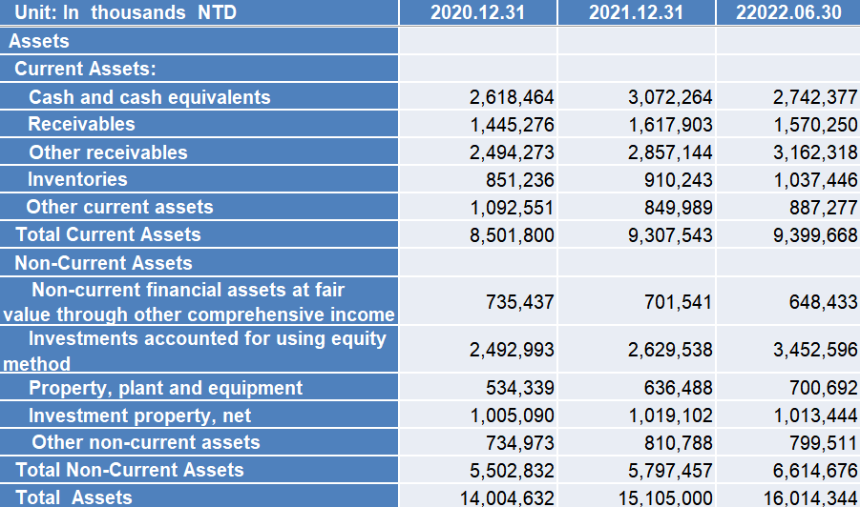
Appendix
Balance Sheet
26

Slide 27
Balance Sheet
27

Slide 28
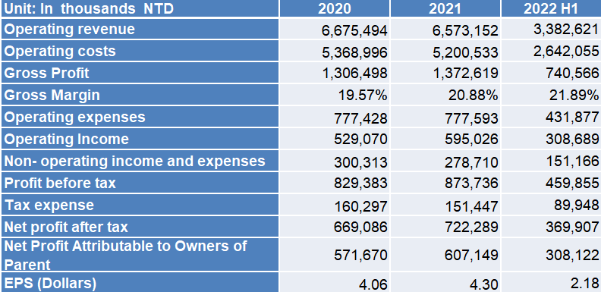
Statement of Comprehensive Income
28

Slide 29
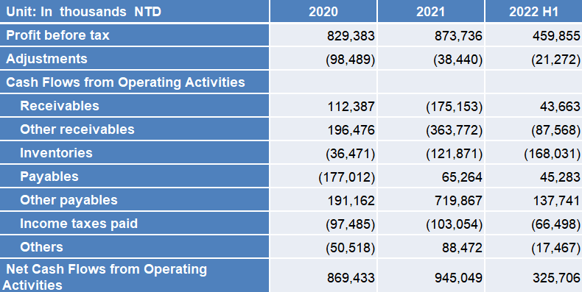
Statements of Cash Flows
29

Slide 30
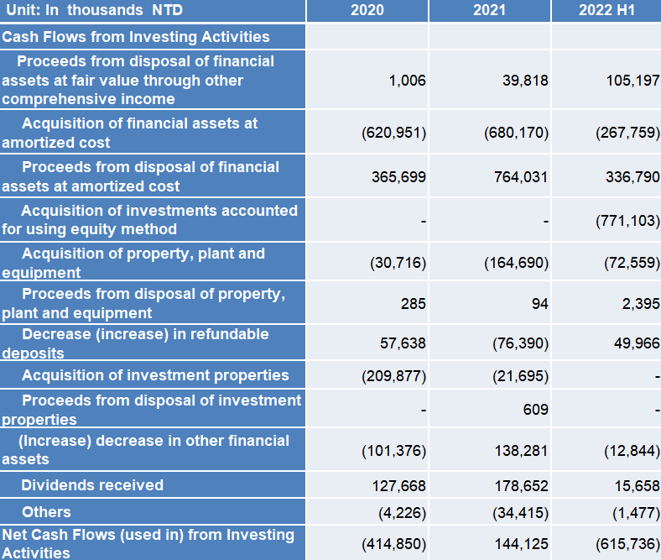
Statements of Cash Flows
30

Slide 31
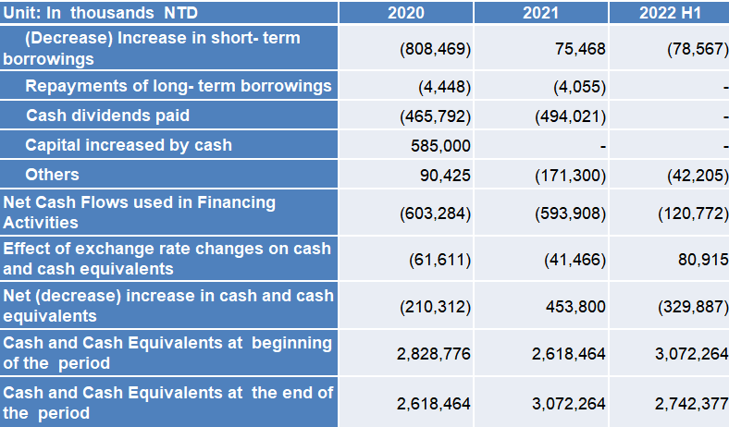
Statements of Cash Flows
31

Slide 32


Growing up with Long-term partners
Excelsior has been operating for 30 years, accumulated core competitiveness with new ideas created, new models to integrate various professional medical fields. Excelsior will keep taking root in the Asia market, the business scope includes Taiwan, Hong Kong, China, Philippines and Malaysia. Through continuously cooperate and integrate with long-term partners, Excelsior expects to become Asia's most valuable Integrated medical healthcare provider.

Slide 33
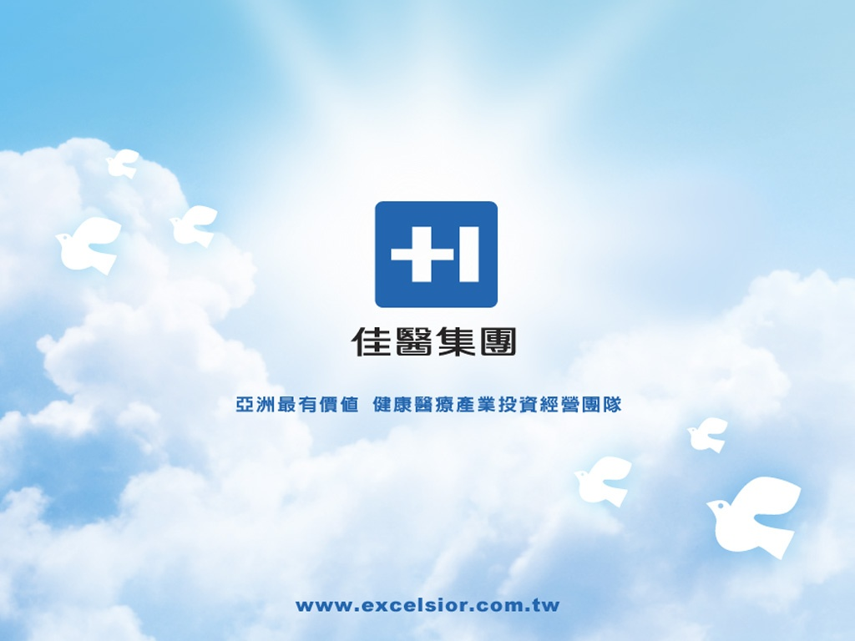
Growing up with Long-term partners
Excelsior has been operating for 30 years, accumulated core competitiveness with new ideas created, new models to integrate variously professional medical fields. Excelsior will keep take root in the Asia market, the business scope includes Taiwan, Hong Kong, China and Philippines regions .Through continuously cooperate and integrate with long-term partners, Excelsior expect to become Asia's most valuable Total healthcare solution provider.

