Slide 1
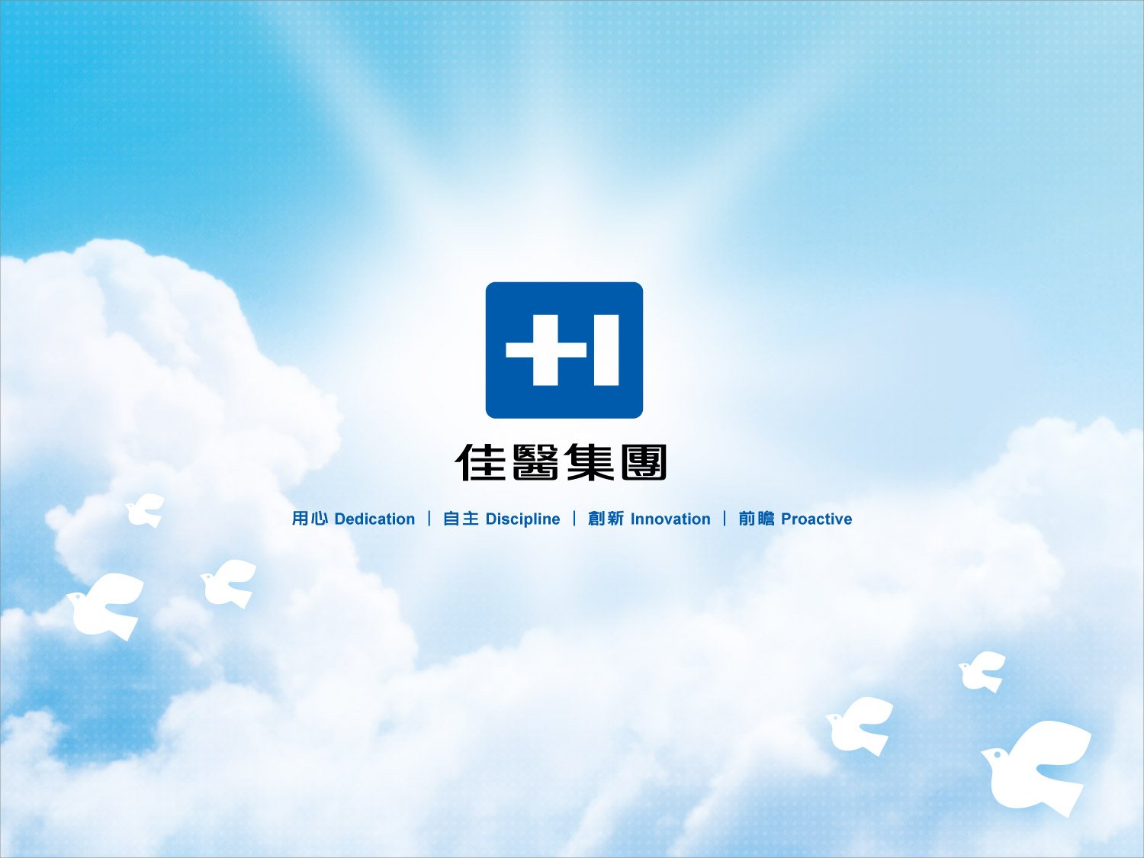
Excelsior Medical Co., Ltd.
Investor Conference
2025/5/28

Slide 2
Disclaimer
This presentation is prepared according to the audited or reviewed financial statements by CPA and the financial figures hereby are based on IFRS, please refer to the published financial statements for full content.
The presentation may contain forward-looking information and may differ materially from the actual results. Excelsior does not warranty as to the accuracy or completeness of such information and nor assume any undertaking further information becomes available or in light of changing circumstances. You shall not place undue reliance on any forward-looking information.
The presentation and its contents may not be reproduced to a third party without the prior written consent by Excelsior.
2

Slide 3

The Business Types
Hemodialysis
Aesthetic Medical
Trading Business
Medical Devices
Medical Consumables
Home Appliances
Product
Planning
Information
Analysis
Sales
Promotion
Hemodialysis channel
Pharma. Sales and Promotion
Market
Management
Creative
Development
Aesthetic Medical channel
Pharma. Distribution and Logistics
Long-term Care channel
Medical Service
Provider
Pharmaceutical
logistics
Medical Supplies Distribution
and Logistics
District Hospital channel
GMP/GDP/ISO Certification
Hair Care Center
Professional Maintenance

Slide 4
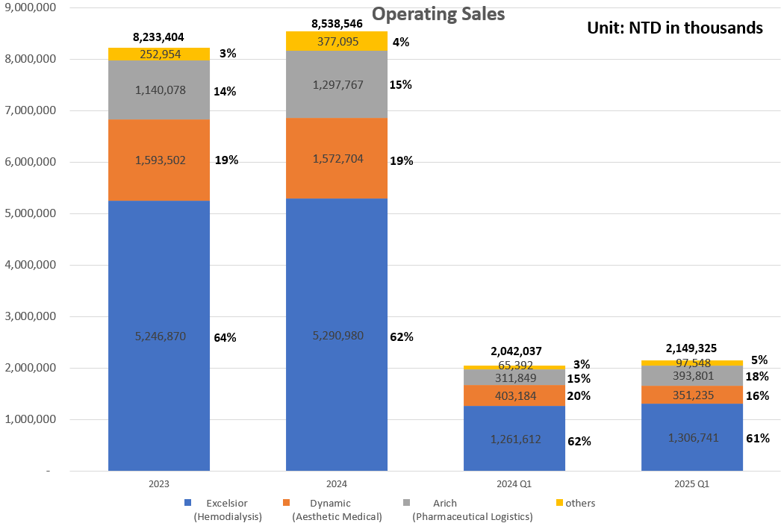
Revenue Overview
Excelsior yearly consolidated sales is more than NT $ 8.5 billion in 2024, the primary revenue comes from Excelsior (Hemodialysis), Dynamic (Aesthetic Medical), Arich (Pharmaceutical Logistics) and others.
According to the company’s function, the business type can be characterized as a trading business, medical service provider and pharmaceutical logistics.

Slide 5
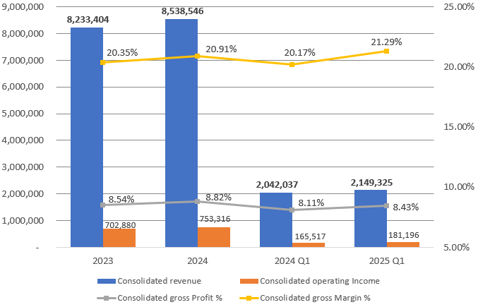
Operating Overview
Unit: NTD in thousands

Slide 6
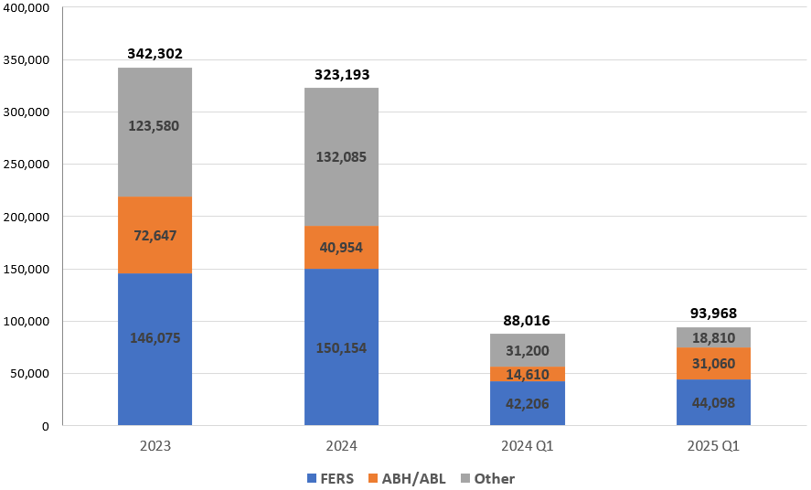
Investment Overview
Unit: NTD in thousands

Slide 7
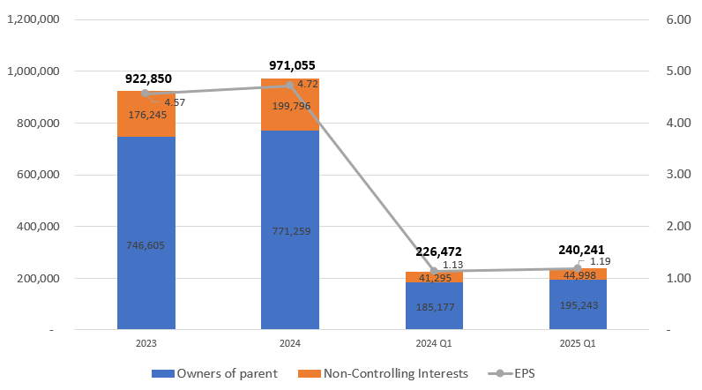
Profit after Tax Overview
Unit: NTD in thousands/
EPS: NTD in Dollars

Slide 8
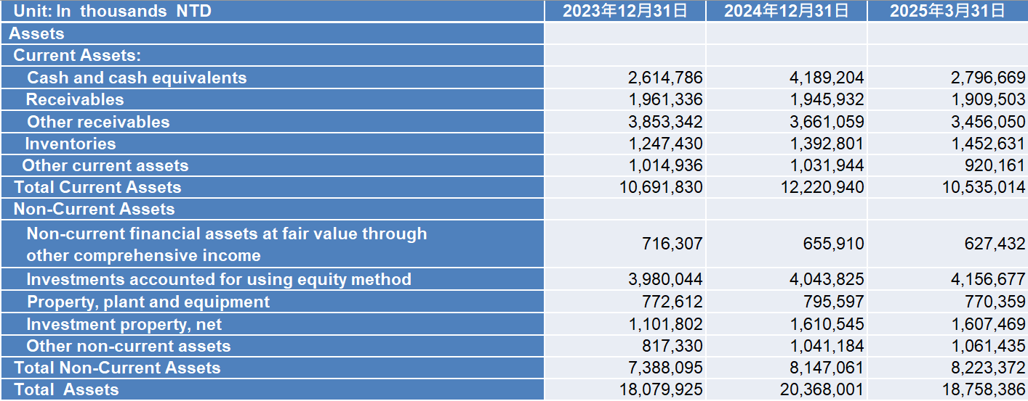
Balance Sheet
8

Slide 9
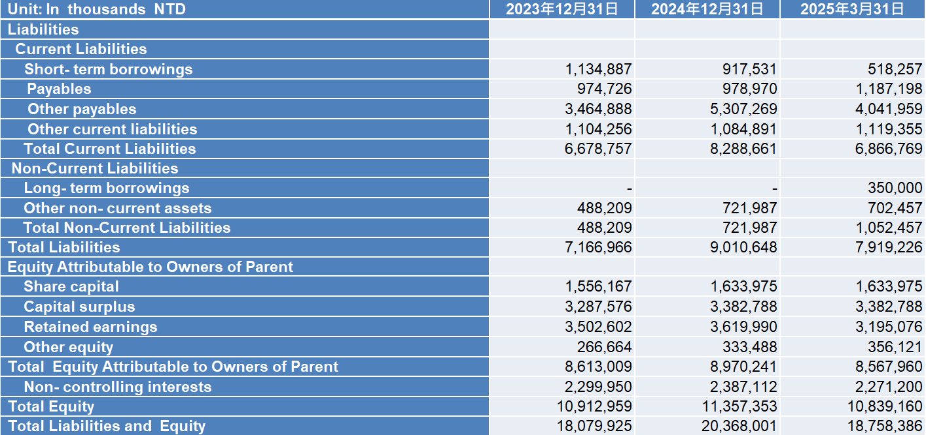
Balance Sheet
9

Slide 10
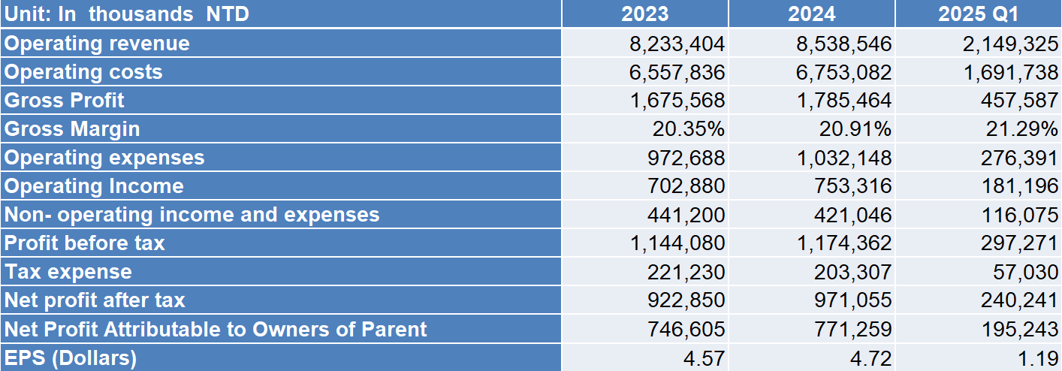
Statement of Comprehensive Income
10

Slide 11
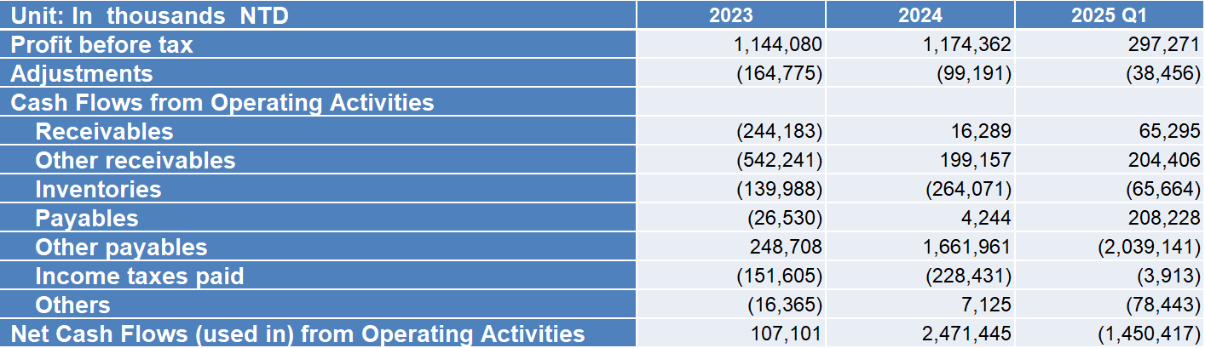
Statements of Cash Flows
11

Slide 12
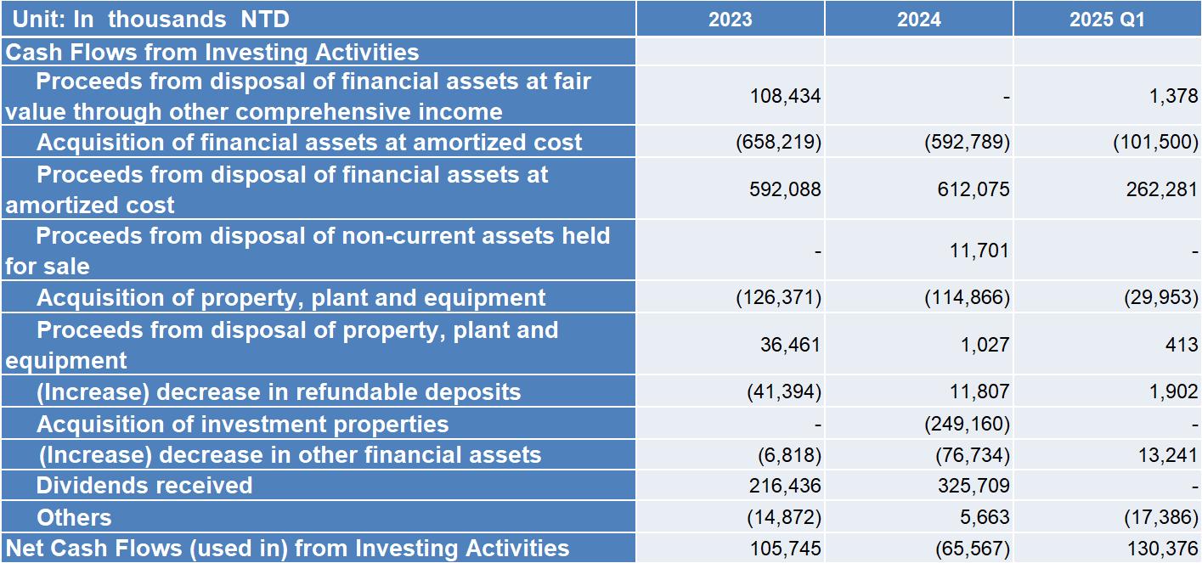
Statements of Cash Flows
12

Slide 13
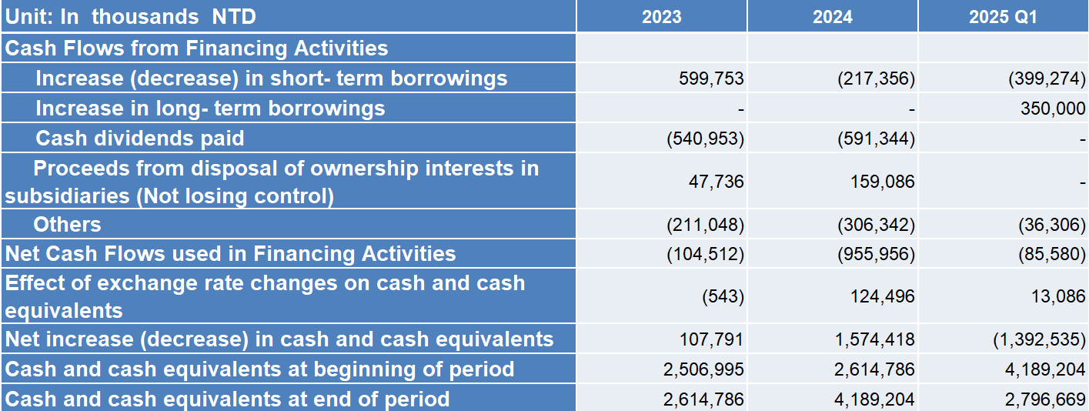
Statements of Cash Flows
13

Slide 14

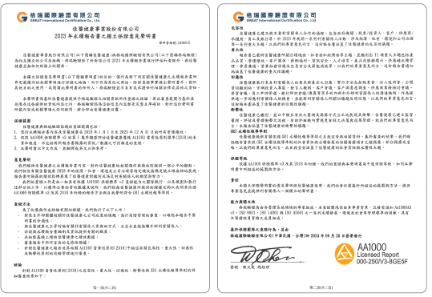
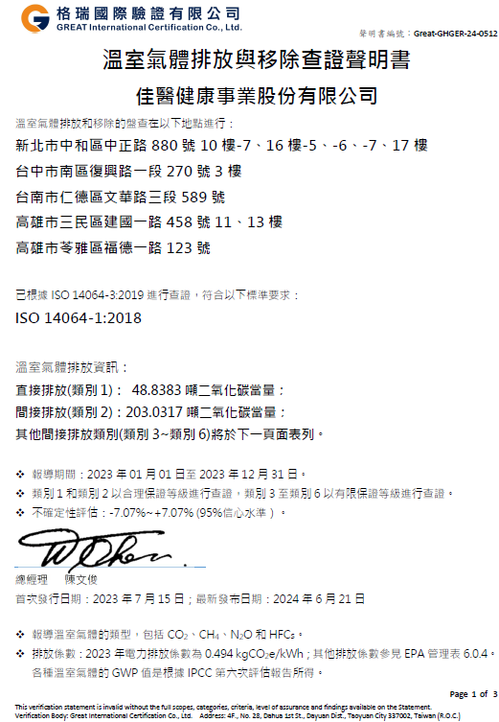
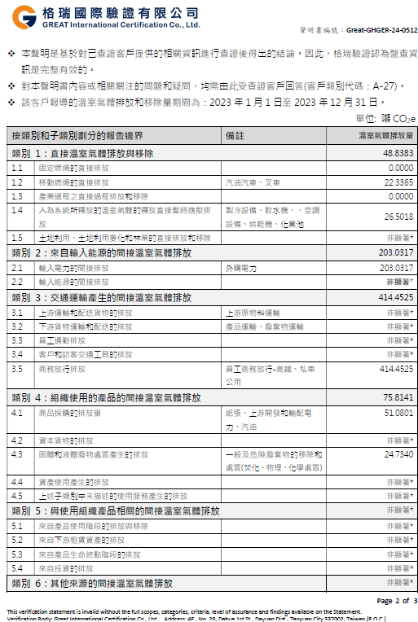

Sustainability Report

Slide 15
Concrete ESG Implementation Results
1.In 2023, our company successfully completed the ISO 14064-1 GHG inventory and assurance status ahead of schedule. We will continue to promote the completion of GHG inventories across all subsidiaries within the group.
2.In 2023, our company implemented a smart energy-saving system for cooling water pumps in office buildings. In 2024, we replaced office lighting with energy-efficient fixtures. In 2025, we completed the replacement of elevators with energy-saving models, continuing to implement energy conservation and carbon reduction measures to protect the planet through concrete actions.
3.To reduce paper consumption, customer orders are approved online, supplier purchase orders are issued via email, and our ERP processes are continually optimized to minimize environmental burden.
Environmental

Slide 16
Concrete ESG Implementation Results
1.In 2023, we visited Taipei Zhaoru Senior Care Center to accompany the elderly in a dumpling-making event. In 2024, we organized a Dragon Boat Festival rice dumpling-making activity at Zhongli Smart Aging Academy for seniors with dementia and a recreational event at Bali Nursing Home. In 2025, we will collaborate with the Excelsior Foundation to host a joint public welfare event for World Alzheimer's Day.
2.Every year, through the Excelsior Foundation, we organize winter relief programs to support underprivileged individuals and elderly people living alone. We also provide scholarships for students from economically disadvantaged families and dialysis patients, encouraging them to complete their education.
3.We continue to host annual blood donation drives within our office parks and donate medical resources to healthcare institutions to support patient care.
4.Our group holds an annual Family Day to emphasize the importance of family support for employees, foster team cohesion, and strengthen corporate culture.
Social

Slide 17
Concrete ESG Implementation Results
1.In 2022, we published our first Sustainability Report. In 2023, we emphasized SASB (Sustainability Accounting Standards Board) and TCFD (Task Force on Climate-Related Financial Disclosures) standards.
2.In 2023, we established the Sustainability Development Committee under the Board of Directors to drive sustainability initiatives, strengthen supplier management, enhance risk management, engage with stakeholders, ensure information security, and uphold ethical business practices, including a whistleblower system for unethical conduct. In 2024, we obtained ISO 27001 certification for our information security management system.
3.In 2024, we ranked within the top 21%–35% (upper-mid tier) in the 10th Corporate Governance Evaluation for listed companies, demonstrating our commitment to corporate governance. We will continue our efforts to enhance overall governance standards.
Governance

Slide 18


Growing up with Long-term partners
Excelsior has been operating for 30 years, accumulated core competitiveness with new ideas created, new models to integrate various professional medical fields. Excelsior will keep taking root in the Asia market, the business scope includes Taiwan, Hong Kong, China, Philippines and Malaysia. Through continuously cooperate and integrate with long-term partners, Excelsior expects to become the Asia's most valuable Integrated medical healthcare group.

Slide 19
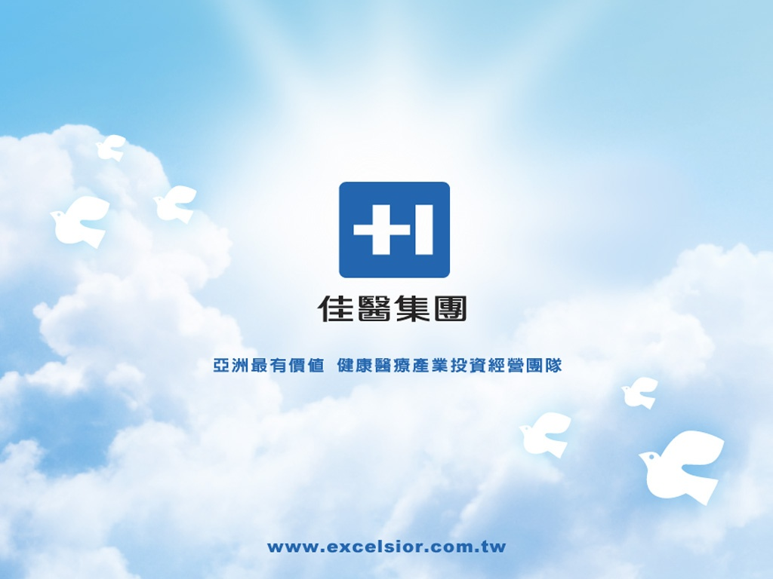
Growing up with Long-term partners
Excelsior has been operating for 30 years, accumulated core competitiveness with new ideas created, new models to integrate variously professional medical fields. Excelsior will keep take root in the Asia market, the business scope includes Taiwan, Hong Kong, China and Philippines regions .Through continuously cooperate and integrate with long-term partners, Excelsior expect to become Asia's most valuable Total healthcare solution provider.

