Slide 1


Slide 2
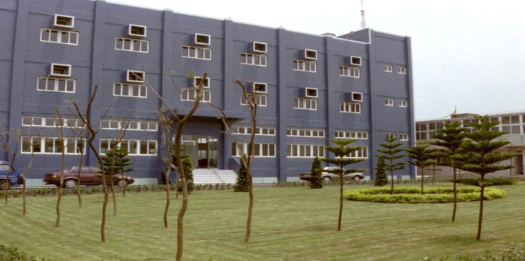
公司概況Profile
員工數Employee：263
設立日期：中華民國七十六年九月十八日
Date of establishment: Sep. 18, 1987
資本額Capital：新台幣795佰萬元(NTD 795mn)
營業項目Business：
原料藥API（66.06%）
中間體Intermediate（25.29%）
特用化學品 Custom-made chemicals（8.65%）
Notes:
a production line dedicated

Slide 3
製藥產業的上、中、下游 SCI’s position
基本原料 RM
上游Upstream
中間體Intermediate:
生產原料藥之
中間步驟所產出之產品Products before API
中游
Midstream
旭富營業範圍
SCI’s businesses
原料藥API:
製劑中之有效成分Curative ingredient
下游
Downstream
製劑: 成品藥 Formulation
Notes:
emulsifier, excipient

Slide 4
公司概況 Outline

Slide 5
營運概況-IS
Unit: K NTD
Notes:
lackluster October sales

Slide 6
產品組合-Products

Slide 7
產品組合-Products

Slide 8
2019 重點產品說明 Product Profile
VA / DiVANa / NaVA
(S)-MMAA / Duloxetine HCl
PGA
Hydroxychloroquine Sulfate
Menthadienol / Olivetol / Ethyl Olivetolate
HDFN / Prop-3 / Propafenone HCl
CBD
LMTM
Ritalinic acid / Methylphenidate
d-Ritalinic acid / Dexmethylphenidate

Slide 9
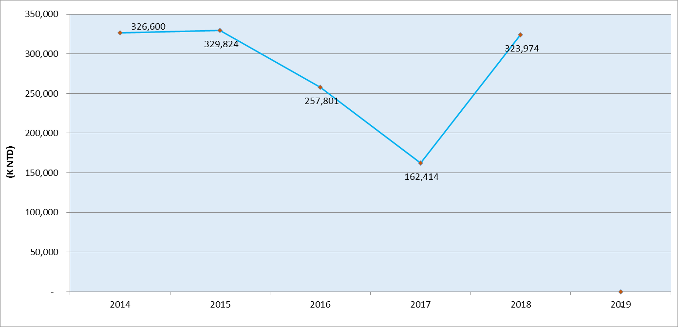
VA Series:
Valproic Acid, Divalproex Sodium, Sodium Valproate
適應症 Application：
癲癇(seizure)、躁鬱症(bipolar disorder)、
偏頭痛(migraine headaches)
Sales up
Notes:
Half of sales from DIVA

Slide 10
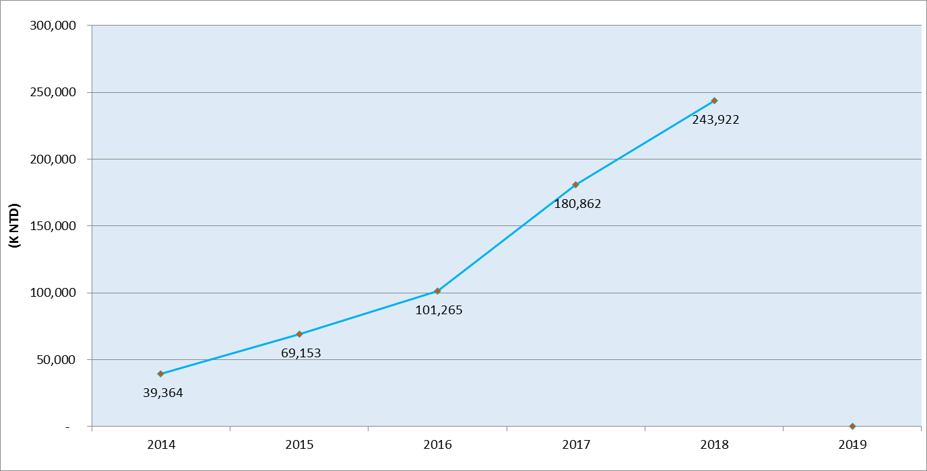
  S-MMAA / Duloxetine HCl
  適應症 Application:
  重鬱症(major depressive disorder)、廣泛性焦慮症(generalized anxiety disorder) 、糖尿病週邊神經痛
  (diabetic neuropathy) 、纖維肌痛（Fibromyalgia)、
  慢性腰痛(日本地區) lower back pain (only in Japan)
Sales up
Notes:
4 billion

Slide 11
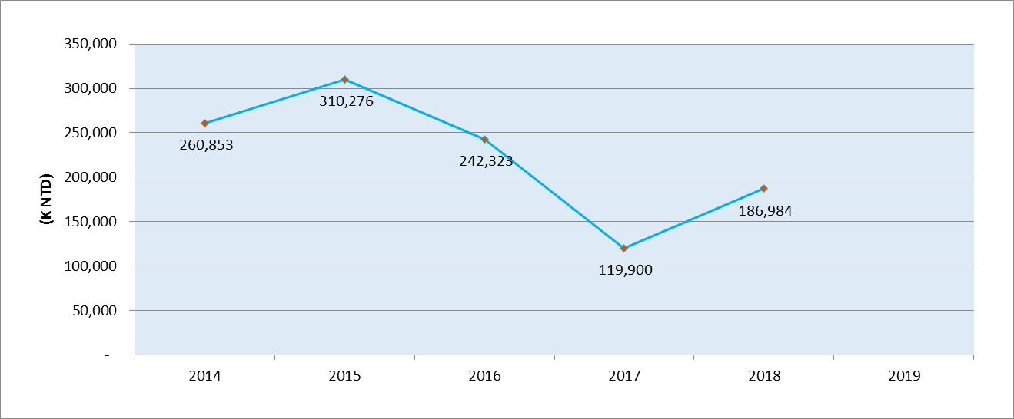
Pyrogallolaldehyde ( PGA)
Benserazide
治療帕金森氏症之中間體
Intermediate for Parkinson’s Disease
Sales up
Notes:
249 million

Slide 12
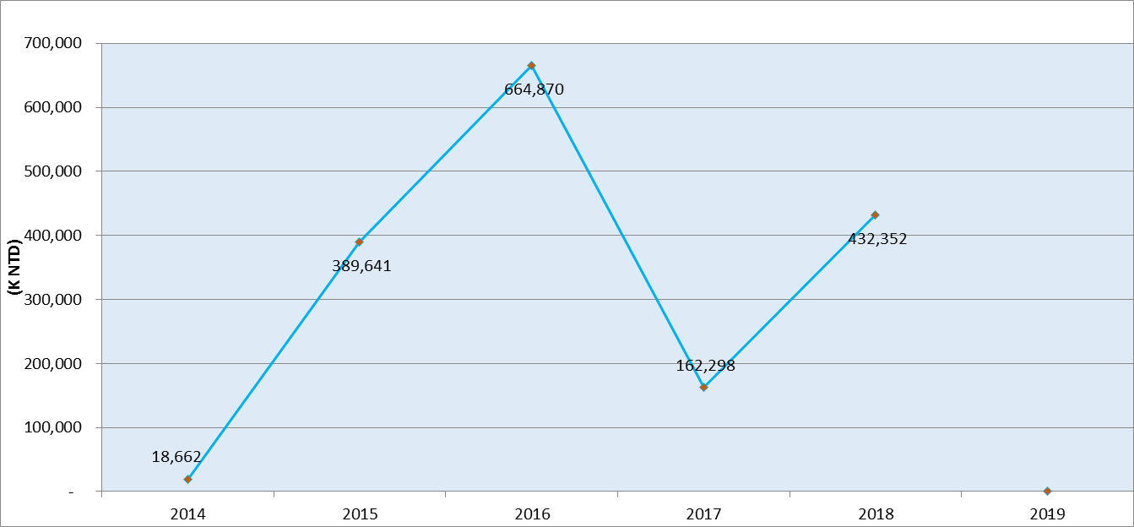

Hydroxychloroquine sulfate
適應症 Application:
類風濕性關節炎(rheumatoid arthritis) 、瘧疾 (malaria)、
慢性多形性日光疹、慢性圓板狀紅斑症 (discoid and systemic lupus erythematosus)

Slide 13
Menthadienol, Olivetol, Ethyl Olivetolate
為Dronabinol (THC 四氫大麻酚)及Cannabidiol
(CBD大麻二酚) 之關鍵中間體
The key intermediates for Dronabinol (THC) and
Cannabidiol (CBD)
THC 適應症 Applications：
化療引起的噁心、嘔吐
Nausea and vomiting due to chemotherapy
愛滋病引起之厭食症 anorexia due to AIDS
CBD 適應症 Applications：
Epidiolex：兒童罕見癲癇以及多發性硬化症
For seizures in patients aged 2 years and older, and Multiple Sclerosis.
多項臨床試驗進行中 More clinical trials are in progress

Slide 14
CBD (Cannabidiol)
CBD之應用廣泛：從癲癇、巴金森氏症、阿茲海默症，到關節炎、躁鬱 、焦慮、失眠、止痛、抗發炎等。
市場規模：
CBD in US market: USD 20 billions in 2020 ?
Total Cannabi Opportunity: ~ 200 billions ???
旭富 CBD (Cannabidiol)
製程開發完成，準備專利申請，
2019年底申請製藥許可證
2020年初申請美國藥證 (US DMF)

Slide 15
CBD (Cannabidiol)
Wide range of medical benefits, from epilepsy, Parkinson’s and Alzheimer’s disease, bipolar disorder, anxiety, pain, inflammation, to arthritis, insomnia, etc.
Market estimations:
USD 20 billions in 2020?
Total Cannabi Opportunity: ~ 200 billions ???
CBD (Cannabidiol) by SCI
Process development completed, patent to be filed
To apply domestic license with TFDA by end of 2019
To file US DMF by beginning of 2020

Slide 16
LMTM 新藥代工 (1)
適應症 Application：
阿茲海默症(Alzheimer`s Disease):臨床3期進行中。
額顳葉型失智症(Frontotemporal lobe degeneration, FTD): 2018年底，已被美國FDA與EU核准為孤兒藥。
疾病現況
全球約有4~5千萬病人，隨著醫療的進步及人口老化，病人數持續增加。
目前並無可以停止或逆轉病程的藥，市面上的藥均只能短期緩解症狀。

Slide 17
LMTM 新藥代工 (2)
Application：
Alzheimer`s Disease: under phase 3 clinical trial
Frontotemporal lobe degeneration (FTD): granted by EU and FDA as Orphan Drug Designation in end of 2018.
Status:
There are approximately 40-50 millions patients worldwide, and is increasing.
While there is no cure for Alzheimer's disease, stopping or slowing down its progression, but just a temporarily improvement on certain symptoms.

Slide 18
Ritalinic acid / Methylphenidate (MEPH) d-Ritalinic acid / Dexmethylphenidate (dex-MEPH)
適應症 Application：
注意力不足 (attention deficit hyperactivity disorder (ADHD) 、過動症 (narcolepsy)
MEPH 製劑需求量 (FDF consumption):
38.8MT, US$ 29.3億 (3/31/2018~3/31/2019)。
Dex-MEPH製劑需求量 (FDF consumption):
2.4MT, US$ 6.3億 (3/31/2018~3/31/2019) 。

Slide 19
新市場 (New Market)：
與印度、中國 、俄羅斯及新興國家之合作
Partner with India, China, Russia and Emerging countries
新藥方向 (New drugs):
大麻二酚 (CBD)
中樞神經用藥 (CNS)
失智症 (dementia)
傷口癒合 (wound healing) / 抗衰老藥物 (anti-aging)
管制藥 (controlled substance)

Slide 20
No. | API | DMF (USA) | CEP (EDQM) | MF (Japan) | DMF (Canada) | CGMP certified (TFDA)
1 | Valproic Acid | 2003 | 2004 | 2008 | 2008 | 2003
2 | Probucol | 2004 |  | 2017 | 2015 | 2015
3 | Divalproex Sodium | 2005 |  |  | 2010 | 2005
4 | Propafenone Hydrochloride | 2010 | 2012 | 2012 | 2012 | 2010
5 | Duloxetine Hydrochloride | 2011 | 2014 | 2017 | 2016 | 2012
6 | Allopurinol | 2011 | 2003 |  |  | 2004
7 | Clindamycin Palmitate HCl | 2011
8 | Articaine Hydrochloride | 2014 | 2014 |  |  | 2013
9 | Hydroxychloroquine Sulfate | 2014 |  |  | 2014 | 2014
10 | Brinzolamide | 2015 |  | 2017 |  | 2015
11 | Sodium Valproate |  | 2006 | 2017 |  | 2004
12 | Pentobarbital Sodium |  | 2011 |  |  | 2009
13 | Methylphenidate HCl |  | 2014 |  |  | 2011
14 | Bisoprolol Fumarate |  |  |  |  | 2006
15 | Thiopental acid |  |  |  |  | 2012
16 | Loxoprofen Sodium Hydrate |  |  | 2011 |  | 2012
17 | Atomoxetine HCl |  |  |  |  | 2016

Slide 21
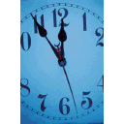
簡 報 完 畢
敬 請 指 教

