Slide 1


OK Biotech Co., Ltd
Stock Code： 4155
Operational Overview
December 12, 2025

Slide 2
Disclaimers
The presentation contains “ forward-looking statements” may include the expectations, or predictions on future results of our company’s and its affiliates’ operations based on the information available at the time the statements were made. Such statements may differ from the actual results for a variety of reasons, including known and unknown risk and uncertainties. The contents are only published for the purpose of information circulation, not for investment advice. No representation or warranty, either expressed or implied, is provided in relation to the accuracy, completeness or reliability of the information contained herein.

Slide 3
Agenda
Our products sales value
Global Customer Overview
Customer Overview
Product line of
OKbiotech Group
5. Outlook for 2025 & 2026

Slide 4
1. Our product sales value
Unit：Expressed in Thousands of NTD
Year | Q3 2025 | Q3 2024 | Growth rate | 2024
Products | Revenue | Revenue | Revenue | Revenue
Strips | 932,205 | 987,062 | -5.56% | 1,319,466
Meters | 212,813 | 245,088 | -13.17% | 327,624
Others | 73,695 | 17,163 | 329.38% | 22,943
Total | 1,218,713 | 1,249,313 | -2.45% | 1,670,033

Slide 5
2. Global Customer Overview
Unit：Expressed in Thousands of NTD
Q3 2025 |  | Q3 2024 |  | 2024
America | 450,202 | America | 517,369 | America | 651,496
Europe | 391,341 | Europe | 353,627 | Europe | 512,818
Africa | 214,660 | Africa | 212,643 | Africa | 284,253
Asia | 117,025 | Asia | 130,309 | Asia | 174,192
Taiwan (Domestic sales) | 45,485 | Taiwan (Domestic sales) | 35,365 | Taiwan (Domestic sales) | 47,275
Total | 1,218,713 | Total | 1,249,313 | Total | 1,670,033

Slide 6
3. Customer Overview -- America
Unit：Expressed in Thousands of NTD, Thousand boxes
 | Q3 2025 | Q3 2024 | 2024
Revenue | 450,202 | 517,369 | 651,496
In the United States market, the Company has established a solid foundation, with its North American client being a subsidiary. Inventory management is reasonable and efficient. In addition to continuously strengthening its presence in the U.S. healthcare channel, the Company is actively expanding into major e-commerce platforms such as Amazon and Walmart to increase the share of direct sales. At the same time, it is developing markets in Central and South America, targeting public health and homecare medical needs to create diversified growth momentum and reinforce its international footprint.
In South America, due to the country’s participation in China’s Belt and Road Initiative and the ongoing commercial interference from large competitors, shipments to the client in this region in 2025 decreased compared with the same period in 2024. The Company has strengthened its marketing efforts to support the client in enhancing competitiveness in public hospital tenders. This initiative is expected to help consolidate existing contracts and secure new tenders, laying a solid foundation for future growth in the South American market.

Slide 7
3.Customer Overview -- Europe
Unit：Expressed in Thousands of NTD
 | Q3 2025 | Q3 2024 | 2024
Revenue | 391,341 | 353,627 | 512,818
The Company has been deeply engaged in the European market over the long term, and this client has gradually demonstrated a stable growth trend, with order volumes and the scope of cooperation continuing to expand. This reflects the client’s strong trust in the Company’s products and services. As local manufacturing collaboration further deepens, the client’s contribution to the Company’s future revenue and profitability is expected to continue increasing, becoming an important growth driver in the European market.

Slide 8
3.Customer Overview -- Africa
Unit：Expressed in Thousands of NTD
 | Q3 2025 | Q3 2024 | 2024
Revenue | 214,660 | 212,643 | 284,253
African clients have fully leveraged the advantages of local manufacturing and cost efficiency, with product quality already recognized by the market. Even in the face of competition from mainland Chinese manufacturers, their products continue to be distributed smoothly in the local market without disruption.

Slide 9
3.Customer Overview -- Asia
Unit：Expressed in Thousands of NTD
 | Q3 2025 | Q3 2024 | 2024
Revenue | 117,025 | 130,309 | 174,192
Asian clients are primarily distributed across Southeast Asia and the Middle East, with a larger number of customers but generally smaller in scale. Due to geopolitical factors, they face more intense price competition from Chinese peers. Nevertheless, the Company continues to adhere to its long-term strategy of cultivating client relationships and deepening regional presence. With this consistent approach, the growth of Asian clients remains promising and can be expected in the future.

Slide 10

4. Product line of OKbiotech Group
Bluetooth Personal sound amplifier
Characteristic：
Independent sound receiver
No calibration required periodically
L/R ear volume adjustment independently
Affordable price
Noise reduction function
Pair Bluetooth with your mobile phone that you can
answer phone calls, or enjoy the music by pressing just one button.

Slide 11
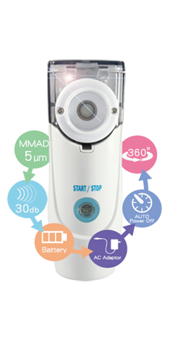

4. Product line of OKbiotech Group
Mesh Nebulizer
Applying micron atomized technology to have medicine atomized to the fine particle for easiest absorption to entering respiratory and lung alone with the best effect of medicine treatment.
-For asthma, allergic rhinitis and COPD patients, follow doctor‘s instructions on atomized spray medication;
-For daily care, have saline to keep respiratory healthy and prevent throat itchy and cough symptoms.
Characteristic：
Portable (home-use) Nebulizer
Mist particle size < MMAD 5μm
Silent operation
Two power sources – batteries & adaptor
Low medication residue

Slide 12
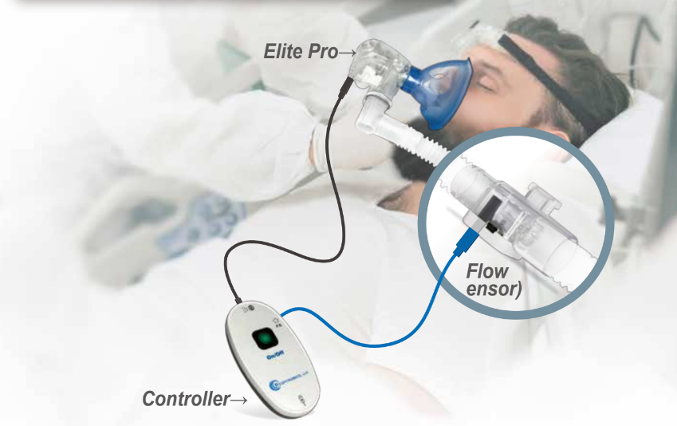
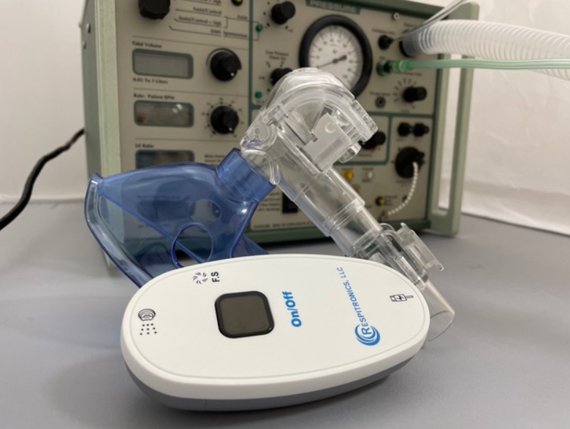
4. Product line of OKbiotech Group
Respitronics Elite nebulization therapy system
Elite pro is created new home and hospital health-based products to treat respiratory patients with respiratory issues. Medication shortages and waste with a new auto shut off valve that runs while the patient inhales and turns off while exhaling, saving 50% of the medication and cost.
Characteristic：
Synchronous operation with ventilation
Silent operation
Low medication residue
Medication level detection
Particle size < MMAD 5μm
High Lung Deposition Rate.

Slide 13
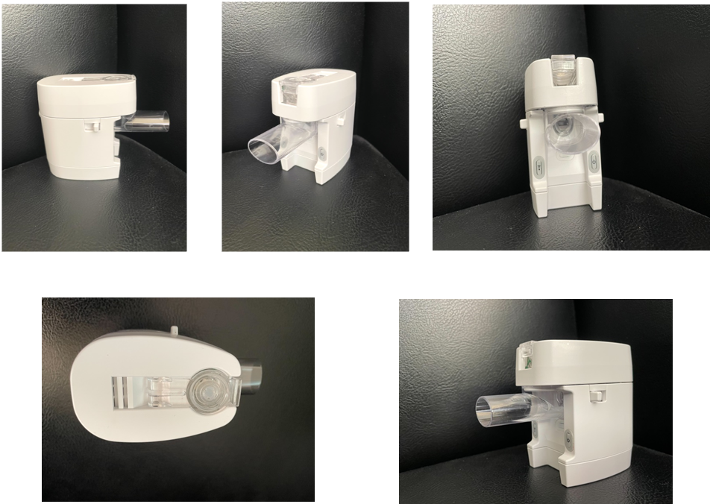
4. Product line of OKbiotech Group
Metered-dose Inhaler
Collaborate with pharmaceutical factory

Slide 14
4. Product line of OKbiotech Group
New product in development
Continuous Glucose Monitoring (CGM)
Non-invasive Glucose Monitor (industry-academia cooperation)

Slide 15
5. Outlook for 2025 & 2026
Since 2024, global customer demand has gradually recovered from the impact of the pandemic, with markets returning to normal and order volumes steadily resuming.
Entering 2025, the Company’s North American clients have continued to grow on a stable foundation, reflecting the increasing maturity of their presence in healthcare and e-commerce channels. Meanwhile, European and North African clients, leveraging local manufacturing and supply chain advantages, have maintained steady expansion, demonstrating resilience and sustainability in their regional markets. In contrast, South American clients, due to the country’s participation in China’s Belt and Road Initiative and the active entry of Chinese manufacturers into public hospital tenders, coupled with ongoing commercial interference from major competitors, experienced a decline in shipments from the Company in 2025 compared with the same period in 2024. Nevertheless, while prudently addressing these challenges, the Company continues to provide marketing and quality support to help clients enhance competitiveness, and remains confident in the long-term growth potential of the South American market.
Taking into account the growth trends across all regions, the Company anticipates that 2026 will continue to see steady global market development, with overall business prospects remaining optimistic and promising.

Slide 16
Thank you !
2025/12/12

