Slide 1
｜ 2023 Q3 Investors’ Conference
Reporter：Mr. Hsin-Kai Shen
Date：November 29, 2023

Slide 2



1
Company Profile
Agenda
2
Products Introduction
3
State of Operation
4
Industrial Upgrading
5
Sustainable Development

Slide 3

Company Profile

Slide 4

TBI MOTION TECHNOLOGY CO., LTD.,
Date of Establishment：July 9, 2010
Chairman：Mr. Ching-Kun Lee
CEO：Mr. Ching-Sheng Lee
Capital：NT$ 952 million
Numbers of Employee：1,030 (As of Oct. 31,2023)
Location：No.123, Sanduo Rd., Shulin Dist., New Taipei City 238, Taiwan
Headquarters Factory Area： 66,120㎡
Stock Number：4540

Slide 5
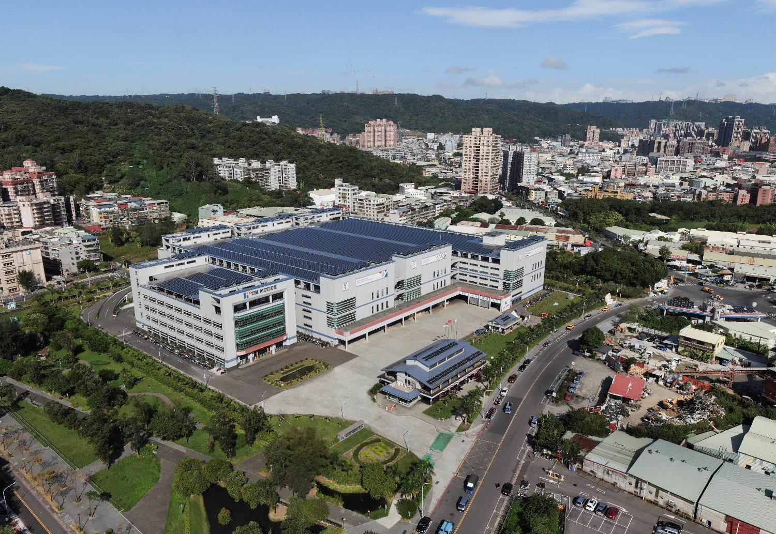
Solar Power System
Environmental Greening
Rainwater Recycling System
Green Conservation
● Headquarters Area

Slide 6
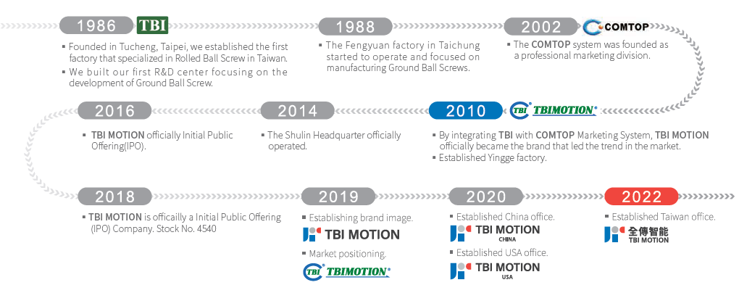
TBI Group Milestone

Slide 7

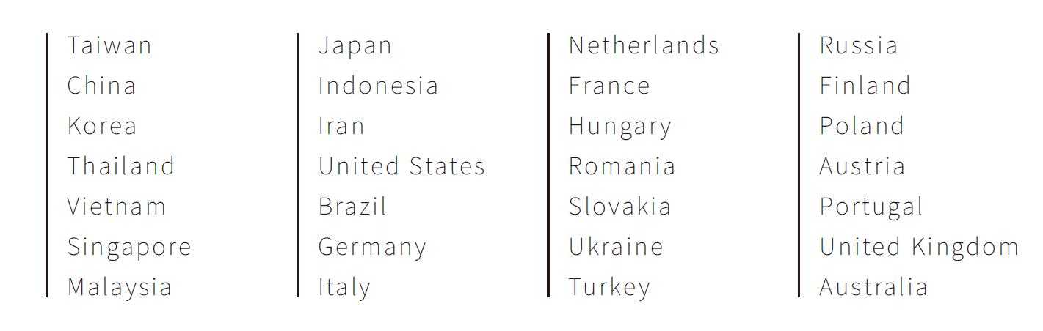
Sales Location
TBI MOTION INTELLIGENCE CO., LTD.
TBI MOTION TECHNOLOGY(USA) LLC
TBI MOTION TECHNOLOGY (SUZHOU) CO.,LTD.

Slide 8
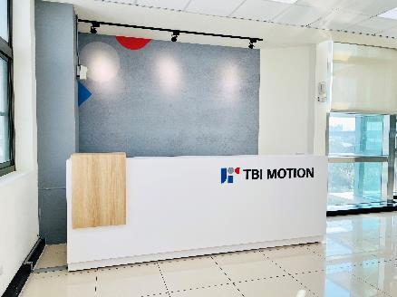
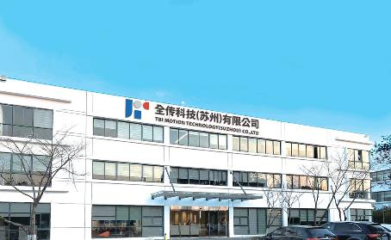
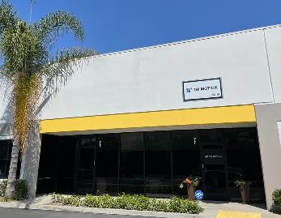
Subsidiaries
TBI MOTION INTELLIGENCE CO., LTD.
Address：4F, No. 123, Sanduo Rd., Shulin Dist., New Taipei City 23876, Taiwan
TEL：886-2-2689-2696
FAX： 886-2-2688-5933
E-mail：tbimotion.intell@tbimotion.com
TBI MOTION TECHNOLOGY (SUZHOU) CO.,LTD.
Address：No.3 Fuyang Industrial Workshop, Fuyuan Road, Chengyang Street, Xiangcheng Economic and Technological Development Zone, Suzhou
TEL：+86-512-6293-0178
E-mail：tbichina@tbimotion-china.com
TBI MOTION TECHNOLOGY(USA) LLC
Address：2003 Raymer Avenue, Suite E&F, Fullerton, CA 92833
TEL：+1-714-519-3424
E-mail：tbiusa@tbimotion.com

Slide 9




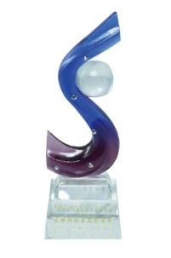
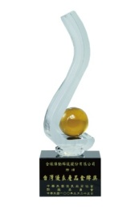
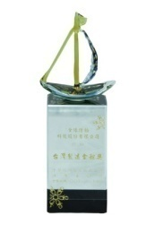

Certification
SGS ISO 14001
EMS
SGS ISO 9001 QMS
SGS ISO 45001
OHSMS
Award
Best Technology Product Premium Award
Taiwan Excellence Gold Award
Taiwan Gold Medal Quality Product Award

Slide 10
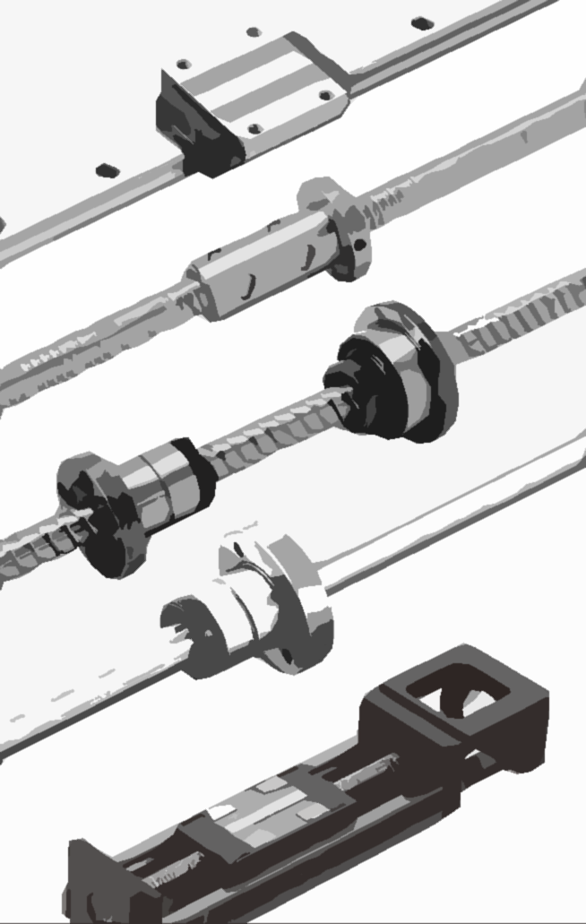
Products Introduction

Slide 11

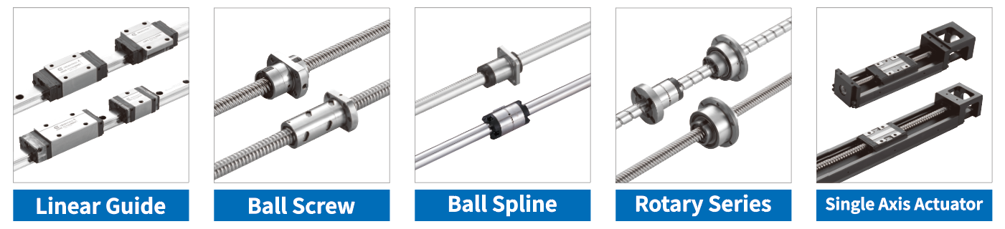
Linear motion solution provider
Miniature Series
Standar Series
Miniature Series
Internal Circulation Series
External Circulation Series
Finished Shaft End Series
End-Caps Circulation Series
Ball Screw - Other
SO Series
SL Series
Rotary Series Ball Screw
Rotary Series Ball Spline
Rotary Series Ball Screw Spline
Standar Series
Light-duty series

Slide 12
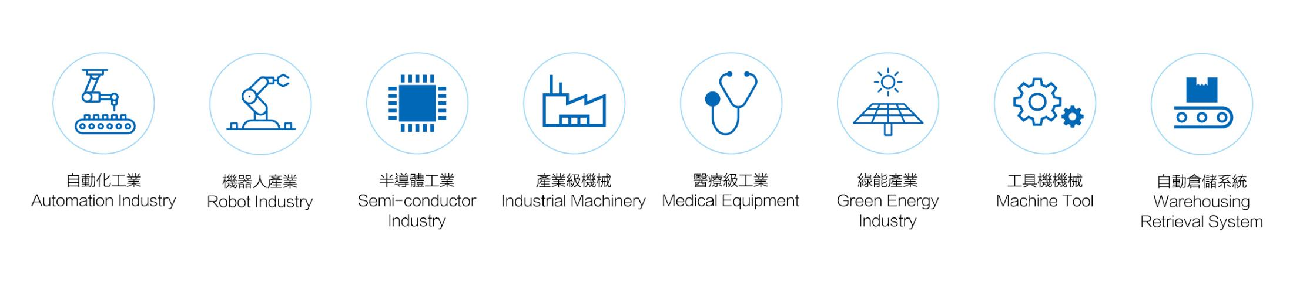
Applied Industry

Slide 13
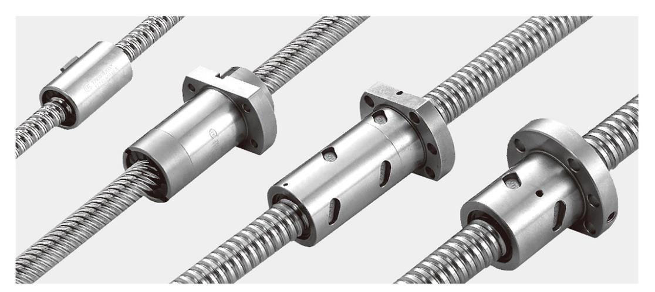
Ball Screw
Ball Screw | Rolled | Ground
Diameter | 06~80mm | 04~160mm
Lead | 01~100mm | 01~100mm
Accuracy | FC5~FC10 | GC1~GC7
Feature | Annual sales volume is first in the industry | Excellent quality and customized
● Complete Product Range

Slide 14
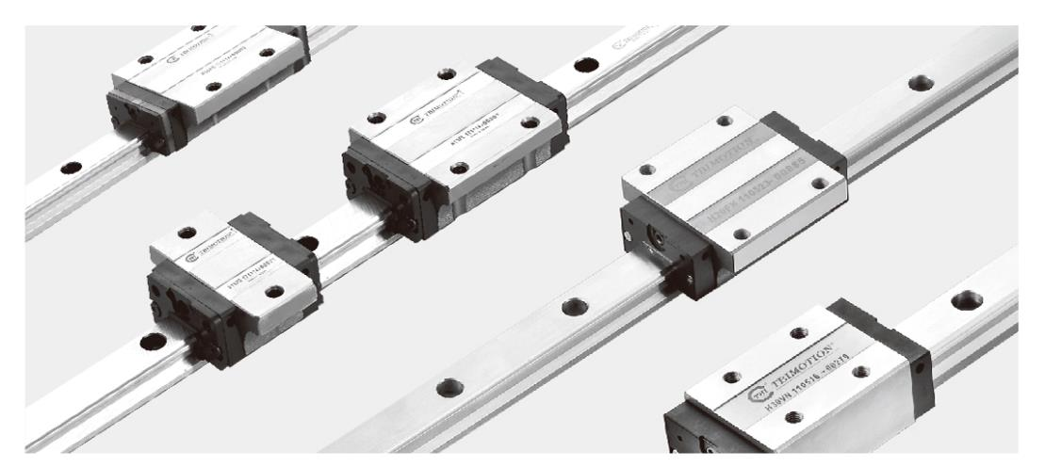
Linear Guid
Model | Dimension (mm)
Standard | 15、20、25、30、35、45
Large | 55、65
Feature
Smooth Movement/High Stability
High Durability
Self-Lubricating and Enhanced Dust-proof
J-flow System Self-Lubricating Linear Guide Series

Slide 15
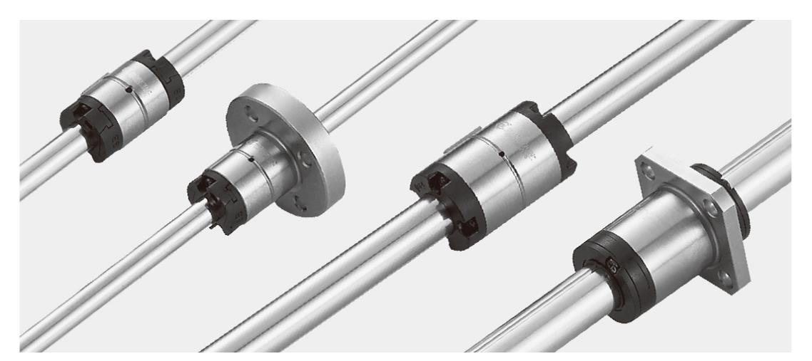
Ball Spline
Dimension | 06~50mm
Feature | Hollow Spline Shaft Easy Mount on Design High Rigidity/ High Load-Carrying Capacity Zero Angular Clearance/ Backlash
●全台第一成功研發量產

Slide 16
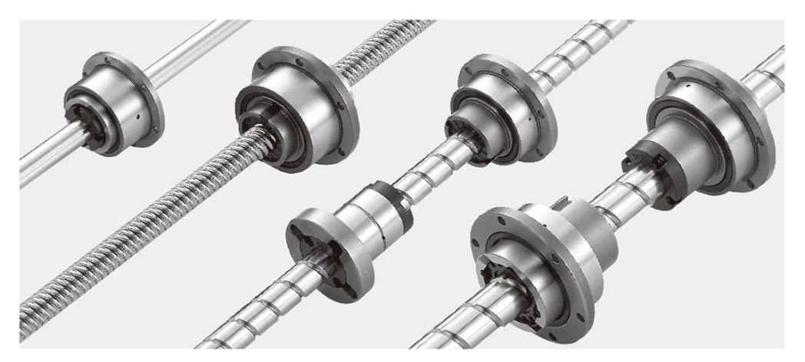
Rotary Series Ball Screw / Spline
Dimension | 16~50mm
Feature | Hollow Shaft Design in Line with Diversified Space Design. One-Piece Forming Design, Small Volume, High Precision Single Axis With Three Operating Modes (Rotation, Spiral, Linear) High Rigidity/ High Speed/ High Quality Both rotary and spiral movement achieve simultaneously

Slide 17
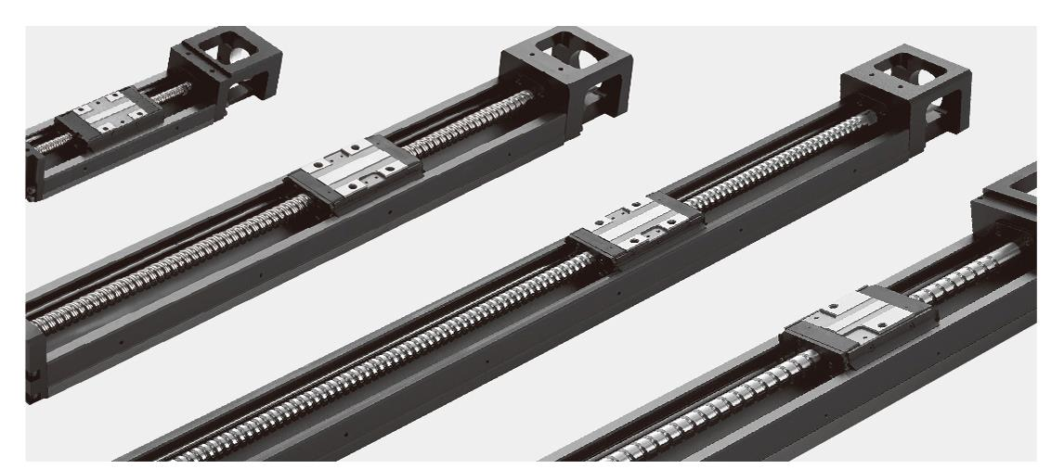
Single Axis Actuator
Dimension | 26, 33, 46(mm)
Feature | Modularization Allows the X-axis and Y-axis to bear loads from all directions. High Rigidity High Accuracy / Space Saving

Slide 18

State of Operation

Slide 19
Revenue
Unit： NT$ million
Data Source: Financial report by CPA audit or review.

Slide 20
Revenue Distribution by Regions

Slide 21
Revenue Distribution by Products

Slide 22
Gross Profit
Unit： NT$ million；%

Slide 23
Non-Operating Income and Expense
Unit： NT$ million
3Q/22 4Q/22 1Q/23 2Q/23 3Q/23

Slide 24
Profit Before Tax & Profit After Tax
Unit： NT$ million；%
3Q/22 4Q/22 1Q/23 2Q/23 3Q/23

Slide 25
EPS
Unit：NT$

Slide 26

Industrial Upgrading

Slide 27

Industrial Upgrading(1/4)
Become an Innovative 'Smart Automation' Motion Component Brand Manufacturer
FUTURE
IN MOTION
Project 1：
Intelligent Supply Chain Operation Center
Project 2：
Warehouse Management System Implementation Project
Project 3：
Advanced Manufacturing and Applied Research & Development Center for Transmission Components"

Slide 28
Industrial Upgrading(2/4)
Project 1
Intelligent Supply Chain Operation Center
Project
Content
Facilitate the digitalization management and mutual information exchange among at least four TBI suppliers to optimize operational management, production quality, and efficiency.
Goal
Optimize Intelligent automation production.
Accelerate supply chain response.
Integrate the Supply Chain Team.

Slide 29
Industrial Upgrading(3/4)
Project 2
Warehouse Management System
Implementation Project
Project
Content
Establish smart warehousing and AGV unmanned handling system
Goal
Optimize warehouse management efficiency.
Accelerate production processes.
Reduce the use of resources.

Slide 30
Industrial Upgrading(4/4)
Project 3
Advanced Manufacturing and Applied
Research & Development Center for
Transmission Components"
Project
Content
Invest in more valuable forward-looking industry technology development, and evaluate vertical and cross-domain integration to maximize the benefits of industrial innovation achievements
Goal
Expand the R&D team.
Invest in the startup industry market.
Enhance the company's competitiveness

Slide 31

Sustainable Development

Slide 32

Sustainable Development
TBI
Compile ESG report according to GRI standards
1.Complete TBI carbon footprint assessment
2.Implement ISO 14064
Obtain ISO14064 certification
Expected completion of carbon emission verification
Year
2023
2024
2025
2026
2027
Capital<2BillionPrepare ESG report
Capital<5BillionComplete carbon footprint assessment
Capital<5Billion
completion of carbon emission verification
FSC

Slide 33
ESG development for 2022
Governance | No incidents of violations of integrity policies, anti-competitive behavior, antitrust and monopoly activities, or other unlawful matters have occurred, and no related whistleblower cases have been received. No incidents of information disclosure, theft, or loss of customer data, and no information security events have occurred. All new suppliers have completed the integrity pledge.
Product | SFYA1632 ball screw receives the Taiwan Excellence Award 2022. Using RoHS:2011/65/EU and REACH-ECHA 244 inspections, confirm that 100% of the product materials do not contain toxic substances. Esteblished R&D center.

Slide 34
ESG development for 2022
Environment | The energy consumption decreased by 7.0% compared to the previous year, and the energy intensity decreased by 10%. Energy saving plan: Diverting the processes of the chiller and air conditioning system, saving 2,303.532 gigajoules (GJ), and reducing 316.7357 tons emission of CO2. The annual reclaimed water volume from air conditioning condensate is 6,210 tons.
Society | Organize social welfare activities such as caring for the elderly, supporting education, and environmental protection.。 Donate a disaster relief vehicle to the Fire Department, Fifth Disaster Relief Brigade, Shuhtan Substation. Hold the seventh edition of the ‘TBI Smart Automation Creative Implementation Competition' attracting 30 teams from across the country to participate.

