Slide 1
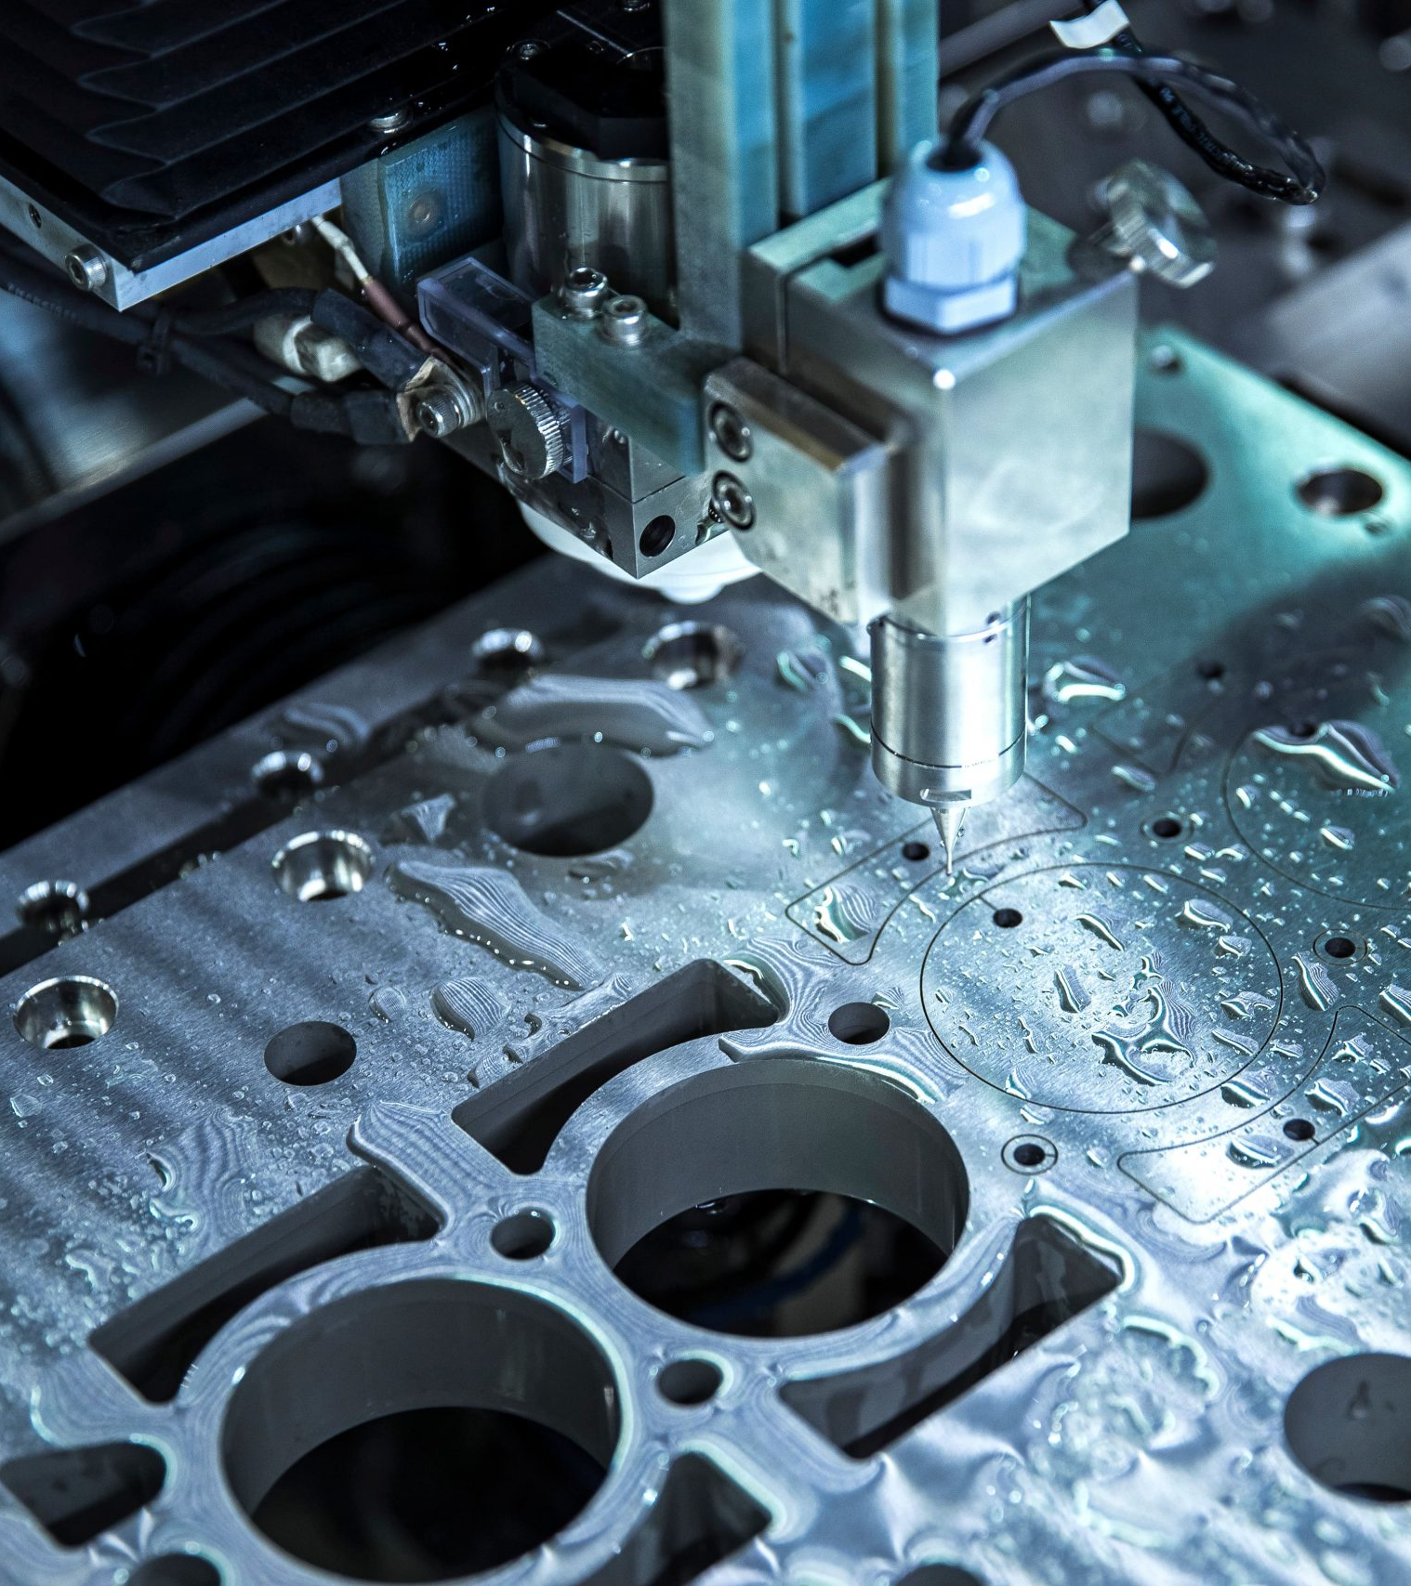

Global PMX Co.,Ltd.
Tariff and Global Investment Opportunity
主講者：趙坤信 總經理特助(Steven Chao )
2025年11月10日
1

Slide 2
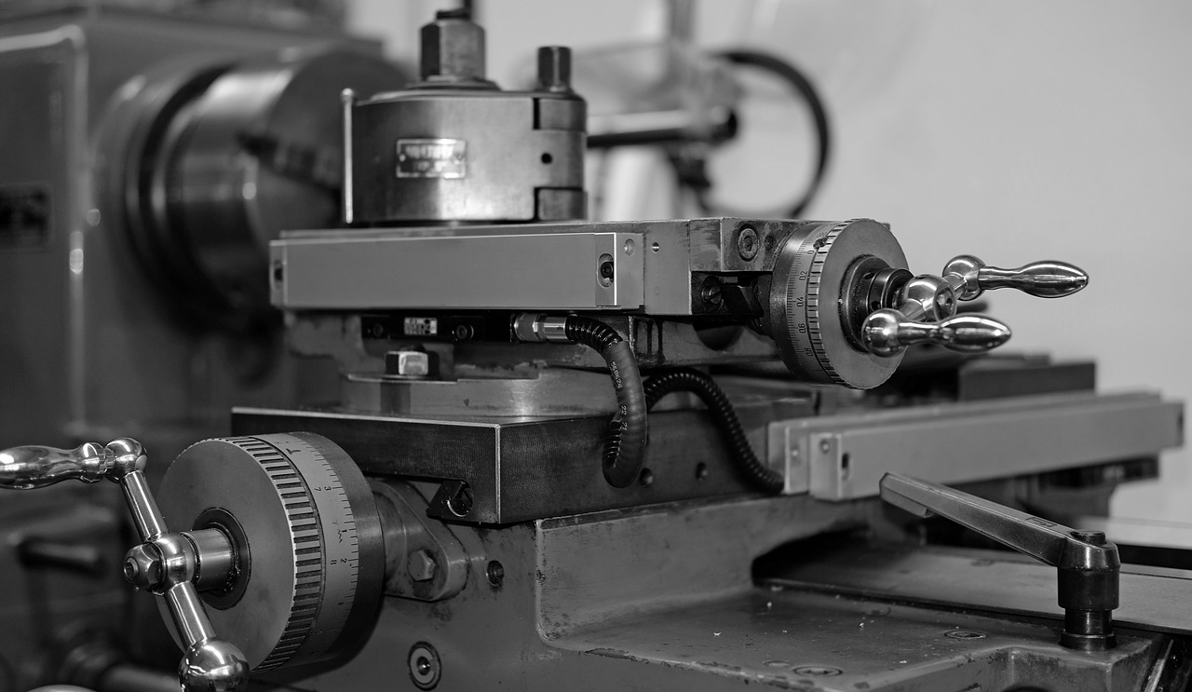
Disclaimer
This presentation is a summary and assessment of our past, present and future operations based on the subjective and objective factors at the time of the presentation; it contains forward-looking statements that are subject to risks, uncertainties and assumptions, some of which are beyond our control, and actual conclusions may differ materially from those in the forward-looking statements.
The information provided, including views on the future, does not expressly or impliedly represent or warrant its accuracy, completeness or reliability and does not purport to be a complete statement of the Company's, industry conditions or significant future developments. The Company does not warrant the accuracy of the information and assumes no obligation to update or revise the information contained in this presentation.
智伸科技股份有限公司
GLOBAL PMX CO., LTD.
2

Slide 3
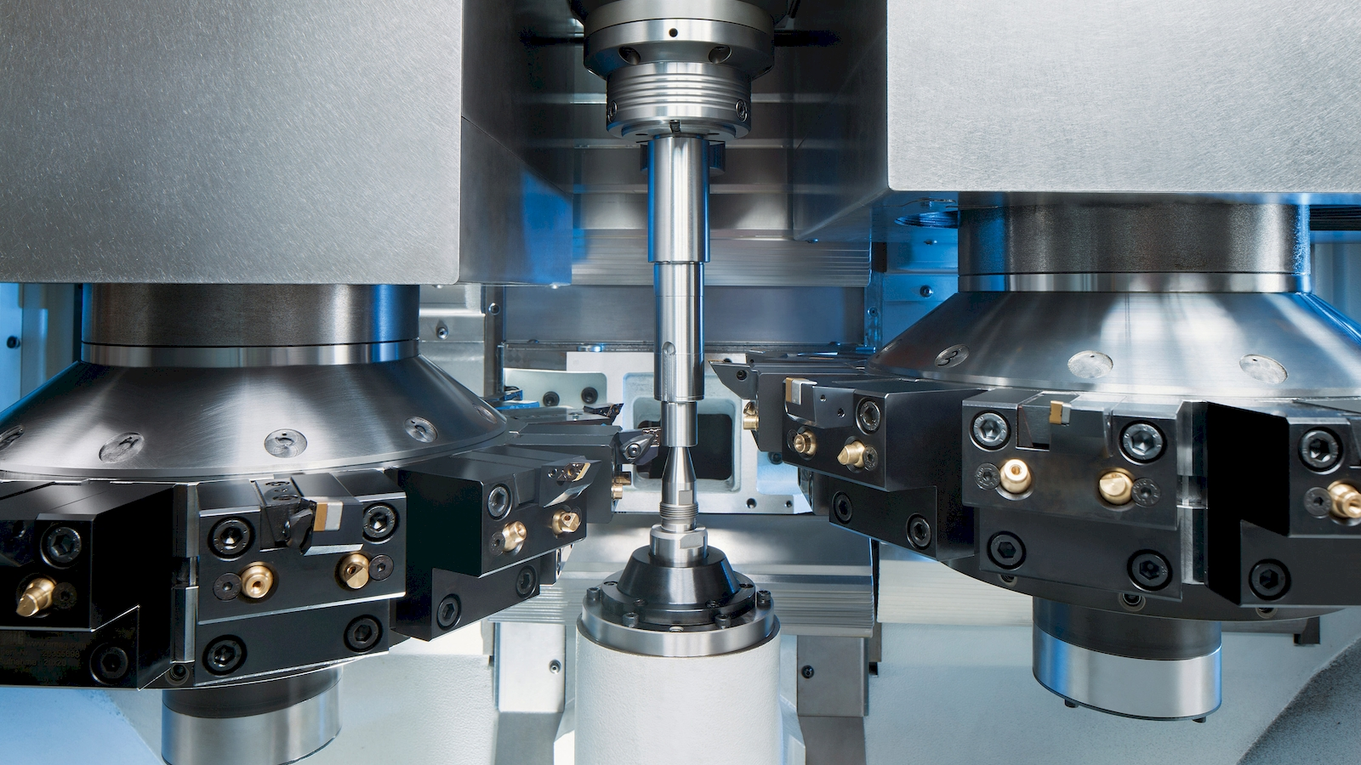

1
公司發展與概況
Company Profile

Slide 4
About
- World Class Precision Machinery OEM Leader
01
Established
Capital
02
1987, Feb-18th
NTD 1,152M
03
Employee
Business
04
Total 2,467
Head Office
New Taipei City, Taiwan
Fine Mechanical Parts including Automotive, Medical, Storage, Sports, Semi
智伸科技股份有限公司
GLOBAL PMX CO., LTD.
4

Slide 5
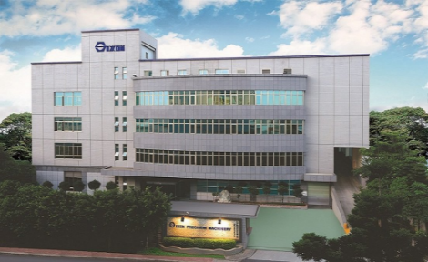
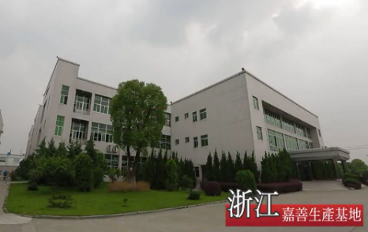
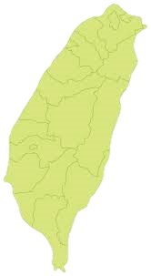
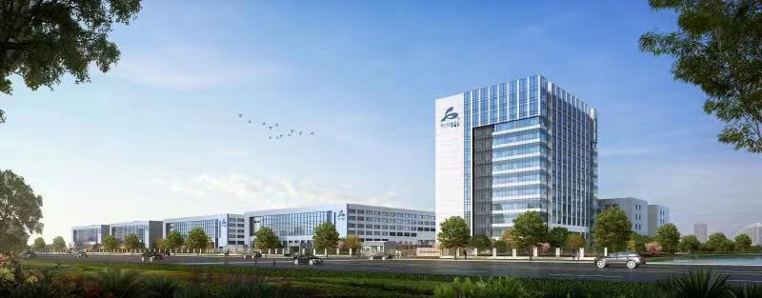
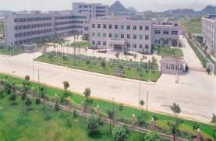
About
- Four Production Bases, Global Supply
TY,Taiwan
Revenue share(%)： 28.63 %
Employee： 723
Capacity(K)： 1,653,491
Products IN：NEVs、Sport、Medical、General、Industrial Products
Europe and America
Asia
~40%
Jiashan,ZJ, China
Revenue share(%) ：41.66%
Employee： 1072
Capacity (K) ： 2,405,995
Products IN ：ADAS、GDI、DCT、NEVs、Medical
~60%
Jiaxing,ZJ, China
Revenue share(%) ：7.30%
Employee： 301
Capacity (K) ： 421,675
Products IN：NEVs、Medical
DG, China
Revenue share(%) ：22.41%
Employee： 306
Capacity (K) ： 1,294,113
Products IN：Electronic、Semi、Auto
智伸科技股份有限公司
GLOBAL PMX CO., LTD.
5

Slide 6






Global Strategy: Expansion Plan in Response to Tariff Changes
Supply chain restructuring, establishing new manufacturing bases in Mexico and Vietnam to strengthen flexibility and competitiveness.
Taiwan Base
Vietnam Factory
Mexico Factory
現有基地
設立中
規劃中
20%+N% | 20% | 0-25%*
Original MFN tariff rate + 20% | Agreed tariff rate | US additional tariff rate
• ￭ Effective Aug 8, 2025: 20% tariff | ￭Transshipment goods: 40% tariff | ￭USMCA products: 0% tarrif
Existing Advantages:
Relative Advantages:
Strategic Value:
Technology R&D Center
Relatively low tariff costs
USMCA tariff-free advantages
Advanced Manufacturing Capabilities
Labor cost advantages
Superior geographical location
Supply Chain Management HQ
CPTPP member country
Maquiladora program
Quality Control Standards
Close to China supply chain
Lowest logistics costs
Talent Development Base
Government investment incentives
Direct access to North American market

Slide 7
Revenue Share By Segment - 2025Q3
Y2025Q3
Semi & Others
Sports
Medical
Automotive
Electronic
智伸科技股份有限公司
GLOBAL PMX CO., LTD.
單位：％ (約略)
11
單位：％ (約略)

Slide 8
Revenue Share By Segment – 2025Q1-Q3
Semi & Others
Sports
Medical
Automotive
Electronic
智伸科技股份有限公司
GLOBAL PMX CO., LTD.
單位：％ (約略)
11
單位：％ (約略)

Slide 9
Business Status-2025Q3 By Segment
Y2025/Q2
Y2025/Q1
Y2024/Q4
Unit：％ (約略)
智伸科技股份有限公司
GLOBAL PMX CO., LTD.
11

Slide 10
2
營收達成與財務狀況
Sales Achievement & Financials

Slide 11
Business Status-Q3 Revenue YoY By Segment
-22%
單位：新台幣千元: ％ (約略)
智伸科技股份有限公司
GLOBAL PMX CO., LTD.
9

Slide 12
Business Status-1-3QRevenue YoY By Segment
+38%
單位：新台幣千元: ％ (約略)
智伸科技股份有限公司
GLOBAL PMX CO., LTD.
9

Slide 13
營運概況- 同期比
 | 2025/Q3 |  | 2024/Q3 |  | YOY | Y2025/Q1-3 |  | Y2024/Q1-3 |  | YOY
Gross Sales | 1,939,781 | 100% | 2,215,678 | 100% | -12.45% | 5,775,281 | 100% | 5,707,405 | 100% | 1.19%
Cost of Goods Sold | (1,518,991) | 78% | (1,680,179) | 76% |  | (4,441,200) | 77% | (4,549,414) | 80%
Gross Profit | 420,790 | 22% | 535,499 | 24% | -21.42% | 1,334,081 | 23% | 1,157,991 | 20% | 15.21%
Operating Expense | (200,538) | 11% | (198,647) | 9% |  | (529,460) | 9% | (607,571) | 11%
Operating Profit | 220,252 | 11% | 336,852 | 15% | -34.61% | 804,621 | 14% | 550,420 | 10% | 46.18%
Non-Operating Income (Expense) | 125,372 | 7% | (70,801) | 3% |  | (205,481) | 4% | 167,301 | 3%
Pre-Tax Income | 345,624 | 18% | 266,051 | 12% | 29.91% | 599,140 | 10% | 717,721 | 13% | -16.52%
Income Tax | (74,672) | 4% | (63,799) | 3% |  | (179,768) | 3% | (172,930) | 3%
Net Income | 270,952 | 14% | 202,252 | 9% | 33.97% | 419,372 | 7% | 544,791 | 10% | -23.02%
EPS (NTD) | 2.35 |  | 1.76 |  | 33.52% | 3.64 |  | 4.73 |  | -23.04%
智伸科技股份有限公司
GLOBAL PMX CO., LTD.
7

Slide 14
營運概況- 季度別
 | 2025/Q3 |  | 2025/Q2 |  | 2025/Q1 |  | 2024/Q3 |  | 2024/Q2
Gross Sales | 1,939,781 | 100% | 1,826,385 | 100% | 2,009,115 | 100% | 2,215,678 | 100% | 1,855,388 | 100%
Cost of Goods Sold | 1,518,991 | 78% | 1,387,151 | 76.00% | 1,535,058 | 76.40% | 1,680,179 | 75.83% | 1,510,491 | 81.41%
Gross Profit | 420,790 | 22% | 439,234 | 24.00% | 474,057 | 23.60% | 535,499 | 24.17% | 344,897 | 18.59%
Operating Expense | 200,538 | 11% | 139,162 | 7.00% | 189,760 | 9.44% | 198,647 | 8.97% | 184,603 | 9.95%
Operating Profit | 220,252 | 11% | 300,072 | 17.00% | 284,297 | 14.15% | 336,852 | 15.20% | 160,294 | 8.64%
Non-Operating Income (Expense) | 125,372 | 7% | -396,271 | -22.00% | 65,418 | 3.26% | -70,801 | -3.20% | 64,386 | 3.47%
Pre-Tax Income | 345,624 | 18% | -96,199 | -5.00% | 349,715 | 17.41% | 266,051 | 12.01% | 224,680 | 12.11%
Income Tax | 74,672 | 4% | -5,767 | - | 110,863 | 5.52% | 63,799 | 2.88% | 54,585 | 2.94%
Net Income | 270,952 | 14% | -90,432 | -5.00% | 238,852 | 11.89% | 202,252 | 9.13% | 170,095 | 9.17%
EPS (NTD) | 2.35 |  | -0.78 |  | 2.07 |  | 1.76 |  | 1.48
智伸科技股份有限公司
GLOBAL PMX CO., LTD.
8

Slide 15

Thank You
公司網址： http://www.global.com.tw/

