Slide 1


Integrity Innovation Commitment Partnership
TaiDoc Technology Corp
May 2020

Slide 2
Company Basics
Founded Date:
May 11th, 1998
Contributed Capital：
NTD 843 Millions
Number of Employees (Worldwide):
1,200 (1,000/Taiwan; 200/Other countries)
Business Area：
Research, Design, and Manufacturing of Medical Device

Slide 3
Product list
Blood Glucose Test Strip, Hemoglobin A1c Analyzer
Professional IR Thermometer, Forehead IR Thermometer with long distance detection (5~15 cm)
Digital Pregnancy Test Device and Test Strips
Digital Ovulation Test Device and Test Strips
Pulse Oximeter
Handheld Ultrasonic Nebulizer
POCT Blood Glucose Test System
ECG Monitor
Vital Sign Monitor

Slide 4
Vision
To be a leading company in the global medical device industry with a world-class brand
To be the top one blood glucose monitoring system (BGMS) manufacturer and supplier in Asia
To be one of the top five BGMS manufacturer and supplier in the global diabetic care industry

Slide 5
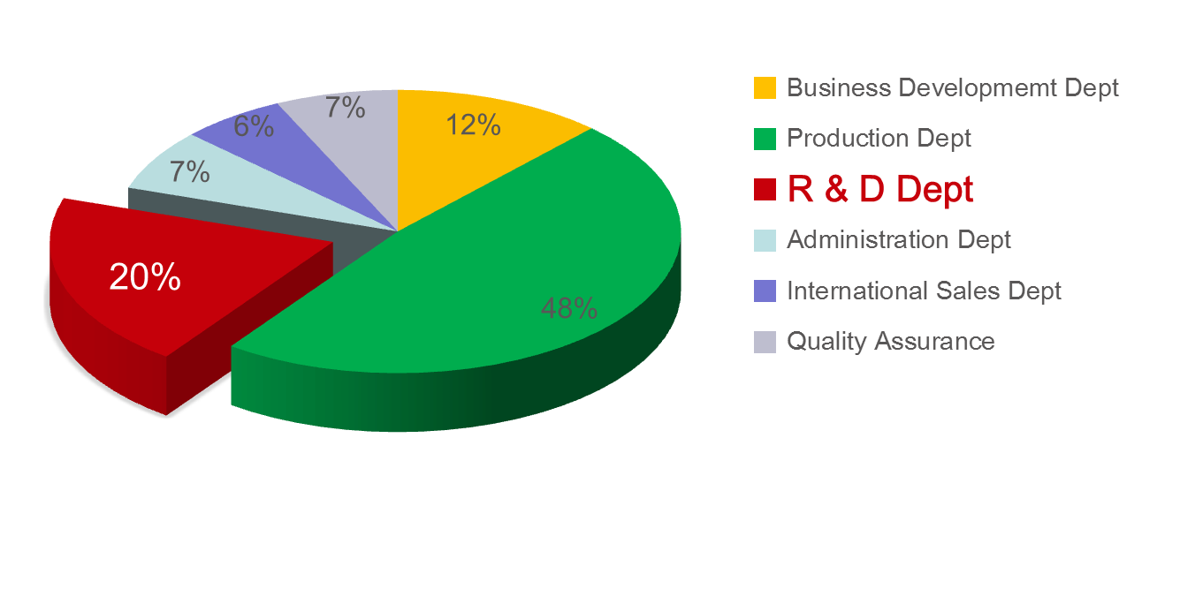
R&D
TaiDoc invests over 20% of its total manpower and above 6% of its annual sales revenue in continuous research and development.

Slide 6

Patent Portfolio
TaiDoc owns more than 160 patents in BGMS, IR Themometer, Nebulizer、Body-fat scale 、Heart-beat ring and etc. in the US, Germany, China, and Taiwan
6

Slide 7
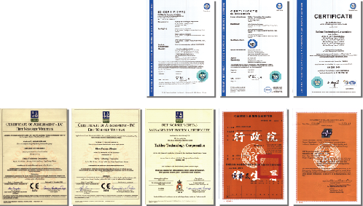
Quality Certificates
Being a quality oriented company, TaiDoc offers a best-in-class, worldwide medical device quality management system that enables the Company to meet stringent quality and process controls.
TaiDoc's Quality System Control Center was established in 2003, which is combined by 5 different sections: Document Control Center, Auditing Section, Medical System Section, Complaint Handling Unit, and Return Merchandise Authorization.
TaiDoc’s Quality System Control Certificates
ISO 9001: 2008
ISO 13485: 2003
GMP: 2003
QSR Compliance: 2003
CMDCAS: 2007
IVD
MDD

Slide 8
Approvals with international health authorities
CE Mark
Blood Glucose Monitoring Systems
2-in-1 Blood Glucose plus Blood Pressure
Monitoring Systems
Blood Pressure Monitoring Systems
Infrared Thermometers
Test Strips
Control Solution
Lancing Device with Sterile Blood Lancet
Ultrasonic nebulizer
Heart Rate Monitor
ECG recorder
Vital Sign monitor
Early Pregnancy Test
SFDA Approval
Blood Glucose Monitoring Systems
Blood Pressure Monitoring Systems
Infrared Thermometers
FDA 510(K) Clearance
Blood Glucose Monitoring Systems
2-in-1 Blood Glucose plus Blood Pressure Monitoring Systems
Blood Pressure Monitoring Systems
Infrared Thermometers
Multi-Parameter Spot-Check Monitor
JCQA Approval
Test Strips
COSMOS Approval
Infrared Thermometers
KFDA Approval
Blood Glucose Monitoring Systems
Test Strips
Infrared Thermometers
DOH / TFDA Approval
Blood Glucose Monitoring Systems
2-in-1 Blood Glucose plus Blood Pressure
Monitoring Systems
Blood Pressure Monitoring Systems
Infrared Thermometers
ANVISA Approval
Blood Glucose Monitoring Systems
Test Strips
Infrared Thermometers
8

Slide 9
Own-Brand History
2006: Established TaiDoc’s first brand company (Pu-Yang Technology Corp.) in Taiwan
2007: Established Fora Care Inc.(USA)
2009: Established Suzhou ForaCare Inc. (China)
Established ForaCare Japan
Established ForaCare Suisse A.G.
2013: Established ForaCare Global Corp.
2014: Established ASIA PACIFIC VISION CORP.
2016 : Established ForaCare Texas, Inc.

Slide 10

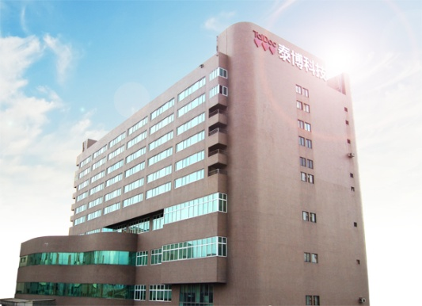

Headquarter and Worldwide Locations
Biocare Suzhou Branch
ForaCare Suisse AG. (Switzerland)
ForaCare Japan
ForaCare China Inc.
ForaCare Inc. (U.S.A.)
TaiDoc Headquarters (Taiwan)
TaiDoc India Office
TaiDoc Middle-East Branch
TaiDoc Factory-Taoyuan-One
TaiDoc Factory-Taoyuan-Two
TaiDoc Headquarters (Taipei)

Slide 11

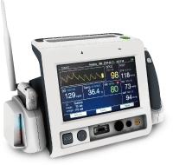

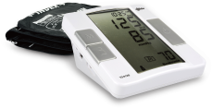
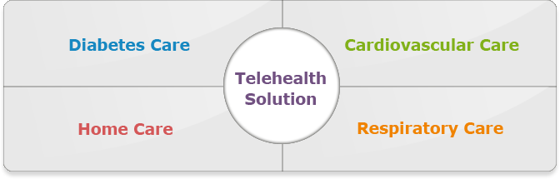
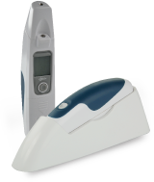
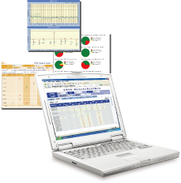

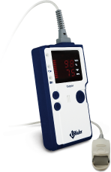
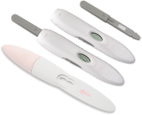
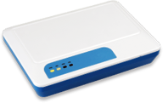
A Diabetes Device OEM/ODM Leader with Own-Brand

Slide 12
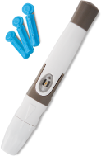
Innovative Products
Diabetes Care
Blood Glucose Monitoring System
Plug & Test
Ejection
Voice
Screen Backlight
Graphic User Interface
Strips
GOD (glucose oxidase)
GDH-FAD (glucose dehydrogenase enzyme)
No Coding System
HCT (hematocrit) Correction
Lancing Device & Lancet
5 Depths
Painless Design
Loading Indicator
Lancet Ejector
30G Lancet

Slide 13

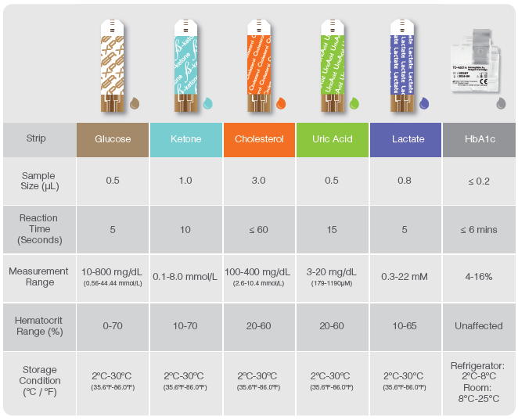
Multiple Parameter Monitoring Systems
Provide 6 parameters for a comprehensive care
21

Slide 14
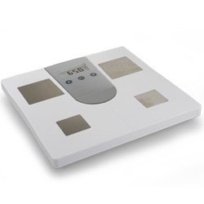
Innovative Products
Home Care
EPT (Early Pregnancy Test)
Traditional HCG Test
Digital HCG Test systems
Infrared Thermometer
Ear Only
Forehead Only
Both Ear & Forehead
Probe Protection
None-contact
Weight Scales
Body Mass Index function
Available data transmission

Slide 15
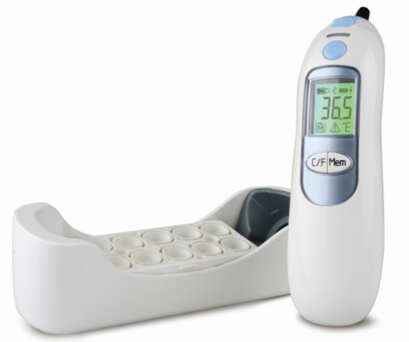
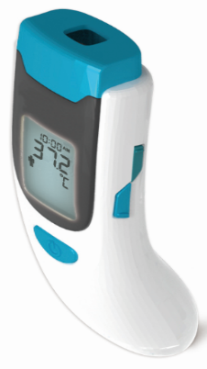

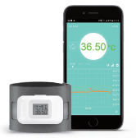
Thermometer
Ear Thermometer
Non-contact Thermometer
Wearable Bluetooth Thermometer
32

Slide 16
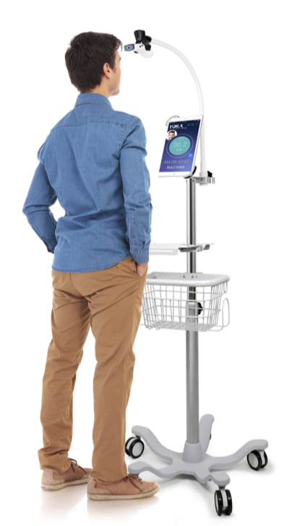
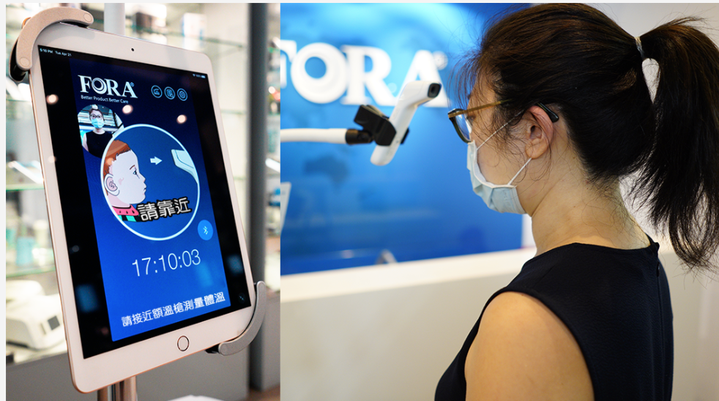
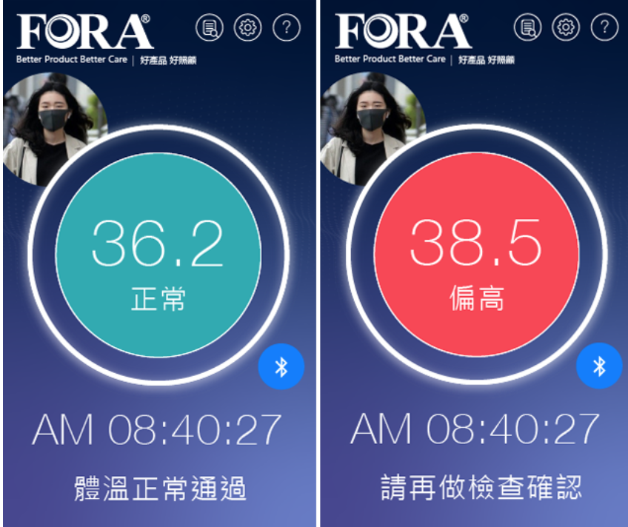
FORA ATMS

Slide 17
Innovative Products
Respiratory care
Nebulizer
Compress Nebulizer
MESH Ultrasonic Nebulizer
Oximeter
Handheld type
Finger Tip type

Slide 18
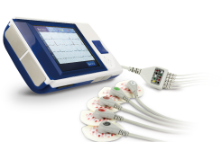
Innovative Products
Cardiovascular care
Multi-Parameter Spot Check Monitor
5 vital sign parameters
blood pressure
blood oxygen saturation
heart pulse rate
body temperature
blood glucose
Blood Pressure Monitor
Clever Inflation technology
Irregular Heartbeat Detection
Automated Averaging Function
2 in 1 – BP+ BGM
Portable ECG Recorder
3.5” color touch screen
user-friendly interface
External Memory Card
2 modes-Four-lead EKG cable
and Personal Health Care mode

Slide 19
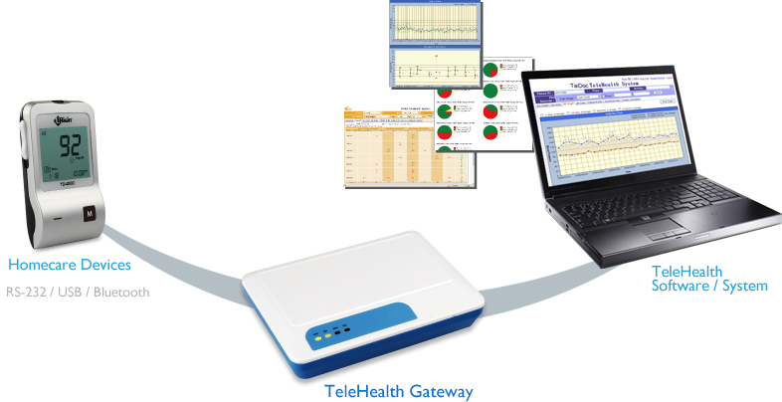
Innovative Products
telehealth care
Gateway
Gateway’s connectivity covers all of our product lines. Our products are designed to connect with the Gateway through Bluetooth, RS232, USB, or GPRS to upload the routine check results onto the online database. This allows the physicians to easily monitor the patients’ status and provide more efficient care to their patients.

Slide 20
Development of Own-Brand vs. OEM/ODM

Slide 21
Sales Breakdown by Product

Slide 22
Sales Breakdown by Region

Slide 23
Revenue growth

Slide 24
Margins

Slide 25
Dividend Policy
 | 2012 | 2013 | 2014 | 2015 | 2016 | 2017 | 2018 | 2019
EPS (NT$) | 2.56 | 5.42 | 6.61 | 6.45 | 6.56 | 5.43 | 11.05 | 8.03
Cash DPS (NT$) | 3 | 4.88 | 5.2 | 5.5 | 5.5 | 5 | 8 | 7

Slide 26
Thank you very much
for your attention!
Notes:
26

