Slide 1
2019 About Bionime
Oct 15, 2019

Slide 2

Bionime Group Taiwan
Notes:
Boionime Headquaters, capitalization value ~ US 50 million dollars.

Slide 3

About Us
Established in April 2003, Bionime is specialized in the business of biotechnology and medical testing. The first product line is the Self Monitoring Blood Glucose (SMBG) System. Bionime integrates the top-tier expertise in medical science, chemistry, electronics and precision mechanism to commercialize the patented technology of unique test strip structure.
Today, Bionime operates 4 subsidiaries in major markets, Europe, America, and China. Our products have been highly recognized by outstanding clinical tests and well-known journals internationally and successfully distributed in the worldwide markets. With the support from our customers, we are confident to grow BIONIME the global competitive leadership in the field of SMBG (Self-Monitor Blood Glucose).

Slide 4


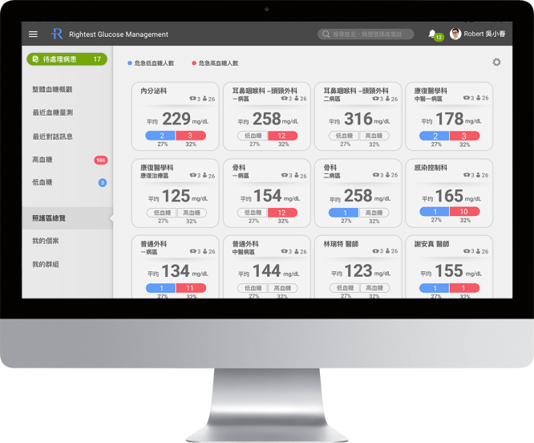
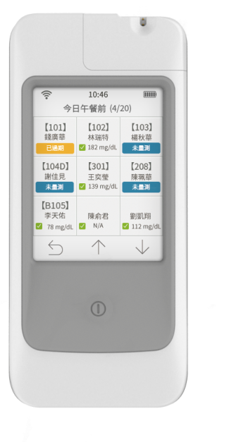

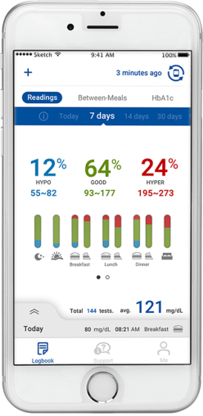
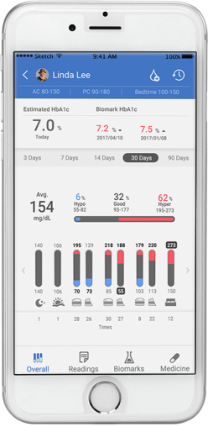
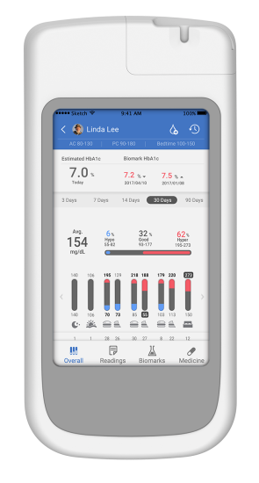
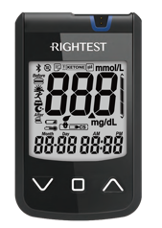
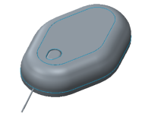

華廣生技公司 從事什麽?
12%的全球醫療支出用於糖尿病照護
各國70%-80%的糖尿病照護費用用於處理糖尿病併發症
血糖管理是避免併發症的唯一方法
華廣創立于2003年
專注於血糖管理系統的研發、設計、製造、行銷
産品含蓋血糖管理的3個主要醫療器材，並以IOT將此3個串接成一 ECO System
IOT
e- Business
SMBG APP
DMS
Mobile DMS
SMBG
POCT
CGM / App
Patch Pump
$
Notes:
Rightest +

Slide 5
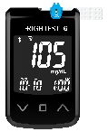
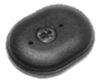

糖尿病照護的產品 (不含醫院診所專業服務費)
藥(80%) + 血糖管理醫療器材(20%)
2015
Diabetes Care Products
US $64B
(all devices + drugs)
Glucose Management
Medical Device
US $14B
Top 3 items
SMBG, CGM,
Insulin Delivery
BIONIME’S
Product Range
SMBG
CGM
Patch Pump
Yearly growth
in 2018 H1
-1.0%
+64%
+20%
Notes:
預計帶出 糖尿病的照顧費用 1/9

Slide 6







華廣產品涵蓋&串接全部
血糖管理系統的Top-3 items 醫療器材
2003 創業產品
華廣的全新產品 研發開始 2010, 2016
BGM
Blood Glucose Monitor
採血式血糖監測儀
CGM
Continuous Glucose Monitor
連續式血糖監測儀
Patch Pump
Disposable Insulin Delivery
拋棄式胰島素注射幫
CGM
Data Cloud
華廣以自建的 Rightest Care System
串接血糖管理的 3個主要醫療器材
成為 IOT智能化的生態系統
Rightest Care Eco System
Patch Pump
BGM

Slide 7
Financial report
Notes:
Revenue 2018 vs 2017 YOY 10%
2019H1 vs 2018H1 YOY 13%

Slide 8
Margin Ratio
Notes:
毛利率下降主要係
1. Meter銷售比重上升,試片比重下降
2. 東寶庫存水位調整，以致於第4季才拉貨

Slide 9
Sales Region
Notes:
中國區域在第4季東寶拉貨後預計會提升

Slide 10
Product Ratio
Notes:
METER比重上升

Slide 11
Meter Quantity
Unit: Piece
Unit: Piece
Year | 2010 | 2011 | 2012 | 2013 | 2014 | 2015 | 2016 | 2017 | 2018 | 2019H1
Quantity | 760,471 | 862,327 | 848,878 | 822,869 | 878,762 | 899,552 | 918,701 | 1,095,581 | 1,283,054 | 643,013

Slide 12
Strip Quantity
Unit: 1,000 piece
Unit: 1,000 piece
Year | 2010 | 2011 | 2012 | 2013 | 2014 | 2015 | 2016 | 2017 | 2018 | 2019H1
Quantity | 196,707 | 272,904 | 298,539 | 323,423 | 332,282 | 356,927 | 428,486 | 483,966 | 518,727 | 231,998

Slide 13
Dividend
Unit: NTD
Year | 2014 | 2015 | 2016 | 2017 | 2018
EPS | 1.22 | 1.91 | 2.82 | 2.52 | 2.23
Cash dividend | 0.94 | 1.4 | 2.54 | - | 2
Capital reserve | - | 0.6 | 1.26 | 4.14 | -
Total | 0.94 | 2.0 | 3.8 | 4.14 | 2
Notes:
近五年股利分配情形

