Slide 1

Gemtek Technology
Investor Conference 2021

Slide 2
Agenda
１
Opening
Speaker - Chairman Howard Chen
2
Operating Report
Speaker – CEO James Lee
3
Market Trend
Speaker - Exec. Board of Director & Spokesman
4
Q & A
5
Live Demo and Refreshment Time

Slide 3

A New Era of Telecommunication
Notes:
異質網路的整合

Slide 4
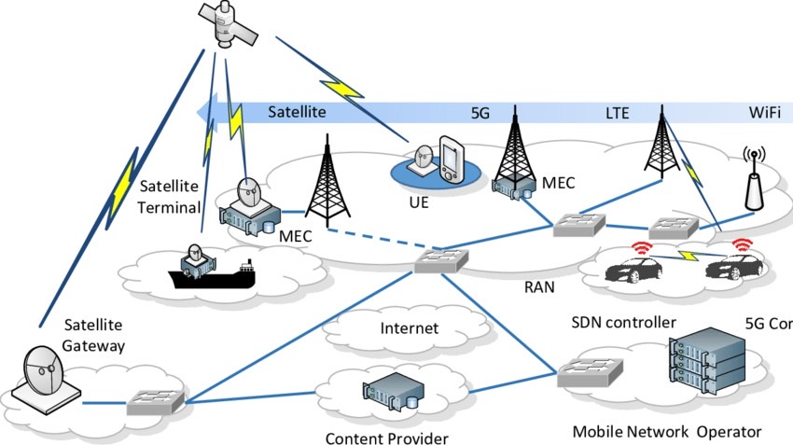
A New Era of Telecommunication
Notes:
Fulfill human’s needs for internet.
Enhance the robustness of communication web.
Everything connected: Better IoT.

Slide 5




Business Opportunity for Gemtek
Central Office
Broadband
Connected Home
Cloud Server
CO
(Central Office)
Small Cell
OLT
Edge Computing
ORAN
CPE
Fiber Gateway
5G Gateway
LEO
Wi-Fi 6,7Mesh
IoT LoRa

Slide 6
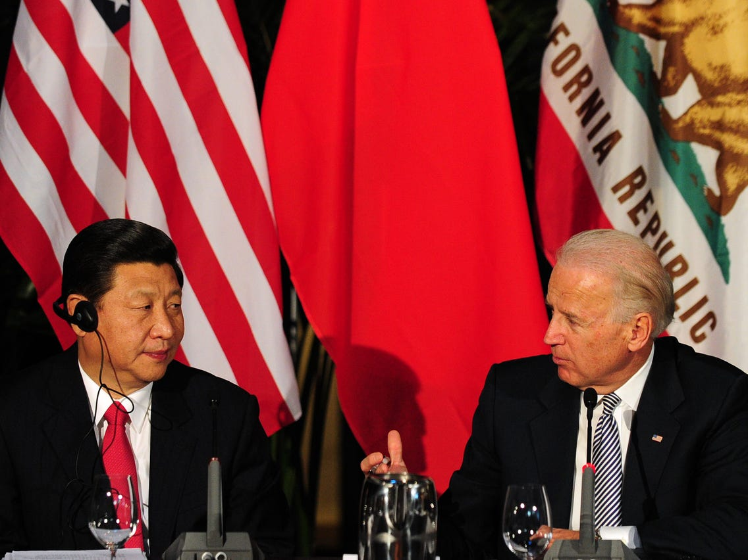
US – China Confrontation
Trade
Technology
Financial

Slide 7
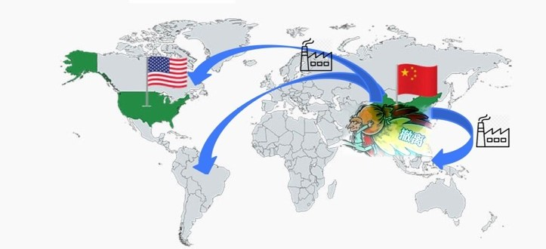
US-China confrontation accelerate shift in global supply chains
Notes:
The impact of tariff increase on China → Significant cost pressure on enterprises and retails.

Slide 8


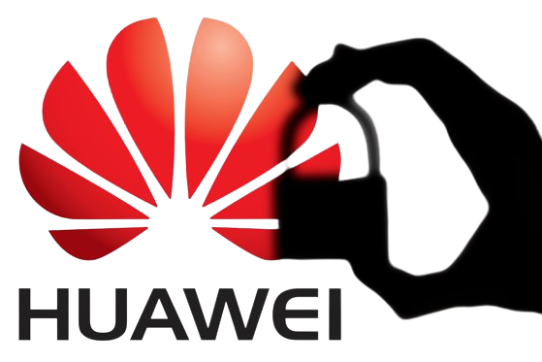
US government is cracking down on Chinese telecom and tech companies
Trump’s Executive order
Cut the supply chain of Huawei.
(ex TSMC、Samsung、Qualcomm, etc.)
Clean network program
Aligned with other countries to boycott HW and SW from China.
The Secure Equipment Act
Reduce the presence of Huawei and ZTE equipment in U.S communications networks.

Slide 9
Challenge & Opportunity

Slide 10






Challenge
Worsen Condition of China Manufacturing
Electricity
Restriction
In China
Material Shortage
Tariff
COVID 19
Currency Risk
Notes:
In the past two years,
we have faces many challenges
First, the Tarriff raise
Second, the deterioration of Chinese manufacturing environment,
because it will raise our cost in producing
Third, covid-19,
in the 1Q of 2020,
Multiple national lockdowns continue to slow
or even temporarily stop the flow of raw materials and finished goods,
disrupting manufacturing as a result.
Gemtek’s 1Q revenue therefore recess 27.31% compare to the last quarter,
In the 2 quarter of 2020,
factory gradually back to normal,
but some demand from retail side
was impacted by the lockdown in USA an Europe Severely influence many business and industry.
As 2021,
western country has a higher vaccinated rate than Asian country,
So the demand of networking product is still very strong,
but in South-east Asia and China still can see lockdown happens,
this can damage the capacity.
Taiwanese dollar exchange raise
also a big downside to gemtek’s margin
The last but not the less,
Material shortage is one of the big challenge for us
At the moment PMIC from TI is not sufficient,
Because it’s packing site is in Malaysia,
so the lockdown lowing the capacity
Material shortage is a worldwide structural issue
since second half of 2020,
It might be ease in the second half of 2021,
But still have many uncertainties.
For now we already ease 70-80% material shortage,
In the other word, if this problem can be solved,
Our monthly revenue can be estimate above 2.5 billions
Now due to the material loss,
our revenue is revise down to 2 billions,
What we can do is preparing material in advance
And urge material order proactively
we will try to transfer Component price race to the customer,
Over all our customer can be catalog in two segment,
one is the large enterprise like Nokia and Intel,
This kind of customer have abilities negotiate the price on their own
we only have to handle the purchase,
Half of our customer belong to this catalog,
so the component price race naturally will absorb by them.
The other kind of customer is small or middle scale business,
Therefore we will have to transfer the extra cost to them,
The price racing can be seen in 3q or 4q
但是2020 2H同時也因為封城帶來WFH的大量網通設備需求；2021上半年因為疫苗的關係歐美解封，此外中國大陸也採取相關措施，所以上半年疫情對科技產業造成的影響區緩，到了2021下半疫情再起，歐美跟亞洲採取的策略走不同路，歐美採取疫苗跟治療用藥不會再採取封城的方式，demand端不會受到影響，但因為製造端多在東南亞跟中國，而這兩地採取的措施較為極端，像是封城就會影響到產能。

Slide 11
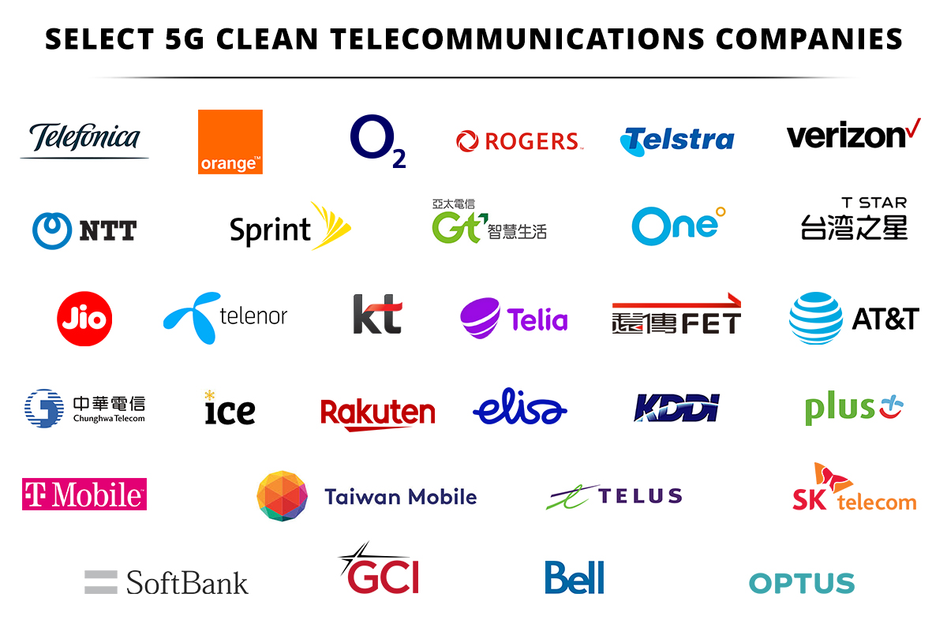
Opportunity – Clean Network Program
Clean Carriers
Clean App Stores
Clean Apps (Exclude TikTok, WeChat, etc.)
Clean Cloud
Clean Cable (Exclude Hong Kong. Connect Taiwan and the Philippines)
Notes:
Many countries are choosing to allow only trusted vendors in their 5G networks. Examples include the United Kingdom, Czech Republic, Poland, Sweden, Estonia, Romania, Denmark, and Latvia. Greece has agreed to use Ericsson, rather than Huawei, to develop its 5G infrastructure.
Some of the largest telecom companies around the globe are also becoming “Clean Telcos.” Orange in France, Jio in India, Telstra in Australia, SK and KT in South Korea, NTT in Japan, and O2 in the United Kingdom are rejecting doing business with tools of the Chinese Communist Party’s surveillance state, like Huawei. The big three telecommunications companies in Canada have decided to partner with Ericsson, Nokia, and Samsung, because public opinion was overwhelmingly against allowing Huawei to build Canada’s 5G networks.

Slide 12
Opportunity – Biden government’s $1.2 trillion USD Infrastructure bill
Airports ports
and waterways 27%
Broadband upgrade 45%
Roads and Bridges 6.5%
Transit and Rail 25%
Notes:
在本次基建法案中，將有650億美元用於改善全美境內寬頻網路部署，特別是偏遠鄉村地區以縮窄城鄉數位差距，以達成在20年代結束前實現全民連網的目標。
https://www.digitimes.com.tw/tech/dt/n/shwnws.asp?CnlID=9&id=0000623427_VBE3EG1234ATDR61WIIMT&wpidx=5
https://edition.cnn.com/2021/07/28/politics/infrastructure-bill-explained/index.html

Slide 13





Opportunity - Transfer Order Effect
Gemtek Can Do
Shipment / Manufacture outside of China.
Highly customize production
Transfer
The Orders place in China product line
Orders from Big EMS company

Slide 14


Opportunity - Declining competitiveness of China
Then - China is a International Factory
Producing cost in China has been rising
Automated production become mainstream
Pandemic & Political issue increase uncertainty
Electricity restriction order
Now – Factories located globally

Slide 15





Opportunity – New Technology
LEO
Fiber

Slide 16
Operating Report
CEO James Lee

Slide 17
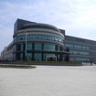
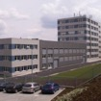
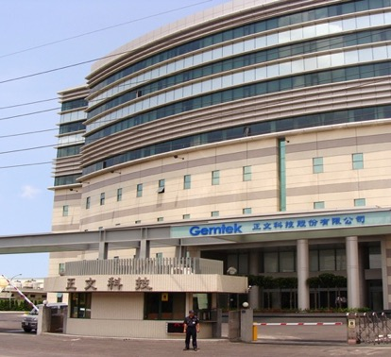
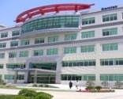
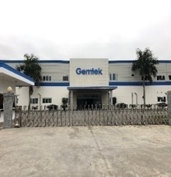
Global Sites
Czech Republic
China CS
Land Size: 9,500 m²
Plant Size: 5,200 m²
Plant Size: 41,000 m²
Land Size: 152,000 m²
China KS
Plant Size: 30,660 m²
Land Area: 14,000 m²
Vietnam
Taiwan HQ
Plant Size: 26,000 m²
Land Size: 36,000 m²
Plant Size: 19,975 m²
Land Size: 29,915 m²
Notes:
Where are we? We started out in Taiwan then we expanded to China and Czech in 2004 and 2009 respectively and they have been up and running since.
The most important highlight is Vietnam which was established recently in 2019 mainly to help company solve issues raised due to the trade war.
We will have more details about Vietnam in the later slides.
As some of the folks from intel are aware, Gemtek is also reinvesting in Taiwan. We will have some information about Taiwan later as well.

Slide 18

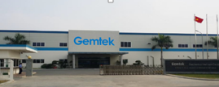

Manufacturing Capacity
 | Hsinchu, Taiwan | Ha Nam, Vietnam | Kunshan & Changshu, China
Capacity (by product) | ≈ 12% | ≈ 38% | ≈ 50%
Capacity (by revenue) | ≈ 5% | ≈ 45% | ≈ 50%
Product | Pilot Run | Wi-Fi Product, LTE, Gateway, GPON, Module, Sip Module | Wi-Fi Product, LTE, Gateway, GPON, Module, Sip Module
Notes:
At the moment,
China is still our main shipment country,
it’s capacity by production is around 50%
We have two factory in China, one in 崑山, one in 常熟
The second main product line is in Hanoi Vietnam,
which has around 45% capacity
The smallest production line is in Taiwan,
Which only has10% capacity
China and Vietnames factory mainly produce mature product,
such as wifi product, LTE, GPON etc.
Taiwan factory is for pilot run product

Slide 19

Vietnam
Nov., 2018
License granted to Gemtek VN
May., 2019
ISO certified
Nov.
1.5M units Shipped
Mar., 2021
600K units/ month output reached
Đồng Văn II Industrial Park
Bach Thuong Commune, Duy Tien District,
Ha Nam Province, Vietnam
Jul.
Gemtek VN 2nd site expansion start

Slide 20



Key Technology Focus
Fiber
Fixed Broadband
Wireless Telecom
Wi-Fi
Wi-Fi 5 IEEE802.11ac
Wi-Fi 6/6E IEEE802.11ax
Wi-Fi 7 IEEE802.11be
GPON / EPON
XGSPON / 10G EPON/ DPoE 2.0
NGPON2 / 25G PON / 50G PON
CBRS /LoRa
LTE (Long Term Evolution)
5G Sub-6
5G mmWave
Low Earth Orbit

Slide 21
RF Band Experience
Band Application | Low (450MHz - 1GHz) | Mid (1 - 2.1GHz) | High (2.3 - 2.7GHz) | Very High (3.3 – 7GHz) | n258 (26GHz) | n257& 261 (28GHz) | n260 (39GHz) | ADAS (77 – 81GHz)
Portable | ✓ | ✓ | ✓
Indoor | ✓ | ✓ | ✓ | ✓
Outdoor | ✓ | ✓ | ✓ | ✓ | ✓ | ✓ | ✓ | ✓
LoRa
LTE
LTE
LTE
CBRS
LoRa
Wi-Fi
Wi-Fi
LTE / 5G Sub-6
LTE / 5G Sub-6
LTE / 5G Sub-6
LTE / 5G Sub-6
LoRa
Wi-Fi
Wi-Fi
LEO
LTE / 5G Sub-6
LTE / 5G Sub-6
LTE / 5G Sub-6
LTE / 5G Sub-6
5G mmWave
5G mmWave
5G mmWave
Automotive
Gemtek expertise

Slide 22
Top US broadband providers surpass 100 Million subscribers
Wireline Phone Companies | Subscribers at end of 2Q 2021 | Net Adds in 2Q 2021
AT&T | 15,481,000 | 46,000
Verizon | 7,263,000 | 70,000
CenturyLink/Lumen | 4,666,000 | -62,000
Frontier^ | 2,798,000 | -22,000
Windstream | 1,131,800 | 9,500
TDS | 513,600 | 11,900
Cincinnati Bell | 437,800 | 200
Consolidated^^ | 393,480 | -4,522
Total Top Telco | 32,684,680 | 49,078
Cable Companies | Subscribers at end of 2Q 2021 | Net Adds in 2Q 2021
Comcast | 31,388,000 | 354,000
Charter | 29,634,000 | 400,000
Cox* | 5,485,000 | 50,000
Altice** | 4,401,300 | 200
Mediacom | 1,468,000 | 14,000
Cable One** | 1,017,000 | 14,000
WOW (WideOpenWest) | 826,300 | 3,400
Atlantic Broadband | 517,851 | 6,847
Total Top Cable | 74,737,451 | 842,447
^ In 2Q 2021, Frontier no longer included wholesale subscribers
^^ In 2Q 2021, Consolidated began reporting only residential subscribers
* LRG (Leichtman Research Group) estimate
** Includes recent acquisitions and LRG pro forma estimates of net adds

Slide 23
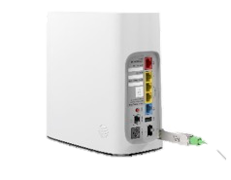
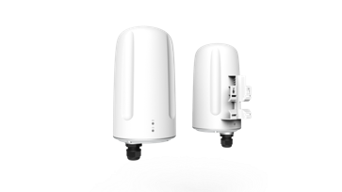
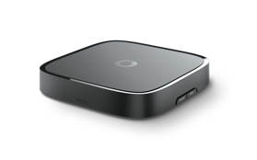
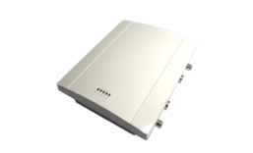

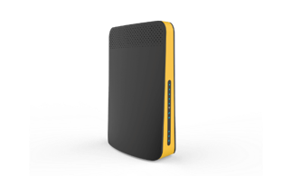

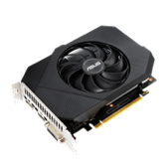
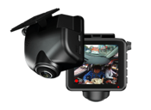
Product Line
xPON
SFP/SFP+, SFU, HGU
5G / LTE
mmWave, Sub-6 CPE
DSL
xDSL, G.Fast
xPON
LTE/ 5G
STB
IP-STB, Cable-STB, OTT Box
Small Cell
LEO
Small Cell
Outdoor, 5G O-Ran
Set Top Box
Module
System
Fixed Wireless Access
Fixed Broadband
Connected Home
Satellite
Wi-Fi / IoT
EMS
Wi-Fi
AP, Router, IoT
Module
Wi-Fi, Motherboards, Graphics Card, SIP
Car Electronics
DVR, mm Wave Radar, Car Tracker

Slide 24
Product Breakdown By Revenue
Others <5%
Wi-fi module
15-20%
Integrated
product
45-55%
1Q - 3Q
Connected
home
15-20%
Market
Telecom
Infrastructure
8-12%

Slide 25
Continue Trending Up
17.33B
14.51B
13.58B
Unit: thousand ntd
  Revenues grew 10.37% in 2020 as compared to ( NTD $19.93B )
  2021 Revenue Target : YoY+13%

Slide 26
Consolidated Comprehensive Income (IFRS)
In NTD (thousand) | 1Q-3Q 2021 | 1Q-3Q 2020
Operating Revenue | 17,302,318 | 15,040,706
Gross Profit | 1,586,274 | 1,729,702
Operating Expenses | 1,224,544 | 1,349,577
Operating Income | 361,730 | 380,125
Non-Operating Income and Expenses | 123,646 | 1,075,967
Net Income | 410,512 | 1,298,764
Net Income Rate | 2.37% | 8.63%
Basic EPS（NTD） | 1.14 | 3.55
Notes:
營業利益 = 營收 – 營業成本 - 營業費用
110 1-3Q 17302318-15716044-1224544
營業利益率 = 營業利益 / 營收
淨利率 = 稅後淨利 / 營收
1-3Q = 410512/17302318

Slide 27




2022 Outlook
/ 7
New Customer
New opportunity
New Technology
New Applications
Uncertainties
COVID-19
Electricity Restriction
Material shortage
Notes:
Our prospect of growth in 2022
Can be seen in three ways
First is the new tech: which is 5g and wifi6e
Second is the new customer in united states and Europe
Also the transfer order can brings bring in business
Third is more and more new application of networking product

Slide 28
Summary
Revenue
． More customer firmed orders in
2022.
Technologies
． Catch the leading position in
Wifi,5G, Fiber…
． higher value technologies:
Small Cell, OLT, Software value
added. LEO (Low Earth Orbit)
Business Model
． ODM/OEM for 1st tier brand
name.
．Direct supply to strategical
operators.
． Global Distribution.
． Provide End To End Networking
product.
． Increase the proportion of high-
margin products.

Slide 29
Market Trend
Founder & executive broader Dr. Young

Slide 30
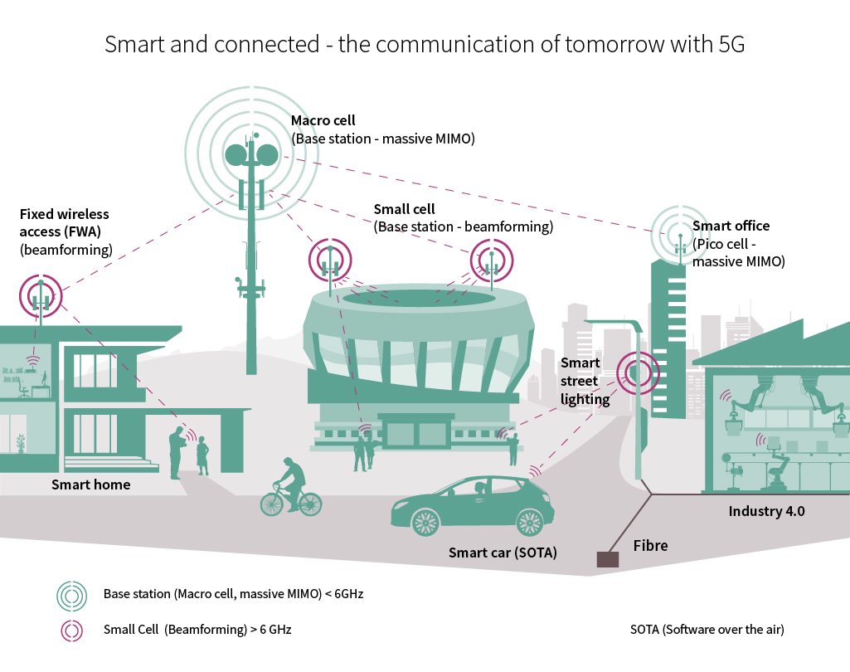
5G Telecom Infrastructure
Base station
Small Cell
Mobile Terminal
Equipment
Fixed Terminal
Equipment
MERC
Switch
Notes:
5G infrastructure has many layer
On the top is Macro cell base station
Gemtek or other company in Taiwan are not capable to produce this
The next layer is small cell,
This is one of our product,
but so far hasn’t been mass produce
Macro cell has a larger coverage, but still has blind sopt,
And bad penetrating power for indoor environment
Therefore we need small cell to raise頻普利用率(Spectral efficiency)
Help macro cell to do data off loading(數據分流)
Macro cell and small cell are base station equipment
In the terminal end there are mobile terminal (移動終端)
And固定無線接入fixed wireless access (室內/室外)
For fix wireless access, we are talking about 5G FWA
It can utilize the presenting 5g infrastructure
Doesn’t need extra time and cost to arrange fibric wires
Especially In the urban area or low population area
it’s more efficient and has ability to deal with geography restriction
Wire construction is complicated and has higher maintain cost
And it has mmwave function
Using FWA is a good way To reach a certain 5G coverage
Put one FWA and aiming to the base station,
then extent a wire inside the building
Also, it can be done in another way,
Just simply place a indoor FWA close to the window
And it will connect to the Macro cell
For gemtek, our main business is on FWA and small cell.
In the future, Taiwan mobile can use FWA to compete with CHT’s wire lan

Slide 31
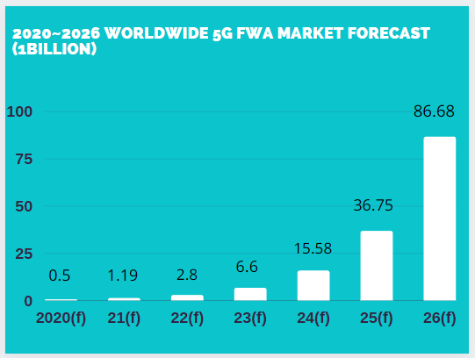
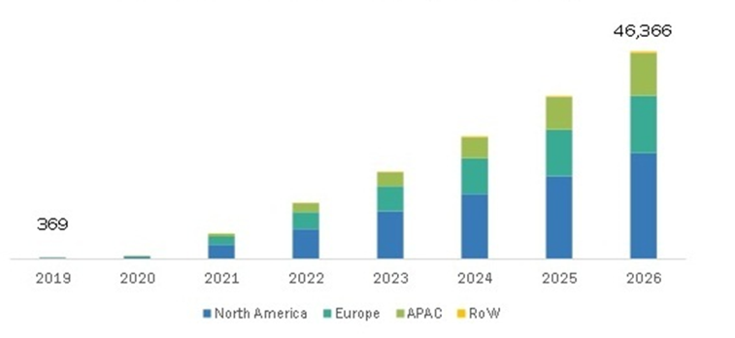
5G Forecast
5G FWA Market by region (USD million)
5G FWA: Game Changer for Fixed Broadband
(1 Billion USD)
Source: Market and market
Source: Digitimes

Slide 32
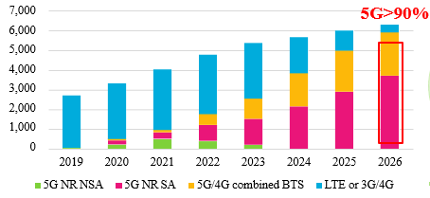
5G Forecast
Global small base station market forecast
55G>90%
Source: MIC
Notes:
At the moment small cell are mainly femtocell and picocell
5G started from 2021
LTE still dominant the market
As the trend 5G and 4G will growing
In the transition time the small cell’s model combine 5g and 4g
Gradually it will only support 5G
At the moment most of the infrastructure is 4g,
so if they replace all the small cell at once will be very costing

Slide 33





One base station supplier become multiple.
Open-RAN
Internet
User Terminal
Base Station
Core Internet
Software & Hardware
deconstructed
Radio Unit (RU)
Distributed Unit (DU)
Centralized Unit (CU)
One equipment become multiple
BS = RU + DU + CU
O-RAN standard interface
DU
Software
CU
Software
NFVI Platform
NFVI Platform
Software virtualized
DU/CU device: independent software supplier
DU/CU = VNF S/W + NFI Server (H/W)
Source:ITRI 工業技術研究院
Notes:
Now with the open ran structure,
One base station supplier become multiple.
Use lap-top manufacturing to metaphor
In the past one lap top is made by one company from the scratch
In this way the producing cost is very high
Now all the lap top component is standardize
So all the parts in lap top can be made by different vendor
And be integrated by one computer Brand Manufacturer
Now the telecommunication infrastructure is taking the same concept
All the component of base station and core internet are standardize
It is helpful for avoid monopoly and raise compatibility.
Taiwanese vendor now has opportunity to get the market share
But actually telecom operator still prefer the experienced base station manufacturer
Ericsson For example, because they have better technology supporting

Slide 34
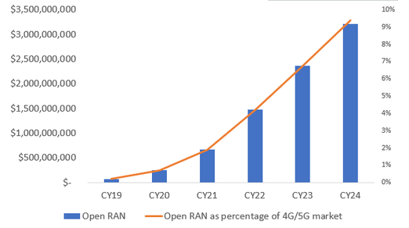
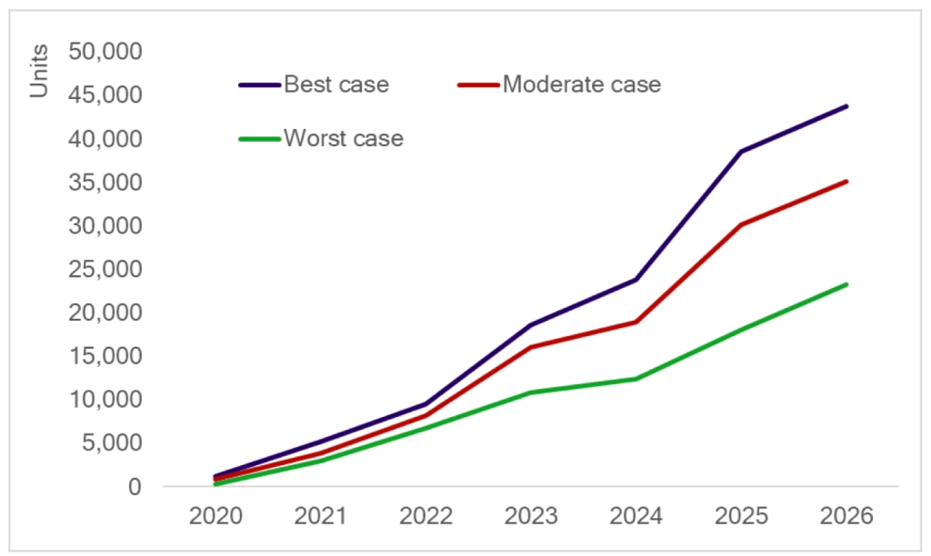
Open-RAN Forecast
Open-RAN market will reach 3.2 Billion USD in 2024
Open-RAN small cell infrastructure in different situation
Source: Omdia

Slide 35
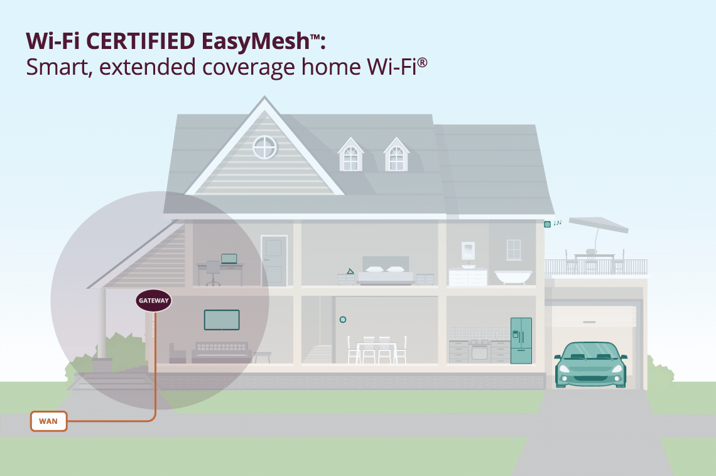
Wi-Fi Technology – Easy Mesh (Wi-Fi 6 / 7)
Notes:
Wifi6’s feature is,
it can organize those ap connected to it
Wifi6 can arrange ap to different channel
And if one of the ap is out of function,
it will build a new operating network
This is called “MESH TECHNOLOGY”

Slide 36
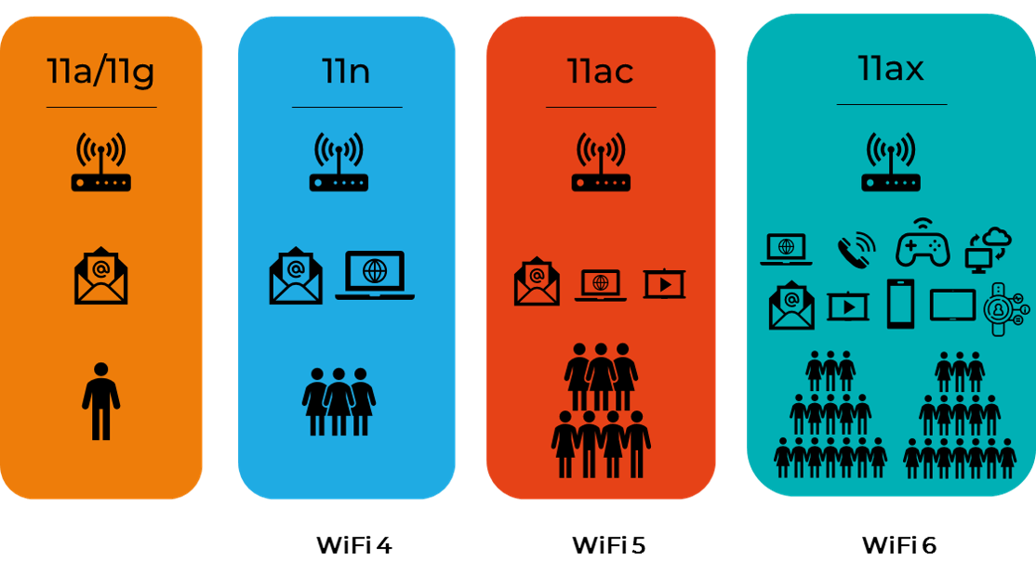
Wi-Fi Technology – Wi-Fi 6
Strength of Wi-Fi 6
Efficiency upgrade
Wi-Fi ap/rt can communicate
with multiple terminal
equipment in the same time
Better performance
  Transmission more data
  Internet speed get faster
  Lower power consumption
Notes:
Except tetecommunication tech evolve into 5 genetation
Wifi tech also make a progress
Wifi6 and 5g work together
bring the communication experience to the best
5g and wifi6 are complementary of each other
It can provide higher data transmission, to support new applicaiotn
Raise network capacity and connect to more devise

Slide 37








Wi-Fi Technology – Wi-Fi 7
User Experience Data Rate
Spectrum Efficiency
Network Energy Efficiency
Connection Density
Key Enhancement
320 MHz channels
4096-QAM
16 spatial streams
Multi-link operation
Multi-AP operation
Deterministic low latency
Multi-Ru (puncturing)
Peak Data Rate
Cost Effective
Area Capacity
Low latency
Source: intel
Notes:
Wifi6’s feature is,
it can organize those ap connected to it
Wifi6 can arrange ap to different channel
And if one of the ap is out of function,
it will build a new operating network
This is called “MESH TECHNOLOGY”

Slide 38
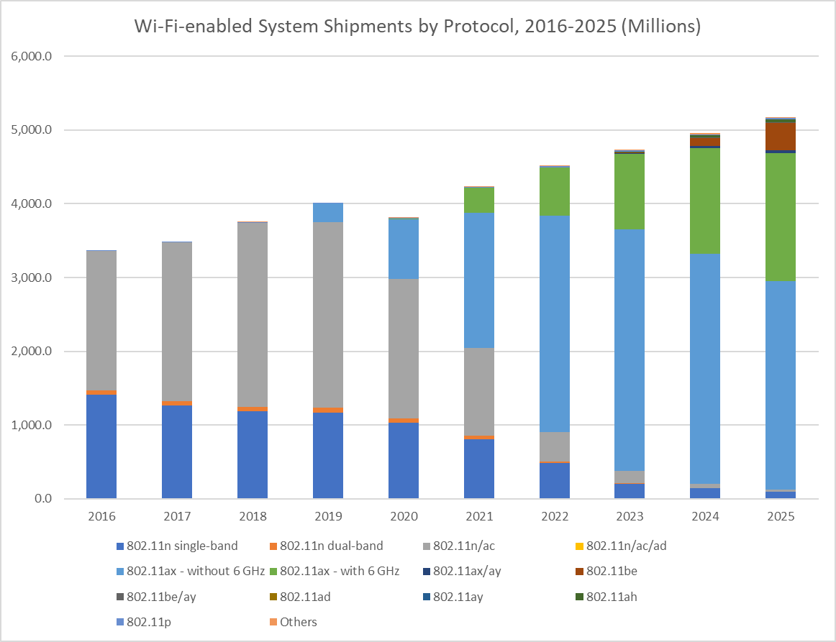
Wi-Fi Market Trend
Wi-Fi 7
Wi-Fi 6E
Wi-Fi 6
Source: IDC
Notes:
WiFi6 can work together with 5G
In the future telecom company will integrate wifi6 and 5G
Wifi6 can share 5G infrastructure’s loading
From 2021 wifi6 started to replace wifi5
Now in the market, most of the shipment is wifi6
Gemtek’s technology is progressing with the market trend
For networking company new technology implication
Means better margin

Slide 39


Gemtek Wi-Fi Product Portfolio
6E
6E
2021
2022
2023
Since 4Q
Since 1Q
Since 1Q
Notes:
現在有哪些 wifi產品
時間軸 以及要推出的產品 wifi6 wifi7 ……

Slide 40
G-PON Market Trend
Source: MIC
North America and EMEA represent Top2 world’s fast growing PON markets

Slide 41
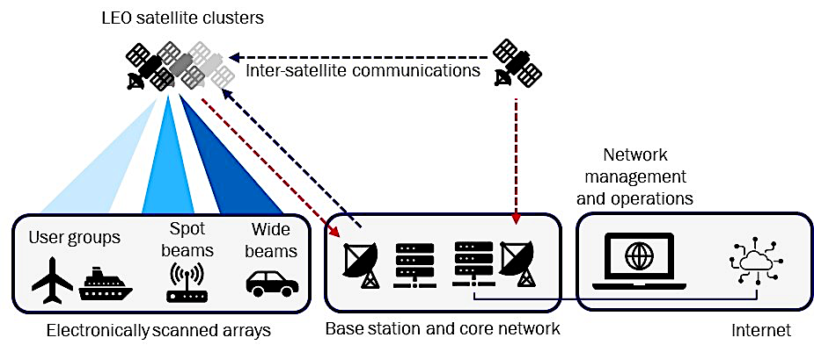
LEO New Business Model
LEO
Wi-Fi 7

Slide 42
LEO
Until 2019 there are 49% population can't access to internet.
Even in the developed country still 13% population can’t access to internet.
Source: MIC
Source: Taiwan institute of Economic Research

Slide 43
LEO – Opportunity For Taiwan
Gemtek can do
Ground Equipment.
User Terminal, including phased array antenna module, system design, verification as well as manufacture. .
Source: TIER
Source: Taiwan institute of Economic Research

