Slide 1
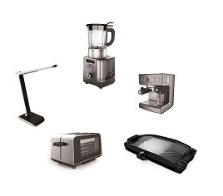
Investor Conference
2020Q3
(Stock Code：4930)
2020/11/24

Slide 2
Disclaimer
Star Comgistic statements of its current expectations are forward-looking statements subject to significant risks and uncertainties and actual results may differ materially from those contained in the forward-looking statements.
We undertake no obligation to update any forward-looking statement whether as a result of new information, future events or otherwise.
1

Slide 3
Agenda
Company Milestone and Business Sectors
2020Q3 Financial Results
Business Outlook
Q&A
2

Slide 4
Company Milestone
3

Slide 5


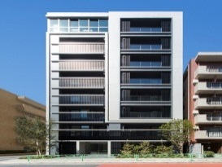



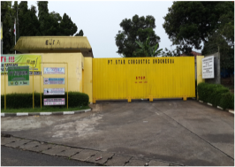
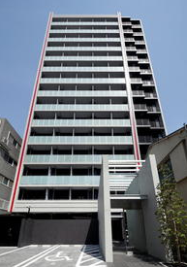
Business Sectors
Star Comgistic Capital Co., Ltd.
Household appliances
Catering
business
Others
Channel
Manufacture
Crown and Fancy Coffee
Real Estate Investment
SCC-AU
TW Sales and Marketing Dep.
TK-Zhanghou
China Sales Dep.
Indonesia
4

Slide 6
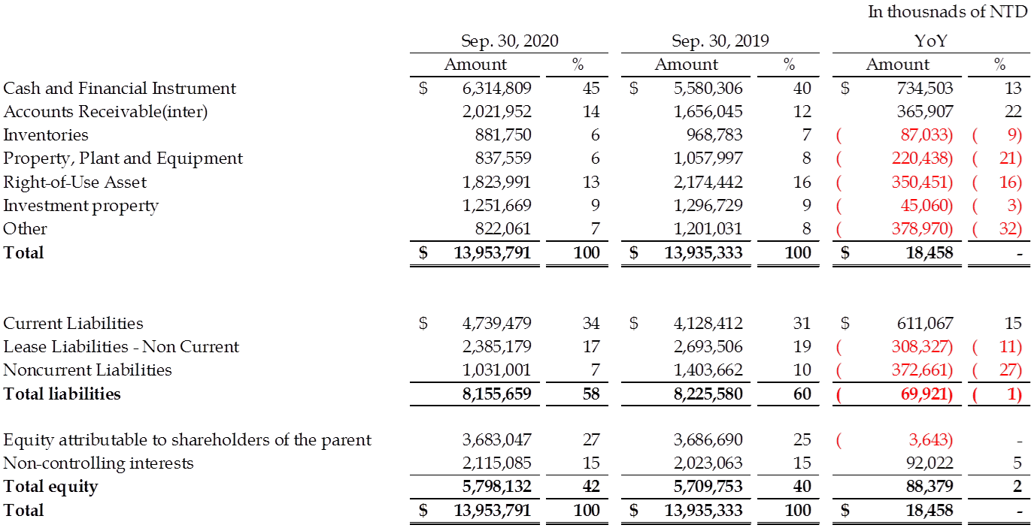
2020Q3 Financial Result－Balance Sheet
5

Slide 7
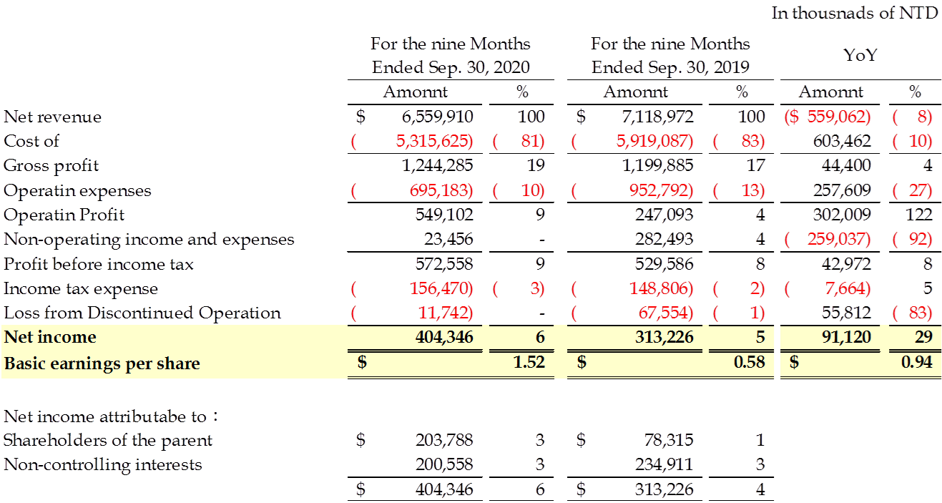
2020Q3 Financial Result－
Consolidated statements of Income
6

Slide 8
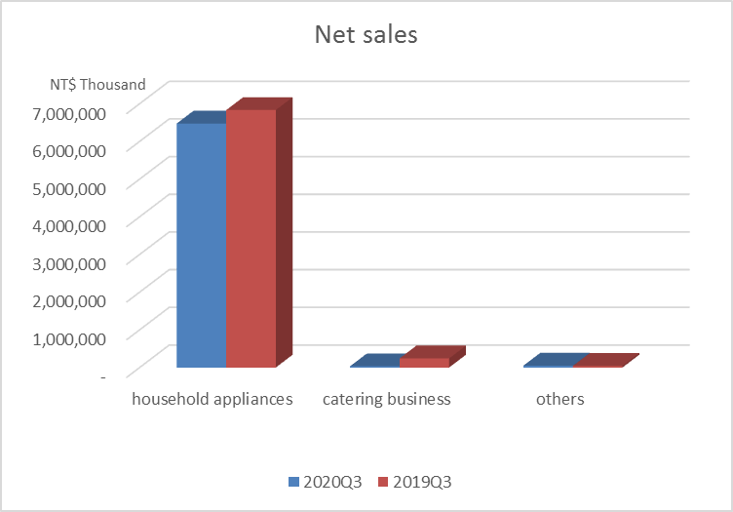
2020Q3 Financial Result－Main Sectors
7

Slide 9
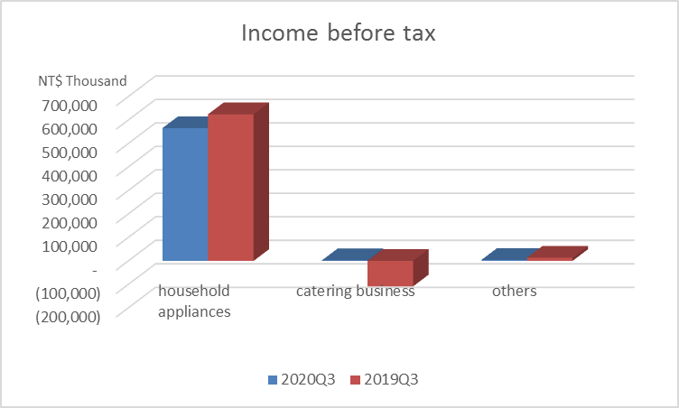
2020Q3 Financial Result－Main Sectors
8

Slide 10
Business Outlook
Household appliances
US-China trade war
Move some production lines to Indonesian factory
Strengthen Supplier Management
Other
Crown Develop B2B
9

Slide 11
Thank you!

