Slide 1
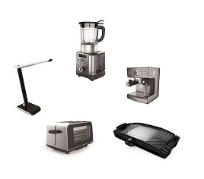
Investor Conference
2025Q4
(Stock Code：4930)
Date:2026/03/19

Slide 2
Disclaimer
This presentation contains forward looking statements and is subject to significant risks and uncertainties. Actual results may differ materially from those in the forward looking statements.
We undertake no obligation to update any forward-looking statement whether as a result of new information, future events or otherwise.

Slide 3
Agenda
Business Sectors
2025Q4 Financial Results
Business Outlook
Q&A

Slide 4


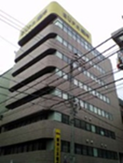


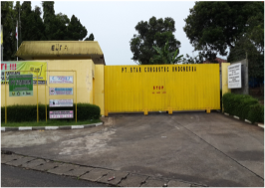
Business Sectors
Star Comgistic Capital Co., Ltd.
Household appliances
Catering
business
Others
Channel
Manufacture
Jin Kuanq
Tsann Kuen Japan
Star Comgistic
Tsann Kuen (Zhang Zhou)
Wu Wha Ma
Tsann Kuen (Xiamen)
PTSCI

Slide 5
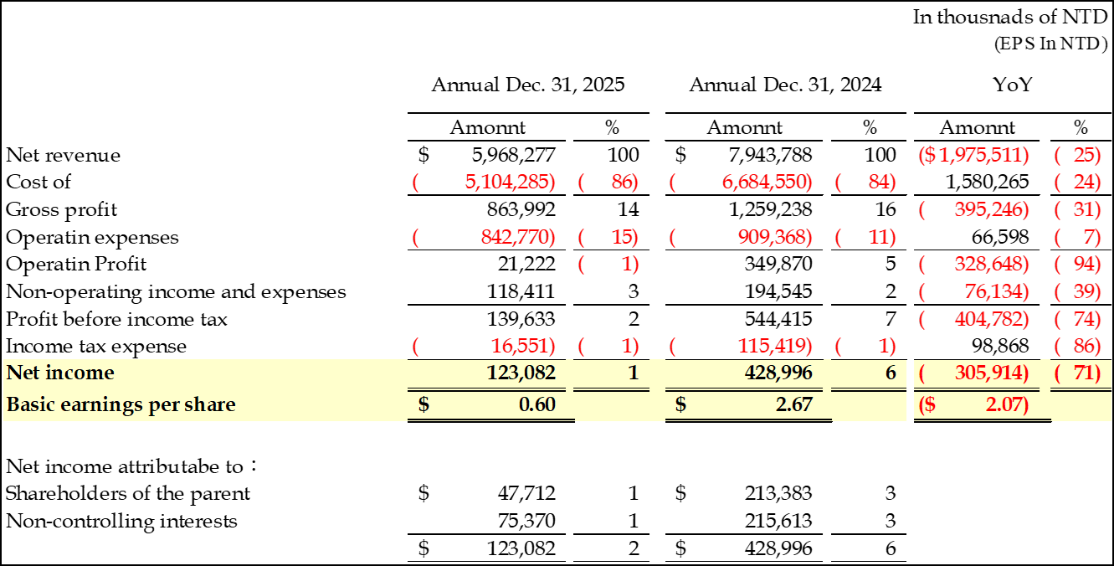
2025 Financial Result -
Consolidated statements of Income

Slide 6
2025 Financial Result - Balance Sheet

Slide 7
Business Outlook
Expand marketing channel.
Offer customized production through R&D.
Negotiate purchase and selling price with strategic partners.
Optimal of manufacturing process and expenses management.

Slide 8
Q&A

