Slide 1
2019 Fourth Quarter
Earnings Conference
January 16, 2020
Notes:
0

Slide 2
Agenda
Welcome Jeff Su
4Q19 Financial Results and 1Q20 Outlook Wendell Huang
Key Messages Wendell Huang C.C. Wei
Q&A

Slide 3
Safe Harbor Notice
TSMC’s statements of its current expectations are forward-looking statements subject to significant risks and uncertainties and actual results may differ materially from those contained in the forward-looking statements.
Information as to those factors that could cause actual results to vary can be found in TSMC’s Annual Report on Form 20-F filed with the United States Securities and Exchange Commission (the “SEC”) on April 17, 2019 and such other documents as TSMC may file with, or submit to, the SEC from time to time.
Except as required by law, we undertake no obligation to update any forward-looking statement, whether as a result of new information, future events, or otherwise.

Slide 4
Statements of Comprehensive Income

Slide 5
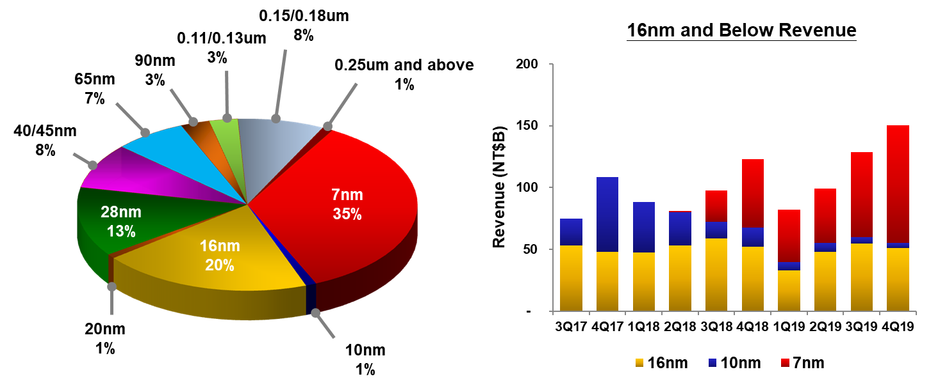
4Q19 Revenue by Technology

Slide 6
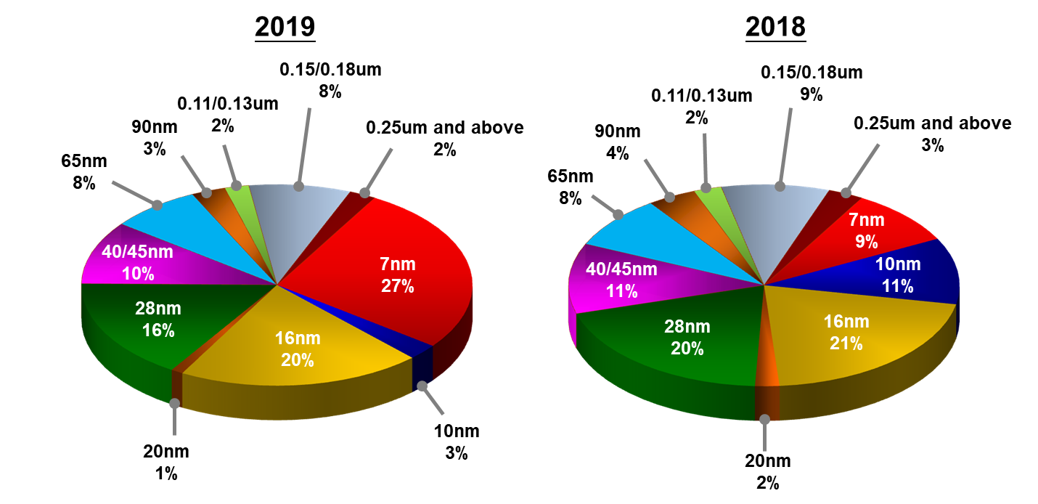
Revenue by Technology

Slide 7
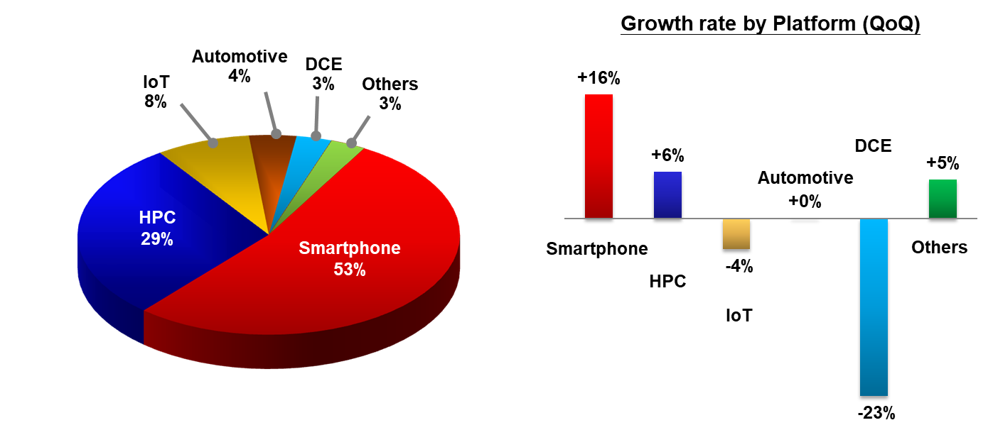
4Q19 Revenue by Platform

Slide 8
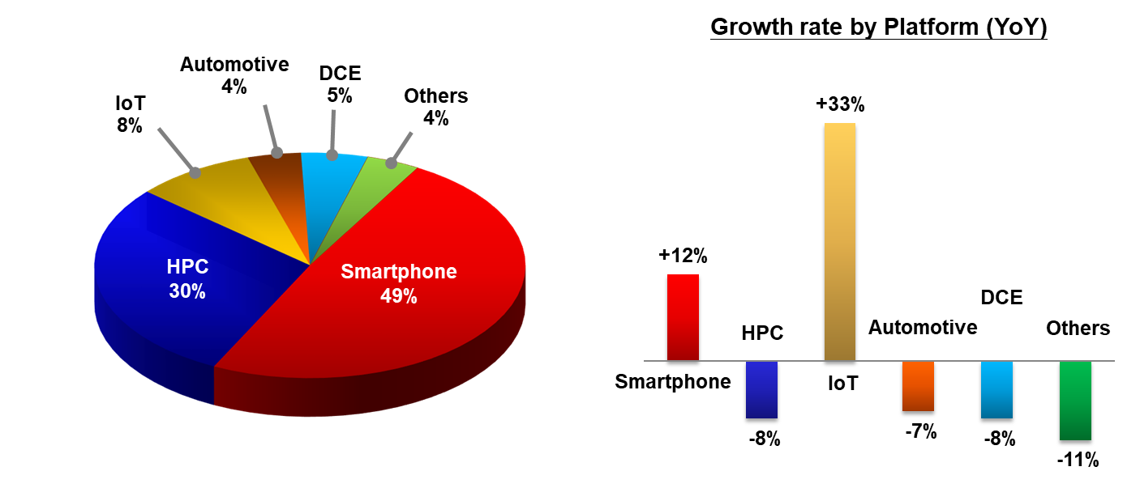
2019 Revenue by Platform

Slide 9
Balance Sheets & Key Indices

Slide 10
Cash Flows
(1)
* Free cash flow = Cash from operating activities – Capital expenditures

Slide 11
2019 Financial Highlights

Slide 12
1Q20 Guidance
Based on our current business outlook, management expects:
Revenue to be between US$ 10.2 billion and US$ 10.3 billion
And, based on the exchange rate assumption of 1 US dollar to 29.9 NT dollars, management expects:
  Gross profit margin to be between 48.5% and 50.5%
  Operating profit margin to be between 37.5% and 39.5%

Slide 13
Recap of Recent Major Events
TSMC Recognizes Outstanding Suppliers at 2019 Supply Chain Management Forum (2019/12/05)
University of Tokyo and TSMC Announce Organization-Wide Advanced Semiconductor Technology Collaboration (2019/11/27)
TSMC Board of Directors Approves NT$2.5 Cash Dividend for Third Quarter 2019 and Sets March 19 as Ex-Dividend Date, March 25 as the record date and April 16, 2020 as the distribution date (2019/11/12)
MediaTek’s World-Leading 8K DTV SoC in Volume Production on TSMC 12FFC Technology (2019/11/08)
TSMC and GLOBALFOUNDRIES Announce Resolution of Global Disputes Through Broad Global Patent Cross-License (2019/10/29)
Please visit TSMC's website (http://www.tsmc.com) and Market Observation Post System (http://mops.twse.com.tw) for details and other announcements
Notes:
12

Slide 14

http://www.tsmc.com
invest@tsmc.com

